Slide 1
Warm-Up – 3/14 – 10 minutes
Utilizing your notes and past knowledge answer the following questions:
Describe the purpose of an altimeter.
How are adjustments made to an altimeter?
What is the window on an altimeter named?
What does a decrease in pressure cause the altimeter to indicate?
Name and describe the five types of altitude a pilot must be familiar.

Slide 2

Questions / Comments

Slide 3
Warm-Up – 3/14 – 10 minutes
Utilizing your notes and past knowledge answer the following questions:
Describe the purpose of an altimeter.
How are adjustments made to an altimeter?
What is the window on an altimeter named?
What does a decrease in pressure cause the altimeter to indicate?
Name and describe the five types of altitude a pilot must be familiar.

Slide 4
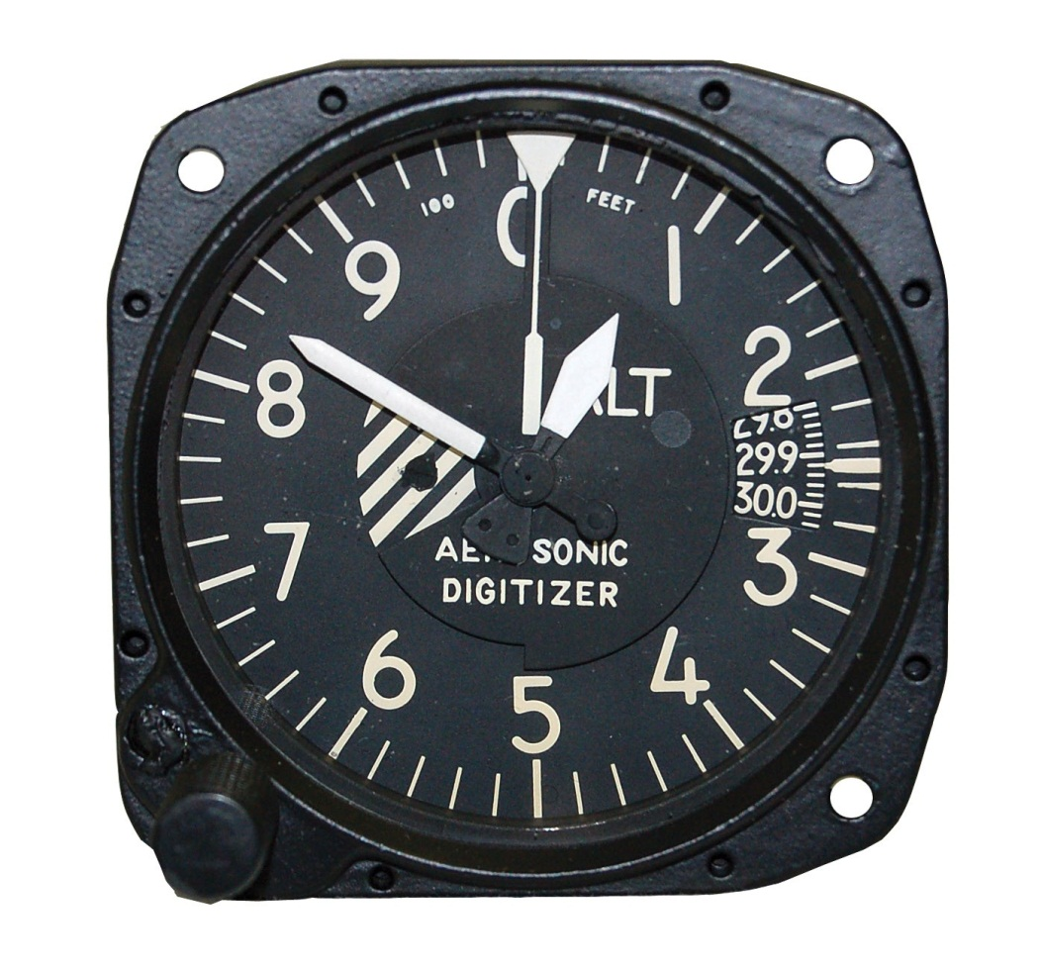
Altimeter
The altimeter is an instrument that measures the height of an aircraft above a given pressure level.
Since the altimeter is the only instrument that is capable of indicating altitude, this is one of the most vital instruments installed in the aircraft.

Slide 5
Warm-Up – 3/14 – 10 minutes
Utilizing your notes and past knowledge answer the following questions:
Describe the purpose of an altimeter.
How are adjustments made to an altimeter?
What is the window on an altimeter named?
What does a decrease in pressure cause the altimeter to indicate?
Name and describe the five types of altitude a pilot must be familiar.

Slide 6
Principle of Operation
Adjustments for nonstandard pressures are accomplished by setting the corrected pressure into a barometric scale located on the face of the altimeter.

Slide 7
Warm-Up – 3/14 – 10 minutes
Utilizing your notes and past knowledge answer the following questions:
Describe the purpose of an altimeter.
How are adjustments made to an altimeter?
What is the window on an altimeter named?
What does a decrease in pressure cause the altimeter to indicate?
Name and describe the five types of altitude a pilot must be familiar.

Slide 8
Principle of Operation
The barometric pressure window is sometimes referred to as the Kollsman window; only after the altimeter is set does it indicate the correct altitude.

Slide 9
Warm-Up – 3/14 – 10 minutes
Utilizing your notes and past knowledge answer the following questions:
Describe the purpose of an altimeter.
How are adjustments made to an altimeter?
What is the window on an altimeter named?
What does a decrease in pressure cause the altimeter to indicate?
Name and describe the five types of altitude a pilot must be familiar.

Slide 10
Altimeter Operation
When the aircraft climbs or descends, changing pressure within the altimeter case expands or contracts the aneroid barometer.
A decrease in pressure causes the altimeter to indicate an increase in altitude, and an increase in pressure causes the altimeter to indicate a decrease in altitude.

Slide 11
Warm-Up – 3/14 – 10 minutes
Utilizing your notes and past knowledge answer the following questions:
Describe the purpose of an altimeter.
How are adjustments made to an altimeter?
What is the window on an altimeter named?
What does a decrease in pressure cause the altimeter to indicate?
Name and describe the five types of altitude a pilot must be familiar.

Slide 12
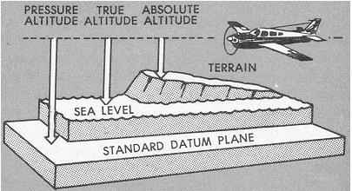
Types of Altitude
1. Indicated altitude—read directly from the altimeter (uncorrected) when it is set to the current altimeter setting.
2. True altitude—the vertical distance of the aircraft above sea level—the actual altitude.

Slide 13
Types of Altitude
3. Absolute altitude—the vertical distance of an aircraft above the terrain, or above ground level (AGL).
4. Pressure altitude—the altitude indicated when the altimeter setting window (barometric scale) is adjusted to 29.92 "Hg.

Slide 14
Types of Altitude
5. Density altitude—pressure altitude corrected for variations from standard temperature.
This is an important altitude because it is directly related to the aircraft’s performance.
The density of the air affects how much power a naturally aspirated engine produces, as well as how efficient the airfoils are.

Slide 15
Questions / Comments

Slide 16
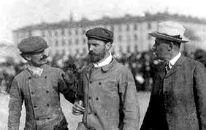
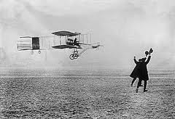
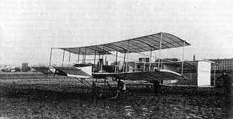
THIS DAY IN AVIATION
March 14
1908 — Henri Farman makes the first flight in his modified Voisin-Farman I-bis, the biplane built by Voisin brothers.

Slide 17
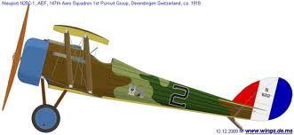
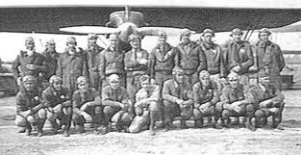
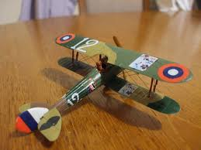
THIS DAY IN AVIATION
March 14
1918 — The first aerial patrol by the 1st Pursuit Group is flown in France.

Slide 18
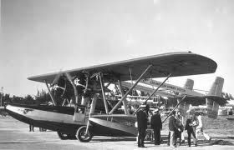
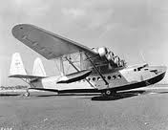
THIS DAY IN AVIATION
March 14
1927 — The Aviation Corp. of America (AVCO), headed by Juan Trippe, forms Pan American Airways to qualify for a contract for airmail deliveries from the post office and establishes the route between Key West, Florida and Havana, Cuba as the first of several routes it would acquire.

Slide 19
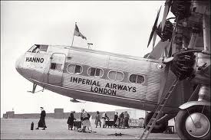
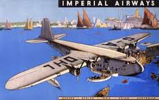
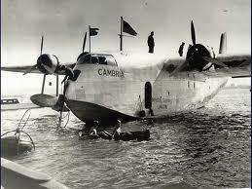
THIS DAY IN AVIATION
March 14
1936 — Imperial Airways opens a weekly service to Hong Kong.

Slide 20
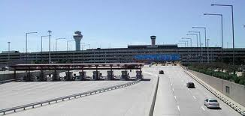
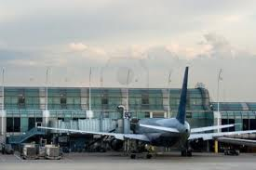
THIS DAY IN AVIATION
March 14
1960 — Within a year of completion of a major expansion program, Chicago's O'Hare International airport has become the busiest terminal in the US, handling 10.2 million passengers in 1959, the Federal Aviation Agency (FAA) reports.
In the same year it handled 431,600 take-offs and landings.

Slide 21
Questions / Comments

Slide 22
February / March 2018
Sunday | Monday | Tuesday | Wednesday | Thursday | Friday | Saturday
25 | 26 Chapter 6 Flight Systems Powerplants | 27 Chapter 6 Flight Systems Propellers | 28 Chapter 6 Flight Systems Induction Carb Systems | 1 Chapter 6 Flight Systems Carb Icing and Heating | 2 Flight Line Friday QUIZ | 3
4 | 5 Chapter 6 Ignition Systems | 6 Chapter 6 Oil Systems | 7 Chapter 6 Fuel Systems | 8 Chapter 6 Electrical Systems | 9 Mighty 8th Museum | 10
11 | 12 Chapter 7 Flight Instruments | 13 Chapter 7 Flight Instruments Altimeter | 14 Chapter 7 Flight Instruments Vertical Speed Indicator | 15 Chapter 7 Flight Instruments Airspeed Indicator | 16 Flight Line Friday QUIZ | 17
18 | 19 Chapter 7 Flight Instruments Gyro Systems | 20 Chapter 7 Flight Instruments Magnetic Compass | 21 Chapter 7 Flight Instruments Review and Test | 22 Chapter 8 Flight Manuals | 23 Chapter 8 Flight Manuals Review and Test | 24

Slide 23
1st Quarter Requirements
(2 days of Class Meetings – Mar 16)
All students will complete the following:
  Take notes - All in class quizzes and tests
  Complete Flight Sim. Tutorials (1 – 5 x 3 + 1)
  Aircraft Fam. and Student Pilot Syllabus
    Lessons 1 – 7 (Straight & Level Flight through First Solo)
    Must pass written with 80%
    Successfully complete 3 times on small sim
    Successfully complete 1 time on Main sim
  Complete ERAU Aviation 101
    6 quizzes and 2 tests
  Student will receive zero points for all incomplete work – NO make-up / extra credit

Slide 24
Questions / Comments

Slide 25

Chapter 7 – Flight Instruments
FAA – Pilot’s Handbook of Aeronautical Knowledge

Slide 26
Today’s Mission Requirements
Mission:
Identify in writing how to interpret and operate flight instruments.
Describe the pilot’s ability to recognize errors and malfunctions with flight instruments.
Describe the pitot-static system and associated instruments.
Describe the vacuum system and related instruments.
Describe the gyroscopic instruments and the magnetic compass.
EQ:
  Describe the importance of Aeronautical Knowledge for the student pilot learning to fly.

Slide 27
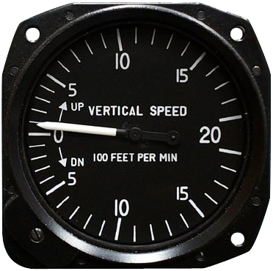
Vertical Speed Indicator (VSI)
The VSI indicates whether the aircraft is climbing, descending, or in level flight.
The rate of climb or descent is indicated in feet per minute (fpm).
If properly calibrated, the VSI indicates zero in level flight.

Slide 28
Principle of Operation
Although the VSI operates solely from static pressure, it is a differential pressure instrument.
It contains a diaphragm with connecting linkage and gearing to the indicator pointer inside an airtight case.

Slide 29
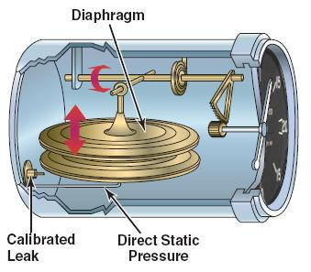
Principle of Operation
The inside of the diaphragm is connected directly to the static line of the pitot-static system.
The instrument case, is also connected to the static line, but through a restricted orifice (calibrated leak).

Slide 30
Principle of Operation
Both the diaphragm and the case receive air from the static line at existing atmospheric pressure.
The diaphragm receives unrestricted air while the case receives the static pressure via the metered leak.

Slide 31
Principle of Operation
inside the diaphragm and the instrument case, the pressures are equal and the pointer is at the zero indication.

Slide 32
Principle of Operation
When the aircraft climbs or descends, the pressure inside the diaphragm changes immediately,
but due to the metering action of the restricted passage,
the case pressure remains higher or lower for a short time, causing the diaphragm to contract or expand.

Slide 33
Principle of Operation
This causes a pressure differential that is indicated on the instrument needle as a climb or descent.

Slide 34
Principle of Operation
The VSI displays two different types of information:
Trend information shows an immediate indication of an increase or decrease in the aircraft’s rate of climb or descent.
Rate information shows a stabilized rate of change in altitude.

Slide 35
Principle of Operation
If an aircraft is maintaining level flight and the pilot pulls back on the control yoke causing the nose of the aircraft to pitch up, the VSI needle moves upward to indicate a climb.

Slide 36
Principle of Operation
If the pitch attitude is held constant, the needle stabilizes after a short period (6–9 seconds) and indicates the rate of climb in hundreds of fpm.
The time period from the initial change in the rate of climb, until the VSI displays an accurate indication of the new rate, is called the lag.

Slide 37
Questions / Comments

Slide 38
1st Quarter Requirements
(2 days of Class Meetings – Mar 16)
All students will complete the following:
  Take notes - All in class quizzes and tests
  Complete Flight Sim. Tutorials (1 – 5 x 3 + 1)
  Aircraft Fam. and Student Pilot Syllabus
    Lessons 1 – 7 (Straight & Level Flight through First Solo)
    Must pass written with 80%
    Successfully complete 3 times on small sim
    Successfully complete 1 time on Main sim
  Complete ERAU Aviation 101
    6 quizzes and 2 tests
  Student will receive zero points for all incomplete work – NO make-up / extra credit

Slide 39
Questions / Comments

