Slide 1
Warm-Up – 1/6 – 10 minutes
Utilizing your notes and past knowledge answer the following questions:
What are the categories of aircraft for which a pilot may be rated?
What CFR and subpart contains the eligibility, aeronautical knowledge, proficiency, and aeronautical requirements for the private pilot?
What is the definition of a complex aircraft?
What are the three categories of aircraft instruments?
On a hot day will an aircraft located at an airport at a high altitude need more or less runway to take off than usual?

Slide 2
Questions / Comments

Slide 3
Warm-Up – 1/6 – 10 minutes
Utilizing your notes and past knowledge answer the following questions:
What are the categories of aircraft for which a pilot may be rated?
What CFR and subpart contains the eligibility, aeronautical knowledge, proficiency, and aeronautical requirements for the private pilot?
What is the definition of a complex aircraft?
What are the three categories of aircraft instruments?
On a hot day will an aircraft located at an airport at a high altitude need more or less runway to take off than usual?

Slide 4
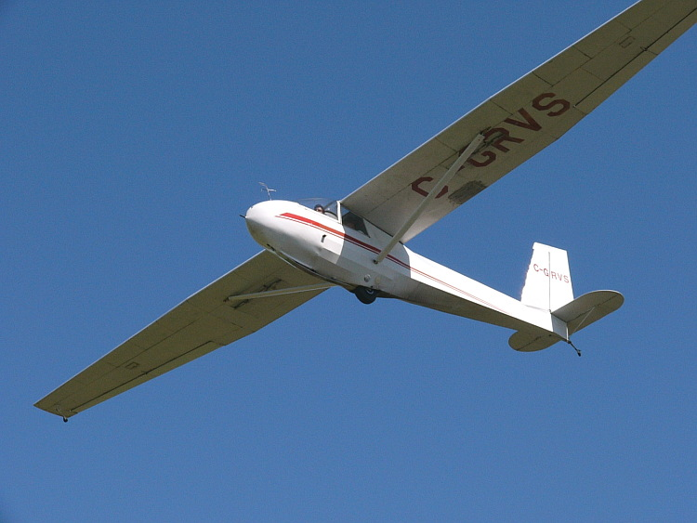
Aircraft Types and Categories
Categories of aircraft for which a pilot may be rated are:
Airplane
•Rotorcraft
•Glider
•Lighter than air
•Powered lift
•Powered parachute
•Weight-shift-control

Slide 5
Warm-Up – 1/6 – 10 minutes
Utilizing your notes and past knowledge answer the following questions:
What are the categories of aircraft for which a pilot may be rated?
What CFR and subpart contains the eligibility, aeronautical knowledge, proficiency, and aeronautical requirements for the private pilot?
What is the definition of a complex aircraft?
What are the three categories of aircraft instruments?
On a hot day will an aircraft located at an airport at a high altitude need more or less runway to take off than usual?

Slide 6
Becoming a Pilot
Eligibility, aeronautical knowledge, proficiency, and aeronautical requirements can be found in 14 CFR part 61, Certification: Pilots, Flight Instructors, and Ground Instructors.
• Recreational Pilot, see subpart D
• Private Pilot, see subpart E
• Sport Pilot, see subpart J

Slide 7
Warm-Up – 1/6 – 10 minutes
Utilizing your notes and past knowledge answer the following questions:
What are the categories of aircraft for which a pilot may be rated?
What CFR and subpart contains the eligibility, aeronautical knowledge, proficiency, and aeronautical requirements for the private pilot?
What is the definition of a complex aircraft?
What are the three categories of aircraft instruments?
On a hot day will an aircraft located at an airport at a high altitude need more or less runway to take off than usual?

Slide 8
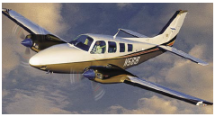
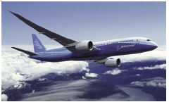
Pilot Certifications Commercial Pilot
A commercial airplane pilot must be able to operate a complex airplane
A complex aircraft must have retractable landing gear, movable flaps, and a controllable pitch propeller.

Slide 9
Warm-Up – 1/6 – 10 minutes
Utilizing your notes and past knowledge answer the following questions:
What are the categories of aircraft for which a pilot may be rated?
What CFR and subpart contains the eligibility, aeronautical knowledge, proficiency, and aeronautical requirements for the private pilot?
What is the definition of a complex aircraft?
What are the three categories of aircraft instruments?
On a hot day will an aircraft located at an airport at a high altitude need more or less runway to take off than usual?

Slide 10
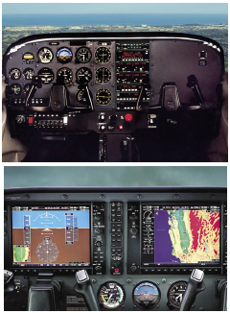
Instrumentation: Moving into the Future
Instrumentation falls into three different categories: performance, control, and navigation.

Slide 11
Warm-Up – 1/6 – 10 minutes
Utilizing your notes and past knowledge answer the following questions:
What are the categories of aircraft for which a pilot may be rated?
What CFR and subpart contains the eligibility, aeronautical knowledge, proficiency, and aeronautical requirements for the private pilot?
What is the definition of a complex aircraft?
What are the three categories of aircraft instruments?
On a hot day will an aircraft located at an airport at a high altitude need more or less runway to take off than usual?

Slide 12
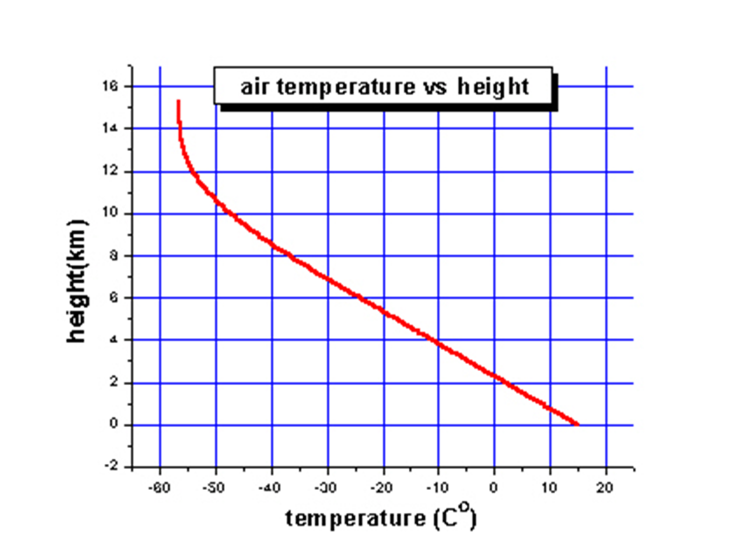
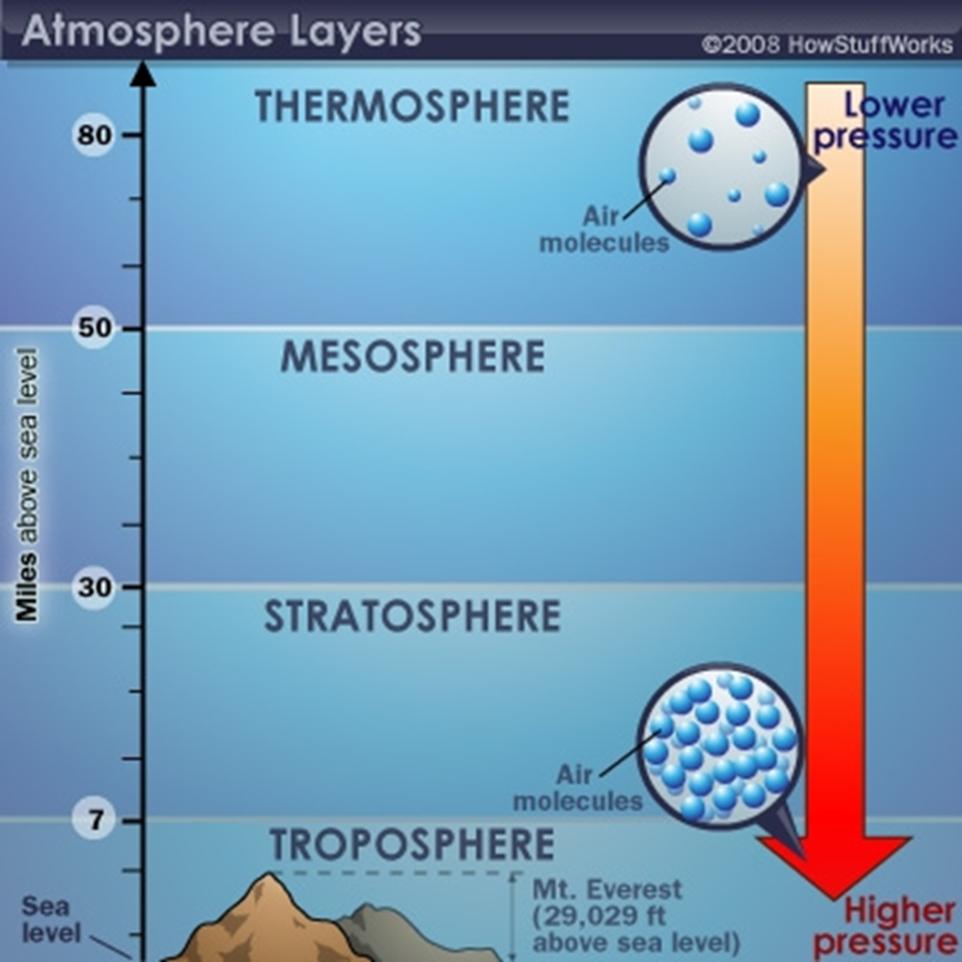
Density
Air at higher altitudes has less pressure – it is also less dense.
Density is also related to temperature.
As air is heated, the molecules move farther apart
Which means there is a decrease in density
On a hot day, aircraft in high altitudes have difficulty taking off – air is too thin

Slide 13
Questions / Comments

Slide 14
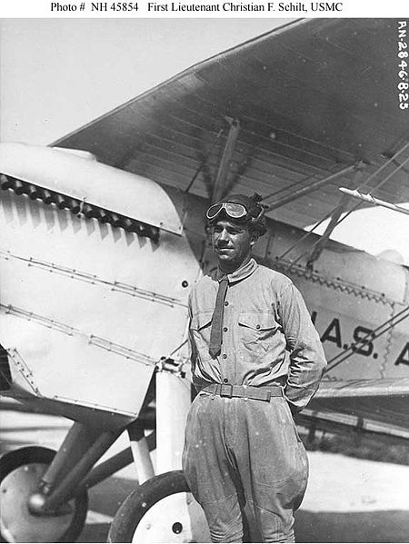
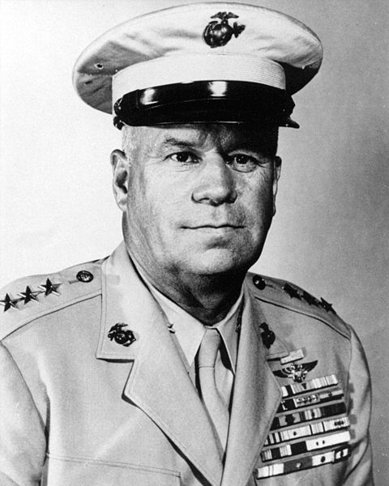
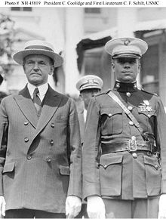
THIS DAY IN AVIATION
January 6
In 1928... Pilot Lt. C. F. Schilt, USMC, lands a Vought O2U-1 Corsair in the street of a Nicaraguan village to rescue wounded officers.
Eighteen servicemen are rescued and, for his bravery, Lt. Schilt is awarded the Medal of Honor.

Slide 15
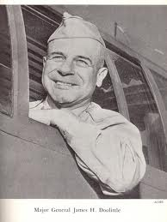
THIS DAY IN AVIATION
January 6
1943 — Major General James Doolittle assumed command of the 8th Air Force.

Slide 16
Questions / Comments

Slide 17
January 2014
Sunday | Monday | Tuesday | Wednesday | Thursday | Friday | Saturday
 |  |  | 1 | 2 | 3 | 4
5 | 6 Chapter 5 Flight Controls Primary Flight Controls | 7 | 8 Chapter 5 Flight Controls Ailerons Adverse Yaw Elevators Stabilators | 9 | 10 Chapter 5 Flight Controls Quiz | 11
12 | 13 | 14 Chapter 5 Flight Controls Canards Flaps | 15 | 16 Chapter 5 Flight Controls Trim Systems Autopilot Chapter TEST Grades Due | 17 NO SCHOOL | 18
19 | 20 NO SCHOOL | 21 | 22 Chapter 6 Aircraft Systems | 23 | 24 Chapter 6 Aircraft Systems | 25
26 | 27 | 28 Chapter 6 Aircraft Systems | 29 | 30 Chapter 6 Aircraft Systems | 31

Slide 18
Questions / Comments

Slide 19
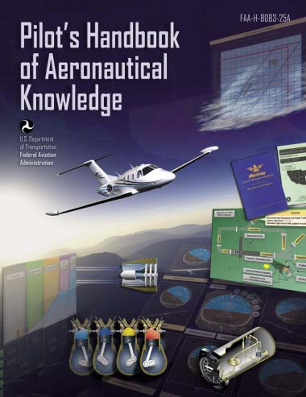
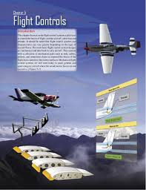
Chapter 5 – Flight Controls
FAA – Pilot’s Handbook of Aeronautical Knowledge

Slide 20
Today’s Mission Requirements
Mission:
Identify in writing the flight control systems a pilot uses to control the forces of flight, and the aircraft’s direction and attitude.
Describe how the flight control systems and characteristics can vary greatly depending on the type of aircraft flown.
Describe in writing the basic flight control system designs.
EQ:
Describe the importance of Aeronautical Knowledge for the student pilot learning to fly.

Slide 21
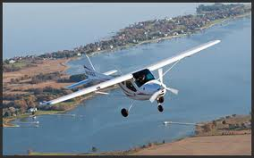
Introduction
This chapter focuses on the flight control systems a pilot uses to control the forces of flight, and the aircraft’s direction and attitude.
Flight control systems and characteristics can vary greatly depending on the type of aircraft flown.

Slide 22
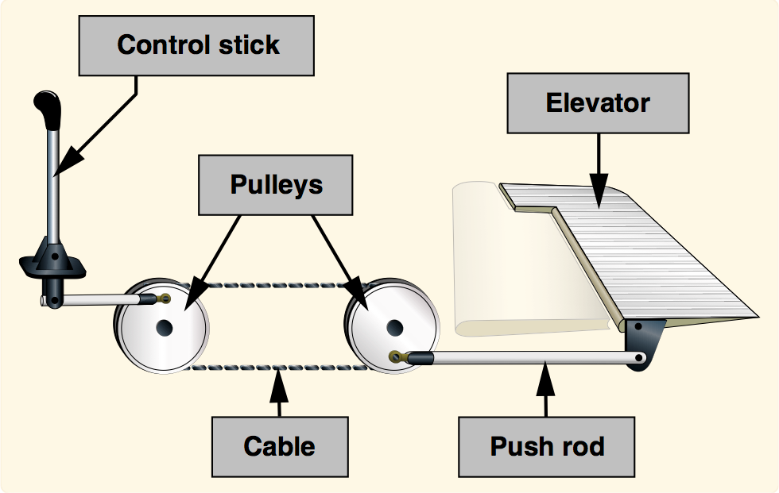
Introduction
Purpose of flight controls
To transmit the forces of the flight deck controls to the control surfaces.
Mechanical flight control systems are still used today in small general and sport category aircraft where the aerodynamic forces are not excessive.

Slide 23
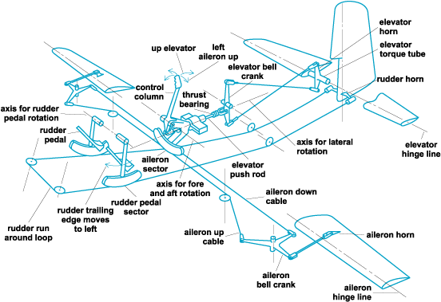

Slide 24
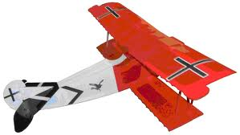
Flight Controls
As aviation matured and aircraft designers learned more about aerodynamics, the industry produced larger and faster aircraft.
Therefore, the aerodynamic forces acting upon the control surfaces increased exponentially.

Slide 25
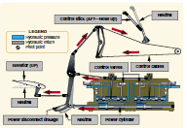
Flight Controls
To make the control force required by pilots manageable, aircraft engineers designed more complex systems.

Slide 26
Flight Controls
At first, hydromechanical designs, consisting of a mechanical circuit and a hydraulic circuit, were used to reduce the complexity, weight, and limitations of mechanical flight controls systems.

Slide 27
Flight Controls
As aircraft became more sophisticated, the control surfaces were actuated by electric motors, digital computers, or fiber optic cables, called “fly-by-wire.”
This flight control system replaces the physical connection between pilot controls and the flight control surfaces with an electrical interface.

Slide 28
Flight Controls
In addition, in some large and fast aircraft, controls are boosted by hydraulically or electrically actuated systems.
In both the fly-by-wire and boosted controls, the feel of the control reaction is fed back to the pilot by simulated means.

Slide 29
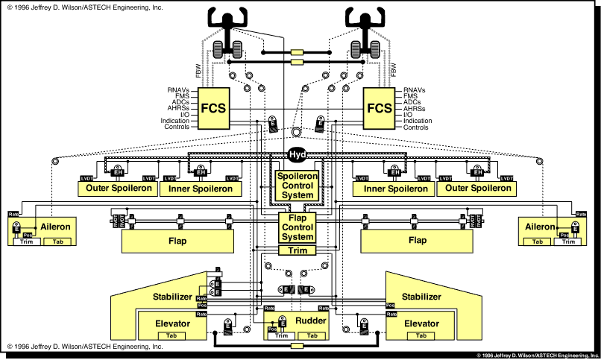

Slide 30
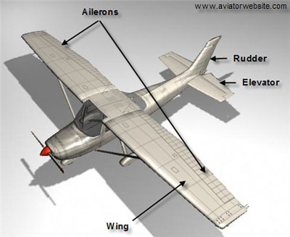
Flight Control Systems Flight Controls
Aircraft flight control systems consist of primary and secondary systems.
The ailerons, elevator (or stabilator), and rudder constitute the primary control system and are required to control an aircraft safely during flight.

Slide 31
Flight Control Systems Flight Controls
Wing flaps, leading edge devices, spoilers, and trim systems constitute the secondary control system
They improve the performance characteristics of the airplane or relieve the pilot of excessive control forces.

Slide 32
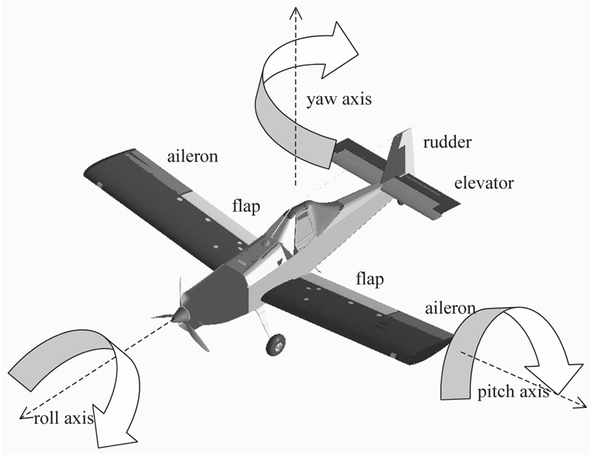
Flight Control Systems Primary Flight Controls
At low airspeeds, the controls usually feel soft and sluggish, and the aircraft responds slowly to control applications.
At higher airspeeds, the controls become increasingly firm and aircraft response is more rapid.

Slide 33
Flight Control Systems Primary Flight Controls
Movement of any of the three primary flight control surfaces (ailerons, elevator or stabilator, or rudder), changes the airflow and pressure distribution over and around the airfoil.

Slide 34
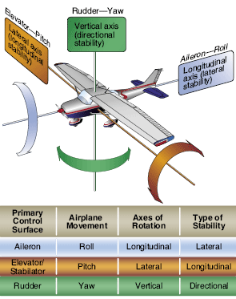
Flight Control Systems Primary Flight Controls
Primary Flight Controls allow a pilot to control the aircraft about its three axes of rotation.
Design features limit the amount of deflection of flight control surfaces.

Slide 35
Flight Control Systems Primary Flight Controls
Control-stop mechanisms may be incorporated into the flight control linkages, or movement of the control column and/or rudder pedals may be limited.
The purpose of these design limits is to prevent the pilot from inadvertently overcontrolling and overstressing the aircraft during normal maneuvers.

Slide 36
Questions / Comments

Slide 37
Lesson Closure - 3 – 2 - 1
3. List 3 things you learned today.
2. List 2 things you have questions about today’s lesson.
1. Create (1) quiz question with answer about today’s lesson.

