Slide 1
Warm-Up – 1/31 – 10 minutes
Utilizing your notes and past knowledge answer the following questions:
What is the formula for temperature?
What is the formula for density?
What is the formula for pressure?
What are the two types of drag?
What are the three types of parasite drag?

Slide 2

Questions / Comments

Slide 3
Warm-Up – 1/31 – 10 minutes
Utilizing your notes and past knowledge answer the following questions:
What is the formula for temperature?
What is the formula for density?
What is the formula for pressure?
What are the two types of drag?
What are the three types of parasite drag?

Slide 4
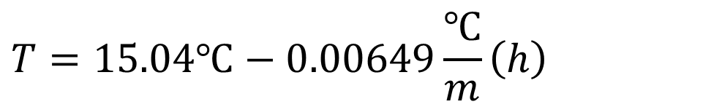


Earth’s Atmosphere Conditions
Temperature Formula
$$T=15.04℃−0.00649\frac{℃}{m}\left(h\right)$$
$$T=Temperature \left(℃\right)$$
$$h=height\left(m\right)$$
Notes:
Lapse rate is the decrease in temperature and pressure as altitude increases. The standard temperature, T, and pressure, P, at sea level is defined as 15 degf and 101.3 Pa to serve as a common reference point. The temperature and pressure obviously are not always these values in actual existence. From these values the atmosphere decreases in temperature and pressure following these equations as the altitude increases up to the top of the troposphere. Beyond this level the atmosphere does not behave linearly. The lapse rate is particularly important to engineers because aircraft performance is greatly impacted by temperature and pressure. Engines and lift generated by the wing are two examples since both use air as working fluid.
More information available at http://www.grc.nasa.gov/WWW/K-12/airplane/atmosmet.html

Slide 5
Warm-Up – 1/31 – 10 minutes
Utilizing your notes and past knowledge answer the following questions:
What is the formula for temperature?
What is the formula for density?
What is the formula for pressure?
What are the two types of drag?
What are the three types of parasite drag?

Slide 6
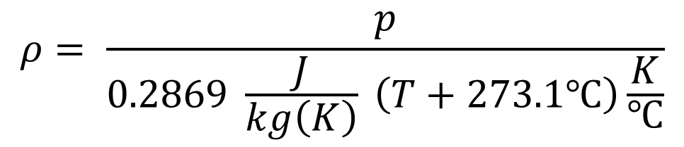



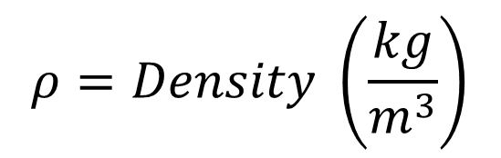
Earth’s Atmosphere Conditions
Density Formula
$$ρ= \frac{p}{0.2869 \frac{J}{kg\left(K\right)} \left(T+273.1℃\right)\frac{K}{℃}}$$
$$ρ=Density \left(\frac{kg}{m^{3}}\right)$$
$$T=Temperature \left(℃\right)$$
$$h=height\left(m\right)$$
$$p=pressure\left(kPa\right)$$
Notes:
Lapse rate is the decrease in temperature and pressure as altitude increases. The standard temperature, T, and pressure, P, at sea level is defined as 15 degf and 101.3 Pa to serve as a common reference point. The temperature and pressure obviously are not always these values in actual existence. From these values the atmosphere decreases in temperature and pressure following these equations as the altitude increases up to the top of the troposphere. Beyond this level the atmosphere does not behave linearly. The lapse rate is particularly important to engineers because aircraft performance is greatly impacted by temperature and pressure. Engines and lift generated by the wing are two examples since both use air as working fluid.

Slide 7
Warm-Up – 1/31 – 10 minutes
Utilizing your notes and past knowledge answer the following questions:
What is the formula for temperature?
What is the formula for density?
What is the formula for pressure?
What are the two types of drag?
What are the three types of parasite drag?

Slide 8

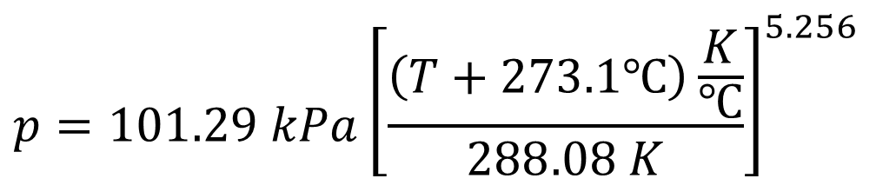
Earth’s Atmosphere Conditions
Pressure Formula
$$p=101.29 kPa{\left[\frac{\left(T+273.1℃\right)\frac{K}{℃}}{288.08 K}\right]}^{5.256}$$
$$T=Temperature \left(℃\right)$$
$$p=pressure\left(kPa\right)$$
Notes:
Lapse rate is the decrease in temperature and pressure as altitude increases. The standard temperature, T, and pressure, P, at sea level is defined as 15 degf and 101.3 Pa to serve as a common reference point. The temperature and pressure obviously are not always these values in actual existence. From these values the atmosphere decreases in temperature and pressure following these equations as the altitude increases up to the top of the troposphere. Beyond this level the atmosphere does not behave linearly. The lapse rate is particularly important to engineers because aircraft performance is greatly impacted by temperature and pressure. Engines and lift generated by the wing are two examples since both use air as working fluid.
More information available at http://www.grc.nasa.gov/WWW/K-12/airplane/atmosmet.html

Slide 9
Warm-Up – 1/31 – 10 minutes
Utilizing your notes and past knowledge answer the following questions:
What is the formula for temperature?
What is the formula for density?
What is the formula for pressure?
What are the two types of drag?
What are the three types of parasite drag?

Slide 10
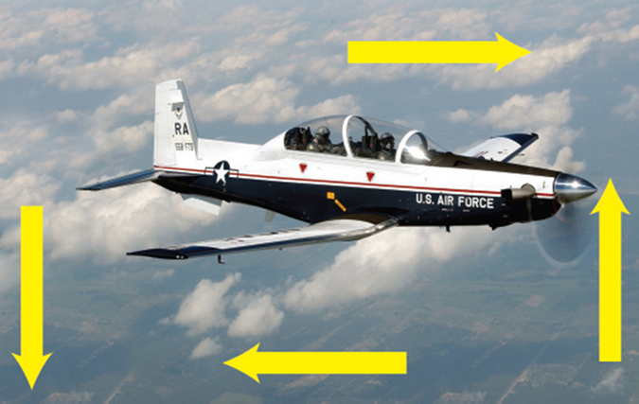

Drag
The force that resists forward motion and acts against thrust.
Two types are:
  Parasite Drag
  Induced Drag

Slide 11
Warm-Up – 1/31 – 10 minutes
Utilizing your notes and past knowledge answer the following questions:
What is the formula for temperature?
What is the formula for density?
What is the formula for pressure?
What are the two types of drag?
What are the three types of parasite drag?

Slide 12
Drag
  Parasite drag is comprised of all the forces that work to slow an aircraft’s movement.
  Drag that is not associated with the production of lift.
  This includes the displacement of the air by the aircraft, turbulence generated in the airstream, or a hindrance of air moving over the surface of the aircraft and airfoil.
  There are three types of parasite drag: form drag, interference drag, and skin friction.

Slide 13
Questions / Comments

Slide 14
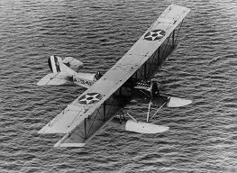
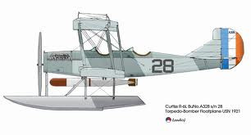
THIS DAY IN AVIATION
January 31
1918 — The Curtiss R-6 twin-float seaplane becomes the first United States built airplane to operate overseas with American forces at Naval Base 13, Ponta Delgado, in the Azores.

Slide 15
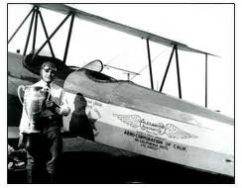
THIS DAY IN AVIATION
January 31
1926 — An American altitude record of 37,704 feet set at Dayton, Ohio.

Slide 16
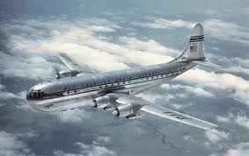
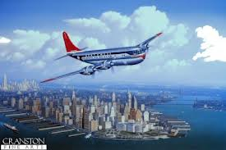
THIS DAY IN AVIATION
January 31
1949 — Pan Am receives its first Boeing Model 377 “Stratocruiser.”

Slide 17
Questions / Comments

Slide 18
February 2018
Sunday | Monday | Tuesday | Wednesday | Thursday | Friday | Saturday
28 | 29 Chapter 4 Aerodynamics of Flight | 30 Chapter 4 Aerodynamics of Flight | 31 Chapter 4 Aerodynamics of Flight | 1 Chapter 4 Aerodynamics of Flight Quiz | 2 Flight Line Friday | 3
4 | 5 Chapter 4 Aerodynamics of Flight | 6 Chapter 4 Aerodynamics of Flight | 7 Chapter 4 Aerodynamics of Flight | 8 Chapter 4 Aerodynamics of Flight | 9 Flight Line Friday QUIZ | 10
11 | 12 Chapter 4 Aerodynamics of Flight | 13 Chapter 4 Aerodynamics of Flight | 14 Chapter 4 Aerodynamics of Flight | 15 Chapter 4 Aerodynamics of Flight | 16 Flight Line Friday TEST | 17
18 | 19 HOLIDAY | 20 Chapter 5 Flight Controls | 21 Chapter 5 Flight Controls | 22 Chapter 5 Flight Controls | 23 Flight Line Friday TEST | 24
25 | 26 Chapter 6 Flight Systems | 27 Chapter 6 Flight Systems | 28 Chapter 6 Flight Systems | 1 Chapter 6 Flight Systems | 2 Flight Line Friday QUIZ | 3

Slide 19
1st Quarter Requirements
(30 days of Class Meetings – Mar 16)
All students will complete the following:
  Take notes - All in class quizzes and tests
  Complete Flight Sim. Tutorials (1 – 5 x 3 + 1)
  Aircraft Fam. and Student Pilot Syllabus
    Lessons 1 – 7 (Straight & Level Flight through First Solo)
    Must pass written with 80%
    Successfully complete 3 times on small sim
    Successfully complete 1 time on Main sim
  Complete ERAU Aviation 101
    6 quizzes and 2 tests
  Student will receive zero points for all incomplete work – NO make-up / extra credit

Slide 20
Questions / Comments

Slide 21

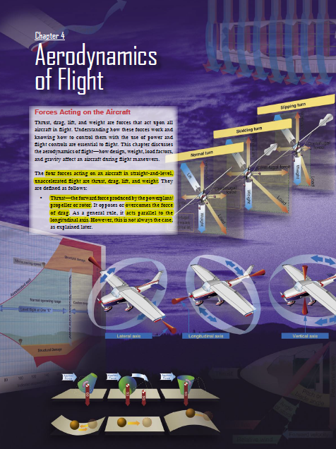
Chapter 4 – Aerodynamics of Flight
FAA – Pilot’s Handbook of Aeronautical Knowledge

Slide 22
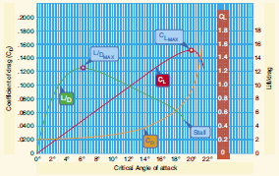
Lift to Drag Ratio
A ratio of L/D indicates airfoil efficiency.
Higher L/D ratios are more efficient than those with lower L/D ratios.
The L/D ratio is determined by dividing the CL by the CD. (CL/CD.)

Slide 23
Lift to Drag Ratio

Slide 24
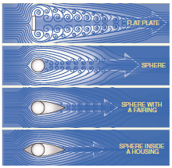
Form Drag
  Form drag is the portion of parasite drag generated by the aircraft due to its shape and airflow around it.
  Examples include the engine cowlings, antennas, and the aerodynamic shape of other components.

Slide 25
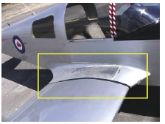
Interference Drag
  Interference drag comes from the intersection of airstreams that creates eddy currents, turbulence, or restricts smooth airflow.
  For example, the intersection of the wing and the fuselage at the wing root has significant interference drag.

Slide 26
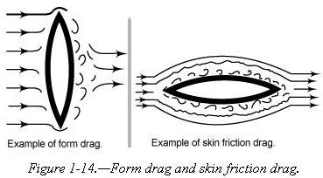
Skin Friction Drag
  Skin friction drag is the aerodynamic resistance due to the contact of moving air with the surface of an aircraft.
  The area between the wing and the free-stream velocity level is about as wide as a playing card and is called the boundary layer.

Slide 27
Skin Friction Drag
  The boundary layer gives any object an “effective” shape that is usually slightly different from the physical shape.
  The boundary layer may also separate from the body, thus creating an effective shape much different from the physical shape of the object.

Slide 28
Skin Friction Drag
  This change in the physical shape of the boundary layer causes a dramatic decrease in lift and an increase in drag.
  When this happens, the airfoil has stalled.

Slide 29
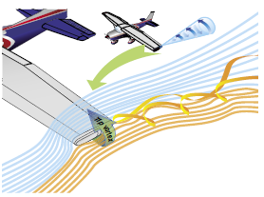
Induced Drag
The high-pressure area on the bottom of an airfoil pushes around the tip to the low-pressure area on the top.
This action creates a rotating flow called a tip vortex

Slide 30
Induced Drag
  These vortices circulate counterclockwise about the right tip and clockwise about the left tip.

Slide 31
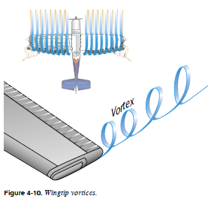
Wingtip Vortices
(Formation of Vortices)
The heavier and slower the aircraft, the greater the AOA and the stronger the wingtip vortices.
Like a boat through water

Slide 32
Wingtip Vortices
(Formation of Vortices)
Thus, an aircraft will create wingtip vortices with maximum strength occurring during the takeoff, climb, and landing phases of flight.

Slide 33
Wingtip Vortices
(Formation of Vortices)
These vortices lead to a particularly dangerous hazard to flight, wake turbulence.

Slide 34
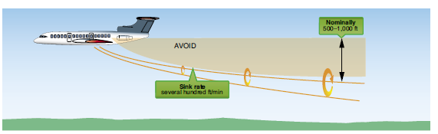
Avoiding Wake Turbulence
Avoid following another aircraft on a similar flightpath at an altitude within 1,000 feet.

Slide 35
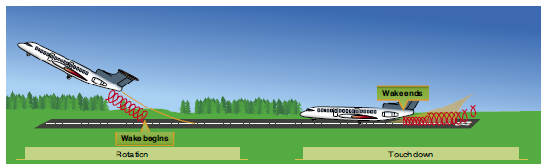
Avoiding Wake Turbulence
Approach the runway above a preceding aircraft’s path when landing behind another aircraft,
touch down after the point at which the other aircraft wheels contacted the runway.

Slide 36
Avoiding Wake Turbulence
If a pilot is unsure of the other aircraft’s takeoff or landing point, approximately 3 minutes provides a margin of safety that allows wake turbulence dissipation

Slide 37
Questions / Comments

Slide 38
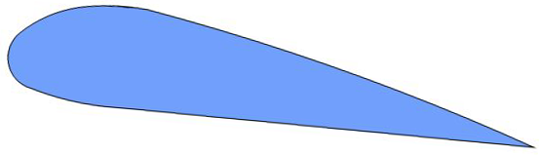




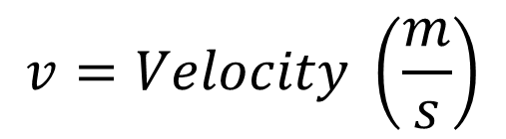

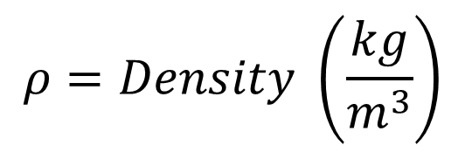
Lift Equation
Lift
Coefficient of Lift, C_{l}
  Determined experimentally
  Combines several factors
    Shape
    Angle of attack
Direction of Flight
$$C_{l}=Coefficient of Lift$$
$$C_{l}=\frac{2L}{Aρv^{2}}$$
$$C_{l}=\frac{L}{qA}$$
$$L=Lift (Weight) \left(N\right)$$
$$A=Wing Area \left(m^{2}\right)$$
$$ρ=Density \left(\frac{kg}{m^{3}}\right)$$
Alternate format
$$v=Velocity \left(\frac{m}{s}\right)$$
$$q=Dynamic Pressure\left(Pa\right)$$
Notes:
Rearranging the coefficient of lift equation shows that lift is increased by wing area, air density, and velocity. Velocity is a squared function, giving it a more significant impact on lift.

Slide 39

Applying the Lift Equation
Calculate Air Density
$$ρ= \frac{p}{0.2869\frac{J}{kg\left(K\right)}\left(T+273.1℃\right)\frac{K}{℃}}$$
$$ρ= \frac{101.29 kPa}{0.2869\frac{J}{kg\left(K\right)}\left(22 ℃+273.1℃\right)\frac{K}{℃}}$$
$$ρ=1.196\frac{kg}{m^{3}}$$

