Slide 1
Warm-Up – 1/30 – 10 minutes
Utilizing your notes and past knowledge answer the following questions:
What is thrust and how can it be generated?
What occurs when the resultant force is stable or zero? – (Hint: when all forces are balanced)
What has the AOA have to be when airspeed is low in order to maintain straight and level flight?
As the pilot generates more airspeed what should the pilot do to maintain straight and level flight with respect to AOA?
If the AOA were not coordinated (decreased) with an increase of thrust, the aircraft would do what ?

Slide 2
Questions / Comments

Slide 3
Warm-Up – 1/30 – 10 minutes
Utilizing your notes and past knowledge answer the following questions:
What is thrust and how can it be generated?
What occurs when the resultant force is stable or zero?
What has the AOA have to be when airspeed is low in order to maintain straight and level flight?
As the pilot generates more airspeed what should the pilot do to maintain straight and level flight with respect to AOA?
If the AOA were not coordinated (decreased) with an increase of thrust, the aircraft would do what ?

Slide 4
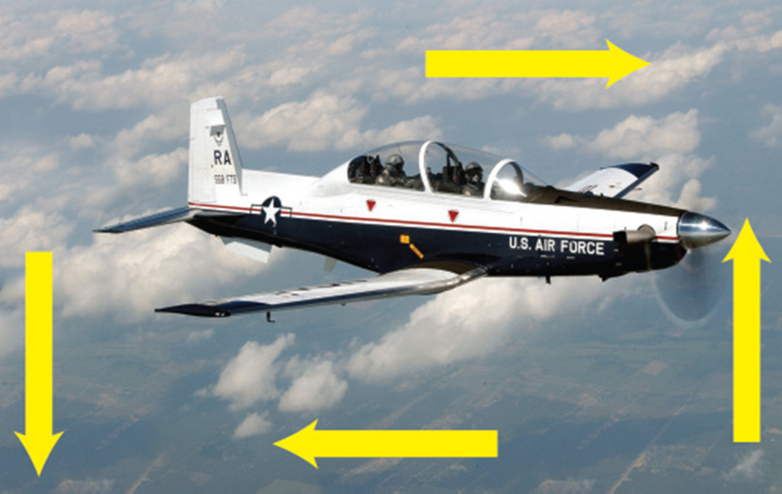
Thrust
The force that pushes or pulls a plane forward through the air.
Propellers, jet engines, tailwinds, and other outside sources – even catapults! – can provide needed thrust.

Slide 5
Warm-Up – 1/30 – 10 minutes
Utilizing your notes and past knowledge answer the following questions:
What is thrust and how can it be generated?
What occurs when the resultant force is stable or zero? – (Hint: when all forces are balanced)
What has the AOA have to be when airspeed is low in order to maintain straight and level flight?
As the pilot generates more airspeed what should the pilot do to maintain straight and level flight with respect to AOA?
If the AOA were not coordinated (decreased) with an increase of thrust, the aircraft would do what ?

Slide 6
Forces of Flight
What is the resultant force?
Force 2 (465 N)
Force 1 (465 N)
Resultant is zero
When opposing forces have the same magnitude and opposite directions, the resultant is zero and the object is in static equilibrium.
Notes:
Static equilibrium means that there is no acceleration. The object stays at rest or continues at its same velocity if already in motion.

Slide 7
Warm-Up – 1/30 – 10 minutes
Utilizing your notes and past knowledge answer the following questions:
What is thrust and how can it be generated?
What occurs when the resultant force is stable or zero?
What has the AOA have to be when airspeed is low in order to maintain straight and level flight?
As the pilot generates more airspeed what should the pilot do to maintain straight and level flight with respect to AOA?
If the AOA were not coordinated (decreased) with an increase of thrust, the aircraft would do what ?

Slide 8
Thrust
When the airspeed is low, the AOA must be relatively high if the balance between lift and weight is to be maintained.
If thrust decreases and airspeed decreases, lift becomes less than weight and the aircraft starts to descend.

Slide 9
Warm-Up – 1/30 – 10 minutes
Utilizing your notes and past knowledge answer the following questions:
What is thrust and how can it be generated?
What occurs when the resultant force is stable or zero?
What has the AOA have to be when airspeed is low in order to maintain straight and level flight?
As the pilot generates more airspeed what should the pilot do to maintain straight and level flight with respect to AOA?
If the AOA were not coordinated (decreased) with an increase of thrust, the aircraft would do what ?

Slide 10
Thrust
To maintain level flight, the pilot can increase the AOA an amount which will generate a lift force again equal to the weight of the aircraft.
While the aircraft will be flying more slowly, it will still maintain level flight if the pilot has properly coordinated thrust and AOA.

Slide 11
Warm-Up – 1/30 – 10 minutes
Utilizing your notes and past knowledge answer the following questions:
What is thrust and how can it be generated?
What occurs when the resultant force is stable or zero?
What has the AOA have to be when airspeed is low in order to maintain straight and level flight?
As the pilot generates more airspeed what should the pilot do to maintain straight and level flight with respect to AOA?
If the AOA were not coordinated (decreased) with an increase of thrust, the aircraft would do what ?

Slide 12
Thrust
With the aircraft in a nose-high attitude, there is a vertical component of thrust that helps support it.
During straight-and-level flight when thrust is increased and the airspeed increases, the AOA must be decreased in level flight.
If the AOA were not coordinated (decreased) with an increase of thrust, the aircraft would climb.

Slide 13
Questions / Comments

Slide 14
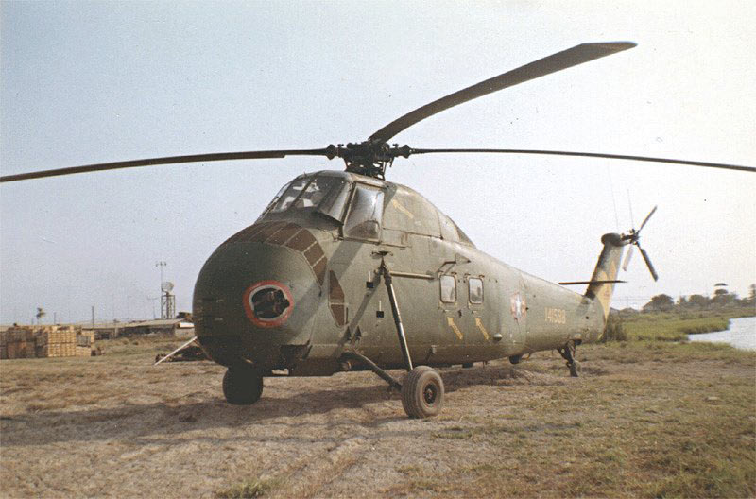
THIS DAY IN AVIATION
January 30
1957 — Sikorsky's HSS-1 (Model S-58) piston-engined helicopter, developed for anti-submarine operations, makes its first flight.

Slide 15
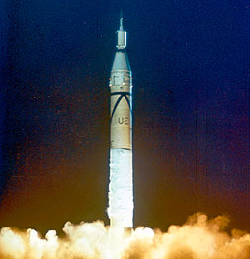
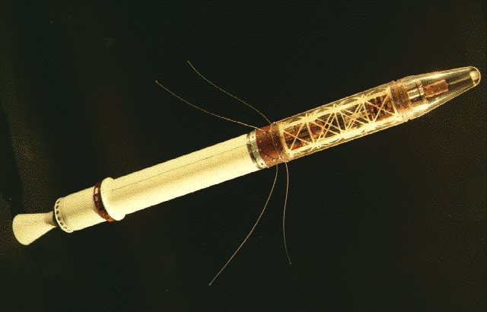
THIS DAY IN AVIATION
January 30
1958 — First United States satellite, “Explorer 1,” launched into orbit.

Slide 16
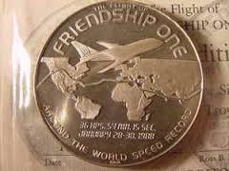
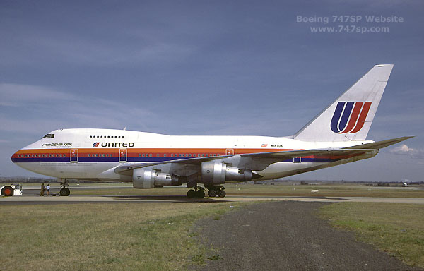
THIS DAY IN AVIATION
January 30
1988 — Boeing's long-range 747SP “Friendship One” returns to Seattle to set a round-the-world record of 36 hours 54 minutes 15 seconds.

Slide 17
Questions / Comments

Slide 18
AVIATION ACES
1B
Pilots (A – 90 & above)
1B
Co-Pilots (B – 80 -89)
Abercrombie
Boidab
Blackbird
Mike
Bassmaster
Frenchie
Brad
Bo
Burch
Potato
Josh
High Shooter (94)

Slide 19
February 2018
Sunday | Monday | Tuesday | Wednesday | Thursday | Friday | Saturday
28 | 29 Chapter 4 Aerodynamics of Flight | 30 Chapter 4 Aerodynamics of Flight | 31 Chapter 4 Aerodynamics of Flight | 1 Chapter 4 Aerodynamics of Flight Quiz | 2 Flight Line Friday | 3
4 | 5 Chapter 4 Aerodynamics of Flight | 6 Chapter 4 Aerodynamics of Flight | 7 Chapter 4 Aerodynamics of Flight | 8 Chapter 4 Aerodynamics of Flight | 9 Flight Line Friday QUIZ | 10
11 | 12 Chapter 4 Aerodynamics of Flight | 13 Chapter 4 Aerodynamics of Flight | 14 Chapter 4 Aerodynamics of Flight | 15 Chapter 4 Aerodynamics of Flight | 16 Flight Line Friday TEST | 17
18 | 19 HOLIDAY | 20 Chapter 5 Flight Controls | 21 Chapter 5 Flight Controls | 22 Chapter 5 Flight Controls | 23 Flight Line Friday TEST | 24
25 | 26 Chapter 6 Flight Systems | 27 Chapter 6 Flight Systems | 28 Chapter 6 Flight Systems | 1 Chapter 6 Flight Systems | 2 Flight Line Friday QUIZ | 3

Slide 20
1st Quarter Requirements (31 days of Class Meetings – Mar 16)
All students will complete the following:
Take notes - All in class quizzes and tests
Complete Flight Sim. Tutorials (1 – 5 x 3 + 1)
Aircraft Fam. and Student Pilot Syllabus
Lessons 1 – 7 (Straight & Level Flight through First Solo)
Must pass written with 80%
Successfully complete 3 times on small sim
Successfully complete 1 time on Main sim
Complete ERAU Aviation 101
6 quizzes and 2 tests
Student will receive zero points for all incomplete work – NO make-up / extra credit

Slide 21
Questions / Comments

Slide 22
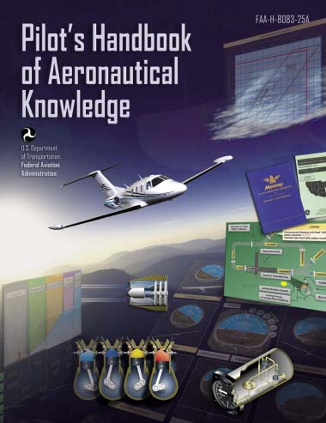
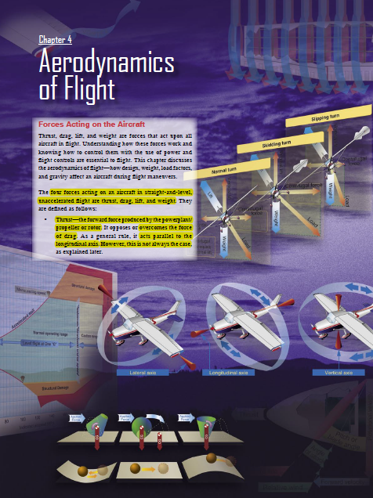
Chapter 4 – Aerodynamics of Flight
FAA – Pilot’s Handbook of Aeronautical Knowledge

Slide 23
Today’s Mission Requirements
Mission:
Identify in writing the forces acting on an aircraft in flight.
Describe how the forces of flight work and how to control them with the use of power and flight controls essential to flight.
Describe the aerodynamics of flight.
Describe in writing how design, weight, load factors, and gravity affect an aircraft during flight maneuvers.
EQ:
Describe the importance of Aeronautical Knowledge for the student pilot learning to fly.

Slide 24
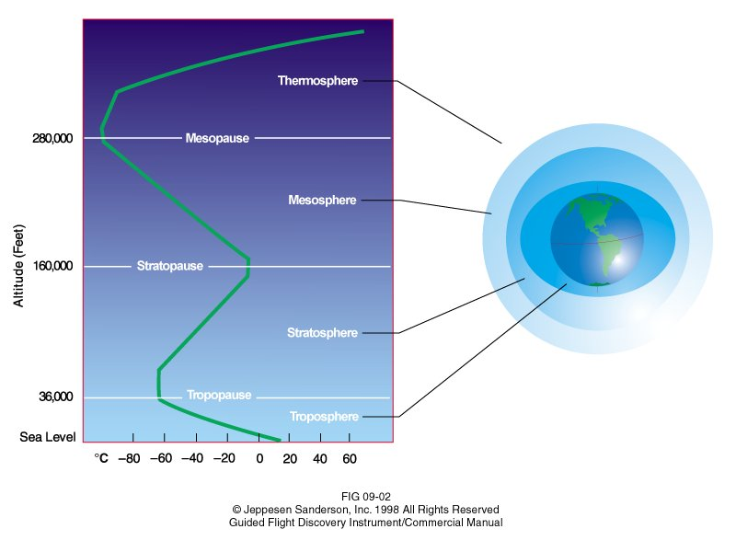
Earth’s Atmosphere Conditions
Lapse rate in troposphere (11 km)
$$T=15.04℃−0.00649\frac{℃}{m}\left(h\right)$$
$$p=101.29 kPa{\left[\frac{\left(T+273.1℃\right)\frac{K}{℃}}{288.08 K}\right]}^{5.256}$$
$$T=Temperature \left(℃\right)$$
$$h=height\left(m\right)$$
$$p=pressure\left(kPa\right)$$
Notes:
Lapse rate is the decrease in temperature and pressure as altitude increases. The standard temperature, T, and pressure, P, at sea level is defined as 15 degf and 101.3 Pa to serve as a common reference point. The temperature and pressure obviously are not always these values in actual existence. From these values the atmosphere decreases in temperature and pressure following these equations as the altitude increases up to the top of the troposphere. Beyond this level the atmosphere does not behave linearly. The lapse rate is particularly important to engineers because aircraft performance is greatly impacted by temperature and pressure. Engines and lift generated by the wing are two examples since both use air as working fluid.
More information available at http://www.grc.nasa.gov/WWW/K-12/airplane/atmosmet.html

Slide 25
Earth’s Atmosphere Conditions
Air density changes based on pressure and temperature
Generally air density lowers as it climbs to higher altitudes
$$ρ= \frac{p}{0.2869 \frac{J}{kg\left(K\right)} \left(T+273.1℃\right)\frac{K}{℃}}$$
$$ρ=Density \left(\frac{kg}{m^{3}}\right)$$
$$T=Temperature \left(℃\right)$$
$$h=height\left(m\right)$$
$$p=pressure\left(kPa\right)$$
Notes:
Lapse rate is the decrease in temperature and pressure as altitude increases. The standard temperature, T, and pressure, P, at sea level is defined as 15 degf and 101.3 Pa to serve as a common reference point. The temperature and pressure obviously are not always these values in actual existence. From these values the atmosphere decreases in temperature and pressure following these equations as the altitude increases up to the top of the troposphere. Beyond this level the atmosphere does not behave linearly. The lapse rate is particularly important to engineers because aircraft performance is greatly impacted by temperature and pressure. Engines and lift generated by the wing are two examples since both use air as working fluid.

Slide 26
Earth’s Atmosphere Conditions
$$T=15.04℃−0.00649\frac{℃}{m}\left(h\right)$$
$$p=101.29 kPa{\left[\frac{\left(T+273.1℃\right)\frac{K}{℃}}{288.08 K}\right]}^{5.256}$$
Notes:
Lapse rate is the decrease in temperature and pressure as altitude increases. The standard temperature, T, and pressure, P, at sea level is defined as 15 degf and 101.3 Pa to serve as a common reference point. The temperature and pressure obviously are not always these values in actual existence. From these values the atmosphere decreases in temperature and pressure following these equations as the altitude increases up to the top of the troposphere. Beyond this level the atmosphere does not behave linearly. The lapse rate is particularly important to engineers because aircraft performance is greatly impacted by temperature and pressure. Engines and lift generated by the wing are two examples since both use air as working fluid.
More information available at http://www.grc.nasa.gov/WWW/K-12/airplane/atmosmet.html

Slide 27
Lift Equation
Lift
Coefficient of Lift, C_{l}
Determined experimentally
Combines several factors
Shape
Angle of attack
Direction of Flight
$$C_{l}=Coefficient of Lift$$
$$C_{l}=\frac{2L}{Aρv^{2}}$$
$$C_{l}=\frac{L}{qA}$$
$$L=Lift (Weight) \left(N\right)$$
$$A=Wing Area \left(m^{2}\right)$$
$$ρ=Density \left(\frac{kg}{m^{3}}\right)$$
Alternate format
$$v=Velocity \left(\frac{m}{s}\right)$$
$$q=Dynamic Pressure\left(Pa\right)$$
Notes:
Rearranging the coefficient of lift equation shows that lift is increased by wing area, air density, and velocity. Velocity is a squared function, giving it a more significant impact on lift.

Slide 28
Applying the Lift Equation
Calculate Air Density
$$ρ= \frac{p}{0.2869\frac{J}{kg\left(K\right)}\left(T+273.1℃\right)\frac{K}{℃}}$$
$$ρ= \frac{101.29 kPa}{0.2869\frac{J}{kg\left(K\right)}\left(22 ℃+273.1℃\right)\frac{K}{℃}}$$
$$ρ=1.196\frac{kg}{m^{3}}$$

Slide 29
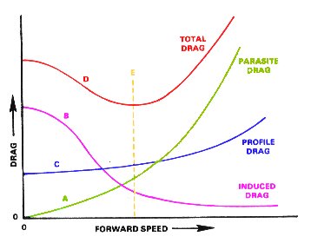
Types
of
Drag

Slide 30
Drag
The force that resists forward motion and acts against thrust.
Two types are:
Parasite Drag
Induced Drag

Slide 31
Drag
Parasite drag is comprised of all the forces that work to slow an aircraft’s movement.
Drag that is not associated with the production of lift.
This includes the displacement of the air by the aircraft, turbulence generated in the airstream, or a hindrance of air moving over the surface of the aircraft and airfoil.
There are three types of parasite drag: form drag, interference drag, and skin friction.

Slide 32
Questions / Comments

