Slide 1
Warm-Up – 1/16 – 10 minutes
Utilizing your notes and past knowledge answer the following questions:
Theoretically, why is the canard considered more efficient?
When a pilot pushes the left rudder pedal forward – which what type of lift is provided to the tail and what direction does it move?
The V-tail design utilizes two slanted tail surfaces to perform the same functions as ___________.
What are the four basic types of flaps?
This flap design not only changes the camber of the wing, it also increases the wing area and slides backwards on tracks. What is it?

Slide 2
Questions / Comments

Slide 3
Warm-Up – 1/16 – 10 minutes
Utilizing your notes and past knowledge answer the following questions:
Theoretically, why is the canard considered more efficient?
Why a pilot pushes the left rudder pedal forward – which what type of lift is provided to the tail and what direction does it move?
The V-tail design utilizes two slanted tail surfaces to perform the same functions as ___________.
What are the four basic types of flaps?
This flap design not only changes the camber of the wing, it also increases the wing area and slides backwards on tracks. What is it?

Slide 4
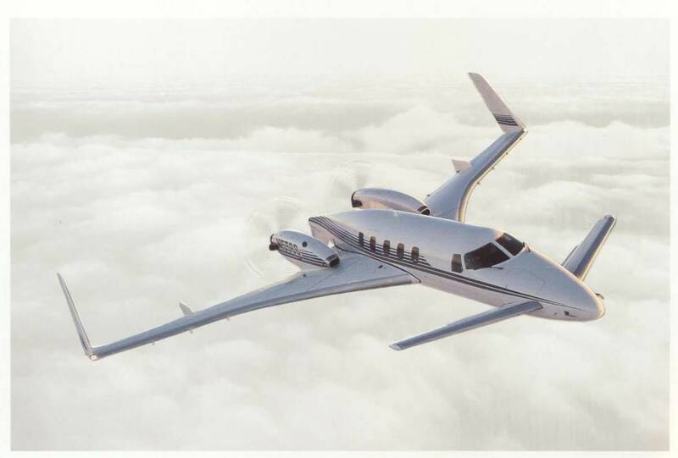
Flight Control Systems Canard
Theoretically, the canard is considered more efficient because using the horizontal surface to help lift the weight of the aircraft should result in less drag for a given amount of lift.

Slide 5
Warm-Up – 1/16 – 10 minutes
Utilizing your notes and past knowledge answer the following questions:
Theoretically, why is the canard considered more efficient?
Why a pilot pushes the left rudder pedal forward – which what type of lift is provided to the tail and what direction does it move?
The V-tail design utilizes two slanted tail surfaces to perform the same functions as ___________.
What are the four basic types of flaps?
This flap design not only changes the camber of the wing, it also increases the wing area and slides backwards on tracks. What is it?

Slide 6
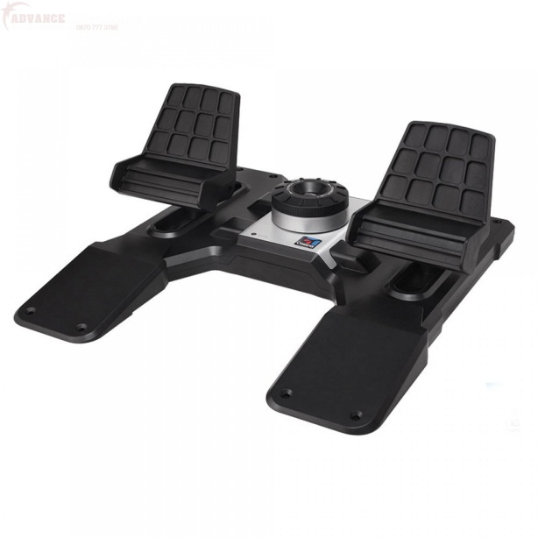
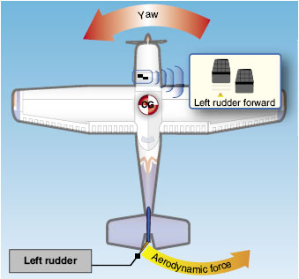
Flight Control Systems Rudder
By pushing the left pedal, the rudder moves left.
This creates a sideward lift that moves the tail to the right and yaws the nose of the airplane to the left.

Slide 7
Warm-Up – 1/16 – 10 minutes
Utilizing your notes and past knowledge answer the following questions:
Theoretically, why is the canard considered more efficient?
Why a pilot pushes the left rudder pedal forward – which what type of lift is provided to the tail and what direction does it move?
The V-tail design utilizes two slanted tail surfaces to perform the same functions as ___________.
What are the four basic types of flaps?
This flap design not only changes the camber of the wing, it also increases the wing area and slides backwards on tracks. What is it?

Slide 8
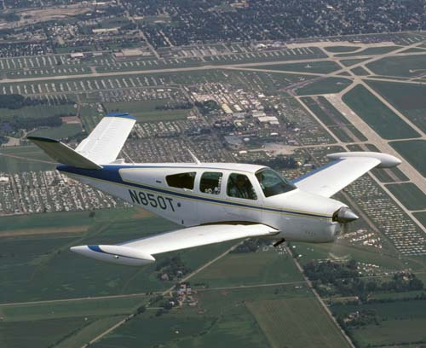
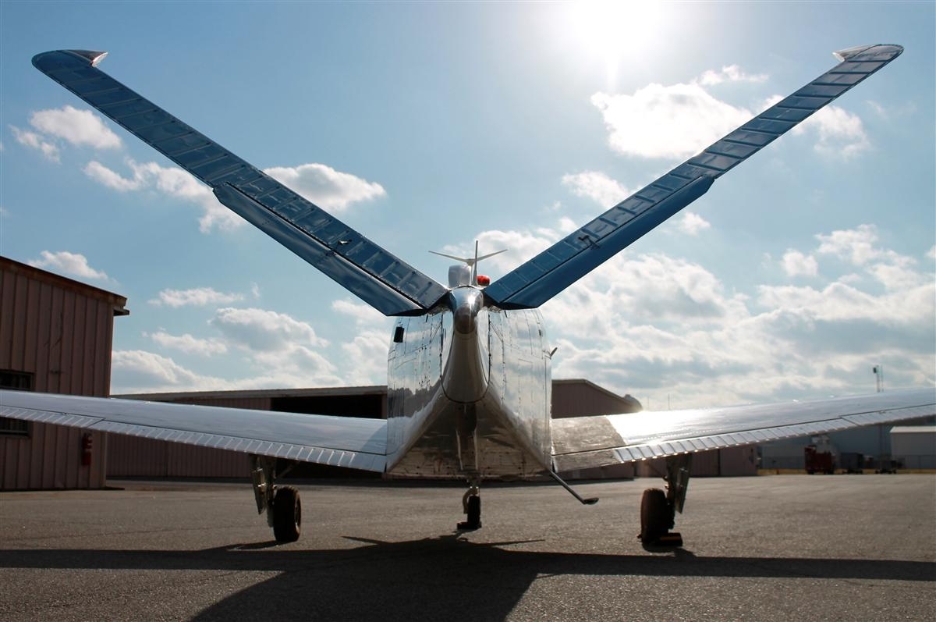
Flight Control Systems V-Tail
The V-tail design utilizes two slanted tail surfaces to perform the same functions as the surfaces of a conventional elevator and rudder configuration.
The fixed surfaces act as both horizontal and vertical stabilizers.

Slide 9
Warm-Up – 1/16 – 10 minutes
Utilizing your notes and past knowledge answer the following questions:
Theoretically, why is the canard considered more efficient?
Why a pilot pushes the left rudder pedal forward – which what type of lift is provided to the tail and what direction does it move?
The V-tail design utilizes two slanted tail surfaces to perform the same functions as ___________.
What are the four basic types of flaps?
This flap design not only changes the camber of the wing, it also increases the wing area and slides backwards on tracks. What is it?

Slide 10
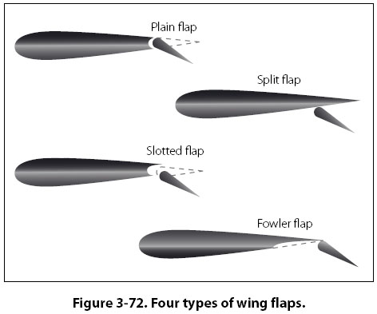
Secondary Flight Controls Flaps
There are four common types of flaps:
plain, split, slotted, and Fowler flaps.

Slide 11
Warm-Up – 1/16 – 10 minutes
Utilizing your notes and past knowledge answer the following questions:
Theoretically, why is the canard considered more efficient?
Why a pilot pushes the left rudder pedal forward – which what type of lift is provided to the tail and what direction does it move?
The V-tail design utilizes two slanted tail surfaces to perform the same functions as ___________.
What are the four basic types of flaps?
This flap design not only changes the camber of the wing, it also increases the wing area and slides backwards on tracks. What is it?

Slide 12
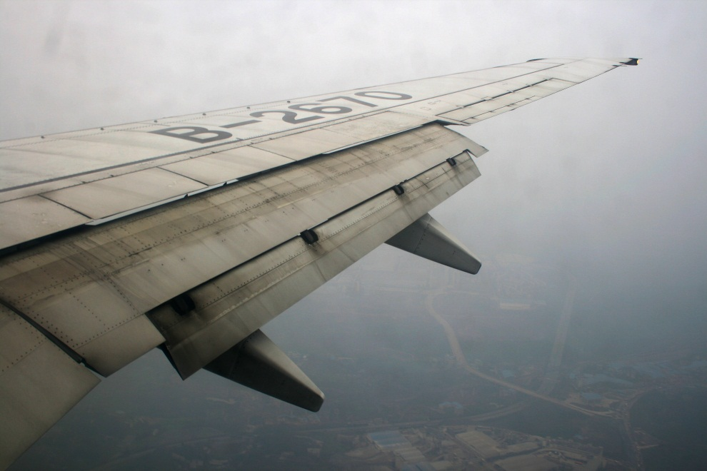
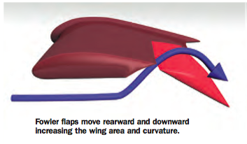
Secondary Flight Controls Flaps
Fowler flaps are a type of slotted flap.
This flap design not only changes the camber of the wing, it also increases the wing area.
Instead of rotating down on a hinge, it slides backwards on tracks.

Slide 13
Questions / Comments

Slide 14
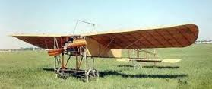
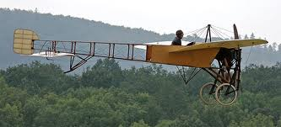
THIS DAY IN AVIATION
January 16
1911 — The first photo reconnaissance flight was unable to locate troops from the air.

Slide 15
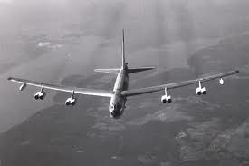
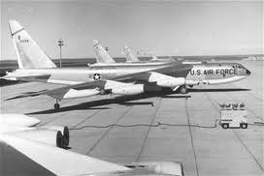
THIS DAY IN AVIATION
January 16
1957 — Five Boeing B-52B “Stratofortresses” of the Ninety-third Bombardment Wing, commanded by Major General Archie J. Old, Jr., commander of the United States Fifteenth Air Force, begin “Operation Power Flite,” the first nonstop round-the-world flight by turbojet aircraft.

Slide 16
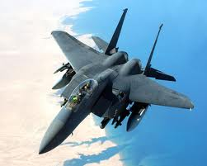
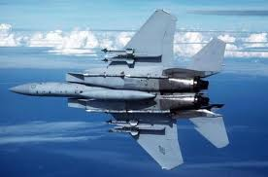
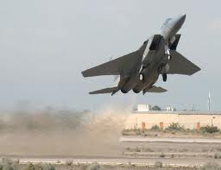
THIS DAY IN AVIATION
January 16
1975 — In “Operation Streak Eagle,” the USAF sets new climb-time records with the McDonnell Douglas F-15A “Eagle” aircraft, operating from Grand Forks Air Force Base, North Dakota.
The “Streak Eagle” reaches a height of:
9,843 ft. in 27.57 sec.
19,685 ft. in 39.33 sec.
29,528 ft. in 48.86 sec.
39,370 ft. in 59.38 sec.
42,212 ft. in 1 min. 17.02 sec

Slide 17
Questions / Comments

Slide 18
January 2014
Sunday | Monday | Tuesday | Wednesday | Thursday | Friday | Saturday
 |  |  | 1 | 2 | 3 | 4
5 | 6 Chapter 5 Flight Controls Primary Flight Controls | 7 | 8 Chapter 5 Flight Controls Ailerons Adverse Yaw Elevators Stabilators | 9 | 10 Chapter 5 Flight Controls Quiz | 11
12 | 13 | 14 Chapter 5 Flight Controls Canards Flaps | 15 | 16 Chapter 5 Flight Controls Trim Systems Autopilot Chapter TEST Grades Due | 17 NO SCHOOL | 18
19 | 20 NO SCHOOL | 21 | 22 Chapter 6 Aircraft Systems | 23 | 24 Chapter 6 Aircraft Systems | 25
26 | 27 | 28 Chapter 6 Aircraft Systems | 29 | 30 Chapter 6 Aircraft Systems | 31

Slide 19
Questions / Comments

Slide 20
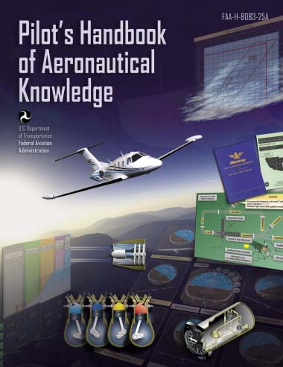
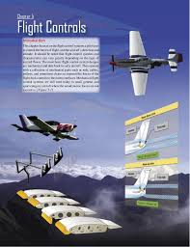
Chapter 5 – Flight Controls
FAA – Pilot’s Handbook of Aeronautical Knowledge

Slide 21
Today’s Mission Requirements
Mission:
Identify in writing the flight control systems a pilot uses to control the forces of flight, and the aircraft’s direction and attitude.
Describe how the flight control systems and characteristics can vary greatly depending on the type of aircraft flown.
Describe in writing the basic flight control system designs.
EQ:
Describe the importance of Aeronautical Knowledge for the student pilot learning to fly.

Slide 22
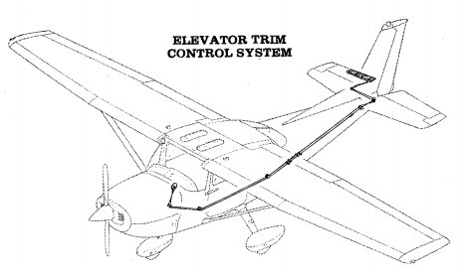
Secondary Flight Controls Trim Systems
Trim systems are used to relieve the pilot of the need to maintain constant pressure on the flight controls, and usually consist of flight deck controls and small hinged devices attached to the trailing edge of one or more of the primary flight control surfaces.

Slide 23
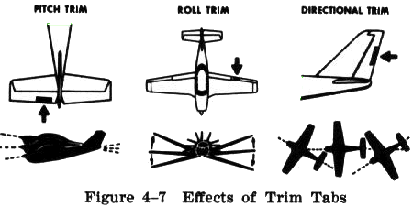
Secondary Flight Controls Trim Systems
Designed to help minimize a pilot’s workload, trim systems aerodynamically assist movement and position of the flight control surface to which they are attached.

Slide 24
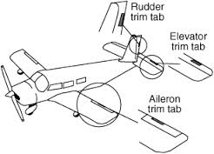
Secondary Flight Controls Trim Systems
Common types of trim systems include:
Trim tabs, balance tabs, antiservo tabs, ground adjustable tabs, and an adjustable stabilizer.

Slide 25
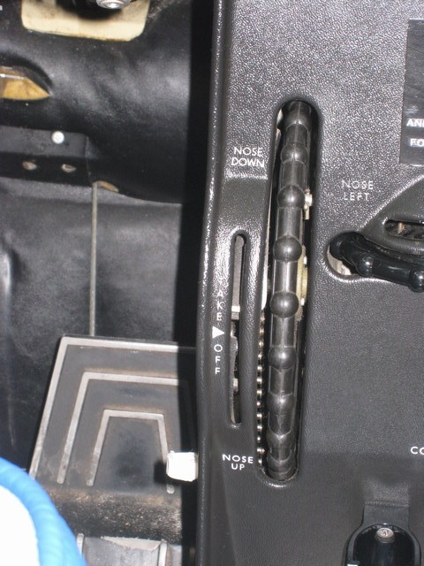
Secondary Flight Controls Trim Tabs
The most common installation on small aircraft is a single trim tab attached to the trailing edge of the elevator.
Most trim tabs are manually operated by a small, vertically mounted control wheel.

Slide 26
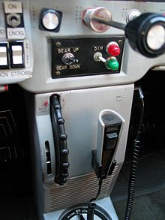
Secondary Flight Controls Trim Tabs
The normal trim procedure is to continue trimming until the aircraft is balanced and the nose-heavy condition is no longer apparent.
Pilots normally establish the desired power, pitch attitude, and configuration first, and then trim the aircraft to relieve control pressures that may exist for that flight condition.

Slide 27
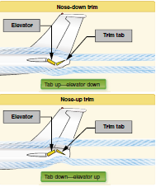
Secondary Flight Controls Trim Tabs
If the trim tab is set to the full nose-up position, the tab moves to its full down position.
The air flowing hits the tab and forces the trailing edge of the elevator up.
This causes the tail of the airplane to move down, and the nose to move up.

Slide 28
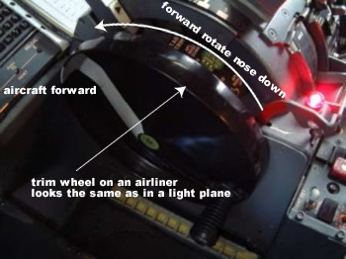
Secondary Flight Controls Trim Tabs
Any time power, pitch attitude, or configuration is changed, expect that retrimming will be necessary to relieve the control pressures for the new flight condition.

Slide 29
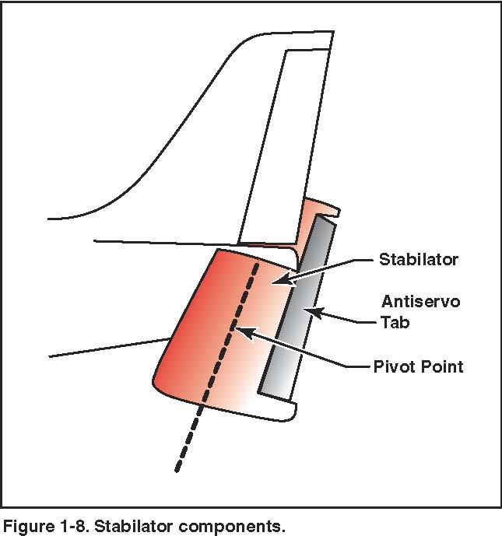
Secondary Flight Controls Antiservo Tabs
They move in the same direction as the trailing edge of the stabilator.
In addition to decreasing the sensitivity of the stabilator, an antiservo tab also functions as a trim device to relieve control pressure and maintain the stabilator in the desired position.

Slide 30
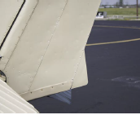
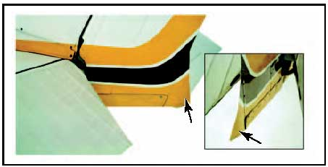
Secondary Flight Controls Ground Adjustable Tabs
Many small aircraft have a nonmovable metal trim tab on the rudder.
This tab is bent in one direction or the other while on the ground to apply a trim force to the rudder.
The correct displacement is determined by trial and error.

Slide 31
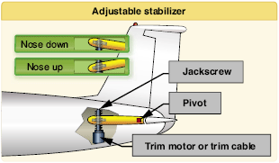
Secondary Flight Controls Adjustable Stabilizer
Rather than using a movable tab on the trailing edge of the elevator, some aircraft have an adjustable stabilizer.
This is accomplished by use of a jackscrew mounted on the leading edge of the stabilator.

Slide 32
Secondary Flight Controls Adjustable Stabilizer
On small aircraft, the jackscrew is cable operated with a trim wheel or crank.
On larger aircraft, it is motor driven.
The trimming effect and flight deck indications for an adjustable stabilizer are similar to those of a trim tab.

Slide 33
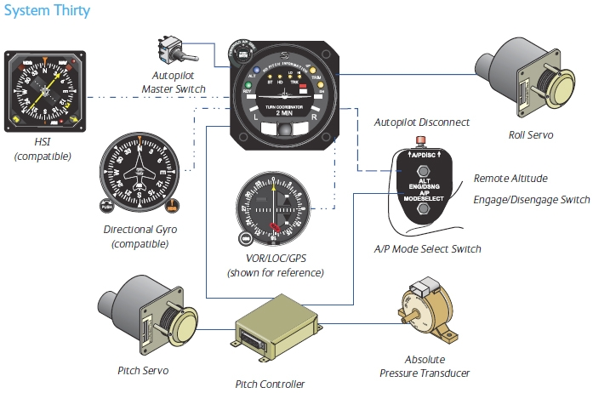
Autopilot
Autopilot is an automatic flight control system that keeps an aircraft in level flight or on a set course.

Slide 34
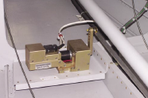
Autopilot
It can be directed by the pilot, or it may be coupled to a radio navigation signal.
Autopilot reduces the physical and mental demands on a pilot and increases safety.

Slide 35
Autopilot
The common features available on an autopilot are altitude and heading hold.
The simplest systems use gyroscopic attitude indicators and magnetic compasses to control servos connected to the flight control system.

Slide 36
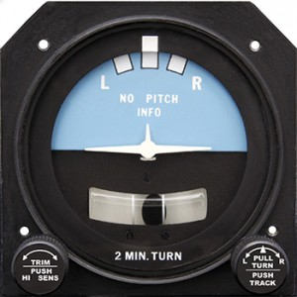
Autopilot
A single-axis autopilot controls the aircraft about the longitudinal axis and a servo actuates the ailerons.

Slide 37
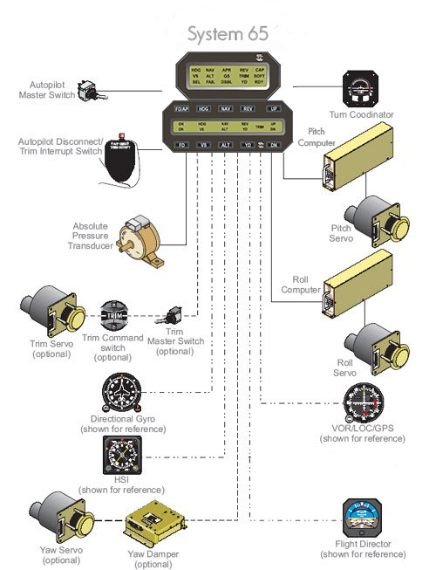
Autopilot
A three-axis autopilot controls the aircraft about the longitudinal, lateral, and vertical axes.
Different servos actuate ailerons, elevator, and rudder.

Slide 38
Autopilot
More advanced systems often include a vertical speed and/or indicated airspeed hold mode.
Advanced autopilot systems are coupled to navigational aids through a flight director.
The autopilot system also incorporates a disconnect safety feature to disengage the system automatically or manually.

Slide 39
Autopilot
Autopilots can be manually overridden.
Because autopilot systems differ widely in their operation, refer to the autopilot operating instructions in the Airplane Flight Manual (AFM) or the Pilot’s Operating Handbook (POH).

Slide 40
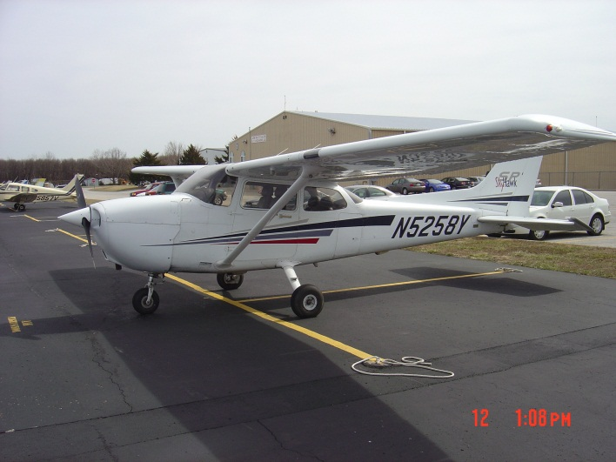
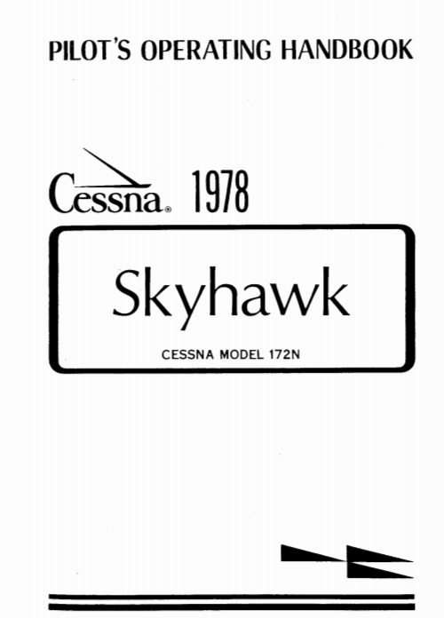
Chapter Summary
Because flight control systems and aerodynamic characteristics vary greatly between aircraft, it is essential that a pilot become familiar with the primary and secondary flight control systems of the aircraft being flown.
The primary source of information is the AFM or the POH.

Slide 41
Questions / Comments

Slide 42
Lesson Closure - 3 – 2 - 1
3. List 3 things you learned today.
2. List 2 things you have questions about today’s lesson.
1. Create (1) quiz question with answer about today’s lesson.

