Slide 1
Warm-Up – 2/7 – 10 minutes
Utilizing your notes and past knowledge answer the following questions:
When an aircraft banks a force acts towards the center of the turn is called the ____________.
A good turn is one in which the nose and tail of the aircraft _____________.
The aircraft loses altitude unless additional lift is created. This is done by ______________ .
Induced drag increases as the lift is __________.
To prevent a reduction in airspeed in level turns what must be applied?

Slide 2

Questions / Comments

Slide 3
Warm-Up – 2/7 – 10 minutes
Utilizing your notes and past knowledge answer the following questions:
When an aircraft banks a force acts towards the center of the turn is called the ____________.
A good turn is one in which the nose and tail of the aircraft _____________.
The aircraft loses altitude unless additional lift is created. This is done by ______________ .
Induced drag increases as the lift is __________.
To prevent a reduction in airspeed in level turns what must be applied?

Slide 4
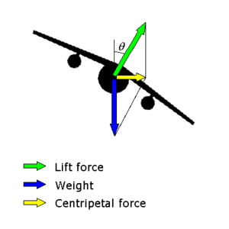
Aerodynamic Forces in Flight Maneuvers
Forces in Turns
The other force, which acts horizontally toward the center of the turn, is called the “horizontal component of lift,” or centripetal force.

Slide 5
Warm-Up – 2/7 – 10 minutes
Utilizing your notes and past knowledge answer the following questions:
When an aircraft banks a force act towards the center of the turn is called the ____________.
A good turn is one in which the nose and tail of the aircraft _____________.
The aircraft loses altitude unless additional lift is created. This is done by ______________ .
Induced drag increases as the lift is __________.
To prevent a reduction in airspeed in level turns what must be applied?

Slide 6
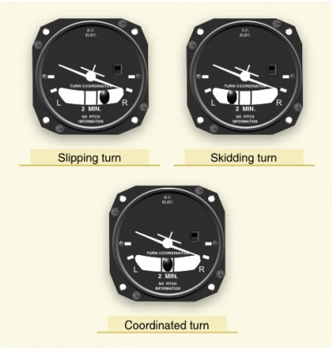
Aerodynamic Forces in Flight Maneuvers
Forces in Turns
A good turn is one in which the nose and tail of the aircraft track along the same path.

Slide 7
Warm-Up – 2/7 – 10 minutes
Utilizing your notes and past knowledge answer the following questions:
When an aircraft banks a force act towards the center of the turn is called the ____________.
A good turn is one in which the nose and tail of the aircraft _____________.
The aircraft loses altitude unless additional lift is created. This is done by ______________ .
Induced drag increases as the lift is __________.
To prevent a reduction in airspeed in level turns what must be applied?

Slide 8
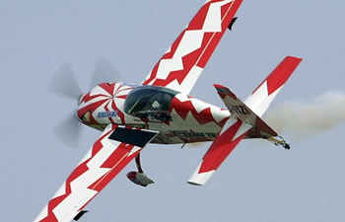
Aerodynamic Forces in Flight Maneuvers
Forces in Turns
Consequently, the aircraft loses altitude unless additional lift is created.
This is done by increasing the AOA until the vertical component of lift is again equal to the weight.

Slide 9
Warm-Up – 2/7 – 10 minutes
Utilizing your notes and past knowledge answer the following questions:
When an aircraft banks a force act towards the center of the turn is called the ____________.
A good turn is one in which the nose and tail of the aircraft _____________.
The aircraft loses altitude unless additional lift is created. This is done by ______________ .
Induced drag increases as the lift is __________.
To prevent a reduction in airspeed in level turns what must be applied?

Slide 10
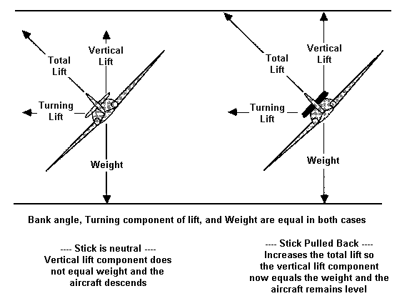
Aerodynamic Forces in Flight Maneuvers
Forces in Turns
To provide a vertical component of lift sufficient to hold altitude in a level turn, an increase in the AOA is required.
Since the drag of the airfoil is directly proportional to its AOA, induced drag increases as the lift is increased.

Slide 11
Warm-Up – 2/7 – 10 minutes
Utilizing your notes and past knowledge answer the following questions:
When an aircraft banks a force act towards the center of the turn is called the ____________.
A good turn is one in which the nose and tail of the aircraft _____________.
The aircraft loses altitude unless additional lift is created. This is done by ______________ .
Induced drag increases as the lift is __________.
To prevent a reduction in airspeed in level turns what must be applied?

Slide 12
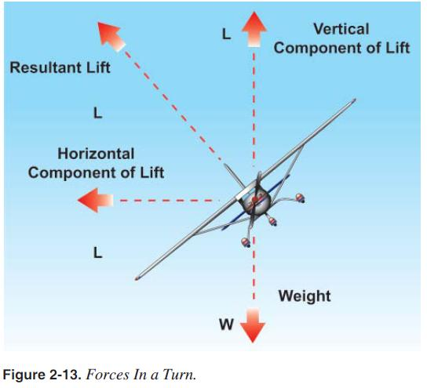
Aerodynamic Forces in Flight Maneuvers
Forces in Turns
Additional thrust (power) must be applied to prevent a reduction in airspeed in level turns.
The required amount of additional thrust is proportional to the angle of bank.

Slide 13
Questions / Comments

Slide 14
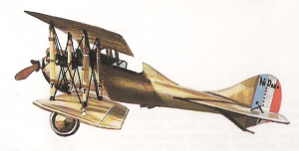
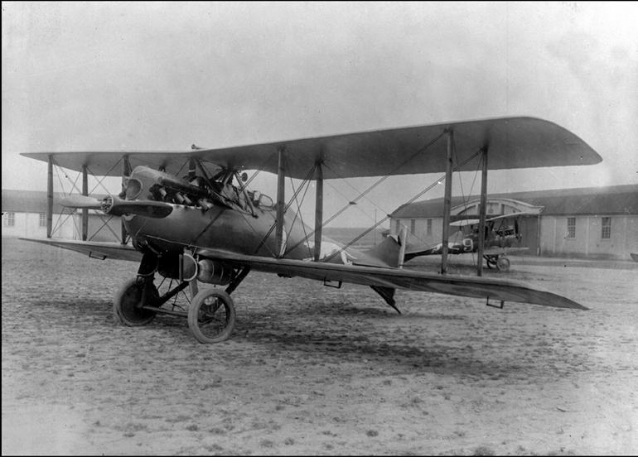
THIS DAY IN AVIATION
February 7
In 1920... French aviator Sadi Lacointe, piloting a Nieuport-Delage 29V, becomes the first pilot to set a new Federation Aeronautique Internationale
(FAI) world speed record after World War I.
He reaches a measured speed of 275.862 km/h (171.141 mph) along 1 km (3,280 ft.) course.

Slide 15

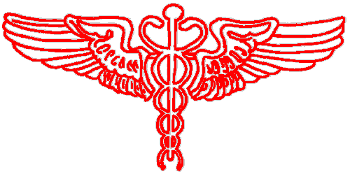
THIS DAY IN AVIATION
February 7
In 1927... Georgetown University medical school in Washington, D.C., offers the first aviation medicine course in the United States.

Slide 16
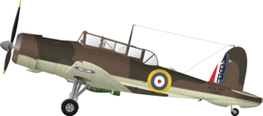
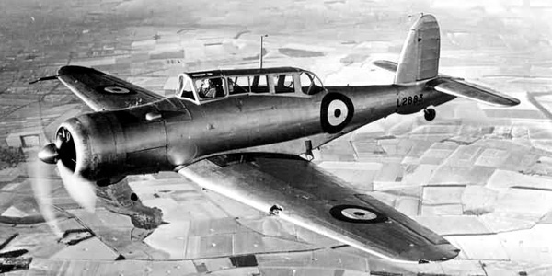
THIS DAY IN AVIATION
February 7
In 1937... The prototype Blackburn B.24 Skua two-seat fighter/dive-bomber makes its maiden flight, piloted by "Dasher" Blake at Brough, Yorkshire; it is Britain's first dive-bomber.

Slide 17

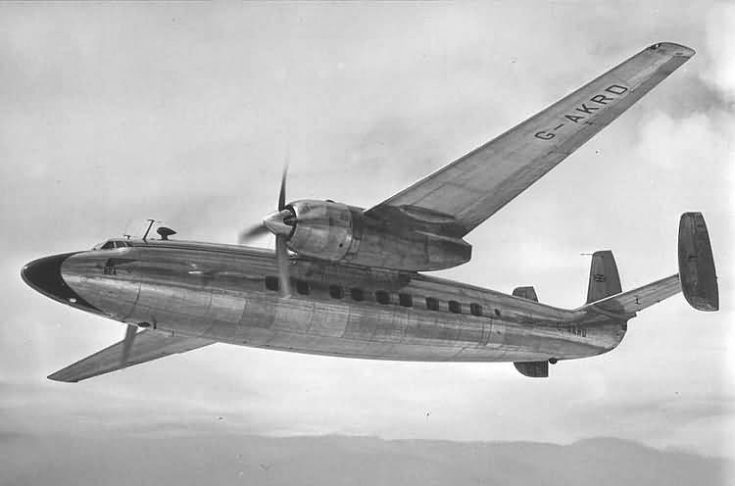
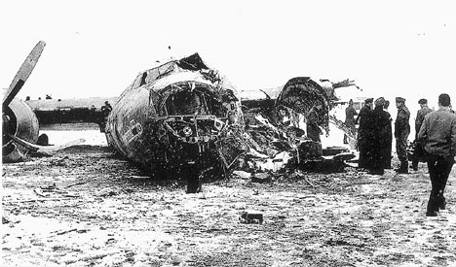
THIS DAY IN AVIATION
February 7
In 1958... One of the best British soccer teams, Manchester United, has been
virtually wiped out in an air crash.
The team was returning from Belgrade after victory against a Yugoslav opponent when their British European Airways (BEA) Airspeed AS.57 Ambassador failed to take off and crashed into a house in Munich, Germany.

Slide 18
Questions / Comments

Slide 19
February 2018
Sunday | Monday | Tuesday | Wednesday | Thursday | Friday | Saturday
 | 29 Chapter 4 Aerodynamics of Flight | 30 Chapter 4 Aerodynamics of Flight | 31 Chapter 4 Aerodynamics of Flight | 1 Chapter 4 Aerodynamics of Flight Quiz | 2 Flight Line Friday | 3
4 | 5 Chapter 4 Aerodynamics of Flight | 6 Chapter 4 Aerodynamics of Flight | 7 Chapter 4 Aerodynamics of Flight | 8 Chapter 4 Aerodynamics of Flight | 9 Flight Line Friday QUIZ | 10
11 | 12 Chapter 4 Aerodynamics of Flight | 13 Chapter 4 Aerodynamics of Flight | 14 Chapter 4 Aerodynamics of Flight | 15 Chapter 4 Aerodynamics of Flight | 16 Flight Line Friday TEST | 17
18 | 19 HOLIDAY | 20 Chapter 5 Flight Controls | 21 Chapter 5 Flight Controls | 22 Chapter 5 Flight Controls | 23 Flight Line Friday TEST | 24
25 | 26 Chapter 6 Flight Systems | 27 Chapter 6 Flight Systems | 8 Chapter 6 Flight Systems | 1 Chapter 6 Flight Systems | 2 Flight Line Friday QUIZ | 3

Slide 20
1st Quarter Requirements
(25 days of Class Meetings – Mar 16)
All students will complete the following:
  Take notes - All in class quizzes and tests
  Complete Flight Sim. Tutorials (1 – 5 x 3 + 1)
  Aircraft Fam. and Student Pilot Syllabus
    Lessons 1 – 7 (Straight & Level Flight through First Solo)
    Must pass written with 80%
    Successfully complete 3 times on small sim
    Successfully complete 1 time on Main sim
  Complete ERAU Aviation 101
    6 quizzes and 2 tests
  Student will receive zero points for all incomplete work – NO make-up / extra credit

Slide 21
Questions / Comments

Slide 22

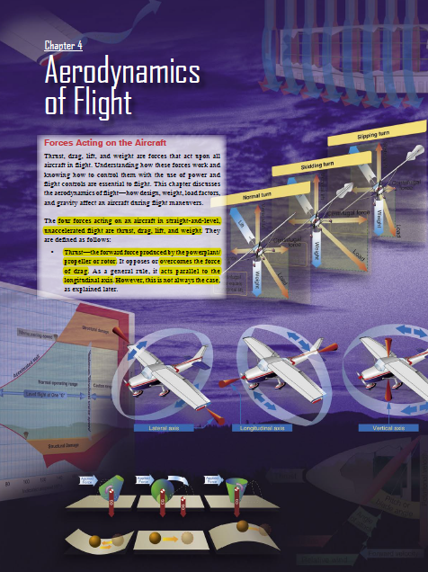
Chapter 4 – Aerodynamics of Flight
FAA – Pilot’s Handbook of Aeronautical Knowledge

Slide 23
Today’s Mission Requirements
Mission:
Identify in writing the forces acting on an aircraft in flight.
Describe how the forces of flight work and how to control them with the use of power and flight controls essential to flight.
Describe the aerodynamics of flight.
Describe in writing how design, weight, load factors, and gravity affect an aircraft during flight maneuvers.
EQ:
  Describe the importance of Aeronautical Knowledge for the student pilot learning to fly.

Slide 24
Aerodynamic Forces in Flight Maneuvers
Forces in Climbs
The wing’s lift in a steady state normal climb is the same as it is in a steady level flight at the same airspeed.

Slide 25
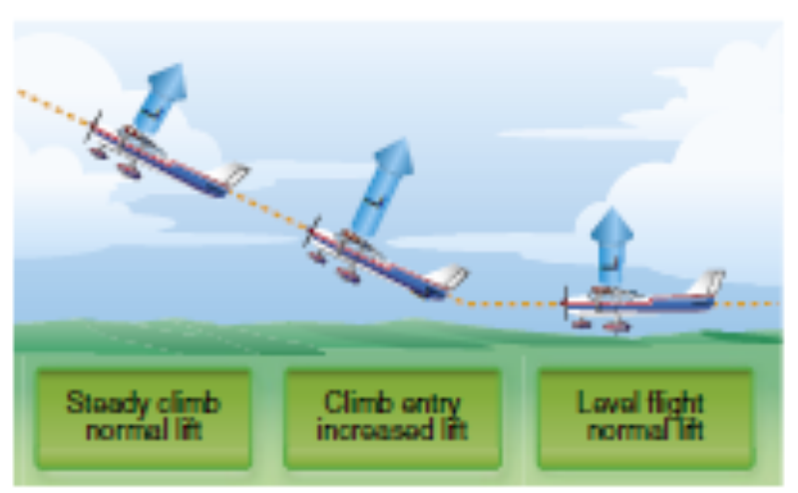
Aerodynamic Forces in Flight Maneuvers
Forces in Climbs
Although the aircraft’s flightpath changed when the climb was established, the AOA of the wing with respect to the inclined flightpath reverts to practically the same values, as does the lift.

Slide 26
Aerodynamic Forces in Flight Maneuvers
Forces in Climbs
After the flightpath is stabilized on the upward incline, the AOA and lift again revert to about the level flight values.

Slide 27
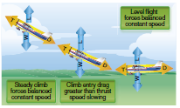
Aerodynamic Forces in Flight Maneuvers
Forces in Climbs
If the climb is entered with no change in power setting, the airspeed gradually diminishes because the thrust required to maintain a given airspeed in level flight is insufficient to maintain the same airspeed in a climb.

Slide 28
Aerodynamic Forces in Flight Maneuvers
Forces in Climbs
Additional power is required to maintain the same airspeed as in level flight.

Slide 29
Aerodynamic Forces in Flight Maneuvers
Forces in Climbs
The amount of power depends on the angle of climb.
When the climb is established steep enough and there is insufficient power available, a slower speed results.

Slide 30
Aerodynamic Forces in Flight Maneuvers
Forces in Climbs
Climb performance is dependent on the amount of excess power available to overcome a portion of weight.
Note that aircraft are able to sustain a climb due to excess thrust.

Slide 31
Aerodynamic Forces in Flight Maneuvers
Forces in Climbs
When the excess thrust is gone, the aircraft is no longer able to climb.
At this point, the aircraft has reached its “absolute ceiling.”

Slide 32
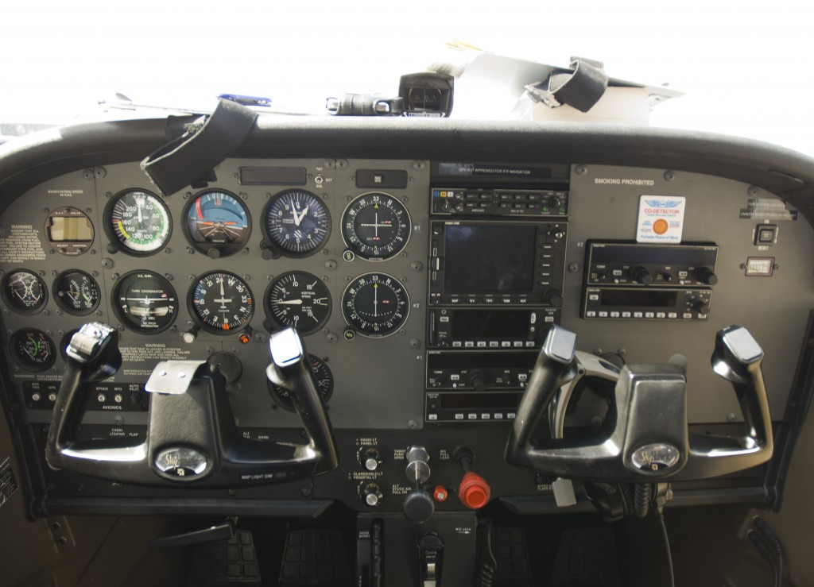
Aerodynamic Forces in Flight Maneuvers
Forces in Decents
Forward pressure is applied to the control yoke to initiate the descent, the AOA is decreased momentarily.

Slide 33
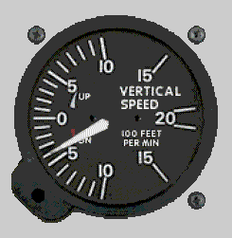
Aerodynamic Forces in Flight Maneuvers
Forces in Decents
To descend at the same airspeed as used in straight-and-level flight, the power must be reduced as the descent is entered.

Slide 34
Questions / Comments

Slide 35
Lesson Closure - 3 – 2 - 1
3. List 3 things you learned today.
2. List 2 things you have questions about today’s lesson.
1. Create (1) quiz question with answer about today’s lesson.

