Slide 1
Warm-Up – 2/6 – 10 minutes
Utilizing your notes and past knowledge answer the following questions:
Ground effect causes a significant reduction in __________.
Ground effect is most during what stages of flight?
The takeoff phase of flight, the aircraft leaving ground effect will experience these four characteristics:
During high, hot and heavy takeoffs, what is a major concern for pilots?
During the landing phase of flight, the aircraft is brought into ground effect may experience this type of flight action.

Slide 2

Questions / Comments

Slide 3
Warm-Up – 2/6 – 10 minutes
Utilizing your notes and past knowledge answer the following questions:
Ground effect causes a significant reduction in __________.
Ground effect is most during what stages of flight?
The takeoff phase of flight, the aircraft leaving ground effect will experience these four characteristics:
During high, hot and heavy takeoffs, what is a major concern for pilots?
During the landing phase of flight, the aircraft is brought into ground effect may experience this type of flight action.

Slide 4
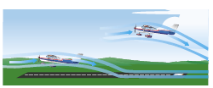
Ground Effect
The reduction in induced flow due to ground effect causes a significant reduction in induced drag but causes no direct effect on parasite drag
the thrust required at low speeds will be reduced.

Slide 5
Warm-Up – 2/6 – 10 minutes
Utilizing your notes and past knowledge answer the following questions:
Ground effect causes a significant reduction in __________.
Ground effect is most during what stages of flight?
The takeoff phase of flight, the aircraft leaving ground effect will experience these four characteristics:
During high, hot and heavy takeoffs, what is a major concern for pilots?
During the landing phase of flight, the aircraft is brought into ground effect may experience this type of flight action.

Slide 6
Ground Effect
A large reduction in induced drag will take place only when the wing is very close to the ground.
Ground effect is most usually recognized during the liftoff for takeoff or just prior to touchdown when landing.

Slide 7
Warm-Up – 2/6 – 10 minutes
Utilizing your notes and past knowledge answer the following questions:
Ground effect causes a significant reduction in __________.
Ground effect is most during what stages of flight?
The takeoff phase of flight, the aircraft leaving ground effect will experience these four characteristics:
During high, hot and heavy takeoffs, what is a major concern for pilots?
During the landing phase of flight, the aircraft is brought into ground effect may experience this type of flight action.

Slide 8
Ground Effect
The takeoff phase of flight, the aircraft leaving ground effect will:
  Require an increase in AOA to maintain the same CL.
  Experience an increase in induced drag and thrust required.
  Experience a decrease in stability and a nose-up change in moment.
  Experience a reduction in static source pressure and increase in indicated airspeed.

Slide 9
Warm-Up – 2/6 – 10 minutes
Utilizing your notes and past knowledge answer the following questions:
Ground effect causes a significant reduction in __________.
Ground effect is most during what stages of flight?
The takeoff phase of flight, the aircraft leaving ground effect will experience these four characteristics:
During high, hot and heavy takeoffs, what is a major concern for pilots?
During the landing phase of flight, the aircraft is brought into ground effect may experience this type of flight action.

Slide 10
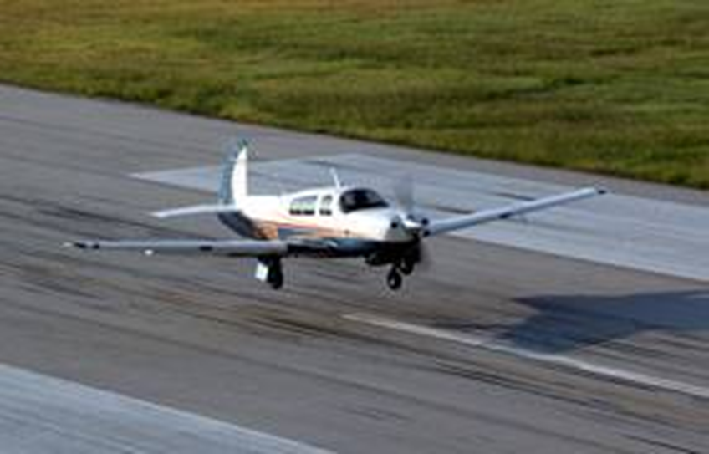
Ground Effect
In extreme conditions, such as high gross weight, high density altitude, and high temperature, a deficiency of airspeed during takeoff may permit the aircraft to become airborne but be incapable of sustaining flight out of ground effect.

Slide 11
Warm-Up – 2/6 – 10 minutes
Utilizing your notes and past knowledge answer the following questions:
Ground effect causes a significant reduction in __________.
Ground effect is most during what stages of flight?
The takeoff phase of flight, the aircraft leaving ground effect will experience these four characteristics:
During high, hot and heavy takeoffs, what is a major concern for pilots?
During the landing phase of flight, the aircraft is brought into ground effect may experience this type of flight action.

Slide 12
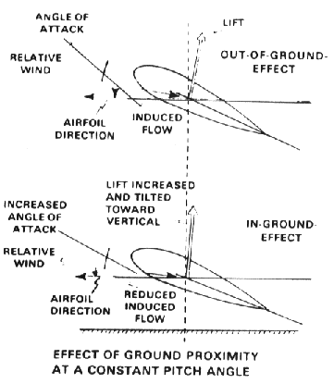
Ground Effect
During the landing phase of flight, the aircraft is brought into ground effect with a constant AOA, the aircraft experiences an increase in CL and a reduction in the thrust required, and a “floating” effect may occur.

Slide 13
Questions / Comments

Slide 14

THIS DAY IN AVIATION
February 6
1916 — The airline Deutsche Luft Reederei flies its first service, which is freight only, between Berlin and Weimar.

Slide 15
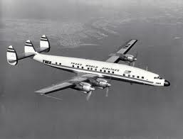
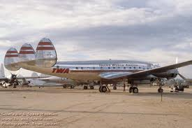
THIS DAY IN AVIATION
February 6
1946 — A TWA Lockheed “Constellation” lands at Orly airport, Paris, from LaGuardia, New York, to complete the airline's first scheduled international flight.

Slide 16
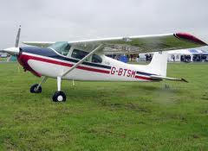
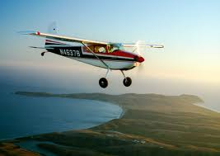
THIS DAY IN AVIATION
February 6
1956 — William Judd lands his Cessna 180 in Paris after a solo flight of 25 hours 15 minutes across the North Atlantic from the United States.

Slide 17
Questions / Comments

Slide 18
February 2018
Sunday | Monday | Tuesday | Wednesday | Thursday | Friday | Saturday
 | 29 Chapter 4 Aerodynamics of Flight | 30 Chapter 4 Aerodynamics of Flight | 31 Chapter 4 Aerodynamics of Flight | 1 Chapter 4 Aerodynamics of Flight Quiz | 2 Flight Line Friday | 3
4 | 5 Chapter 4 Aerodynamics of Flight | 6 Chapter 4 Aerodynamics of Flight | 7 Chapter 4 Aerodynamics of Flight | 8 Chapter 4 Aerodynamics of Flight | 9 Flight Line Friday QUIZ | 10
11 | 12 Chapter 4 Aerodynamics of Flight | 13 Chapter 4 Aerodynamics of Flight | 14 Chapter 4 Aerodynamics of Flight | 15 Chapter 4 Aerodynamics of Flight | 16 Flight Line Friday TEST | 17
18 | 19 HOLIDAY | 20 Chapter 5 Flight Controls | 21 Chapter 5 Flight Controls | 22 Chapter 5 Flight Controls | 23 Flight Line Friday TEST | 24
25 | 26 Chapter 6 Flight Systems | 27 Chapter 6 Flight Systems | 8 Chapter 6 Flight Systems | 1 Chapter 6 Flight Systems | 2 Flight Line Friday QUIZ | 3

Slide 19
1st Quarter Requirements
(26 days of Class Meetings – Mar 16)
All students will complete the following:
  Take notes - All in class quizzes and tests
  Complete Flight Sim. Tutorials (1 – 5 x 3 + 1)
  Aircraft Fam. and Student Pilot Syllabus
    Lessons 1 – 7 (Straight & Level Flight through First Solo)
    Must pass written with 80%
    Successfully complete 3 times on small sim
    Successfully complete 1 time on Main sim
  Complete ERAU Aviation 101
    6 quizzes and 2 tests
  Student will receive zero points for all incomplete work – NO make-up / extra credit

Slide 20
Questions / Comments

Slide 21

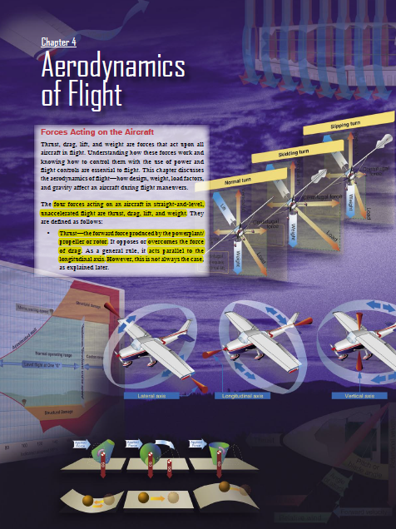
Chapter 4 – Aerodynamics of Flight
FAA – Pilot’s Handbook of Aeronautical Knowledge

Slide 22
Today’s Mission Requirements
Mission:
Identify in writing the forces acting on an aircraft in flight.
Describe how the forces of light work and how to control them with the use of power and flight controls essential to flight.
Describe the aerodynamics of flight.
Describe in writing how design, weight, load factors, and gravity affect an aircraft during flight maneuvers.
EQ:
  Describe the importance of Aeronautical Knowledge for the student pilot learning to fly.

Slide 23
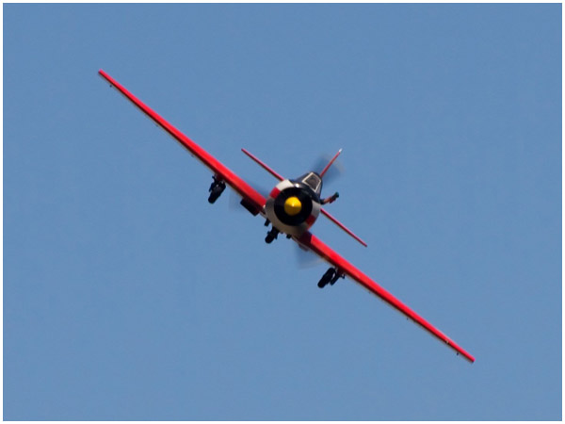
Aerodynamic Forces in Flight Maneuvers
Forces in Turns
Aircraft in a bank lift did not act directly opposite to the weight, rather it now acts in the direction of the bank.
A basic truth about turns: when the aircraft banks, lift acts inward toward the center of the turn, as well as upward.

Slide 24
Aerodynamic Forces in Flight Maneuvers
Forces in Turns
One component, which acts vertically and opposite to the weight (gravity), is called the “vertical component of lift.”

Slide 25
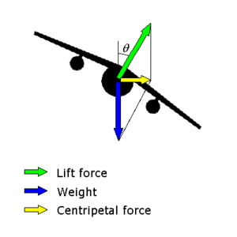
Aerodynamic Forces in Flight Maneuvers
Forces in Turns
The other force, which acts horizontally toward the center of the turn, is called the “horizontal component of lift,” or centripetal force.

Slide 26
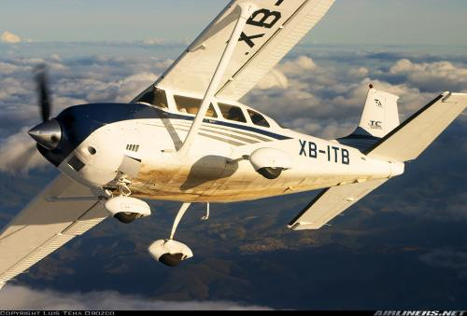
Aerodynamic Forces in Flight Maneuvers
Forces in Turns
This explains why, in a correctly executed turn, the force that turns the aircraft is not supplied by the rudder.
The rudder is used to correct any deviation between the straight track of the nose and tail of the aircraft.

Slide 27
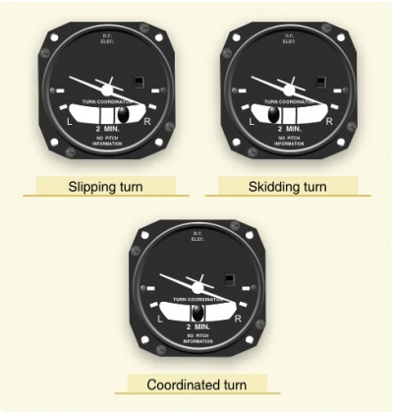
Aerodynamic Forces in Flight Maneuvers
Forces in Turns
A good turn is one in which the nose and tail of the aircraft track along the same path.

Slide 28
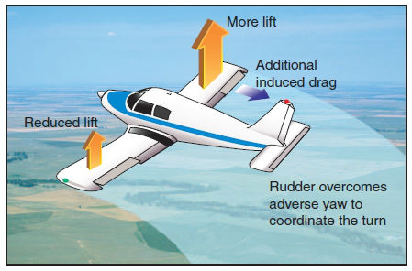
Aerodynamic Forces in Flight Maneuvers
Forces in Turns
If no rudder is used in a turn, the nose of the aircraft yaws to the outside of the turn.
The rudder is used to bring the nose back in line with the relative wind.

Slide 29
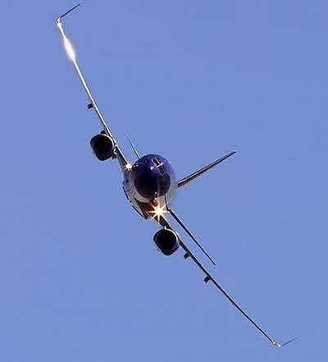
Aerodynamic Forces in Flight Maneuvers
Forces in Turns
An aircraft is not steered like a boat or an automobile.
In order for an aircraft to turn, it must be banked.
When an aircraft is banked, it turns, provided it is not slipping to the inside of the turn.

Slide 30
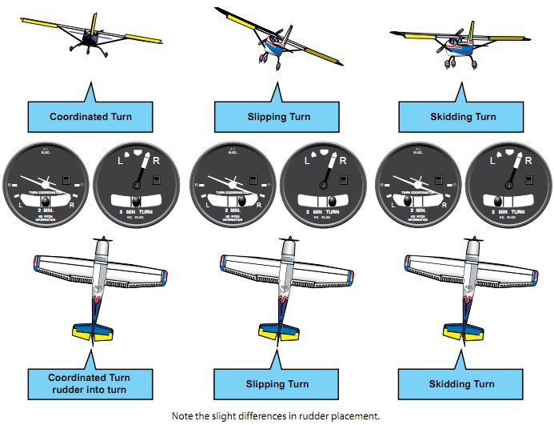

Slide 31
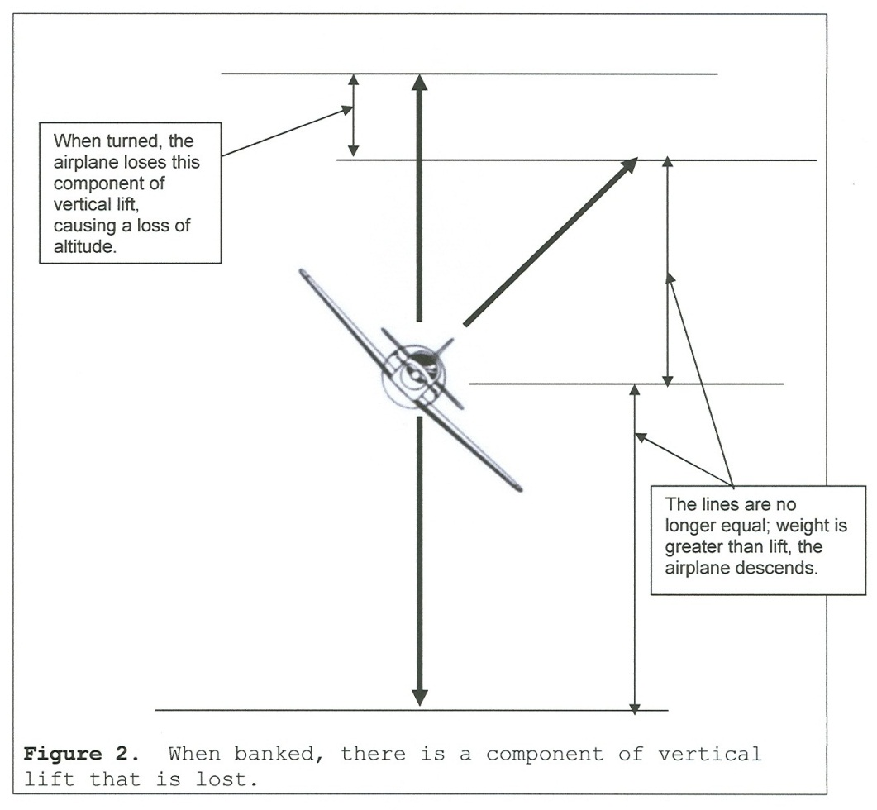
Aerodynamic Forces in Flight Maneuvers
Forces in Turns
Since the lift during the bank is divided into vertical and horizontal components, the amount of lift opposing gravity and supporting the aircraft’s weight is reduced.

Slide 32
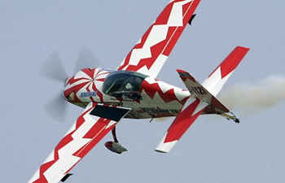
Aerodynamic Forces in Flight Maneuvers
Forces in Turns
Consequently, the aircraft loses altitude unless additional lift is created.
This is done by increasing the AOA until the vertical component of lift is again equal to the weight.

Slide 33
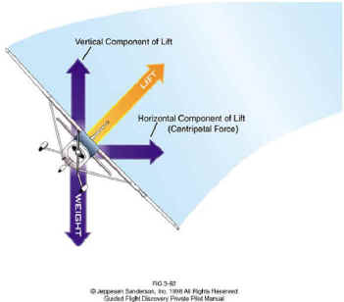
Aerodynamic Forces in Flight Maneuvers
Forces in Turns
An important fact for pilots to remember when making constant altitude turns is that the vertical component of lift must be equal to the weight to maintain altitude.

Slide 34
Aerodynamic Forces in Flight Maneuvers
Forces in Turns
As the angle of bank is increased, the horizontal component of lift increases, thereby increasing the Rate One Turn (ROT).

Slide 35
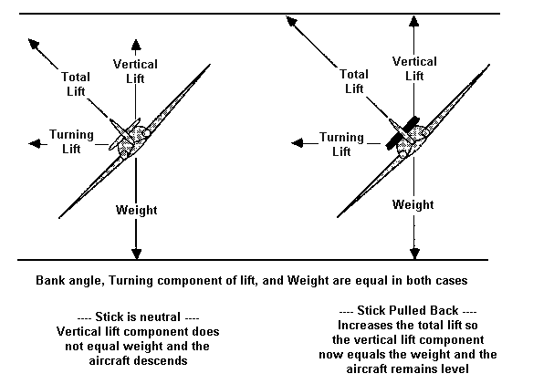
Aerodynamic Forces in Flight Maneuvers
Forces in Turns
To provide a vertical component of lift sufficient to hold altitude in a level turn, an increase in the AOA is required.
Since the drag of the airfoil is directly proportional to its AOA, induced drag increases as the lift is increased.

Slide 36
Aerodynamic Forces in Flight Maneuvers
Forces in Turns
A small angle of bank results in a small reduction in airspeed while a large angle of bank results in a large reduction in airspeed.

Slide 37
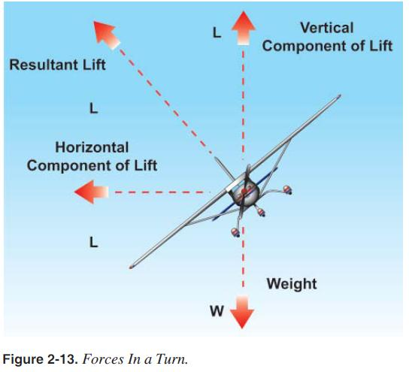
Aerodynamic Forces in Flight Maneuvers
Forces in Turns
Additional thrust (power) must be applied to prevent a reduction in airspeed in level turns.
The required amount of additional thrust is proportional to the angle of bank.

Slide 38
Questions / Comments

Slide 39
Lesson Closure - 3 – 2 - 1
3. List 3 things you learned today.
2. List 2 things you have questions about today’s lesson.
1. Create (1) quiz question with answer about today’s lesson.

