Slide 1
Warm-Up – 2/3 – 10 minutes
Utilizing your notes and past knowledge answer the following questions:
What are the two types of induction systems used on an aircraft?
What is the chief disadvantage of a float-type carburetor?
Where are carburetors normally calibrated and what position is the fuel/air mixture set?
Describe what happens to the fuel mixture as the aircraft gains altitude?
Describe what must be done to the mixture as an aircraft descends from high altitude?

Slide 2

Questions / Comments

Slide 3
Warm-Up – 2/3 – 10 minutes
Utilizing your notes and past knowledge answer the following questions:
What are the two types of induction systems used on an aircraft?
What is the chief disadvantage of a float-type carburetor?
Where are carburetors normally calibrated and what position is the fuel/air mixture set?
Describe what happens to the fuel mixture as the aircraft gains altitude?
Describe what must be done to the mixture as an aircraft descends from high altitude?

Slide 4
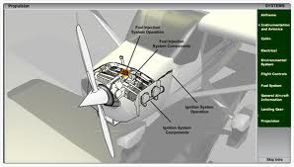
Aircraft Systems
Induction Systems
Two types of induction systems are commonly used in small aircraft engines:
1. The carburetor system, which mixes the fuel and air in the carburetor before this mixture enters the intake manifold.

Slide 5
Aircraft Systems
Induction Systems
2. The fuel injection system, which mixes the fuel and air immediately before entry into each cylinder or injects fuel directly into each cylinder.

Slide 6
Warm-Up – 2/3 – 10 minutes
Utilizing your notes and past knowledge answer the following questions:
What are the two types of induction systems used on an aircraft?
What is the chief disadvantage of a float-type carburetor?
Where are carburetors normally calibrated and what position is the fuel/air mixture set?
Describe what happens to the fuel mixture as the aircraft gains altitude?
Describe what must be done to the mixture as an aircraft descends from high altitude?

Slide 7
Aircraft Systems
Carburetor Systems
The chief disadvantage of the float carburetor, however, is its icing tendency.

Slide 8
Warm-Up – 2/3 – 10 minutes
Utilizing your notes and past knowledge answer the following questions:
What are the two types of induction systems used on an aircraft?
What is the chief disadvantage of a float-type carburetor?
Where are carburetors normally calibrated and what position is the fuel/air mixture set?
Describe what happens to the fuel mixture as the aircraft gains altitude?
Describe what must be done to the mixture as an aircraft descends from high altitude?

Slide 9
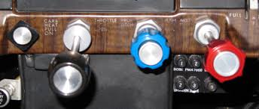
Aircraft Systems
Mixture Control
Carburetors are normally calibrated at sea-level pressure, where the correct fuel-to-air mixture ratio is established with the mixture control set in the FULL RICH position.

Slide 10
Warm-Up – 2/3 – 10 minutes
Utilizing your notes and past knowledge answer the following questions:
What are the two types of induction systems used on an aircraft?
What is the chief disadvantage of a float-type carburetor?
Where are carburetors normally calibrated and what position is the fuel/air mixture set?
Describe what happens to the fuel mixture as the aircraft gains altitude?
Describe what must be done to the mixture as an aircraft descends from high altitude?

Slide 11

Aircraft Systems
Mixture Control
However, as altitude increases, the density of air entering the carburetor decreases, while the density of the fuel remains the same.

Slide 12
Warm-Up – 2/3 – 10 minutes
Utilizing your notes and past knowledge answer the following questions:
What are the two types of induction systems used on an aircraft?
What is the chief disadvantage of a float-type carburetor?
Where are carburetors normally calibrated and what position is the fuel/air mixture set?
Describe what happens to the fuel mixture as the aircraft gains altitude?
Describe what must be done to the mixture as an aircraft descends from high altitude?

Slide 13
Aircraft Systems
Mixture Control
During a descent from high altitude, the mixture must be enriched, or it may become too lean.

Slide 14
Questions / Comments

Slide 15
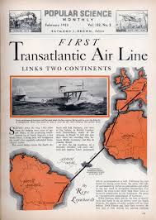
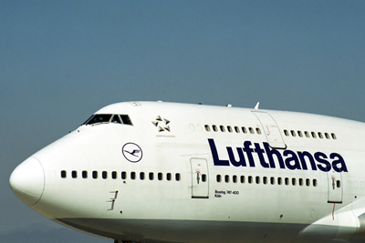
THIS DAY IN AVIATION
February 3
1934 — The first scheduled trans-Atlantic airmail service between Berlin, Germany, and Rio de Janeiro, Brazil, is inaugurated by Luft Hansa.
The journey is made in four stages.

Slide 16
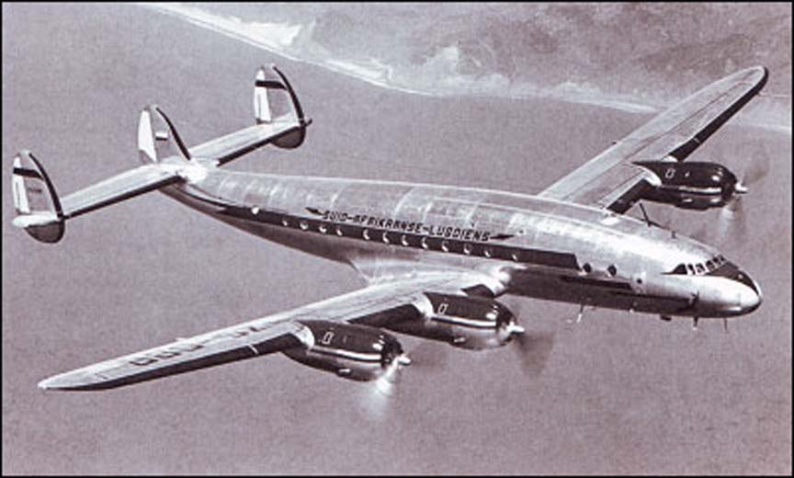
THIS DAY IN AVIATION
February 3
1946 — Pan American inaugurates the first commercial use of Lockheed Model 49 “Constellation” with the aircraft's first scheduled service between New York and Bermuda.

Slide 17
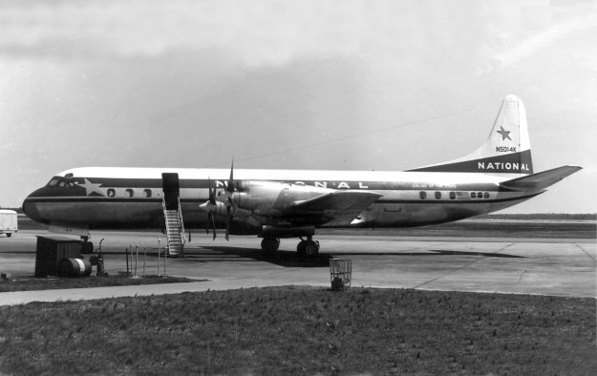
THIS DAY IN AVIATION
February 3
1948 — All 145 pilots and co-pilots at National Airlines go on strike, grounding the carrier's 22 aircraft.
The dispute is mainly over air safety.

Slide 18
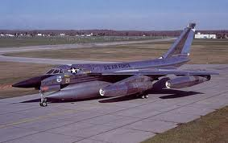
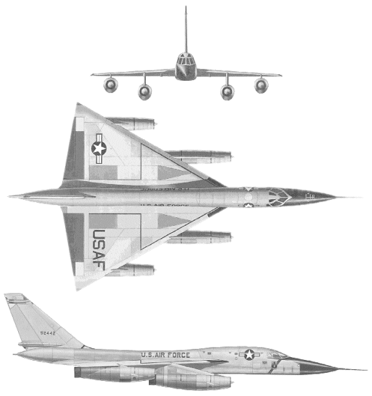
THIS DAY IN AVIATION
February 3
1964 — The Federal Aviation Agency launches “Operation Bongo Mark 2” to investigate the effects of supersonic flight; over the coming months, a Convair B-58 “Hustler” will fly through the sound barrier at low altitude over Oklahoma City.

Slide 19
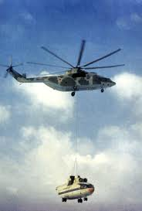
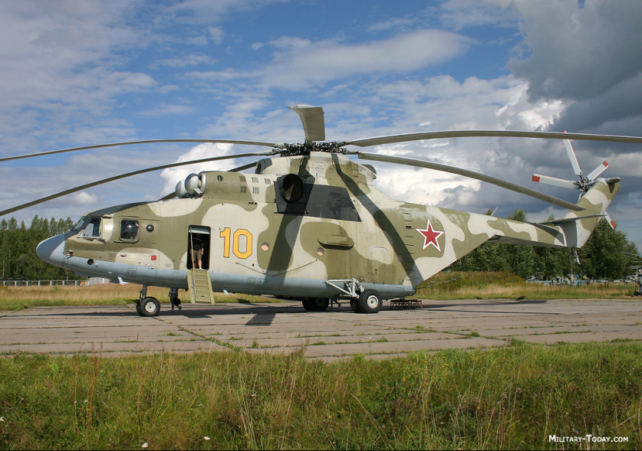
THIS DAY IN AVIATION
February 3
1982 — A Mil Mi-26 helicopter sets a world record in the USSR, lifting 125,153.8 lb. to a height of 6,562 feet.

Slide 20
Questions / Comments

Slide 21
February 2014
Sunday | Monday | Tuesday | Wednesday | Thursday | Friday | Saturday
 |  |  |  |  |  | 1
2 | 3 Chapter 6 Aircraft Systems | 4 | 5 Chapter 6 Aircraft Systems | 6 | 7 Chapter 6 Aircraft Systems | 8
9 | 10 | 11 Chapter 6 Aircraft Systems | 12 | 13 Chapter 6 Aircraft Systems | 14 | 15
16 | 17 NO SCHOOL | 18 Chapter 6 Aircraft Systems | 19 | 20 Chapter 6 Aircraft Systems | 21 | 22
23 | 24 Chapter 6 Aircraft Systems | 25 | 26 Chapter 6 Aircraft Systems | 27 | 28 Chapter 6 Aircraft Systems

Slide 22
Questions / Comments

Slide 23

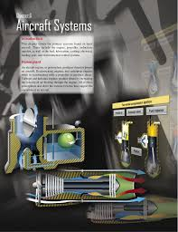
Chapter 6 – Aircraft Systems
FAA – Pilot’s Handbook of Aeronautical Knowledge

Slide 24
Today’s Mission Requirements
Mission:
Identify in writing the primary systems found on most aircraft.
Describe the basic operation and characteristics of the primary aircraft systems.
EQ:
  Describe the importance of Aeronautical Knowledge for the student pilot learning to fly.

Slide 25
Aircraft Systems
Ignition System
In a spark ignition engine the ignition system provides a spark that ignites the fuel/air mixture in the cylinders and is made up of magnetos, spark plugs, high-tension leads, and the ignition switch.

Slide 26
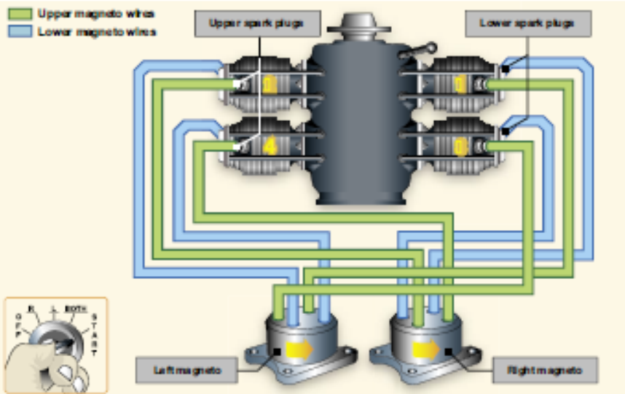
Aircraft Systems
Ignition System
A magneto uses a permanent magnet to generate an electrical current completely independent of the aircraft’s electrical system.

Slide 27
Aircraft Systems
Ignition System
The magneto generates sufficiently high voltage to jump a spark across the spark plug gap in each cylinder.

Slide 28
Aircraft Systems
Ignition System
The system begins to fire when the starter is engaged and the crankshaft begins to turn.
It continues to operate whenever the crankshaft is rotating.

Slide 29
Aircraft Systems
Ignition System
Most standard certificated aircraft incorporate a dual ignition system with two individual magnetos, separate sets of wires, and spark plugs to increase reliability of the ignition system.
Each magneto operates independently to fire one of the two spark plugs in each cylinder.

Slide 30
Aircraft Systems
Ignition System
The firing of two spark plugs improves combustion of the fuel/air mixture and results in a slightly higher power output.
If one of the magnetos fails, the other is unaffected.

Slide 31
Aircraft Systems
Ignition System
The engine will continue to operate normally, although a slight decrease in engine power can be expected.
The same is true if one of the two spark plugs in a cylinder fails.
The operation of the magneto is controlled in the flight deck by the ignition switch.

Slide 32
Aircraft Systems
Ignition System
The switch has five positions:
1. OFF
2. R (right)
3. L (left)
4. BOTH
5. START

Slide 33
Aircraft Systems
Ignition System
With RIGHT or LEFT selected, only the associated magneto is activated.
The system operates on both magnetos with BOTH selected.

Slide 34
Aircraft Systems
Ignition System
A malfunctioning ignition system can be identified during the pretakeoff check by observing the decrease in rpm that occurs when the ignition switch is first moved from BOTH to RIGHT, and then from BOTH to LEFT.

Slide 35
Aircraft Systems
Ignition System
A small decrease in engine rpm is normal during this check.
The permissible decrease is listed in the AFM or POH.

Slide 36
Aircraft Systems
Ignition System
If the engine stops running when switched to one magneto or if the rpm drop exceeds the allowable limit, do not fly the aircraft until the problem is corrected.
The cause could be fouled plugs, broken or shorted wires between the magneto and the plugs, or improperly timed firing of the plugs.

Slide 37
Aircraft Systems
Ignition System
It should be noted that “no drop” in rpm is not normal, and in that instance, the aircraft should not be flown.

Slide 38
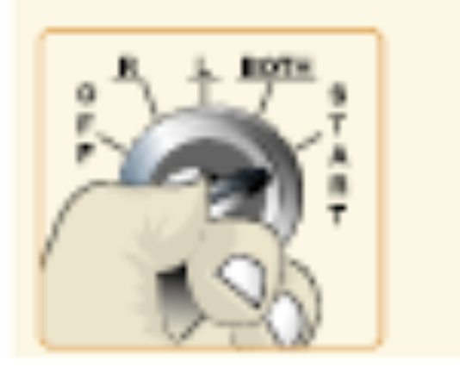
Aircraft Systems
Ignition System
Following engine shutdown, turn the ignition switch to the OFF position.
Even with the battery and master switches OFF, the engine can fire and turn over if the ignition switch is left ON and the propeller is moved because the magneto requires no outside source of electrical power.

Slide 39
Aircraft Systems
Ignition System
Be aware of the potential for serious injury in this situation.
Even with the ignition switch in the OFF position, if the ground wire between the magneto and the ignition switch becomes disconnected or broken, the engine could accidentally start if the propeller is moved with residual fuel in the cylinder.

Slide 40
Aircraft Systems
Ignition System
If this occurs, the only way to stop the engine is to move the mixture lever to the idle cutoff position, then have the system checked by a qualified aviation maintenance technician.

Slide 41
Aircraft Systems
Oil Systems
The engine oil system performs several important functions:
  Lubrication of the engine’s moving parts
  Cooling of the engine by reducing friction
  Removing heat from the cylinders
  Providing a seal between the cylinder walls and pistons
  Carrying away contaminants

Slide 42
Aircraft Systems
Oil Systems
Reciprocating engines use either a wet-sump or a dry-sump oil system.
In a wet-sump system, the oil is located in a sump, which is an integral part of the engine.
In a dry-sump system, the oil is contained in a separate tank, and circulated through the engine by pumps.

Slide 43
Aircraft Systems
Oil Systems
The main component of a wet-sump system is the oil pump, which draws oil from the sump and routes it to the engine.
After the oil passes through the engine, it returns to the sump.
In some engines, additional lubrication is supplied by the rotating crankshaft, which splashes oil onto portions of the engine.

Slide 44
Aircraft Systems
Oil Systems
The oil pressure gauge provides a direct indication of the oil system operation.
It ensures the pressure in pounds per square inch (psi) of the oil supplied to the engine.

Slide 45
Aircraft Systems
Oil Systems
Green indicates the normal operating range, while red indicates the minimum and maximum pressures.
There should be an indication of oil pressure during engine start.
Refer to the AFM/POH for manufacturer limitations.

Slide 46
Aircraft Systems
Oil Systems
The oil temperature gauge measures the temperature of oil.
A green area shows the normal operating range and the red line indicates the maximum allowable temperature.

Slide 47
Aircraft Systems
Oil Systems
Unlike oil pressure, changes in oil temperature occur more slowly.
This is particularly noticeable after starting a cold engine, when it may take several minutes or longer for the gauge to show any increase in oil temperature.

Slide 48
Aircraft Systems
Oil Systems
Check oil temperature periodically during flight especially when operating in high or low ambient air temperature.

Slide 49
Aircraft Systems
Oil Systems
High oil temperature indications may signal a plugged oil line, a low oil quantity, a blocked oil cooler, or a defective temperature gauge.
Low oil temperature indications may signal improper oil viscosity during cold weather operations.

Slide 50
Aircraft Systems
Oil Systems
The oil filler cap and dipstick (for measuring the oil quantity) are usually accessible through a panel in the engine cowling.
Placards near the access panel provide information about the correct oil type and weight, as well as the minimum and maximum oil quantity.

Slide 51
Questions / Comments

Slide 52
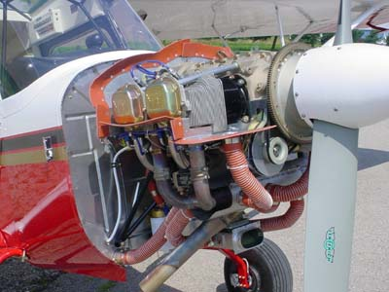
Class Summary
Ignition Systems
Carburetor heat is an anti-icing system that preheats the air before it reaches the carburetor, and is intended to keep the fuel/air mixture above the freezing temperature to prevent the formation of carburetor ice.

Slide 53
Class Summary
Oil Systems
In a fuel injection system, the fuel is injected directly into the cylinders, or just ahead of the intake valve.

Slide 54
Questions / Comments

Slide 55
Lesson Closure - 3 – 2 - 1
3. List 3 things you learned today.
2. List 2 things you have questions about today’s lesson.
1. Create (1) quiz question with answer about today’s lesson.

