Slide 1
Warm-Up – 2/20 – 10 minutes
Utilizing your notes and past knowledge answer the following questions:
What are the categories of aircraft for which a pilot may be rated?
What CFR and subpart contains the eligibility, aeronautical knowledge, proficiency, and aeronautical requirements for the private pilot?
What is the definition of a complex aircraft?
What are the three categories of aircraft instruments?
On a hot day will an aircraft located at an airport at a high altitude need more or less runway to take off than usual?

Slide 2
Questions / Comments

Slide 3
Warm-Up – 2/20 – 10 minutes
Utilizing your notes and past knowledge answer the following questions:
What are the categories of aircraft for which a pilot may be rated?
What CFR and subpart contains the eligibility, aeronautical knowledge, proficiency, and aeronautical requirements for the private pilot?
What is the definition of a complex aircraft?
What are the three categories of aircraft instruments?
On a hot day will an aircraft located at an airport at a high altitude need more or less runway to take off than usual?

Slide 4
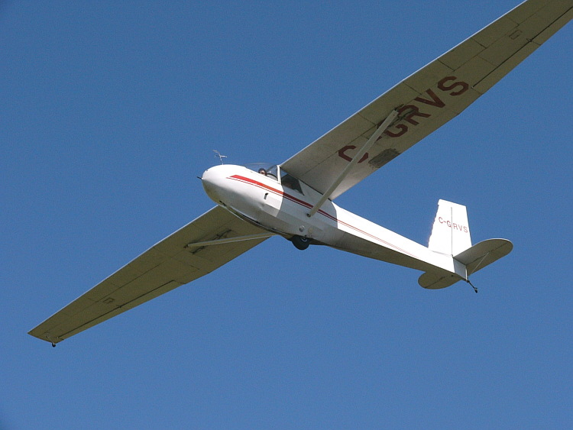
Aircraft Types and Categories
Categories of aircraft for which a pilot may be rated are:
Airplane
•Rotorcraft
•Glider
•Lighter than air
•Powered lift
•Powered parachute
•Weight-shift-control

Slide 5
Warm-Up – 2/20 – 10 minutes
Utilizing your notes and past knowledge answer the following questions:
What are the categories of aircraft for which a pilot may be rated?
What CFR and subpart contains the eligibility, aeronautical knowledge, proficiency, and aeronautical requirements for the private pilot?
What is the definition of a complex aircraft?
What are the three categories of aircraft instruments?
On a hot day will an aircraft located at an airport at a high altitude need more or less runway to take off than usual?

Slide 6
Becoming a Pilot
Eligibility, aeronautical knowledge, proficiency, and aeronautical requirements can be found in 14 CFR part 61, Certification: Pilots, Flight Instructors, and Ground Instructors.
• Recreational Pilot, see subpart D
• Private Pilot, see subpart E
• Sport Pilot, see subpart J

Slide 7
Warm-Up – 2/20 – 10 minutes
Utilizing your notes and past knowledge answer the following questions:
What are the categories of aircraft for which a pilot may be rated?
What CFR and subpart contains the eligibility, aeronautical knowledge, proficiency, and aeronautical requirements for the private pilot?
What is the definition of a complex aircraft?
What are the three categories of aircraft instruments?
On a hot day will an aircraft located at an airport at a high altitude need more or less runway to take off than usual?

Slide 8
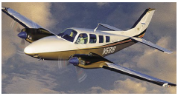
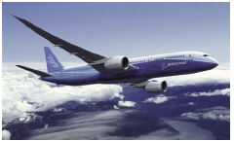
Pilot Certifications Commercial Pilot
A commercial airplane pilot must be able to operate a complex airplane
A complex aircraft must have retractable landing gear, movable flaps, and a controllable pitch propeller.

Slide 9
Warm-Up – 2/20 – 10 minutes
Utilizing your notes and past knowledge answer the following questions:
What are the categories of aircraft for which a pilot may be rated?
What CFR and subpart contains the eligibility, aeronautical knowledge, proficiency, and aeronautical requirements for the private pilot?
What is the definition of a complex aircraft?
What are the three categories of aircraft instruments?
On a hot day will an aircraft located at an airport at a high altitude need more or less runway to take off than usual?

Slide 10
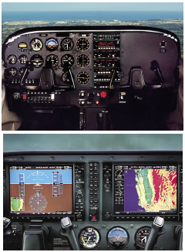
Instrumentation: Moving into the Future
Instrumentation falls into three different categories: performance, control, and navigation.

Slide 11
Warm-Up – 2/20 – 10 minutes
Utilizing your notes and past knowledge answer the following questions:
What are the categories of aircraft for which a pilot may be rated?
What CFR and subpart contains the eligibility, aeronautical knowledge, proficiency, and aeronautical requirements for the private pilot?
What is the definition of a complex aircraft?
What are the three categories of aircraft instruments?
On a hot day will an aircraft located at an airport at a high altitude need more or less runway to take off than usual?

Slide 12
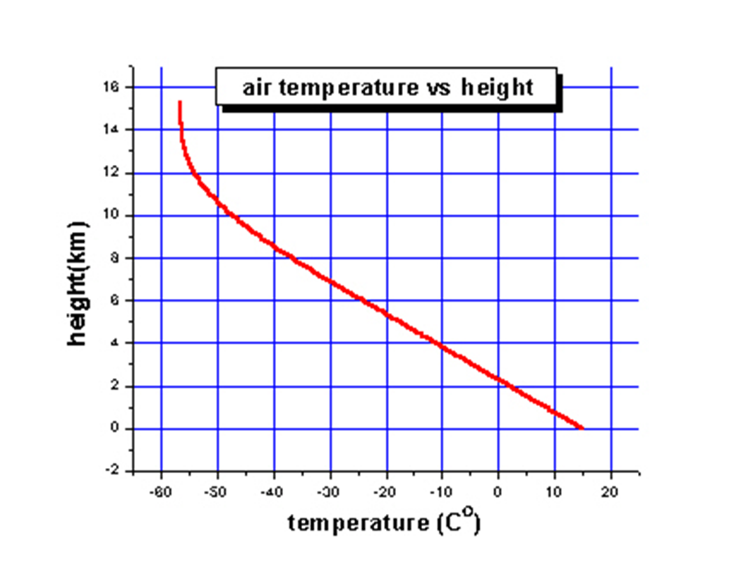
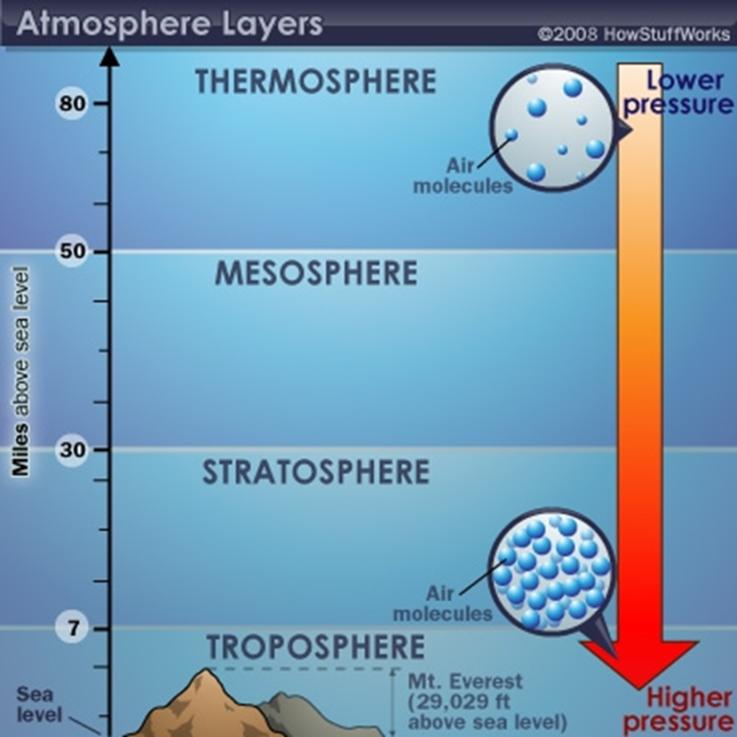
Density
Air at higher altitudes has less pressure – it is also less dense.
Density is also related to temperature.
As air is heated, the molecules move farther apart
Which means there is a decrease in density
On a hot day, aircraft in high altitudes have difficulty taking off – air is too thin

Slide 13
Questions / Comments

Slide 14
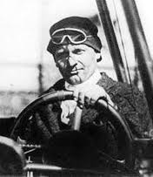
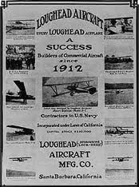
THIS DAY IN AVIATION
February 20
1915 — During the Panama-Pacific Exhibition, Allan Loughead is allowed to launch an air service and flies 600 passengers across the bay during 50 days.
The 10-minute flight costs $10 per passenger.

Slide 15
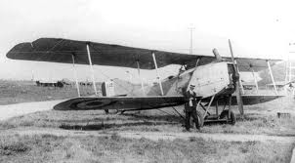
THIS DAY IN AVIATION
February 20
1924 — In Dakar, Lieutenant-Colonel Tulasne, Capt. Gama and Lieutenant Michel complete the first trip across the Sahara desert and back, piloting Breguet-14 airplanes.

Slide 16
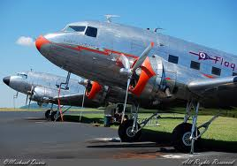
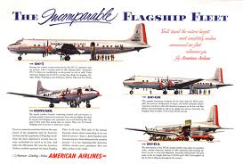
THIS DAY IN AVIATION
February 20
1935 — Leland S. Andrews, with Henry Myers, co-pilot, and G. D. Rayburn, radio operator, flies an American Airlines plane from Los Angeles, California, to Floyd Bennett Field, Brooklyn, New York, in 11 hrs. 34 min. 16 sec. making transcontinental record for passenger transport airplanes.

Slide 17
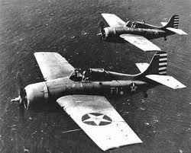
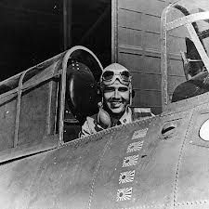
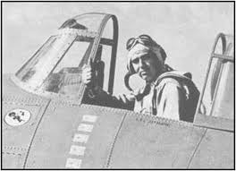
THIS DAY IN AVIATION
February 20
1942 — First United States Fighter Ace of World War II, Lieut. Edward O'Hare from the USS Lexington off Rabaul.

Slide 18
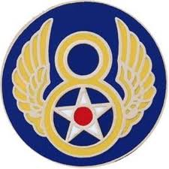
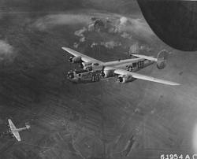
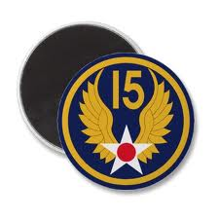
THIS DAY IN AVIATION
February 20
1944 — 8th and 15th Air Forces began a six-day strikes against Germany.

Slide 19
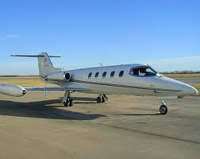
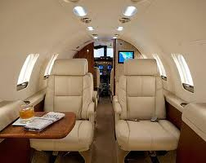
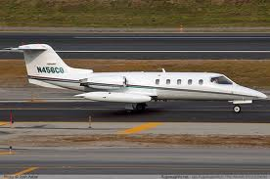
THIS DAY IN AVIATION
February 20
1968 — A standard Learjet 25 sets a new “time-to-climb” record by climbing to 40,000 feet in 6 minutes 29 seconds.

Slide 20
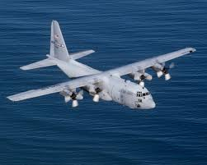
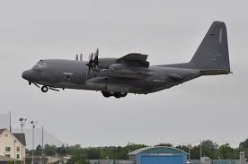
THIS DAY IN AVIATION
February 20
1972 — A USAF Lockheed HC-130H “Hercules” piloted by a crew commanded by Lt. Comdr. Ed Allison sets a new world record for unrefueled flight by turboprop aircraft.
It flies a distance of 14,052.94 km (8,732.5 mi.) between the Taiwanese base of Ching Chuan Kang AB and Scott AFB, Illinois.

Slide 21
Questions / Comments

Slide 22
February 2018
Sunday | Monday | Tuesday | Wednesday | Thursday | Friday | Saturday
 | 29 Chapter 4 Aerodynamics of Flight | 30 Chapter 4 Aerodynamics of Flight | 31 Chapter 4 Aerodynamics of Flight | 1 Chapter 4 Aerodynamics of Flight Quiz | 2 Flight Line Friday | 3
4 | 5 Chapter 4 Aerodynamics of Flight | 6 Chapter 4 Aerodynamics of Flight | 7 Chapter 4 Aerodynamics of Flight | 8 Chapter 4 Aerodynamics of Flight | 9 Flight Line Friday QUIZ | 10
11 | 12 Chapter 4 Aerodynamics of Flight | 13 Chapter 4 Aerodynamics of Flight | 14 Chapter 4 Aerodynamics of Flight | 15 Chapter 4 Aerodynamics of Flight | 16 Flight Line Friday TEST | 17
18 | 19 HOLIDAY | 20 Chapter 5 Flight Controls | 21 Chapter 5 Flight Controls | 22 Chapter 5 Flight Controls | 23 Flight Line Friday TEST | 24
25 | 26 Chapter 6 Flight Systems | 27 Chapter 6 Flight Systems | 8 Chapter 6 Flight Systems | 1 Chapter 6 Flight Systems | 2 Flight Line Friday QUIZ | 3

Slide 23
1st Quarter Requirements (17 days of Class Meetings – Mar 16)
All students will complete the following:
Take notes - All in class quizzes and tests
Complete Flight Sim. Tutorials (1 – 5 x 3 + 1)
Aircraft Fam. and Student Pilot Syllabus
Lessons 1 – 7 (Straight & Level Flight through First Solo)
Must pass written with 80%
Successfully complete 3 times on small sim
Successfully complete 1 time on Main sim
Complete ERAU Aviation 101
6 quizzes and 2 tests
Student will receive zero points for all incomplete work – NO make-up / extra credit

Slide 24
AVIATION ACES
2B
Pilots (A – 90 & above)
2B
Co-Pilots (B – 80 – 89)
Potato
Blackbird
Frenchie
Bo
Josh
Burch
Linares
High Shooter (98)

Slide 25
Questions / Comments

Slide 26
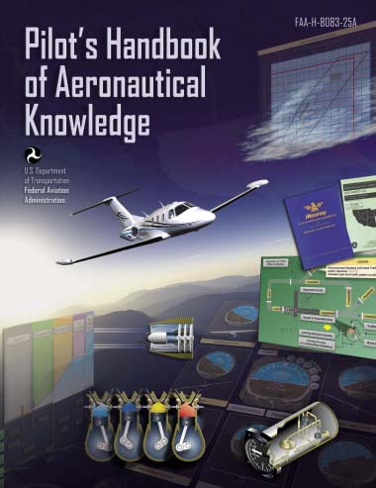
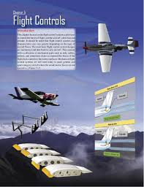
Chapter 5 – Flight Controls
FAA – Pilot’s Handbook of Aeronautical Knowledge

Slide 27
Today’s Mission Requirements
Mission:
Identify in writing the flight control systems a pilot uses to control the forces of flight, and the aircraft’s direction and attitude.
Describe how the flight control systems and characteristics can vary greatly depending on the type of aircraft flown.
Describe in writing the basic flight control system designs.
EQ:
Describe the importance of Aeronautical Knowledge for the student pilot learning to fly.

Slide 28
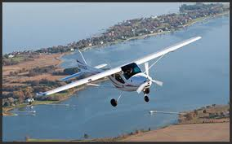
Introduction
This chapter focuses on the flight control systems a pilot uses to control the forces of flight, and the aircraft’s direction and attitude.
Flight control systems and characteristics can vary greatly depending on the type of aircraft flown.

Slide 29
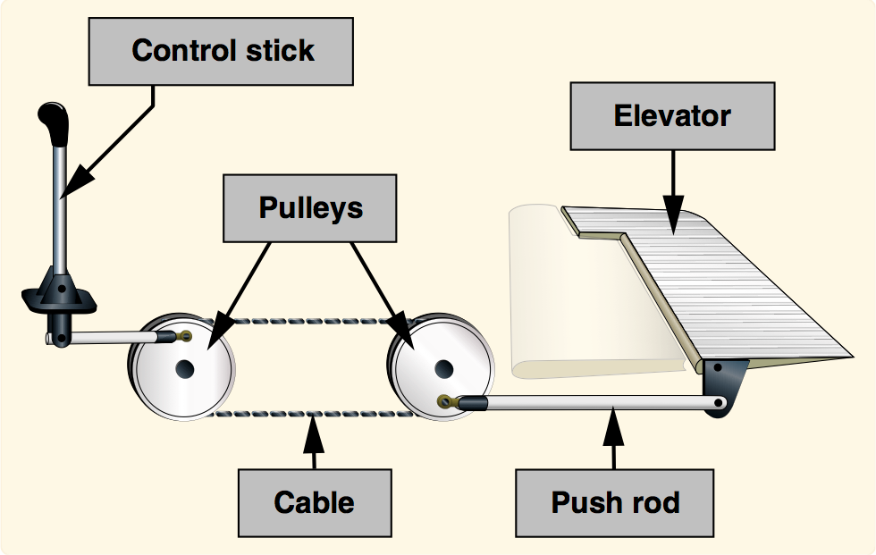
Introduction
Purpose of flight controls
To transmit the forces of the flight deck controls to the control surfaces.
Mechanical flight control systems are still used today in small general and sport category aircraft where the aerodynamic forces are not excessive.

Slide 30
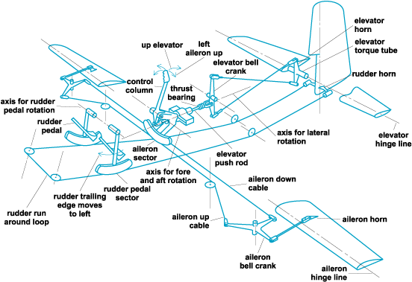

Slide 31
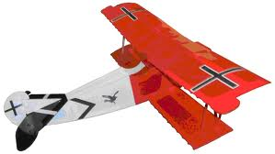
Flight Controls
As aviation matured and aircraft designers learned more about aerodynamics, the industry produced larger and faster aircraft.
Therefore, the aerodynamic forces acting upon the control surfaces increased exponentially.

Slide 32
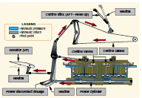
Flight Controls
To make the control force required by pilots manageable, aircraft engineers designed more complex systems.

Slide 33
Flight Controls
At first, hydromechanical designs, consisting of a mechanical circuit and a hydraulic circuit, were used to reduce the complexity, weight, and limitations of mechanical flight controls systems.

Slide 34
Flight Controls
As aircraft became more sophisticated, the control surfaces were actuated by electric motors, digital computers, or fiber optic cables, called “fly-by-wire.”
This flight control system replaces the physical connection between pilot controls and the flight control surfaces with an electrical interface.

Slide 35
Flight Controls
In addition, in some large and fast aircraft, controls are boosted by hydraulically or electrically actuated systems.
In both the fly-by-wire and boosted controls, the feel of the control reaction is fed back to the pilot by simulated means.

Slide 36
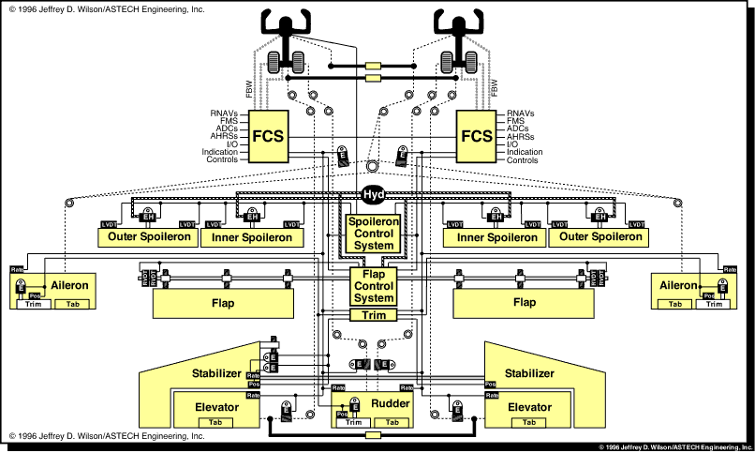

Slide 37
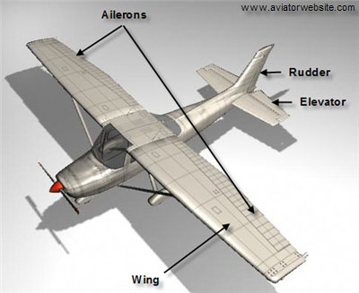
Flight Control Systems Flight Controls
Aircraft flight control systems consist of primary and secondary systems.
The ailerons, elevator (or stabilator), and rudder constitute the primary control system and are required to control an aircraft safely during flight.

Slide 38
Flight Control Systems Flight Controls
Wing flaps, leading edge devices, spoilers, and trim systems constitute the secondary control system
They improve the performance characteristics of the airplane or relieve the pilot of excessive control forces.

Slide 39
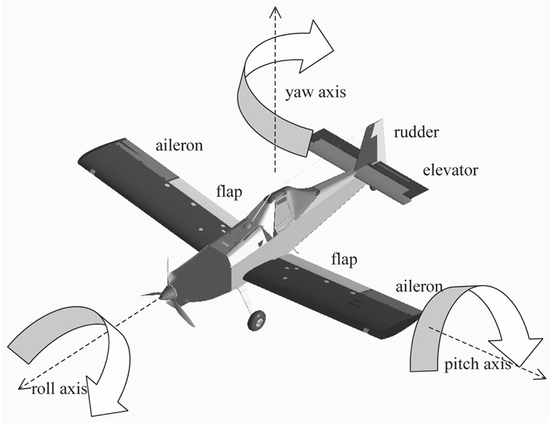
Flight Control Systems Primary Flight Controls
At low airspeeds, the controls usually feel soft and sluggish, and the aircraft responds slowly to control applications.
At higher airspeeds, the controls become increasingly firm and aircraft response is more rapid.

Slide 40
Flight Control Systems Primary Flight Controls
Movement of any of the three primary flight control surfaces (ailerons, elevator or stabilator, or rudder), changes the airflow and pressure distribution over and around the airfoil.

Slide 41
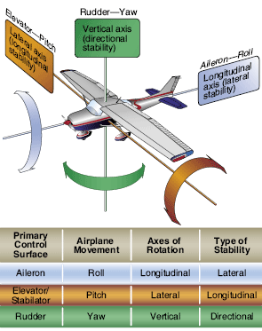
Flight Control Systems Primary Flight Controls
Primary Flight Controls allow a pilot to control the aircraft about its three axes of rotation.
Design features limit the amount of deflection of flight control surfaces.

Slide 42
Flight Control Systems Primary Flight Controls
Control-stop mechanisms may be incorporated into the flight control linkages, or movement of the control column and/or rudder pedals may be limited.
The purpose of these design limits is to prevent the pilot from inadvertently overcontrolling and overstressing the aircraft during normal maneuvers.

Slide 43
Questions / Comments

Slide 44
1st Quarter Requirements (17 days of Class Meetings – Mar 15)
All students will complete the following:
Take notes - All in class quizzes and tests
Complete Flight Sim. Tutorials (1 – 5 x 3 + 1)
Aircraft Fam. and Student Pilot Syllabus
Lessons 1 – 7 (Straight & Level Flight through First Solo)
Must pass written with 80%
Successfully complete 3 times on small sim
Successfully complete 1 time on Main sim
Complete ERAU Aviation 101
6 quizzes and 2 tests
Student will receive zero points for all incomplete work – NO make-up / extra credit

Slide 45
Lesson Closure - 3 – 2 - 1
3. List 3 things you learned today.
2. List 2 things you have questions about today’s lesson.
1. Create (1) quiz question with answer about today’s lesson.

