Slide 1
Warm-Up – 12/5 – 10 minutes
Utilizing your notes and past knowledge answer the following questions:
What are the three elements that can influence the torque of an aircraft?
During the takeoff roll, an additional turning moment around the vertical axis is induced by torque reaction. How does the pilot correct this?
At high propeller speeds and low forward speed, this spiraling rotation is very compact and exerts a strong sideward force on what aircraft surface?
When an aircraft is flying with a high AOA, where is the “bite” of the propeller felt more?
The downswinging blade has more lift and tends to pull (yaw) the aircraft’s tail in which direction?

Slide 2
Questions / Comments

Slide 3
Warm-Up – 12/5 – 10 minutes
Utilizing your notes and past knowledge answer the following questions:
What are the three elements that can influence the torque of an aircraft?
During the takeoff roll, an additional turning moment around the vertical axis is induced by torque reaction. How does the pilot correct this?
At high propeller speeds and low forward speed, this spiraling rotation is very compact and exerts a strong sideward force on what aircraft surface?
When an aircraft is flying with a high AOA, where is the “bite” of the propeller felt more?
The downswinging blade has more lift and tends to pull (yaw) the aircraft’s tail in which direction?

Slide 4
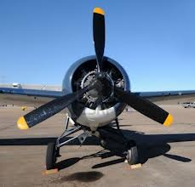
Torque and P-Factor
The elements are:
1. Torque reaction from engine and propeller,
2. Corkscrewing effect of the slipstream,
3. Asymmetric loading of the propeller (P-factor).

Slide 5
Warm-Up – 12/5 – 10 minutes
Utilizing your notes and past knowledge answer the following questions:
What are the three elements that can influence the torque of an aircraft?
During the takeoff roll, an additional turning moment around the vertical axis is induced by torque reaction. How does the pilot correct this?
At high propeller speeds and low forward speed, this spiraling rotation is very compact and exerts a strong sideward force on what aircraft surface?
When an aircraft is flying with a high AOA, where is the “bite” of the propeller felt more?
The downswinging blade has more lift and tends to pull (yaw) the aircraft’s tail in which direction?

Slide 6
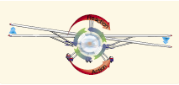
Torque Reaction
When the aircraft’s wheels are on the ground during the takeoff roll, an additional turning moment around the vertical axis is induced by torque reaction.
The takeoff roll is corrected by the pilot’s use of the rudder or rudder trim.

Slide 7
Warm-Up – 12/5 – 10 minutes
Utilizing your notes and past knowledge answer the following questions:
What are the three elements that can influence the torque of an aircraft?
During the takeoff roll, an additional turning moment around the vertical axis is induced by torque reaction. How does the pilot correct this?
At high propeller speeds and low forward speed, this spiraling rotation is very compact and exerts a strong sideward force on what aircraft surface?
When an aircraft is flying with a high AOA, where is the “bite” of the propeller felt more?
The downswinging blade has more lift and tends to pull (yaw) the aircraft’s tail in which direction?

Slide 8
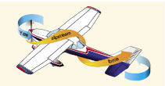
Corkscrew Effect
At high propeller speeds and low forward speed (as in the takeoffs and approaches to power-on stalls), this spiraling rotation is very compact and exerts a strong sideward force on the aircraft’s vertical tail surface.

Slide 9
Warm-Up – 12/5 – 10 minutes
Utilizing your notes and past knowledge answer the following questions:
What are the three elements that can influence the torque of an aircraft?
During the takeoff roll, an additional turning moment around the vertical axis is induced by torque reaction. How does the pilot correct this?
At high propeller speeds and low forward speed, this spiraling rotation is very compact and exerts a strong sideward force on what aircraft surface?
When an aircraft is flying with a high AOA, where is the “bite” of the propeller felt more?
The downswinging blade has more lift and tends to pull (yaw) the aircraft’s tail in which direction?

Slide 10
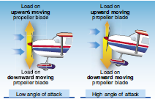
Asymmetric Loading (P-Factor)
When an aircraft is flying with a high AOA, the “bite” of the downward moving blade is greater than the “bite” of the upward moving blade.

Slide 11
Warm-Up – 12/5 – 10 minutes
Utilizing your notes and past knowledge answer the following questions:
What are the three elements that can influence the torque of an aircraft?
During the takeoff roll, an additional turning moment around the vertical axis is induced by torque reaction. How does the pilot correct this?
At high propeller speeds and low forward speed, this spiraling rotation is very compact and exerts a strong sideward force on what aircraft surface?
When an aircraft is flying with a high AOA, where is the “bite” of the propeller felt more?
The downswinging blade has more lift and tends to pull (yaw) the aircraft’s tail in which direction?

Slide 12
Asymmetric Loading (P-Factor)
Since the propeller blade is an airfoil, increased velocity means increased lift.
The downswinging blade has more lift and tends to pull (yaw) the aircraft’s nose to the left.

Slide 13
Questions / Comments

Slide 14
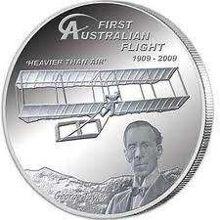
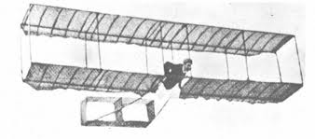
THIS DAY IN AVIATION
December 5
1909 — George Taylor makes the first manned glider flight in Australia in a glider of his own design.
He eventually makes a total of 29 flights at Narrabeen Beach in New South Wales, Australia.

Slide 15
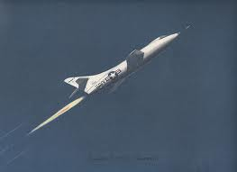
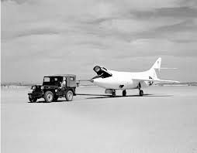
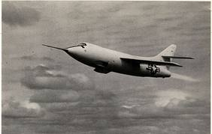
THIS DAY IN AVIATION
December 5
1949 — Douglas D-558-2 “Skyrocket” exceeds speed of sound in test flight at Muroc Air Force Base, California.

Slide 16
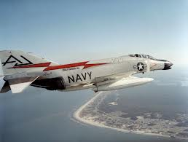
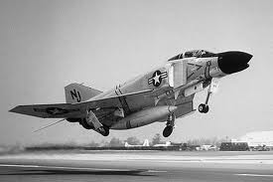
THIS DAY IN AVIATION
December 5
1961 — A United States Navy McDonnell F4H “Phantom II,” piloted by Commander George W. Ellis, sets a new world altitude record of 66,443 feet for sustained horizontal flight.

Slide 17
Questions / Comments

Slide 18
December 2013
Sunday | Monday | Tuesday | Wednesday | Thursday | Friday | Saturday
1 | 2 | 3 Chapter 4 Torque | 4 | 5 Chapter 4 Load Factors | 6 | 7
8 | 9 Chapter 4 | 10 | 11 Chapter 4 | 12 | 13 Chapter 4 Test Flightline Friday | 14
15 | 16 | 17 Chapter 4 | 18 | 19 Chapter 4 | 20 | 21
22 | 23 NO SCHOOL | 24 NO SCHOOL | 25 NO SCHOOL | 26 NO SCHOOL | 27 NO SCHOOL | 28
29 | 30 NO SCHOOL | 31 NO SCHOOL

Slide 19
Questions / Comments

Slide 20
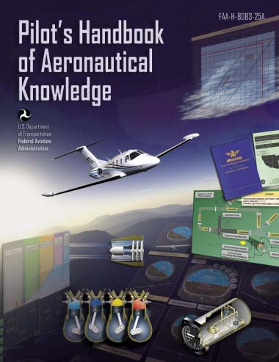
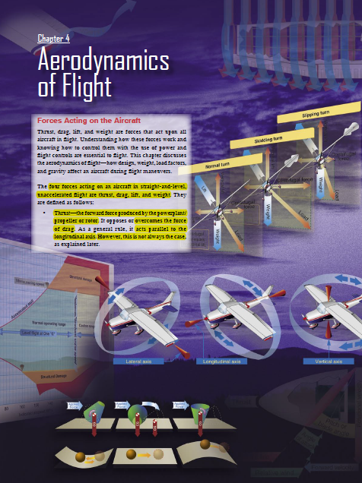
Chapter 4 – Aerodynamics of Flight
FAA – Pilot’s Handbook of Aeronautical Knowledge

Slide 21
Today’s Mission Requirements
Mission:
Identify in writing the forces acting on an aircraft in flight.
Describe how the forces of flight work and how to control them with the use of power and flight controls essential to flight.
Describe in writing how design, weight, load factors, and gravity affect an aircraft during flight maneuvers.
EQ:
Describe the importance of Aeronautical Knowledge for the student pilot learning to fly.

Slide 22
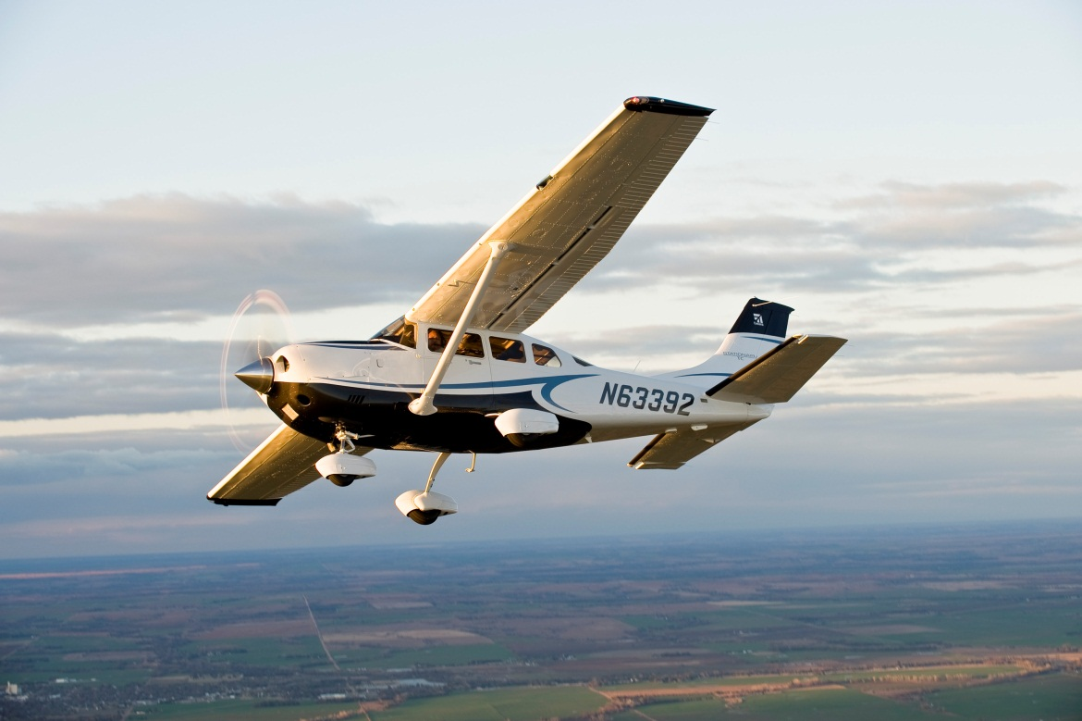
Load Factors
Load factor is the ratio of the maximum load an aircraft can sustain to the gross weight of the aircraft.

Slide 23
Load Factors
Measured in Gs (acceleration of gravity), a unit of force equal to the force exerted by gravity on a body at rest and indicates the force to which a body is subjected when it is accelerated.

Slide 24
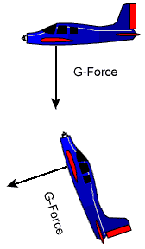
Load Factors
For example, a load factor of 3 means the total load on an aircraft’s structure is three times its gross weight.
Since load factors are expressed in terms of Gs, a load factor of 3 may be spoken of as 3 Gs, or a load factor of 4 as 4 Gs.

Slide 25
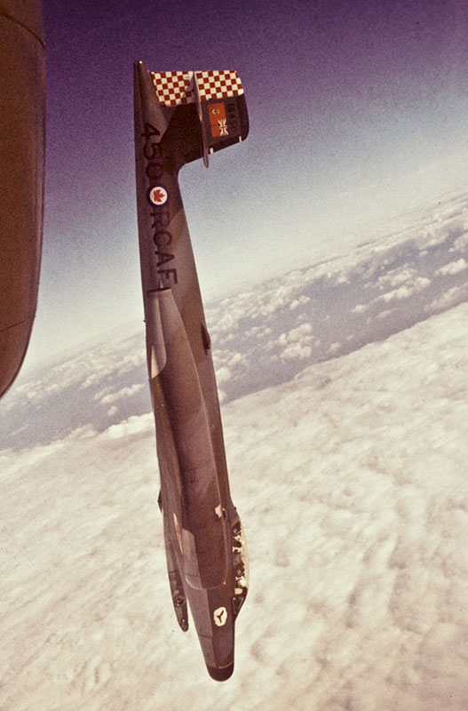
Load Factors
If an aircraft is pulled up from a dive, subjecting the pilot to 3 Gs, he or she would be pressed down into the seat with a force equal to three times his or her weight.

Slide 26
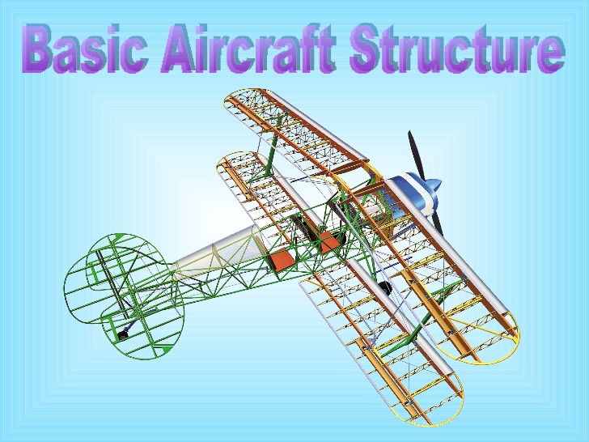
Torque Reaction
Load factor is a primary consideration in the design of the structure of all aircraft.

Slide 27
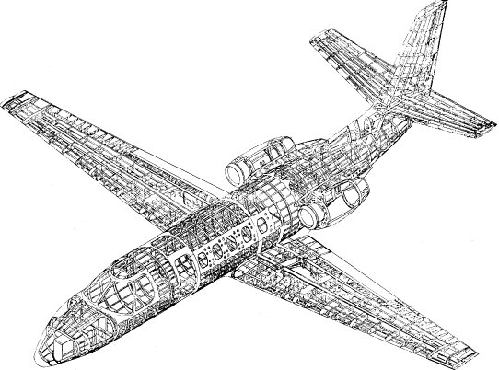
Corkscrew Effect
A knowledge of load factors is important for two reasons:
1. It is possible for a pilot to impose a dangerous overload on the aircraft structures.
2. An increased load factor increases the stalling speed and makes stalls possible at seemingly safe flight speeds.

Slide 28
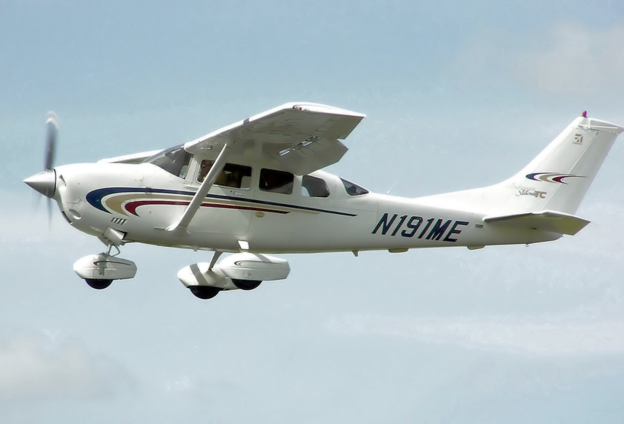
Load Factors in Aircraft Design
The answer to the question “How strong should an aircraft be?” is determined largely by the use to which the aircraft is subjected.

Slide 29
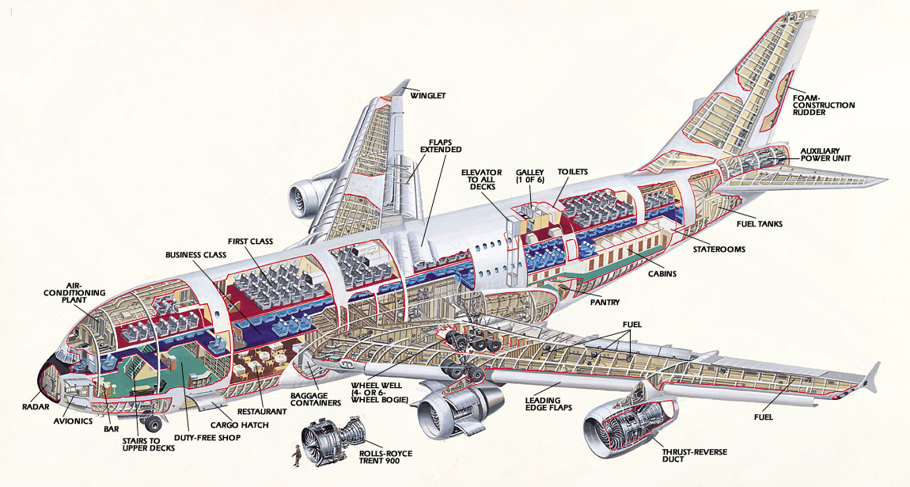
Corkscrew Effect
The Code of Federal Regulations (CFR) requires the aircraft structure be capable of supporting one and one-half times these limit load factors without failure, it is accepted that parts of the aircraft may bend or twist under these loads and that some structural damage may occur.

Slide 30
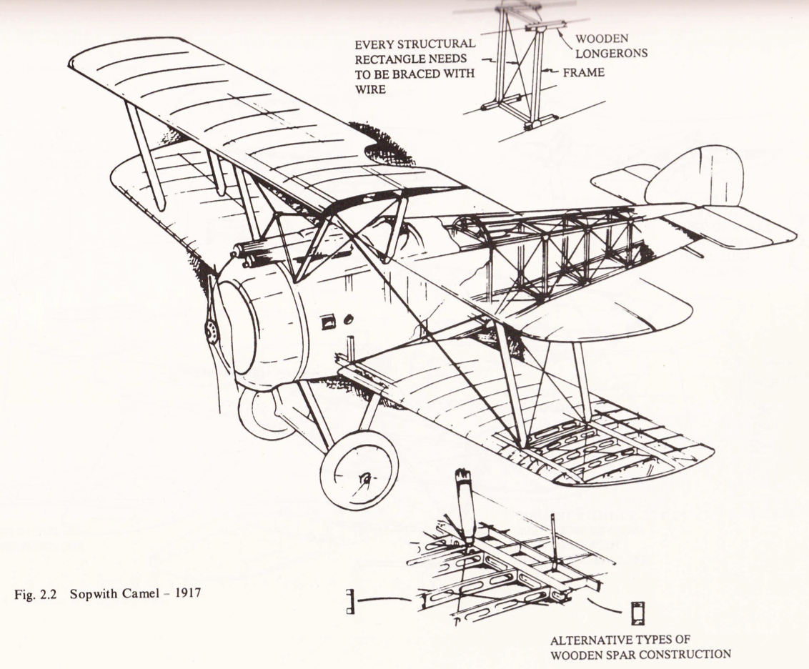
Corkscrew Effect
This 1.5 load limit factor is called the “factor of safety” and provides, to some extent, for loads higher than those expected under normal and reasonable operation.

Slide 31
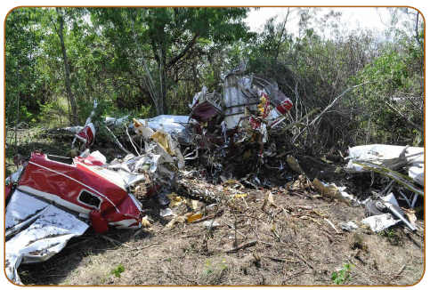
Corkscrew Effect
This strength reserve is not something which pilots should willfully abuse; rather, it is there for protection when encountering unexpected conditions.

Slide 32
Asymmetric Loading (P-Factor)
The maximum safe load factors (limit load factors) specified for aircraft in the various categories are:
CATEGORY LIMIT LOAD FACTOR
Normal 3.8 to –1.52
Utility 4.4 to –1.76
(mild acrobatics, including spins)
Acrobatic 6.0 to –3.00
There is an upward graduation in load factor with the increasing severity of maneuvers.

Slide 33
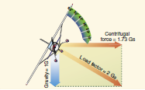
Load Factors in Steep Turns
In a constant altitude, coordinated turn in any aircraft, the load factor is the result of two forces:
centrifugal force and gravity.
The load factor increases at a terrific rate after a bank has reached 45° or 50°.

Slide 34
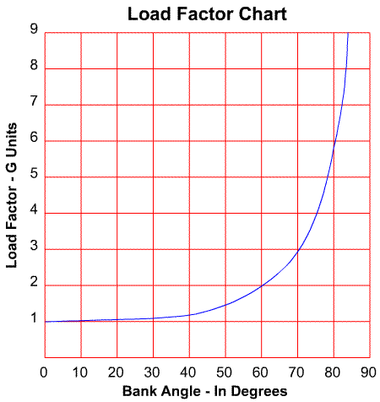
Load Factors in Steep Turns
The load factor for any aircraft in a 60° bank is 2 Gs.
The load factor in an 80° bank is 5.76 Gs.
The wing must produce lift equal to these load factors if altitude is to be maintained.

Slide 35
Questions / Comments

Slide 36
Lesson Closure - 3 – 2 - 1
3. List 3 things you learned today.
2. List 2 things you have questions about today’s lesson.
1. Create (1) quiz question with answer about today’s lesson.

