Slide 1
Warm-Up – 12/1 – 10 minutes
Utilizing your notes and past knowledge answer the following questions:
Name the four type of weather observations.
What are the two methods upper air observations can be made?
Describe convective SIGMETs and what action should pilots take?

Slide 2

Questions / Comments

Slide 3
Warm-Up – 12/1 – 10 minutes
Utilizing your notes and past knowledge answer the following questions:
Name the four type of weather observations.
What are the two methods upper air observations can be made?
Describe convective SIGMETs and what action should pilots take?

Slide 4
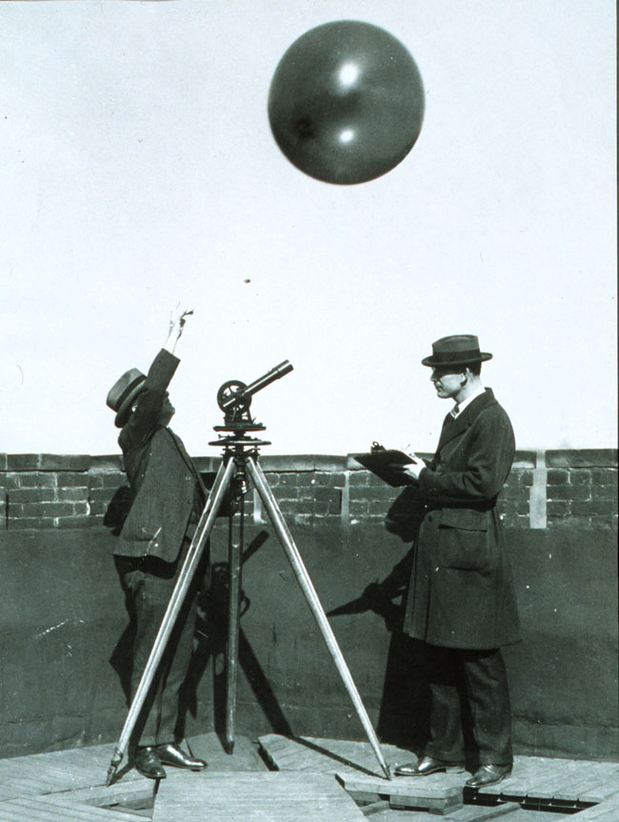
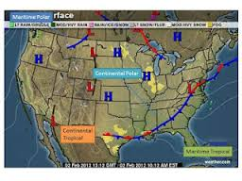
Observations
There are four types of weather observations: surface, upper air, radar, and satellite.

Slide 5
Warm-Up – 12/1 – 10 minutes
Utilizing your notes and past knowledge answer the following questions:
Name the four type of weather observations.
What are the two methods upper air observations can be made?
Describe convective SIGMETs and what action should pilots take?

Slide 6
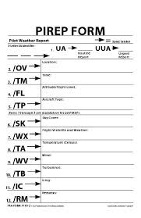
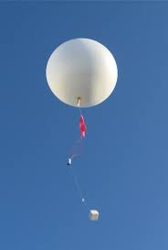
Upper Air Observations
Observations of upper air weather are more challenging than surface observations.
There are only two methods that upper air weather can be observed:
  radiosonde observations
  pilot weather reports (PIREPs).

Slide 7
Warm-Up – 12/1 – 10 minutes
Utilizing your notes and past knowledge answer the following questions:
Name the four type of weather observations.
What are the two methods upper air observations can be made?
Describe convective SIGMETs and what action should pilots take?

Slide 8
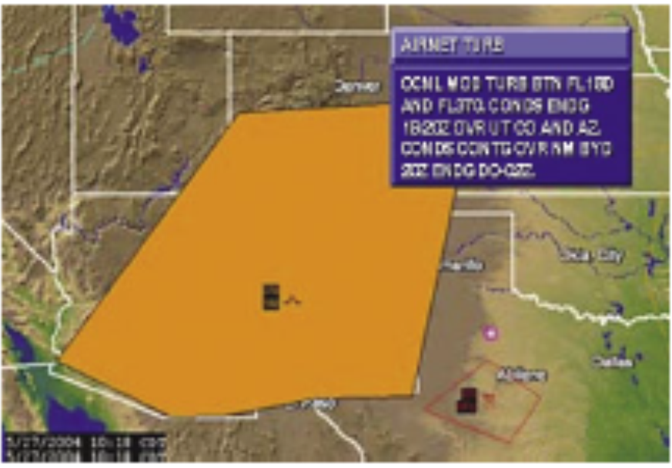
Airmen’s Meteorological Information (AIRMET)
Convective SIGMET's are issued for SEVERE WEATHER. Severe Thunderstorms, etc.
Pilot's DO NOT WANT TO FLY through areas of Convective SIGMET'S.

Slide 9
Questions / Comments

Slide 10
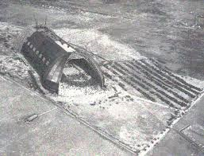
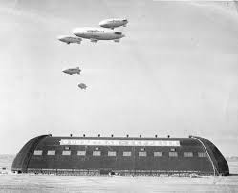
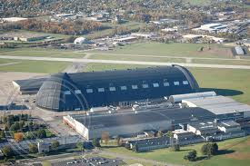
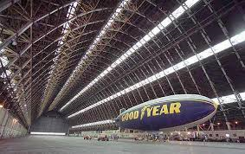
THIS DAY IN AVIATION
December 1
1928 — Goodyear-Zeppelin Corporation begins construction of airship hangar at Akron, Ohio.
The hangar is 1,175 feet long, 325 feet wide and 200 feet high.

Slide 11
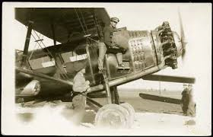
THIS DAY IN AVIATION
December 1
1928 — Interstate Air Lines starts daily mail and passenger service between Chicago, Illinois and Atlanta, Georgia, 623 miles.

Slide 12
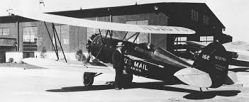
THIS DAY IN AVIATION
December 1
1928 — Pitcairn Aviation Inc. starts daily mail service between Atlanta, Georgia, and Miami, Florida, 622 miles.

Slide 13
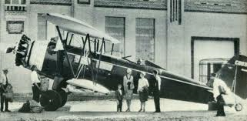
THIS DAY IN AVIATION
December 1
1928 — Interstate Air Line starts daily mail and passenger service between St. Louis, Missouri and Evansville, Indiana, 145 miles.

Slide 14
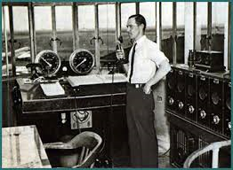
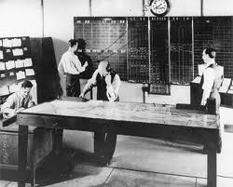
THIS DAY IN AVIATION
December 1
1934 — The first airway traffic control center is opened in Newark, New Jersey, operated by the staff of Eastern Air Lines, United Air Lines, American Airlines and TWA.

Slide 15
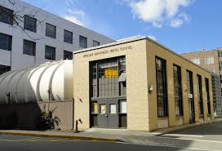
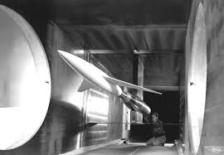
THIS DAY IN AVIATION
December 1
1949 — $2.6 million Naval supersonic wind tunnel is dedicated at Massachusetts Institute of Technology.

Slide 16
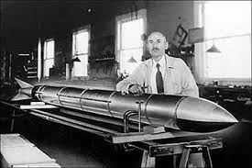
THIS DAY IN AVIATION
December 1
1949 — American Rocket Society outlines specifications for transcontinental rocket airship, capable of 3,000 mile flight in less than 60 minutes.

Slide 17
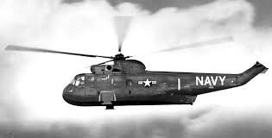
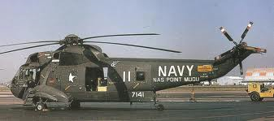
THIS DAY IN AVIATION
December 1
1961 — The United States Navy claims three world speed records for its Sikorsky HSS-2 helicopters.
The twin-turbine craft sets marks of 182.8-mph for 100-km, 179.5-mph for 500-km, and 175.3-mph for 1,000 km.

Slide 18
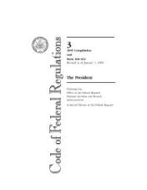

THIS DAY IN AVIATION
December 1
1969 — The first legislation to limit aircraft noise levels at airports is introduced in United States Federal Air Regulation, Part 36.

Slide 19
Questions / Comments

Slide 20
December 2015
SUNDAY | MONDAY | TUESDAY | WEDNESDAY | THURSDAY | FRIDAY | SATURDAY
29 | 30 Chapter 12 Weather Services | 1 Chapter 12 Weather Services | 2 Savannah Tech Field Trip | 3 Chapter 12 Review | 4 Chapter 12 TEST | 5
6 | 7 | 8 | 9 | 10 Open House 1200 - 1400 | 11 Patriots Point Field Trip | 12
13 | 14 | 15 | 16 | 17 | 18 | 19
20 | 21 HOLIDAY | 22 HOLIDAY | 23 HOLIDAY | 24 HOLIDAY | 25 HOLIDAY | 26

Slide 21
2nd Quarter Requirements
(9 Class Meetings – Dec 14)
All students will complete the following:
  Take notes - All in class quizzes and tests
  Private Pilot Syllabus
    Lessons 1 – 6 (Taxiing through Air Traffic Control)
    Must pass written with 80%
    Successfully complete 3 times on small sim
    Successfully complete 1 time on Main sim
  Complete ERAU Aviation 101
    3 quizzes and 1 test
  Student will receive zero points for all incomplete work – NO make-up / extra credit
NOTE: All unfinished Student Pilot and ERAU must be complete prior to starting Private Pilot and last 3 quizzes and test for ERAU.

Slide 22
Questions / Comments

Slide 23

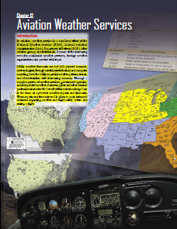
Chapter 12– Aviation Weather Services
FAA – Pilot’s Handbook of Aeronautical Knowledge

Slide 24
Today’s Mission Requirements
Mission:
Describe the combined effort associated with Aviation Weather Services.
Describe how meteorologists can predict weather patterns, trends and characteristics of weather systems.
Identify the various reports available and utilized by pilots.
Describe the basic information provided on reports that enable pilots to make informed decisions regarding weather safety before and during flight.
EQ:
  Describe the importance of Aeronautical Knowledge for the student pilot learning to fly.

Slide 25
Questions / Comments

Slide 26
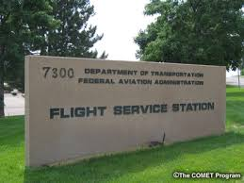
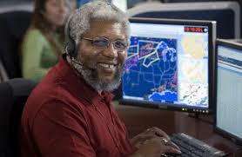
Automated Flight Service Station (AFSS)
A preflight weather briefing from an AFSS can be obtained 24 hours a day by calling 1-800-WX BRIEF from almost anywhere in the United States
The AFSS also provides inflight weather briefing services, as well as scheduled and unscheduled weather broadcasts.

Slide 27
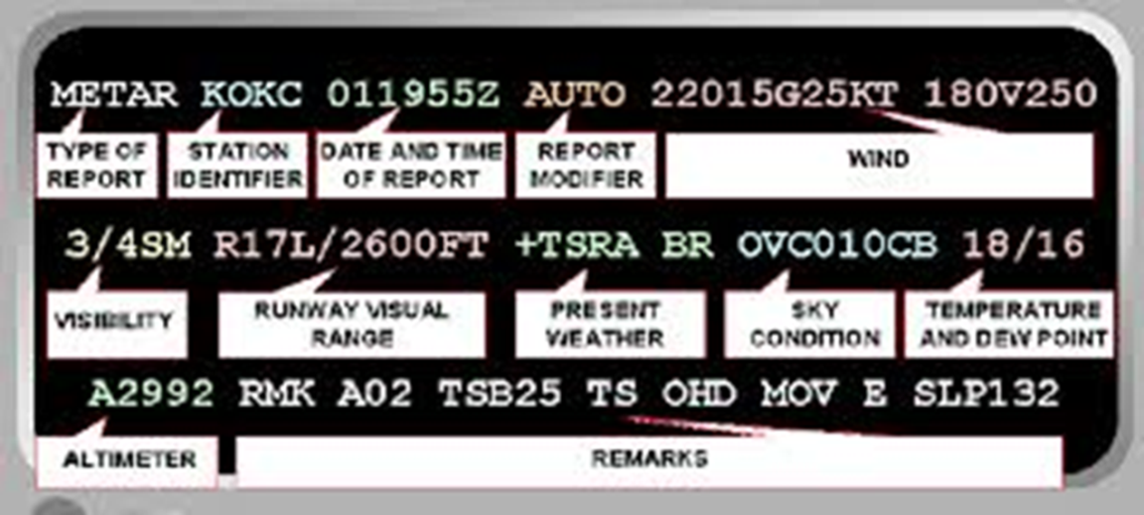
Aviation Routine Weather Report (METAR)
A METAR is an observation of current surface weather reported in a standard international format.
METARS are issued hourly unless significant weather changes have occurred.

Slide 28
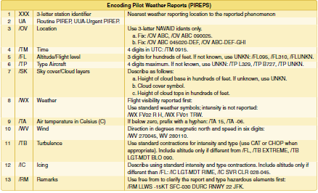
Pilot Weather Report (PIREPs)
PIREPs provide valuable information regarding the conditions as they actually exist in the air, which cannot be gathered from any other source.

Slide 29
Pilot Weather Report (PIREPs)
Pilots can confirm
  height of bases
  tops of clouds,
  locations of wind shear and turbulence
  location of inflight icing.
When unexpected weather conditions are encountered, pilots are encouraged to make a report to a FSS or ATC.

Slide 30
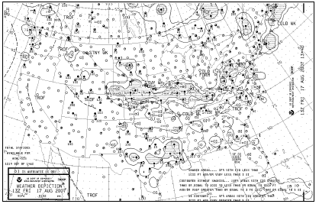
Weather Depiction Chart
A weather depiction chart details surface conditions as derived from METAR and other surface observations.

Slide 31
Weather Depiction Chart
Prepared and transmitted by computer every 3 hours beginning at 0100Z time, and is valid at the time of the plotted data.
It is designed to be used for flight planning by giving an overall picture of the weather across the United States.

Slide 32
Weather Depiction Chart
Provides a graphic display of IFR, VFR, and MVFR (marginal VFR) weather.
Areas of IFR conditions (ceilings less than 1,000 feet and visibility less than three miles) are shown by a hatched area outlined by a smooth line.

Slide 33
Weather Depiction Chart
MVFR regions (ceilings 1,000 to 3,000 feet, visibility 3 to 5 miles) are shown by a nonhatched area outlined by a smooth line.
Areas of VFR (no ceiling or ceiling greater than 3,000 feet and visibility greater than five miles) are not outlined.

Slide 34

Chapter Summary
While no weather forecast is guaranteed to be 100 percent accurate, pilots have access to a myriad of weather information on which to base flight decisions.

Slide 35
Chapter Summary
Weather products available for preflight planning to en route information received over the radio or via satellite link provide the pilot with the most accurate and up-to-date information available.
Each report provides a piece of the weather puzzle.

Slide 36
Chapter Summary
Pilots use several reports to get an overall picture and gain an understanding of the weather that will affect the safe completion of a flight.

Slide 37
Questions / Comments

Slide 38
2nd Quarter Requirements
(9 Class Meetings – Dec 14)
All students will complete the following:
  Take notes - All in class quizzes and tests
  Private Pilot Syllabus
    Lessons 1 – 6 (Taxiing through Air Traffic Control)
    Must pass written with 80%
    Successfully complete 3 times on small sim
    Successfully complete 1 time on Main sim
  Complete ERAU Aviation 101
    3 quizzes and 1 test
  Student will receive zero points for all incomplete work – NO make-up / extra credit
NOTE: All unfinished Student Pilot and ERAU must be complete prior to starting Private Pilot and last 3 quizzes and test for ERAU.

