Slide 1
Warm-Up – 8/31 – 10 minutes
Utilizing your notes and past knowledge answer the following questions:
What are the subcomponents of an airplane?
What is the basic structure of an aircraft?
What is designed to withstand all aerodynamic forces?
What is the primary function of an aircraft electrical system?
What are the three axis of flight?

Slide 2
Questions / Comments

Slide 3
Warm-Up – 8/31 – 10 minutes
Utilizing your notes and past knowledge answer the following questions:
What are the subcomponents of an airplane?
What is the basic structure of an aircraft?
What is designed to withstand all aerodynamic forces?
What is the primary function of an aircraft electrical system?
What are the three axis of flight?

Slide 4
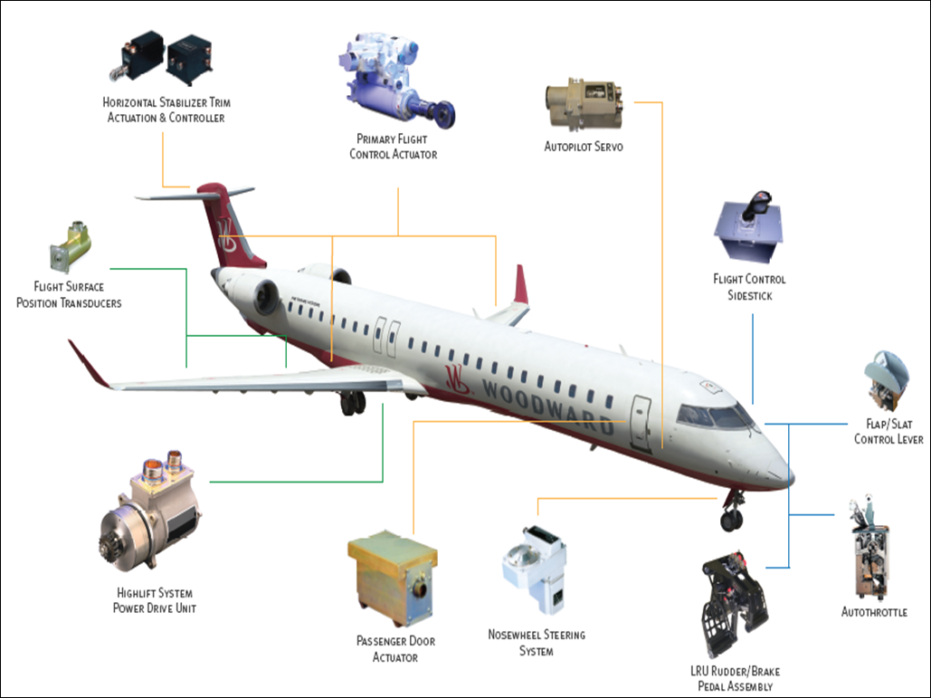
Subcomponents
The subcomponents of an airplane include the airframe, electrical system, flight controls, and brakes.

Slide 5
Warm-Up – 8/31 – 10 minutes
Utilizing your notes and past knowledge answer the following questions:
What are the subcomponents of an airplane?
What is the basic structure of an aircraft?
What is designed to withstand all aerodynamic forces?
What is the primary function of an aircraft electrical system?
What are the three axis of flight?

Slide 6
Subcomponents
The airframe is the basic structure of an aircraft and is designed to withstand all aerodynamic forces, as well as the stresses imposed by the weight of the fuel, crew, and payload.

Slide 7
Warm-Up – 8/31 – 10 minutes
Utilizing your notes and past knowledge answer the following questions:
What are the subcomponents of an airplane?
What is the basic structure of an aircraft?
What is designed to withstand all aerodynamic forces?
What is the primary function of an aircraft electrical system?
What are the three axis of flight?

Slide 8
Subcomponents
The airframe is the basic structure of an aircraft and is designed to withstand all aerodynamic forces, as well as the stresses imposed by the weight of the fuel, crew, and payload.

Slide 9
Warm-Up – 8/31 – 10 minutes
Utilizing your notes and past knowledge answer the following questions:
What are the subcomponents of an airplane?
What is the basic structure of an aircraft?
What is designed to withstand all aerodynamic forces?
What is the primary function of an aircraft electrical system?
What are the three axis of flight?

Slide 10
Subcomponents
The primary function of an aircraft electrical system is to generate, regulate, and distribute electrical power throughout the aircraft.
There are several different power sources on aircraft to power the aircraft electrical systems.

Slide 11
Warm-Up – 8/31 – 10 minutes
Utilizing your notes and past knowledge answer the following questions:
What are the subcomponents of an airplane?
What is the basic structure of an aircraft?
What is designed to withstand all aerodynamic forces?
What is the primary function of an aircraft electrical system?
What are the three axis of flight?

Slide 12
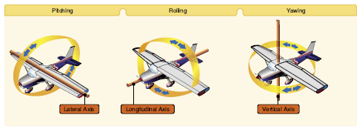
Lift and Basic Aerodynamics
An aircraft moves in three dimensions and is controlled by moving it about one or more of its axes.

Slide 13
Questions / Comments

Slide 14
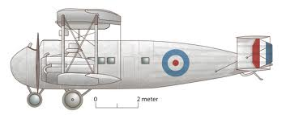
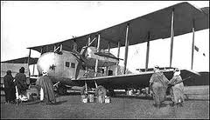
THIS DAY IN AVIATION
August 31
1921 — The first production Vickers “Vernon,” the first troop carrier designed for the British RAF (Royal Air Force), is delivered by the British manufacturer.

Slide 15
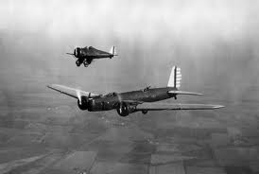
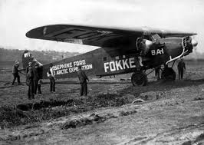
THIS DAY IN AVIATION
August 31
1932 — Air Corps pilots flew 5 miles above the Earth's surface to photograph an eclipse of the Sun.

Slide 16
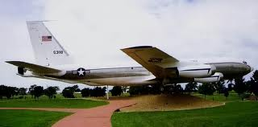
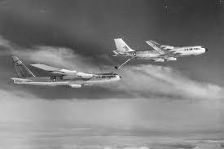
THIS DAY IN AVIATION
August 31
1956 — The first Boeing KC-135A (55-3118) makes its first flight and is taken over by the USAF on January 31, 1957.

Slide 17
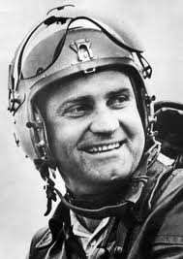
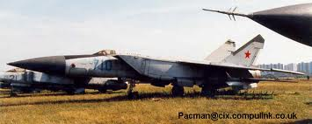
THIS DAY IN AVIATION
August 31
1977 — Soviet test pilot Alexander Fedotov claims a new world height record for manned aircraft when he climbs to a height of 37,650 m (123,523 ft.) flying the Mikoyan E-266M.

Slide 18
Questions / Comments

Slide 19
September 2015
Sunday | Monday | Tuesday | Wednesday | Thursday | Friday | Saturday
30 | 31 Chapter 3 Principles of Flight | 1 Chapter 3 Principles of Flight | 2 Chapter 3 Principles of Flight Progress Reports Due | 3 Chapter 3 Principles of Flight | 4 Flightline Friday Progress Reports Sent Home | 5
6 | 7 HOLIDAY | 8 Chapter 3 Principles of Flight | 9 Chapter 3 Principles of Flight | 10 Chapter 3 Principles of Flight | 11 Flightline Friday | 12
13 | 14 | 15 | 16 | 17 | 18 Flightline Friday | 19
20 | 21 | 22 | 23 Progress Reports Due | 24 | 25 Progress Reports Sent Home | 26

Slide 20
Questions / Comments

Slide 21
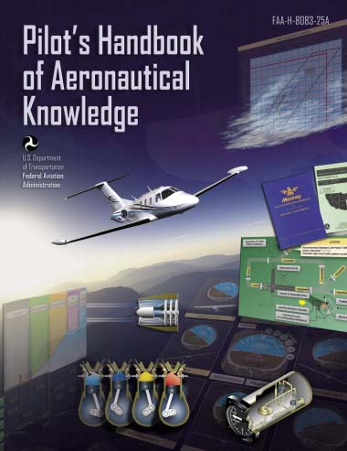
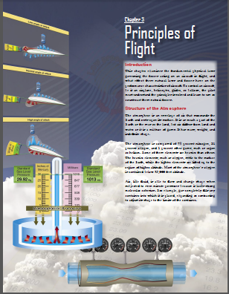
Chapter 3 – Principles of Flight
FAA – Pilot’s Handbook of Aeronautical Knowledge

Slide 22
Today’s Mission Requirements
Mission:
Identify in writing the fundamental physical laws governing the forces acting on an aircraft in flight.
Discuss the layers of the atmosphere, its composition and height.
Describe the atmospheric properties of pressure, temperature, and density
Describe in writing the effect these natural laws and forces have on the performance characteristics of an aircraft.
Describe in writing the means a pilot must understand the principles involved and learn to use or counteract these natural forces.
EQ:
Describe the importance of Aeronautical Knowledge for the student pilot learning to fly.

Slide 23
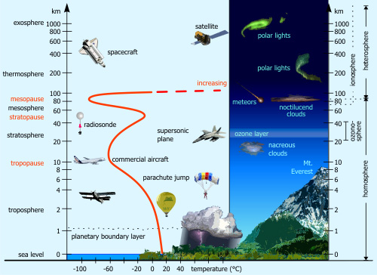
Physics of the Atmosphere

Slide 24
Introduction
To control an aircraft, be it an airplane, helicopter, glider, or balloon, the pilot must understand the principles involved and learn to use or counteract these natural forces.

Slide 25
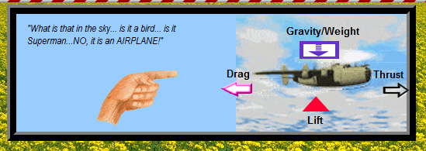
Aerodynamics
Aerodynamics concerns the motion of air and other gaseous fluids and other forces acting on objects in motion through the air (gases).
In effect, Aerodynamics is concerned with the object (aircraft), the movement (Relative Wind), and the air (Atmosphere).

Slide 26
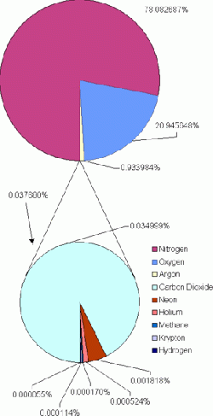
The Realm of Flight
The layers of the atmosphere:
Troposphere, stratosphere, mesosphere, thermosphere, and exosphere
The atmosphere is a mixture of gases
79% nitrogen
21% oxygen
1% of other gases
The atmosphere extends to about 100 miles (approx. 528,000 ft)

Slide 28
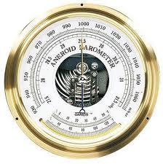
Atmospheric Pressure
Pilots are mainly concerned with atmospheric pressure.

Slide 29
Atmospheric Pressure
It is one of the basic factors in weather changes, helps to lift an aircraft, and actuates some of the important flight instruments.

Slide 30
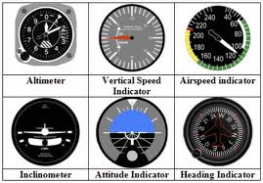
Atmospheric Pressure
These instruments are the altimeter, airspeed indicator, vertical speed indicator, and manifold pressure gauge.

Slide 31
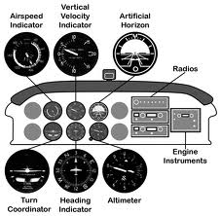

Slide 32
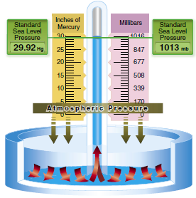
Atmospheric Pressure
Air is very light, but it has mass and is affected by the attraction of gravity.
It has weight
It has force
It is a fluid substance
Its effect on bodies within the air is called pressure.

Slide 33
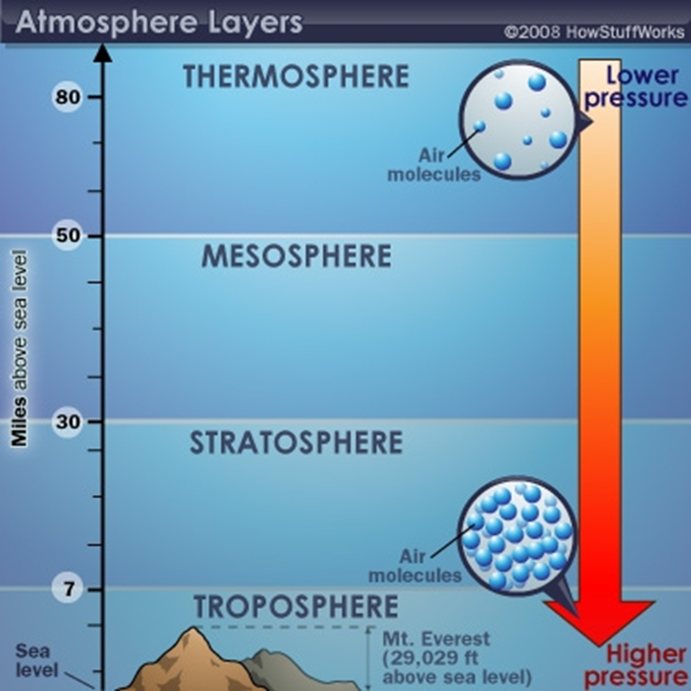
Pressure
Top layer of atmosphere has less pressure
Pressure is greatest at Earth’s surface
Pressure decreases with increase in altitude
“Standard Pressure” is 14.7 psi or 29.92 inches

Slide 34
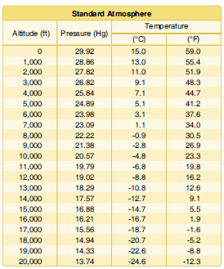
Atmospheric Pressure
Since aircraft performance is compared and evaluated with respect to the standard atmosphere, all aircraft instruments are calibrated for the standard atmosphere.

Slide 35
Pressure Altitude
An altimeter is essentially a sensitive barometer calibrated to indicate altitude in the standard atmosphere.

Slide 36
Pressure Altitude
The pressure altitude can be determined by either of two methods:
1. Setting the barometric scale of the altimeter to 29.92 and reading the indicated altitude.
2. Applying a correction factor to the indicated altitude according to the reported altimeter setting.

Slide 37
Density Altitude
The density of air has significant effects on the aircraft’s performance because as air becomes less dense, it reduces:
• Power because the engine takes in less air.
• Thrust because a propeller is less efficient in thin air.
• Lift because the thin air exerts less force on the airfoils.

Slide 38
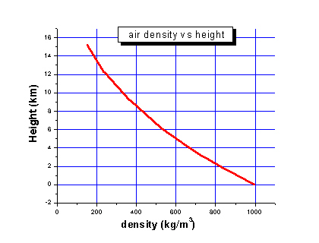
Density
Density of air means how many molecules are squeezed into a given volume.
Higher density air is squeezed more tightly than lower density air.
Cool day at sea level, air is dense – aircraft perform very well.

Slide 39
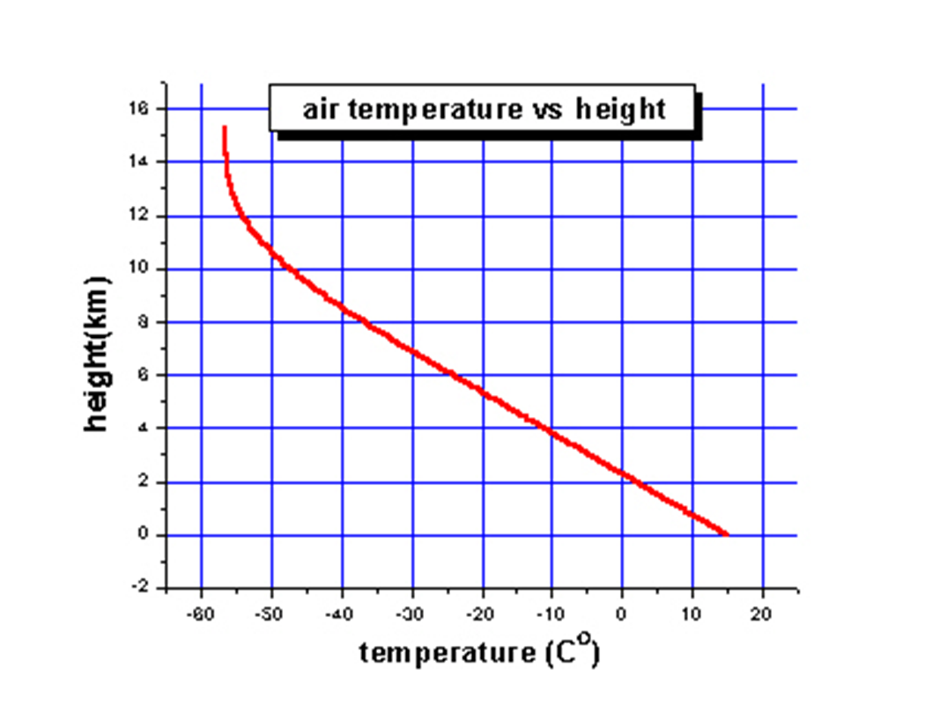
Density
Air at higher altitudes has less pressure – it is also less dense.
Density is also related to temperature.
As air is heated, the molecules move farther apart
Which means there is a decrease in density
On a hot day, aircraft in high altitudes have difficulty taking off – air is too thin

Slide 40
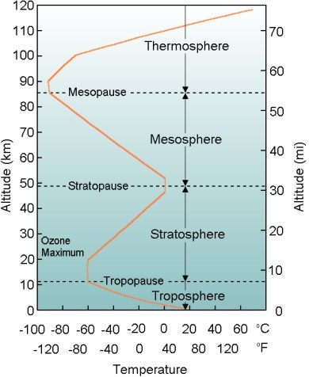
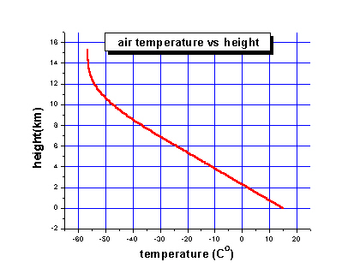
Temperature
Temperature is a measure of energy
The hotter the air, the more energy it has inside and the faster the molecules move around.
Temperature decreases approx 3 ½ degrees for every 1,000 ft increase in altitude
Decrease occurs up to about 38,000 ft

Slide 41
Density Altitude Effect of Humidity on Density
Humidity may become an important factor in the performance of an aircraft.
Water vapor is lighter than air; consequently, moist air is lighter than dry air.

Slide 42
Density Altitude Effect of Humidity on Density
This amount varies with temperature.
Warm air holds more water vapor, while colder air holds less.

Slide 43
Questions / Comments

Slide 44
Sporty’ s Learn to Fly

Slide 45
Density Altitude Effect of Humidity on Density
As the water content of the air increases, the air becomes less dense, increasing density altitude and decreasing performance.

