Slide 1
Warm-Up – 8/29 – 10 minutes
Utilizing your notes and past knowledge answer the following questions:
What are the categories Aircraft are organized into during the certification process.?
What is the minimum age and medical proof required for a student pilot desiring to become a certified as a sport pilot?
As a recreational pilot, what are the medical certificate requirements and list 3 flight limitations?
What is the definition of a complex aircraft?
What is the minimum age and flight hours required of a airline transport pilot?

Slide 2
Questions / Comments

Slide 3
Warm-Up – 8/29 – 10 minutes
Utilizing your notes and past knowledge answer the following questions:
What are the categories Aircraft are organized into during the certification process.?
What is the minimum age and medical proof required for a student pilot desiring to become a certified as a sport pilot?
As a recreational pilot, what are the medical certificate requirements and list 3 flight limitations?
What is the definition of a complex aircraft?
What is the minimum age and flight hours required of a airline transport pilot?

Slide 4
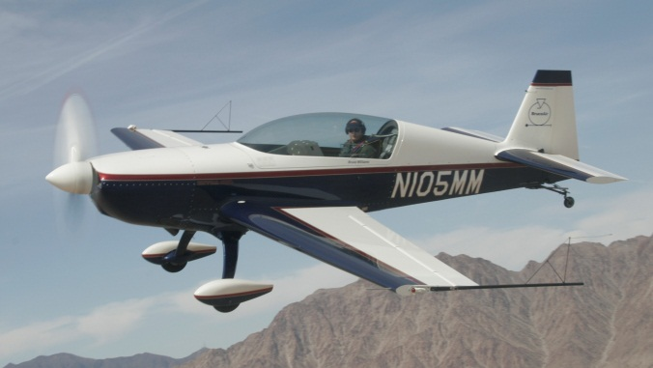
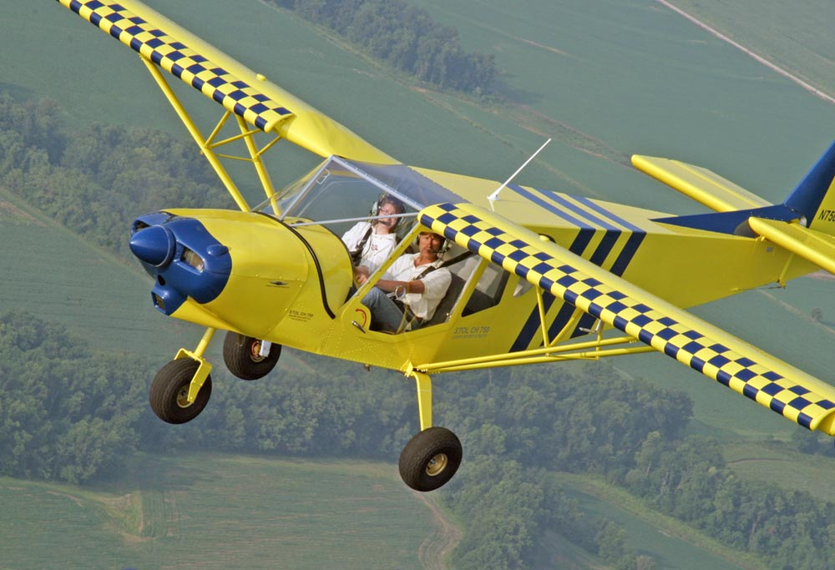
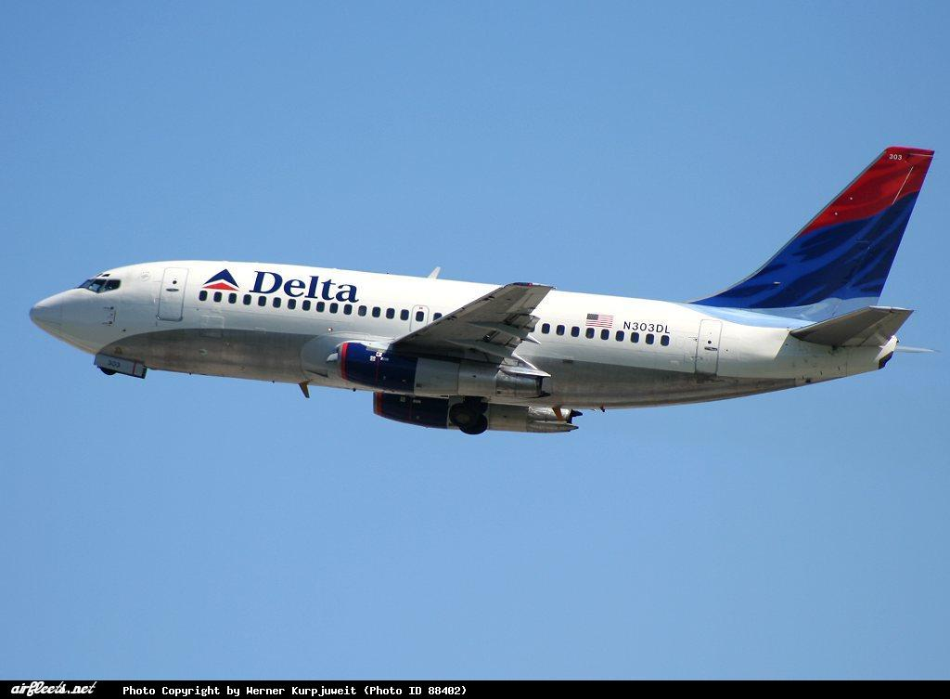
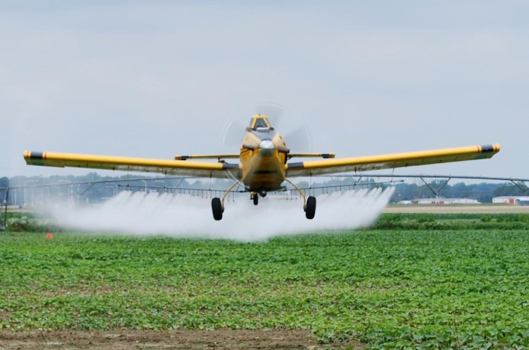
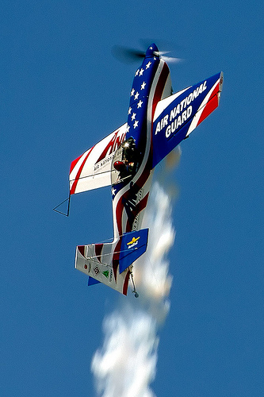
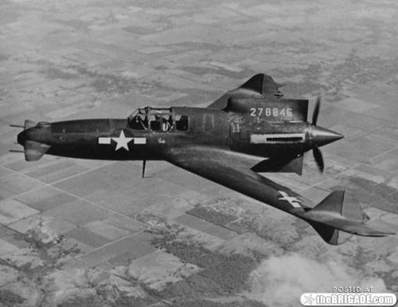
Aircraft Certification Categories
Aircraft are organized into categories during the certification process.
Normal
Utility
Transport
Acrobatic
Restricted
Experimental

Slide 5
Warm-Up – 8/29 – 10 minutes
Utilizing your notes and past knowledge answer the following questions:
What are the categories Aircraft are organized into during the certification process.?
What is the minimum age and medical proof required for a student pilot desiring to become a certified as a sport pilot?
As a recreational pilot, what are the medical certificate requirements and list 3 flight limitations?
What is the definition of a complex aircraft?
What is the minimum age and flight hours required of a airline transport pilot?

Slide 6
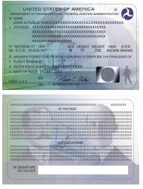
Pilot Certifications Sport Pilot
To earn a Sport Pilot Certificate, one must:
Be at least 16 to become a student sport pilot (14 for glider).
Be at least 17 to test for a sport pilot certificate (16 for gliders).
Be able to read, write, and understand English.
Hold a current and valid driver’s license as evidence of medical eligibility.

Slide 7
Warm-Up – 8/29 – 10 minutes
Utilizing your notes and past knowledge answer the following questions:
What are the categories Aircraft are organized into during the certification process.?
What is the minimum age and medical proof required for a student pilot desiring to become a certified as a sport pilot?
As a recreational pilot, what are the medical certificate requirements and list 3 flight limitations?
What is the definition of a complex aircraft?
What is the minimum age and flight hours required of a airline transport pilot?

Slide 8
Pilot Certifications Recreational Pilot
A logbook endorsement from an instructor
Pass the required practical test
Third-class medical certificate issued under part 14 CFR part 67, except for gliders and balloons—medical eligibility not required

Slide 9
Pilot Certifications Recreational Pilot
As a recreational pilot, cross-country flight is limited to a 50 NM range from departure airport but is permitted with additional training per 14 CFR section 61.101(c).
Additional limitations
flight during the day
no flying in airspace where communications with ATC are required.

Slide 10
Warm-Up – 8/29 – 10 minutes
Utilizing your notes and past knowledge answer the following questions:
What are the categories Aircraft are organized into during the certification process.?
What is the minimum age and medical proof required for a student pilot desiring to become a certified as a sport pilot?
As a recreational pilot, what are the medical certificate requirements and list 3 flight limitations?
What is the definition of a complex aircraft?
What is the minimum age and flight hours required of a airline transport pilot?

Slide 11
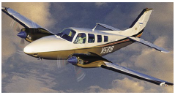
Pilot Certifications Commercial Pilot
A commercial airplane pilot must be able to operate a complex airplane
A complex aircraft must have retractable landing gear, movable flaps, and a controllable pitch propeller.

Slide 12
Warm-Up – 8/29 – 10 minutes
Utilizing your notes and past knowledge answer the following questions:
What are the categories Aircraft are organized into during the certification process.?
What is the minimum age and medical proof required for a student pilot desiring to become a certified as a sport pilot?
As a recreational pilot, what are the medical certificate requirements and list 3 flight limitations?
What is the definition of a complex aircraft?
What is the minimum age and flight hours required of a airline transport pilot?

Slide 13
Pilot Certifications Airline Transport Pilot
The ATP Certificate is a prerequisite for acting as a pilot in command (PIC) of scheduled airline operations.
The minimum pilot experience is 1,500 hours of flight time.
In addition, the pilot must be at least 23 years of age, be able to read, write, speak, and understand the English language, and be “of good moral standing.”

Slide 14
Questions / Comments

Slide 15
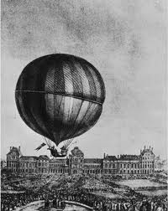
THIS DAY IN AVIATION
August 29
1879 — In Ontario, Nellie Thurston becomes the first Canadian woman to fly in a balloon.

Slide 16
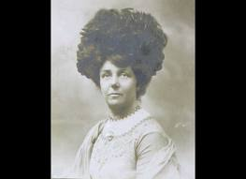
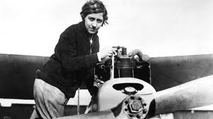
THIS DAY IN AVIATION
August 29
1911 — Mrs. A. Hewlett is the first British woman to gain a pilot's license.

Slide 17
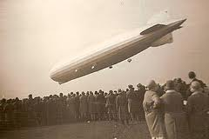
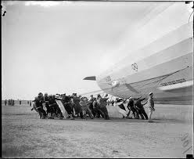
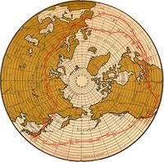
THIS DAY IN AVIATION
August 29
1929 — “Graf Zeppelin” lands at Lakehurst, New Jersey, completing round-the-world flight, begun on 8 August.
The distance flown was 20,000 miles in 21 days 7 hours.
The actual flying time was 263 hours 43 minutes.

Slide 18
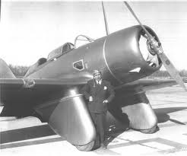
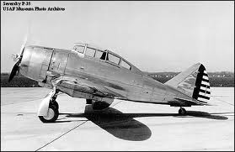
THIS DAY IN AVIATION
August 29
1938 — Flying from New York to Los Angeles, Major Alexander de Seversky makes an east-west transcontinental speed record flight of 10 hours 3 minutes.
The aircraft flown was a Seversky “Pursuit” powered by a Pratt & Whitney “ Twin Wasp” engine.

Slide 19
Questions / Comments

Slide 20
August 2014
Sunday | Monday | Tuesday | Wednesday | Thursday | Friday | Saturday
 |  |  |  |  | 1 | 2
3 | 4 | 5 | 6 | 7 | 8 | 9
10 | 11 | 12 | 13 | 14 | 15 | 16
17 | 18 | 19 Welcome to Ground School | 20 | 21 Chapter 1 – Intro to Flying | 22 | 23
24 | 25 Chapter 1 – Intro to Flying | 26 | 27 Chapter 1 – Intro to Flying | 28 | 29 Chapter 1 – Intro to Flying Chapter 1 QUIZ | 30
31

Slide 21
Questions / Comments

Slide 22
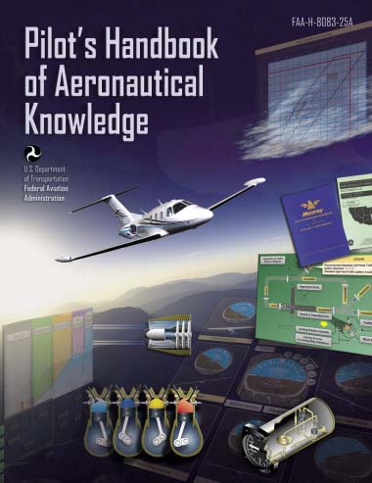
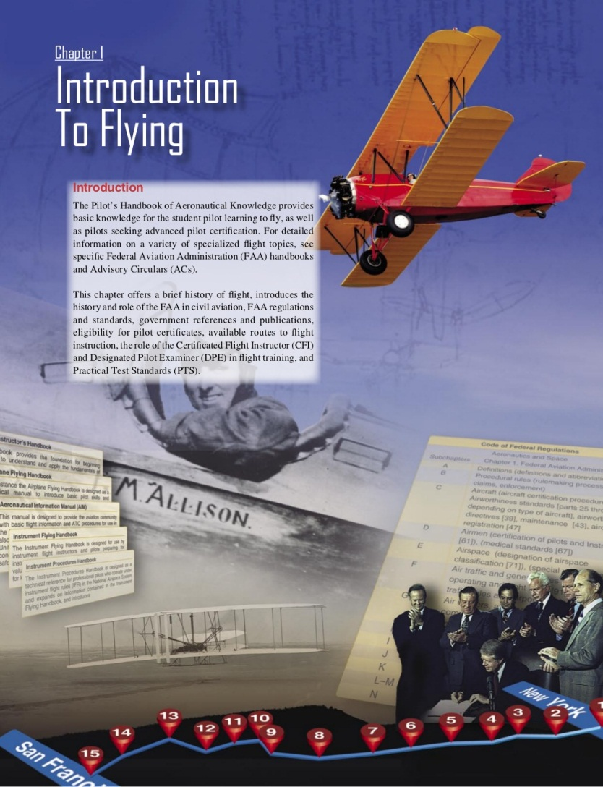
Chapter 1 – Introduction to Flying
FAA – Pilot’s Handbook of Aeronautical Knowledge

Slide 23
Today’s Mission Requirements
Mission:
Describe in writing the eligibility for pilot certificates.
Describe in writing the available routes to flight instruction.
Describe in writing Practical Test Standards (PTS).
EQ:
Describe the importance of Aeronautical Knowledge for the student pilot learning to fly.

Slide 24
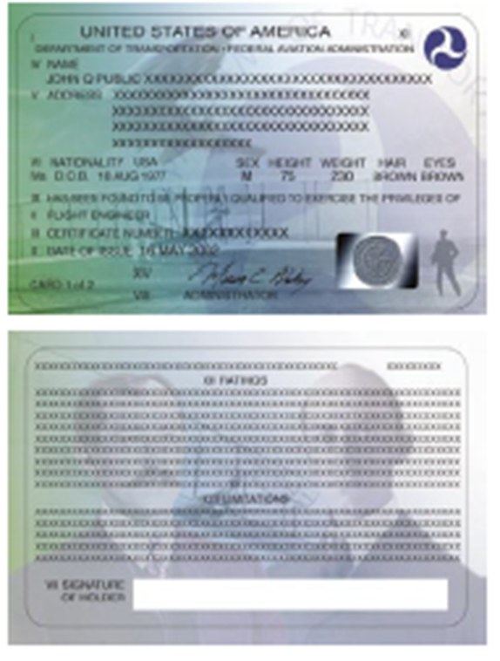
Flying Over America

Slide 25
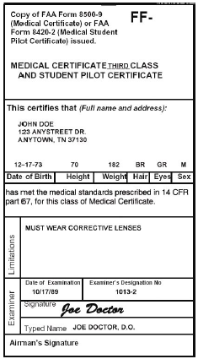
The Student Pilot Medical Certification Requirements
A medical certificate is obtained by passing a physical examination administered by a doctor who is an FAA-authorized AME.
Medical certificates are designated as first class, second class, or third class.
Generally, first class is designed for the airline transport pilot; second class for the commercial pilot; and third class for the student, recreational, and private pilot.

Slide 26
The Student Pilot Medical Certification Requirements
A Student Pilot Certificate is issued by an AME at the time of the student’s first medical examination.
The student certificate is valid until the last day of the month, 24 months after it was issued.

Slide 27
The Student Pilot Medical Certification Requirements
The FAA suggests the individual get a medical certificate before beginning flight training to avoid the expense of flight training that cannot be continued due to a medical condition.
Balloon or glider pilots do not need a medical certificate, but do need to write a statement certifying that no medical defect exists that would prevent them from piloting a balloon or glider.

Slide 28
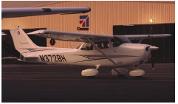
Pilot Certifications Private Pilot
A private pilot is one who flies for pleasure or personal business without accepting compensation for flying except in some very limited, specific circumstances.
The Private Pilot Certificate is the certificate held by the majority of active pilots.

Slide 29
Pilot Certifications Private Pilot
It allows command of any aircraft for any noncommercial purpose, and gives almost unlimited authority to fly under VFR.
Passengers may be carried, and flight in furtherance of a business is permitted; however, a private pilot may not be compensated in any way for services as a pilot, although passengers can pay a pro rata share of flight expenses, such as fuel or rental costs.

Slide 30
Flight School Part 141 and Part 61
All flight training is conducted under the auspices of the FAA following the regulations outlined in either 14 CFR part 141 or 61.
14 CFR part 141 flight schools are certificated by the FAA.

Slide 31
Flight School Part 141 and Part 61
14 CFR part 61 outlines certificate and rating requirements for pilot certification through noncertificated schools and individual flight instructors.

Slide 32
Flight School Part 141 and Part 61
14 CFR part 61 dictates the required minimum flight experience and knowledge-based training necessary to gain a specific pilot’s license, but it does not stipulate how the training is to be organized.

Slide 33
Pilot Certifications Private Pilot
If training under 14 CFR part 61, experience requirements include:
at least 40 hours of piloting time,
including 20 hours of flight with an instructor
10 hours of solo flight.

Slide 34
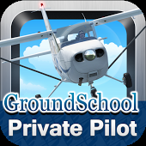
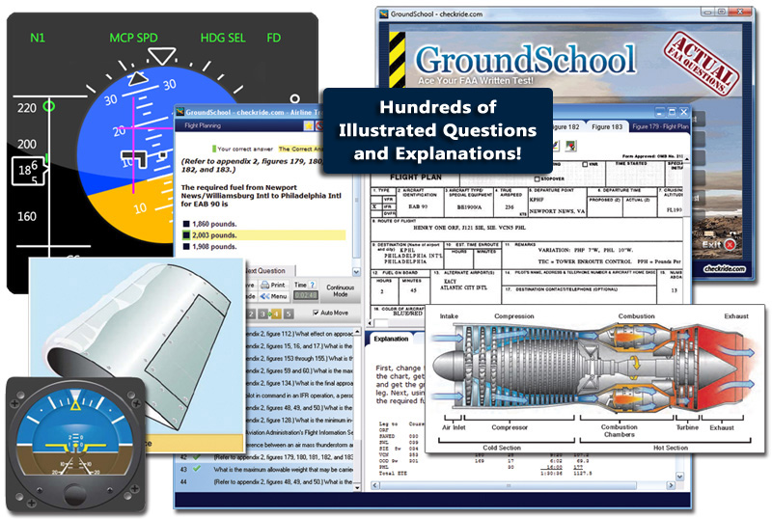
Knowledge and Skills Examinations Knowledge Examination
The knowledge test is the computer portion of the exams taken to obtain pilot certification.
The test contains questions of the objective, multiple-choice type.
To pass, a minimum score of 70 must be attained.

Slide 35
Knowledge and Skills Examinations Knowledge Examination
If pursuing a recreational pilot or private pilot certificate, it is important to become familiar with 14 CFR part 61, section 61.23, Medical Certificates: Requirements and Duration;
14 CFR section 61.35, Knowledge Test: Prerequisites and Passing Grades; and 14 CFR section 61.83, Eligibility Requirements for Student Pilot, for detailed information pertaining to prerequisites and eligibility.

Slide 36
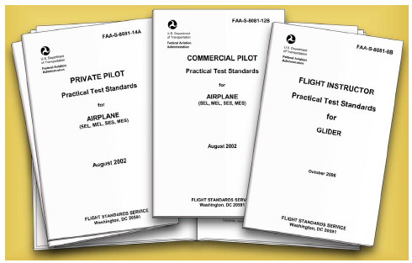
Knowledge and Skills Examinations Practical Examination
The FAA has developed PTSs for FAA pilot certificates and associated ratings.
These practical tests are administered by FAA ASIs and DPEs.
14 CFR part 61 specifies the areas of operation in which knowledge and skill must be demonstrated by the applicant.

Slide 37
Knowledge and Skills Examinations Practical Examination
The flight proficiency maneuvers listed in 14 CFR part 61 are the standard skill requirements for certification.
They are outlined in the PTS as “areas of operation.”
These are phases of the practical test arranged in a logical sequence within the standard.
They begin with preflight preparation and end with postflight procedures.

Slide 38
Questions / Comments

Slide 39
Today’s Mission Requirements
Mission:
Describe in writing the eligibility for pilot certificates.
Describe in writing the available routes to flight instruction.
Describe in writing the role of the Certificated Flight Instructor (CFI) and Designated Pilot Examiner (DPE) in flight training.
Describe in writing Practical Test Standards (PTS).
EQ:
Describe the importance of Aeronautical Knowledge for the student pilot learning to fly.

Slide 40
Questions / Comments

Slide 41
Knowledge and Skills Examinations Practical Examination
The applicant will be asked to present the following documentation:
• FAA Form 8710-1 (8710.11 for sport pilot applicants), Application for an Airman Certificate and/or Rating, with the flight instructor’s recommendation.
• An Airman Knowledge Test Report with a satisfactory grade.

Slide 42
Knowledge and Skills Examinations Practical Examination
A medical certificate (not required for glider or balloon), and a student pilot certificate endorsed by a flight instructor for solo, solo cross-country (airplane and rotorcraft), and for the make and model aircraft to be used for the practical test (driver’s license or medical certificate for sport pilot applicants).
The pilot log book records.
A graduation certificate from an FAA-approved school (if applicable).

Slide 43
Questions / Comments

Slide 44
Questions / Comments

