Slide 1
Warm-Up – 8/28 – 10 minutes
Utilizing your notes and past knowledge answer the following questions:
What parts of the aircraft are included within the empennage?
What is the second type of empennage design?
Describe the landing gear called conventional.
What are the two ways to steer an aircraft while on the ground?
Describe the pressure locations on a propeller.

Slide 2
Questions / Comments

Slide 3
Warm-Up – 8/28 – 10 minutes
Utilizing your notes and past knowledge answer the following questions:
What parts of the aircraft are included within the empennage?
What is the second type of empennage design?
Describe the landing gear called conventional.
What are the two ways to steer an aircraft while on the ground?
Describe the pressure locations on a propeller.

Slide 4
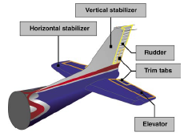
Major Components Empennage
The empennage includes the entire tail group and consists of fixed surfaces such as the vertical stabilizer and the horizontal stabilizer.
The movable surfaces include the rudder, the elevator, and one or more trim tabs.

Slide 5
Warm-Up – 8/28 – 10 minutes
Utilizing your notes and past knowledge answer the following questions:
What parts of the aircraft are included within the empennage?
What is the second type of empennage design?
Describe the landing gear called conventional.
What are the two ways to steer an aircraft while on the ground?
Describe the pressure locations on a propeller.

Slide 6
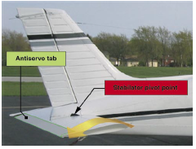
Major Components Empennage
A second type of empennage design incorporates a one-piece horizontal stabilizer that pivots from a central hinge point.
This type of design is called a stabilator, and is moved using the control wheel, just as the elevator is moved.

Slide 7
Warm-Up – 8/28 – 10 minutes
Utilizing your notes and past knowledge answer the following questions:
What parts of the aircraft are included within the empennage?
What is the second type of empennage design?
Describe the landing gear called conventional.
What are the two ways to steer an aircraft while on the ground?
Describe the pressure locations on a propeller.

Slide 8
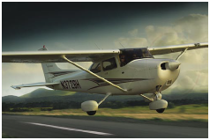
Major Components Landing Gear
Landing gear with a rear mounted wheel is called conventional landing gear.
Airplanes with conventional landing gear are sometimes referred to as tailwheel airplanes.

Slide 9
Warm-Up – 8/28 – 10 minutes
Utilizing your notes and past knowledge answer the following questions:
What parts of the aircraft are included within the empennage?
What is the second type of empennage design?
Describe the landing gear called conventional.
What are the two ways to steer an aircraft while on the ground?
Describe the pressure locations on a propeller.

Slide 10
Major Components Landing Gear
Most aircraft are steered by moving the rudder pedals, whether nosewheel or tailwheel.
Additionally, some aircraft are steered by using differential braking (alternating the application of brakes on one side then the other).

Slide 11
Warm-Up – 8/28 – 10 minutes
Utilizing your notes and past knowledge answer the following questions:
What parts of the aircraft are included within the empennage?
What is the second type of empennage design?
Describe the landing gear called conventional.
What are the two ways to steer an aircraft while on the ground?
Describe the pressure locations on a propeller.

Slide 12
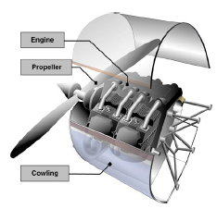
Major Components The Powerplant
A propeller is a rotating airfoil that produces thrust through aerodynamic action.
A low pressure area is formed at the back of the propeller’s airfoil, and high pressure is produced at the face of the propeller, similar to the way lift is generated by an airfoil used as a lifting surface or wing.

Slide 13
Questions / Comments

Slide 14
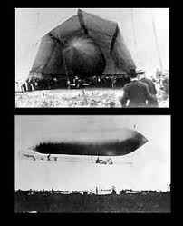
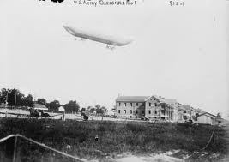
THIS DAY IN AVIATION
August 28
1908 — The United States Army accepts its first dirigible.
It is 96 feet long, with a 20-hp Curtiss engine.

Slide 15
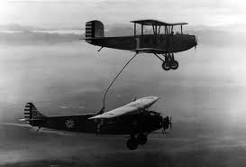
THIS DAY IN AVIATION
August 28
1923 — A New World refueled flight duration record of 37 hours 15 minutes 4.8 seconds set.

Slide 16
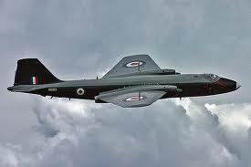
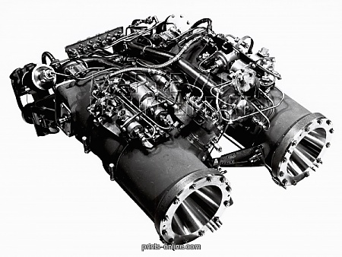
THIS DAY IN AVIATION
August 28
1957 — A record altitude for manned aircraft is achieved by the RAF Canberra serial no. WK 163 piloted by chief test pilot M. Randrup.
He flies the aircraft to 70,310 ft. with the aid of a Double Scorpion rocket motor.

Slide 17
Questions / Comments

Slide 18
August 2015
Sunday | Monday | Tuesday | Wednesday | Thursday | Friday | Saturday
 |  |  |  |  |  | 1
2 | 3 | 4 | 5 | 6 | 7 | 8
9 | 10 | 11 | 12 | 13 | 14 | 15
16 | 17 Welcome to Aviation | 18 Chapter 1 Intro to Flying | 19 Chapter 1 Intro to Flying | 20 Chapter 1 Intro to Flying | 21 Flight Line Friday Quiz | 22
23 | 24 Chapter 2 Aircraft Structure | 25 Chapter 2 Aircraft Structure | 26 Chapter 2 Aircraft Structure | 27 Chapter 2 Aircraft Structure | 28 Flight Line Friday Quiz | 29
30 | 31

Slide 19
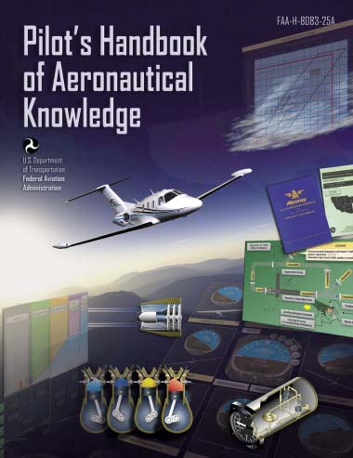
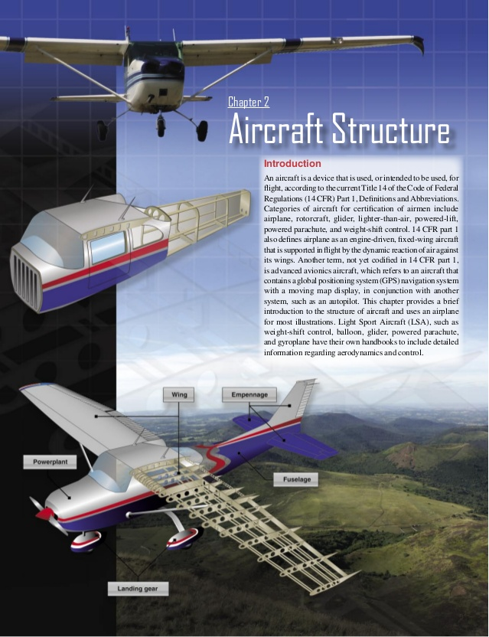
Chapter 2 – Aircraft Structure
FAA – Pilot’s Handbook of Aeronautical Knowledge

Slide 20
Today’s Mission Requirements
Mission:
Describe in writing the major components of an aircraft.
Describe in writing the subcomponents of an aircraft.
Describe in writing types of aircraft construction.
EQ:
Describe the importance of Aeronautical Knowledge for the student pilot learning to fly.

Slide 21
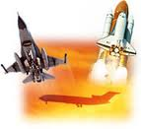
Fastest Aircraft

Slide 22
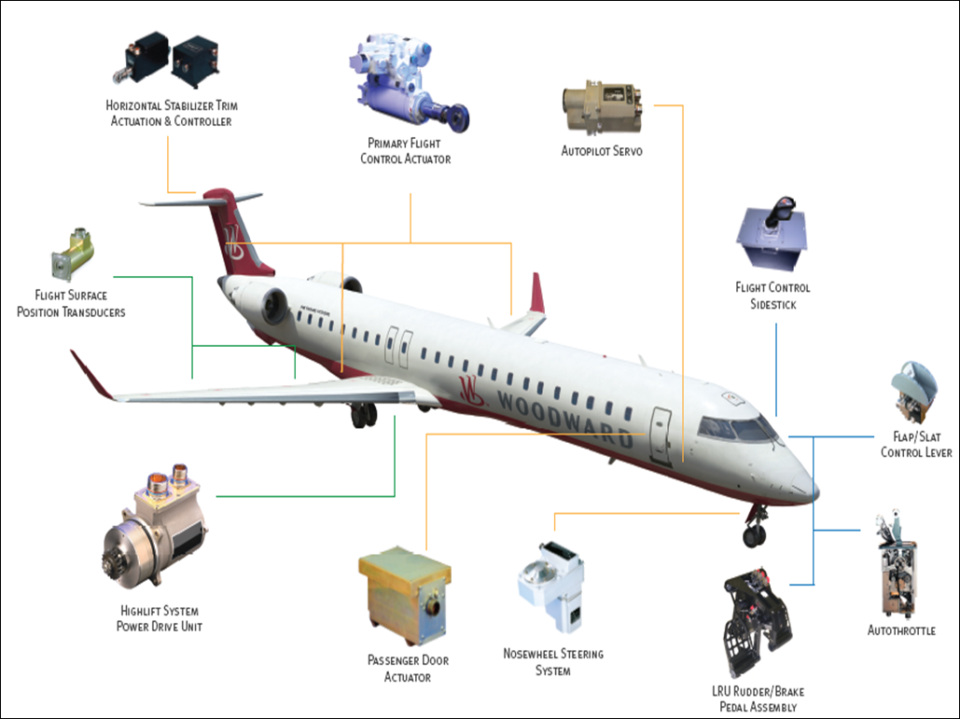
Subcomponents
The subcomponents of an airplane include the airframe, electrical system, flight controls, and brakes.

Slide 23
Subcomponents
The airframe is the basic structure of an aircraft and is designed to withstand all aerodynamic forces, as well as the stresses imposed by the weight of the fuel, crew, and payload.

Slide 24
Subcomponents
The primary function of an aircraft electrical system is to generate, regulate, and distribute electrical power throughout the aircraft.
There are several different power sources on aircraft to power the aircraft electrical systems.

Slide 25
Subcomponents
These power sources include: engine-driven alternating current (AC) generators, auxiliary power units (APUs), and external power.
The aircraft’s electrical power system is used to operate the flight instruments, essential systems such as anti-icing, etc., and passenger services, such as cabin lighting.

Slide 26
Subcomponents
The flight controls are the devices and systems which govern the attitude of an aircraft and, as a result, the flightpath followed by the aircraft.

Slide 27
Subcomponents
The primary flight controls utilize hinged, trailing-edge surfaces called elevators for pitch, ailerons for roll, and the rudder for yaw.

Slide 28
Subcomponents
Airplane brakes consist of multiple pads (called caliper pads) that are hydraulically squeezed toward each other with a rotating disk (called a rotor) between them.

Slide 29
Subcomponents
The pads place pressure on the rotor which is turning with the wheels.
As a result of the increased friction on the rotor, the wheels inherently slow down and stop turning.

Slide 30
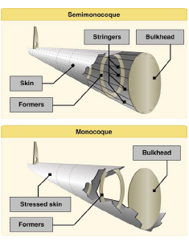
Types of Aircraft Construction
Most modern aircraft use a form of this stressed skin structure known as monocoque or semimonocoque construction.

Slide 31
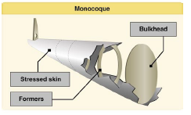
Types of Aircraft Construction Monocoque
Monocoque construction uses stressed skin to support almost all loads much like an aluminum beverage can.
Because most twisting and bending stresses are carried by the external skin rather than by an open framework, the need for internal bracing was eliminated or reduced, saving weight and maximizing space.

Slide 32
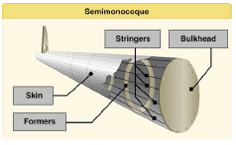
Types of Aircraft Construction Semimonocoque
Semimonocoque construction uses a substructure to which the airplane’s skin is attached.
The substructure, which consists of bulkheads and/or formers of various sizes and stringers, reinforces the stressed skin by taking some of the bending stress from the fuselage.

Slide 33
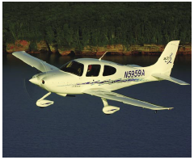
Types of Aircraft Construction Composite Construction
Composite is a broad term and can mean materials such as fiberglass, carbon fiber cloth, Kevlar© cloth, and mixtures of all of the above.
Composite construction offers two advantages: extremely smooth skins and the ability to easily form complex curved or streamlined structures.

Slide 34
Questions / Comments

Slide 35
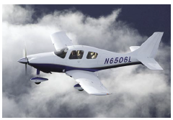
Types of Aircraft Construction Advantages of Construction
Composite construction offers several advantages over metal, wood, or fabric, with its lighter weight being the most frequently cited.
A more important advantage is that a very smooth, compound curved, aerodynamic structure made from composites reduces drag.

Slide 36
Types of Aircraft Construction Advantages of Construction
Lack of corrosion is a third advantage of composites.
Engineers are no longer as concerned about corrosion from moisture condensation on the hidden areas of the fuselage skins, such as behind insulation blankets.
This should lead to lower long-term maintenance costs for the airlines.

Slide 37
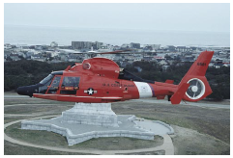
Types of Aircraft Construction Advantages of Construction
Another advantage of composites is their good performance in a flexing environment, such as in helicopter rotor blades.
Composites do not suffer from metal fatigue and crack growth as do metals.

Slide 38
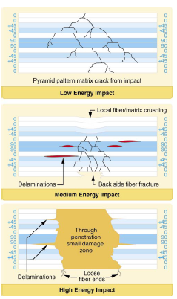
Types of Aircraft Construction Disadvantages of Construction
Composite construction comes with its own set of disadvantages, the most important of which is the lack of visual proof of damage.
Composites respond differently from other structural materials to impact, and there is often no obvious sign of damage.

Slide 39
Types of Aircraft Construction Disadvantages of Construction
The potential for heat damage to the resin is another disadvantage of using composites.
While “too hot” depends on the particular resin system chosen, many epoxies begin to weaken over 150° F.

Slide 40
Types of Aircraft Construction Disadvantages of Construction
White paint on composites is often used to minimize this issue.
For example, the bottom of a wing that is painted black facing a black asphalt ramp on a hot, sunny day, can get as hot as 220 °F.
The same structure, painted white, rarely exceeds 140 °F

Slide 41
Types of Aircraft Construction Disadvantages of Construction
Chemical paint strippers are very harmful to composites, and must not be used on them.

Slide 42
Types of Aircraft Construction The Future of Composites
Composites have earned an important role in aircraft structure design.
Their design flexibility, corrosion resistance, and well the high strength-to-weight ratios possible are the big advantages.

Slide 43
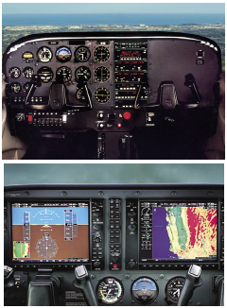
Instrumentation: Moving into the Future
With the release of the electronic flight display (EFD) system, conventional instruments have been replaced by multiple liquid crystal display (LCD) screens.

Slide 44
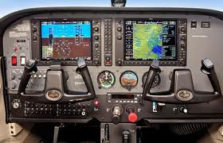
Instrumentation: Moving into the Future
The first screen is installed in front of the left seat pilot position and is referred to as the primary flight display (PFD).
The second screen, positioned approximately in the center of the instrument panel, is referred to as the multi-function display (MFD).

Slide 45
Instrumentation: Moving into the Future
Instrumentation falls into three different categories: performance, control, and navigation.

Slide 46
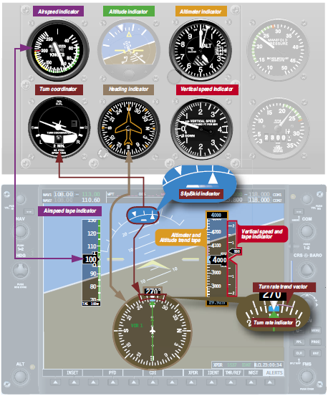
Instrumentation: Performance
The performance instruments indicate the aircraft’s actual performance.
Performance is determined by reference to the altimeter, airspeed or vertical speed indicator (VSI), heading indicator, and turn-and-slip indicator.

Slide 47
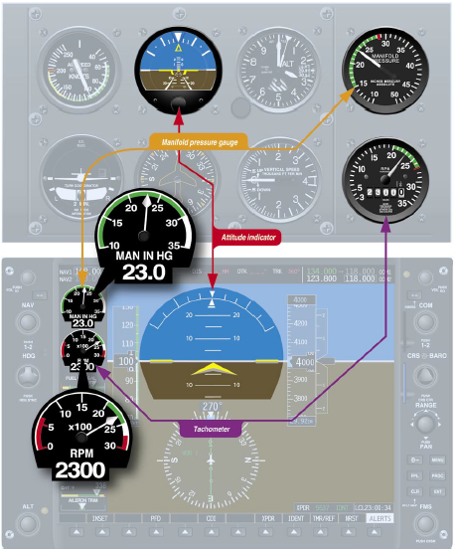
Instrumentation: Control
The control instruments display immediate attitude and power changes, and are calibrated to permit adjustments in precise increments.
The instrument for attitude display is the attitude indicator.

Slide 48
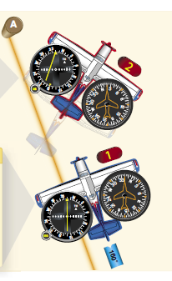
Instrumentation: Navigation
The instruments indicate the position of the aircraft relative to a selected navigation facility or fix.
They also provide pilotage information so the aircraft can be maneuvered to keep it on a predetermined path.

Slide 49
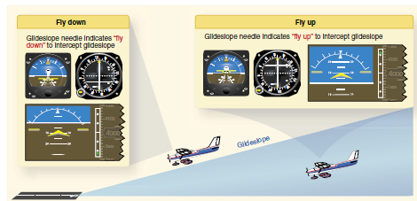
Instrumentation: Navigation
Navigation instruments are comprised of indicators that display GPS, very high frequency (VHF) omni-directional radio range (VOR), nondirectional beacon (NDB), and instrument landing system (ILS) information.

Slide 50
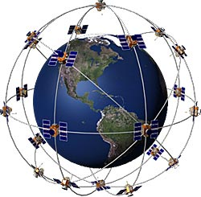
Instrumentation: GPS
GPS is a satellite-based navigation system composed of a network of satellites placed into orbit by the United States Department of Defense (DOD).
GPS works in all weather conditions, anywhere in the world, 24 hours a day.

Slide 51
Instrumentation: GPS
A GPS receiver must be locked onto the signal of at least three satellites to calculate a two-dimensional position (latitude and longitude) and track movement.
With four or more satellites in view, the receiver can determine the user’s three-dimensional position (latitude, longitude, and altitude).

Slide 52
Questions / Comments

