Slide 1
Warm-Up – 4/4 – 10 minutes
Utilizing your notes and past knowledge answer the following questions:
What is one of the oldest and simplest instruments for indicating direction?
This is one of the basic instruments required by Title 14 of the Code of Federal Regulations.
Describe the long and short graduation marks between the letters and numbers.
What can cause a compass error called deviation?
What results in the compass card swinging back and forth around the heading being flown?

Slide 2

Questions / Comments

Slide 3
Warm-Up – 4/4 – 10 minutes
Utilizing your notes and past knowledge answer the following questions:
What is one of the oldest and simplest instruments for indicating direction?
This is one of the basic instruments required by Title 14 of the Code of Federal Regulations.
Describe the long and short graduation marks between the letters and numbers.
What can cause a compass error called deviation?
What results in the compass card swinging back and forth around the heading being flown?

Slide 4
Magnetic Compass
One of the oldest and simplest instruments for indicating direction is the magnetic compass.
It is also one of the basic instruments required by Title 14 of the Code of Federal Regulations (14 CFR) part 91 for both VFR and IFR flight.

Slide 5
Warm-Up – 4/4 – 10 minutes
Utilizing your notes and past knowledge answer the following questions:
What is one of the oldest and simplest instruments for indicating direction?
This is one of the basic instruments required by Title 14 of the Code of Federal Regulations.
Describe the long and short graduation marks between the letters and numbers.
What can cause a compass error called deviation?
What results in the compass card swinging back and forth around the heading being flown?

Slide 6
Magnetic Compass
One of the oldest and simplest instruments for indicating direction is the magnetic compass.
It is also one of the basic instruments required by Title 14 of the Code of Federal Regulations (14 CFR) part 91 for both VFR and IFR flight.

Slide 7
Warm-Up – 4/4 – 10 minutes
Utilizing your notes and past knowledge answer the following questions:
What is one of the oldest and simplest instruments for indicating direction?
This is one of the basic instruments required by Title 14 of the Code of Federal Regulations.
Describe the long and short graduation marks between the letters and numbers.
What can cause a compass error called deviation?
What results in the compass card swinging back and forth around the heading being flown?

Slide 8
Magnetic Compass
There are long and short graduation marks between the letters and numbers.
Each long mark representing 10° and each short mark representing 5°.

Slide 9
Warm-Up – 4/4 – 10 minutes
Utilizing your notes and past knowledge answer the following questions:
What is one of the oldest and simplest instruments for indicating direction?
This is one of the basic instruments required by Title 14 of the Code of Federal Regulations.
Describe the long and short graduation marks between the letters and numbers.
What can cause a compass error called deviation?
What results in the compass card swinging back and forth around the heading being flown?

Slide 10
Magnetic Compass
Deviation
Magnetic fields in an aircraft caused by electrical current flowing in the structure
Nearby wiring or any magnetized part of the structure
Conflict with the Earth’s magnetic field and cause a compass error called deviation.

Slide 11
Warm-Up – 4/4 – 10 minutes
Utilizing your notes and past knowledge answer the following questions:
What is one of the oldest and simplest instruments for indicating direction?
This is one of the basic instruments required by Title 14 of the Code of Federal Regulations.
Describe the long and short graduation marks between the letters and numbers.
What can cause a compass error called deviation?
What results in the compass card swinging back and forth around the heading being flown?

Slide 12
Magnetic Compass
Oscillation Error
Oscillation is a combination of all of the other errors
It results in the compass card swinging back and forth around the heading being flown.

Slide 13
Questions / Comments

Slide 14
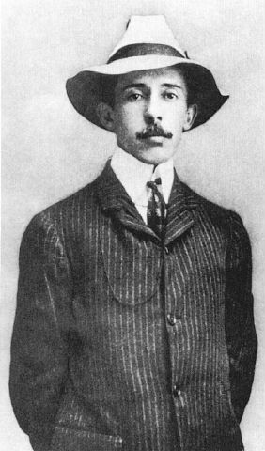
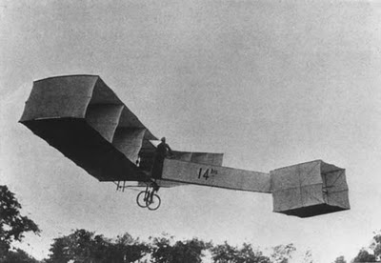
THIS DAY IN AVIATION
April 4
1907 — Santos-Dumont, disappointed by his failure on March 27 and shocked by Charles Voisin's flight of 197 feet shortly afterwards, tries again with his No. 14bis.
He makes a short flight of 164 feet in Saint-Cyr, France.

Slide 15
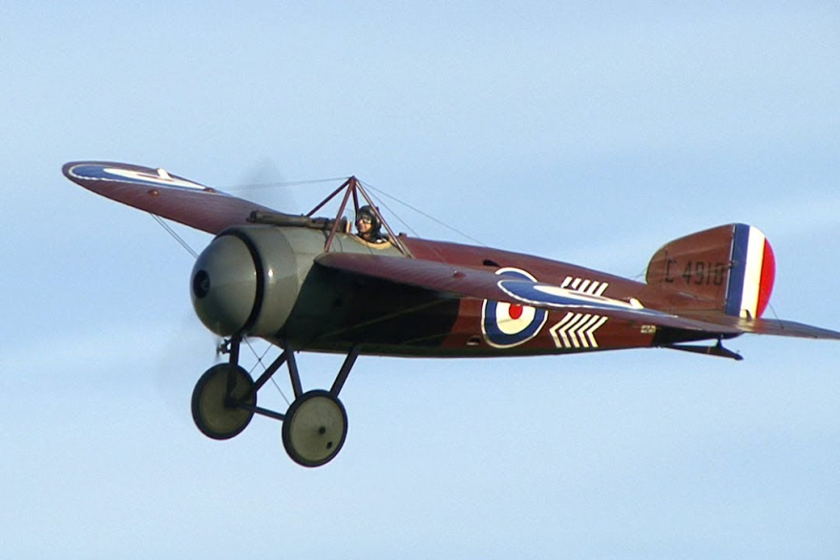
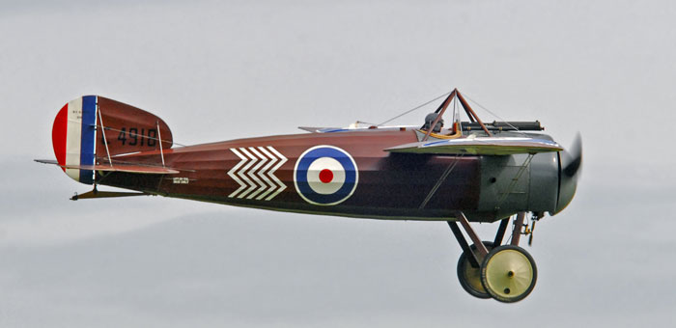
THIS DAY IN AVIATION
April 4
1919 — Lieutenant Cortinez, of the Chilean Army, crosses the Andes Mountains at an altitude of 19,800 feet in a British Bristol monoplane.

Slide 16
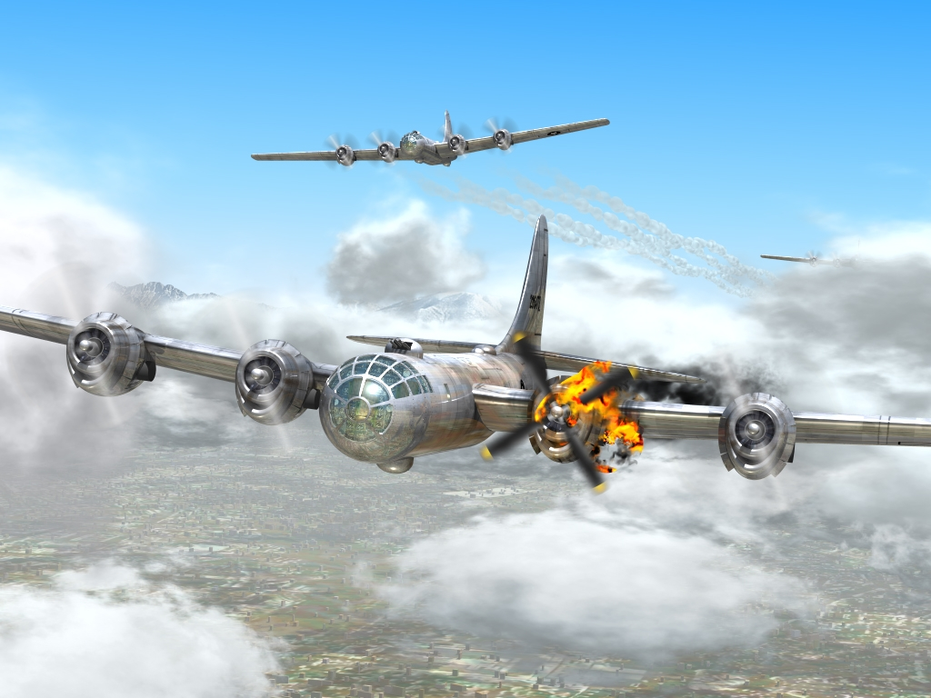
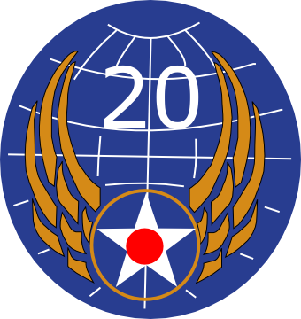
THIS DAY IN AVIATION
April 4
1944 — USAAF Twentieth Air Force was activated.

Slide 17

THIS DAY IN AVIATION
April 4
1946 — Sears, Roebuck & Company begins a new, regular weekly overnight shipment of women's clothing from New York to the West Coast by airplane.

Slide 18

THIS DAY IN AVIATION
April 4
1947 — The International Civil Aviation Organization (ICAO) is officially founded in Montréal, Canada.
It is an inter-governmental organization, established to regulate air transportation on a worldwide basis, its authority restricted only by the number of signatory nations.

Slide 19

THIS DAY IN AVIATION
April 4
1966 — British Overseas Airways Corporation (BOAC) opens its first scheduled service to Mexico, flying to Mexico City via Bermuda and Kingston, Jamaica.

Slide 20
Questions / Comments

Slide 21
March/April 2014
Sunday | Monday | Tuesday | Wednesday | Thursday | Friday | Saturday
30 | 31 Chapter 7 Gyro Systems | 1 | 2 Chapter 7 Magnetic Compass | 3 | 4 FltLine Friday Chapter 7 Test | 5 Aviation Day Lady’s Island Airport
6 | 7 | 8 Chapter 8 Flight Manuals | 9 | 10 Chapter 9 Weight & Balance | 11 | 12
13 | 14 SPRING BREAK | 15 SPRING BREAK | 16 SPRING BREAK | 17 SPRING BREAK | 18 SPRING BREAK | 19
20 | 21 | 22 | 23 | 24 | 25 FltLine Friday | 26 Aviation Day Hilton Head Airport
27 | 28 | 29 | 30

Slide 22
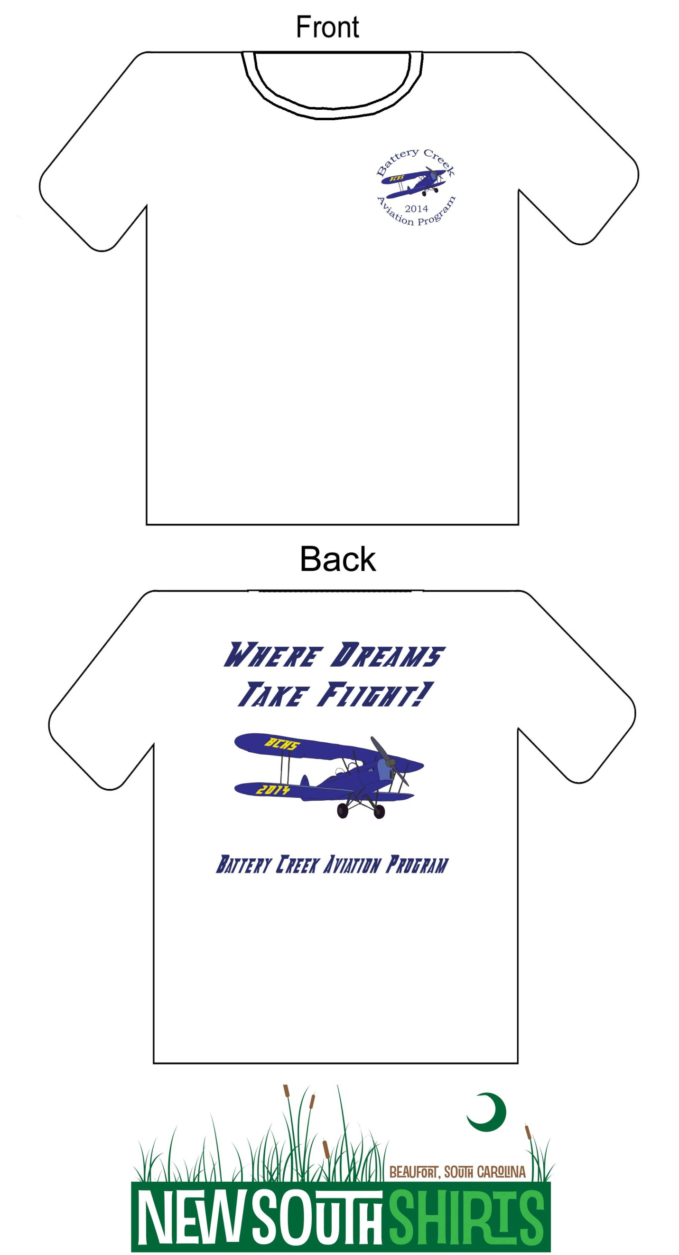

Slide 24
Questions / Comments

Slide 25

Chapter 7 – Flight Instruments
FAA – Pilot’s Handbook of Aeronautical Knowledge

Slide 26
Today’s Mission Requirements
Mission:
Chapter 7 Test Review
Chapter 7 Test.
EQ:
  Describe the importance of Aeronautical Knowledge for the student pilot learning to fly.

Slide 27
Chapter 7 – Flight Instruments
FAA – Pilot’s Handbook of Aeronautical Knowledge
TEST

Slide 28
Questions / Comments

