Slide 1
Warm-Up – 4/29 – 10 minutes
Utilizing your notes and past knowledge answer the following questions:
(True/False) The tip of the propeller blade travels slower than the hub.
(True/False) Engine icing symptoms may sometimes be accompanied by vibration or engine roughness.
(True/False) The oil pressure gauge provides a direct indication of the oil system operation.
(True/False) With an increase in altitude – pressure, temperature and density increases.
(True/False) Weight and balance is only concerned with passengers and fuel.

Slide 2

Questions / Comments

Slide 3
Warm-Up – 4/29 – 10 minutes
Utilizing your notes and past knowledge answer the following questions:
(True/False) The tip of the propeller blade travels slower than the hub.
(True/False) Engine icing symptoms may sometimes be accompanied by vibration or engine roughness.
(True/False) The oil pressure gauge provides a direct indication of the oil system operation.
(True/False) With an increase in altitude – pressure, temperature and density increases.
(True/False) Weight and balance is only concerned with passengers and fuel.

Slide 4
FALSE

Slide 5
Warm-Up – 4/29 – 10 minutes
Utilizing your notes and past knowledge answer the following questions:
(True/False) The tip of the propeller blade travels slower than the hub.
(True/False) Engine icing symptoms may sometimes be accompanied by vibration or engine roughness.
(True/False) The oil pressure gauge provides a direct indication of the oil system operation.
(True/False) With an increase in altitude – pressure, temperature and density increases.
(True/False) Weight and balance is only concerned with passengers and fuel.

Slide 6
TRUE

Slide 7
Warm-Up – 4/29 – 10 minutes
Utilizing your notes and past knowledge answer the following questions:
(True/False) The tip of the propeller blade travels slower than the hub.
(True/False) Engine icing symptoms may sometimes be accompanied by vibration or engine roughness.
(True/False) The oil pressure gauge provides a direct indication of the oil system operation.
(True/False) With an increase in altitude – pressure, temperature and density increases.
(True/False) Weight and balance is only concerned with passengers and fuel.

Slide 8
TRUE

Slide 9
Warm-Up – 4/29 – 10 minutes
Utilizing your notes and past knowledge answer the following questions:
(True/False) The tip of the propeller blade travels slower than the hub.
(True/False) Engine icing symptoms may sometimes be accompanied by vibration or engine roughness.
(True/False) The oil pressure gauge provides a direct indication of the oil system operation.
(True/False) With an increase in altitude – pressure, temperature and density increases.
(True/False) Weight and balance is only concerned with passengers and fuel.

Slide 10
FALSE

Slide 11
Warm-Up – 4/29 – 10 minutes
Utilizing your notes and past knowledge answer the following questions:
(True/False) The tip of the propeller blade travels slower than the hub.
(True/False) Engine icing symptoms may sometimes be accompanied by vibration or engine roughness.
(True/False) The oil pressure gauge provides a direct indication of the oil system operation.
(True/False) With an increase in altitude – pressure, temperature and density increases.
(True/False) Weight and balance is only concerned with passengers and fuel.

Slide 12
FALSE

Slide 13
Questions / Comments

Slide 14
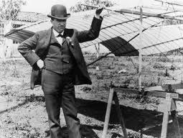
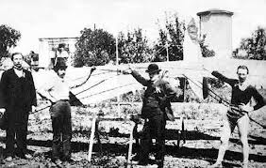
THIS DAY IN AVIATION
April 29
1905 — In Santa Clara, California, Daniel Maloney is launched from a tethered balloon to make a free flight in a tandem-wing glider, which “Professor” Montgomery, a schoolteacher and keen amateur aviator, has designed.

Slide 15
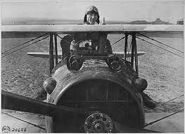
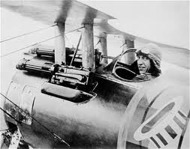
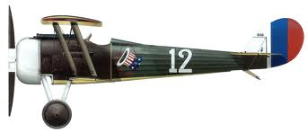
THIS DAY IN AVIATION
April 29
1918 — Lieut. Edward V. Rickenbacker downed his first enemy aircraft.

Slide 16
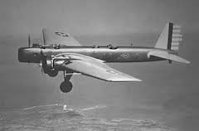
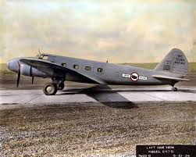
THIS DAY IN AVIATION
April 29
1931 — The Boeing B-9 bomber flies for the first time and marks the next step in airframe development in the evolution of the Boeing 247, the first modern-type airliner.

Slide 17
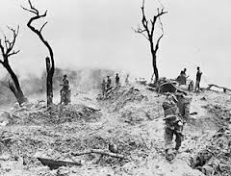
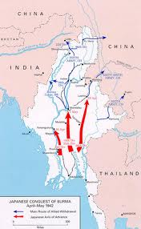
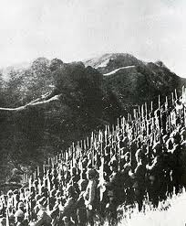
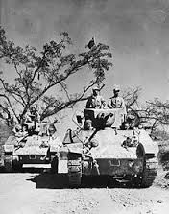
THIS DAY IN AVIATION
April 29
1942 — The Japanese take central Burma.

Slide 18
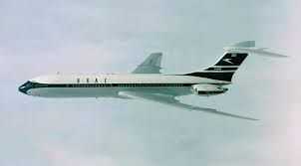
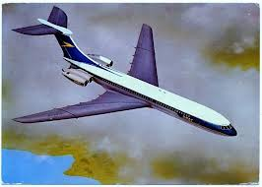
THIS DAY IN AVIATION
April 29
1964 — British Overseas Airways Corporation (BOAC) introduces the Vickers VC10 jet airliner into regular passenger service, on its route to Lagos, Nigeria.

Slide 19
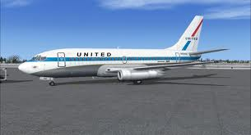
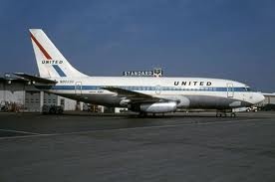

THIS DAY IN AVIATION
April 29
1968 — United AirLines becomes the first carrier to put the Boeing 737-200, a larger capacity version of the standard 737, into service.

Slide 20
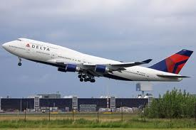
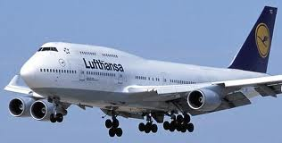
THIS DAY IN AVIATION
April 29
1988 — The first flight of the Boeing 747-400 is made.
This advanced model has a crew of two and can carry between 412 and 509 passengers over 8,000 miles.
Sales in 1990 of 170 of these wide-body transports broke all records.

Slide 21
Questions / Comments

Slide 22
April 2014
Sunday | Monday | Tuesday | Wednesday | Thursday | Friday | Saturday
6 | 7 | 8 Chapter 8 Flight Manuals | 9 | 10 Chapter 9 Weight & Balance | 11 | 12
13 | 14 SPRING BREAK | 15 SPRING BREAK | 16 SPRING BREAK | 17 SPRING BREAK | 18 SPRING BREAK | 19
20 | 21 | 22 | 23 | 24 | 25 FltLine Friday | 26 Aviation Day Hilton Head Airport
27 | 28 | 29 Chapter 10 Aircraft Performance | 30 | 1 Chapter 10 Aircraft Performance | 2

Slide 23
Questions / Comments

Slide 24

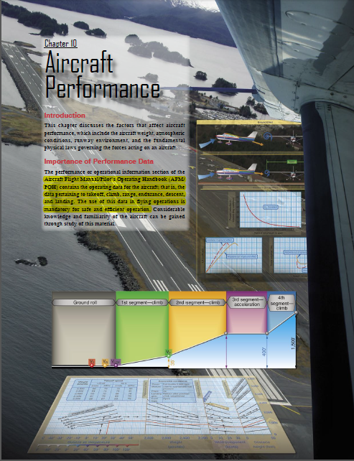
Chapter 10 – Aircraft Performance
FAA – Pilot’s Handbook of Aeronautical Knowledge

Slide 25
Today’s Mission Requirements
Mission:
Describe the factors that affect aircraft performance.
Identify how aircraft weight, atmospheric conditions, runway environment, and the fundamental physical laws governing the forces can affect aircraft performance.
EQ:
  Describe the importance of Aeronautical Knowledge for the student pilot learning to fly.

Slide 26
Importance of Performance Data
The performance or operational information section of the Aircraft Flight Manual/Pilot’s Operating Handbook (AFM/ POH) contains the operating data for the aircraft; that is, the data pertaining to takeoff, climb, range, endurance, descent, and landing.
The use of this data in flying operations is mandatory for safe and efficient operation.

Slide 27
Importance of Performance Data
Since the characteristics of the atmosphere have a major effect on performance, it is necessary to review two dominant factors—pressure and temperature.
Alt. = 1/ptd

Slide 28

Range Performance
The ability of an aircraft to convert fuel energy into flying distance is one of the most important items of aircraft performance.

Slide 29
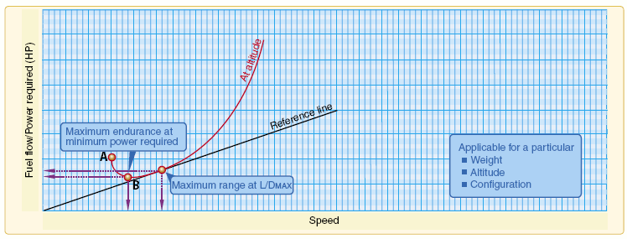
Range Performance
If maximum endurance is desired, the flight condition must provide a minimum fuel flow.

Slide 30
Range Performance
As airspeed is increased, power requirements decrease due to aerodynamic factors and fuel flow decreases to point B.
This is the point of maximum endurance.

Slide 31
Range Performance
Beyond this point increases in airspeed come at a cost.
Airspeed increases require additional power and fuel flow increases with additional power.

Slide 32
Range Performance
If maximum specific range is desired, the flight condition must provide a maximum of speed per fuel flow.

Slide 33
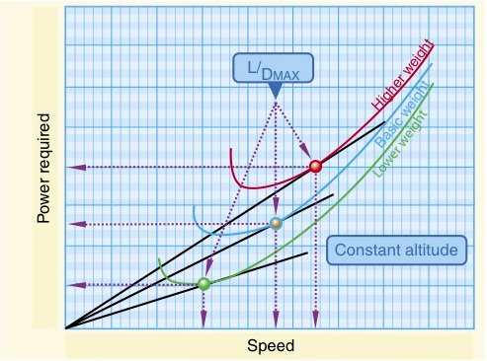
Range Performance
The maximum range condition is obtained at maximum lift/drag ratio (L/DMAX), and it is important to note that for a given aircraft configuration, the L/DMAX occurs at a particular AOA and lift coefficient, and is unaffected by weight or altitude.

Slide 34

Range Performance
A variation in weight will alter the values of airspeed and power required to obtain the L/DMAX.

Slide 35
Region of Reversed Command
The power required curve illustrates the fact that at low airspeeds near the stall or minimum controllable airspeed, the power setting required for steady, level flight is quite high.

Slide 36
Region of Reversed Command
Flight in the region of normal command means that while holding a constant altitude, a higher airspeed requires a higher power setting and a lower airspeed requires a lower power setting.

Slide 37
Region of Reversed Command
The majority of aircraft flying (climb, cruise, and maneuvers) is conducted in the region of normal command.

Slide 38
Region of Reversed Command
The region of reversed command is encountered in the low speed phases of flight.
In the region of reversed command, a decrease in airspeed must be accompanied by an increased power setting in order to maintain steady flight.

Slide 39
Region of Reversed Command
An airplane performing a low airspeed, high pitch attitude power approach for a short-field landing is an example of operating in the region of reversed command.

Slide 40
Region of Reversed Command
If during a soft-field takeoff and climb, for example, the pilot attempts to climb out of ground effect without first attaining normal climb pitch attitude and airspeed, the airplane may inadvertently enter the region of reversed command at a dangerously low altitude.
Even with full power, the airplane may be incapable of climbing or even maintaining altitude. The pilot’s only recourse in this situation is to lower the pitch

Slide 41
Region of Reversed Command
Even with full power, the airplane may be incapable of climbing or even maintaining altitude.

Slide 42
Region of Reversed Command
Airplane pilots must give particular attention to precise control of airspeed when operating in the low flight speeds of the region of reversed command.

Slide 43
Takeoff and Landing Performance
The majority of pilot-caused aircraft accidents occur during the takeoff and landing phase of flight.

Slide 44
Runway Surface and Gradient
Runway conditions affect takeoff and landing performance.

Slide 45
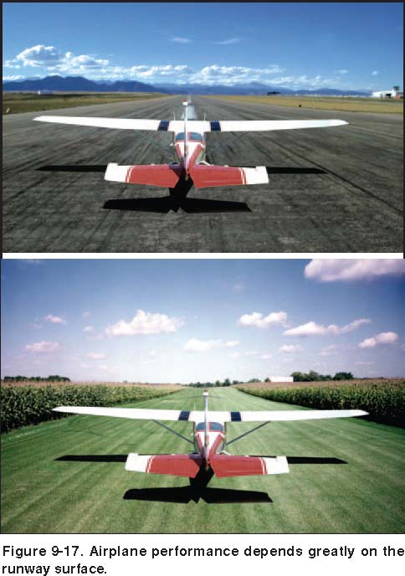
Runway Surface and Gradient
The runway surface encountered may be concrete, asphalt, gravel, dirt, or grass.
Any surface that is not hard and smooth will increase the ground roll during takeoff.

Slide 46
Runway Surface and Gradient
Braking effectiveness is another consideration when dealing with various runway types.
The condition of the surface affects the braking ability of the airplane.

Slide 47
Runway Surface and Gradient
The gradient or slope of the runway is the amount of change in runway height over the length of the runway.
A positive gradient indicates the runway height increases, and a negative gradient indicates the runway decreases in height.

Slide 48
Runway Surface and Gradient
An upsloping runway impedes acceleration and results in a longer ground run during takeoff.
However, landing on an upsloping runway typically reduces the landing roll.

Slide 49
Runway Surface and Gradient
A downsloping runway aids in acceleration on takeoff resulting in shorter takeoff distances.
The opposite is true when landing, as landing on a downsloping runway increases landing distances.

Slide 50
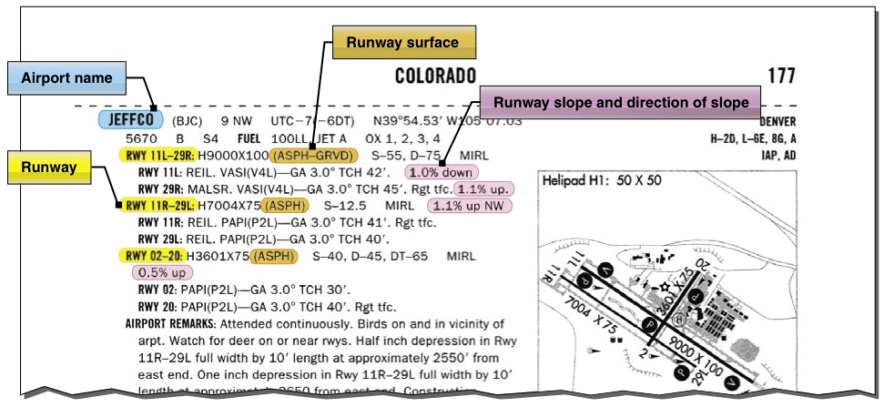
Runway Surface and Gradient
Runway slope information is contained in the A/FD.

Slide 51
Questions / Comments

Slide 52
Water on the Runway and Dynamic Hydroplaning
Water on the runways reduces the friction between the tires and the ground, and can reduce braking effectiveness.
This is also true of braking effectiveness when runways are covered in ice.

Slide 53
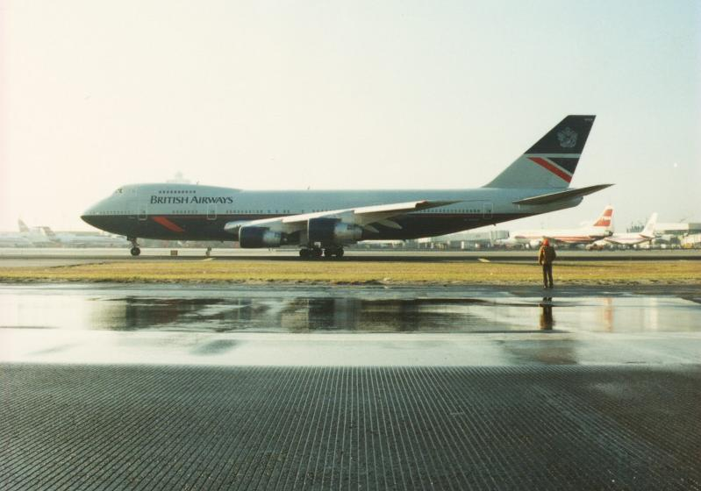

Water on the Runway and Dynamic Hydroplaning
To help minimize dynamic hydroplaning, some runways are grooved to help drain off water; most runways are not.

Slide 54
Water on the Runway and Dynamic Hydroplaning
Landing at higher than recommended touchdown speeds will expose the aircraft to a greater potential for hydroplaning.
And once hydroplaning starts, it can continue well below the minimum initial hydroplaning speed.

Slide 55

Takeoff Performance
The minimum takeoff distance is of primary interest in the operation of any aircraft.

Slide 56
Takeoff Performance
Depending on the aircraft characteristics, the lift-off speed will be anywhere from 1.05 to 1.25 times the stall speed or minimum control speed.

Slide 57
Takeoff Performance
The effect of gross weight on takeoff distance is significant and proper consideration of this item must be made in predicting the aircraft’s takeoff distance.

Slide 58
Takeoff Performance
1. Higher lift-off speed
2. Greater mass to accelerate
3. Increased retarding force (drag and ground friction)

Slide 59
Takeoff Performance
If the gross weight increases, a greater speed is necessary to produce the greater lift necessary to get the aircraft airborne.

Slide 60

Chapter Summary
The goal of every pilot is a safe flight; center of gravity and the importance to properly balance an aircraft can mean the difference between life and death.

Slide 61
Assignment
Complete Weight and Balance Worksheet on website and turn in for grade.
GS Weight and Balance Worksheet

Slide 62
Questions / Comments

