Slide 1
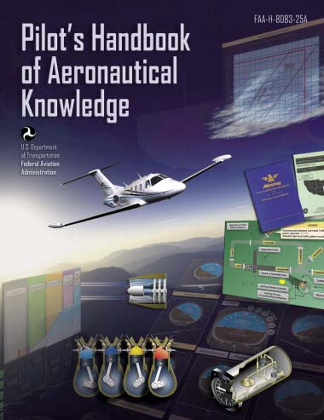
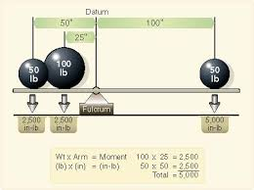
Chapter 9 – Weight and Balance
FAA – Pilot’s Handbook of Aeronautical Knowledge

Slide 2
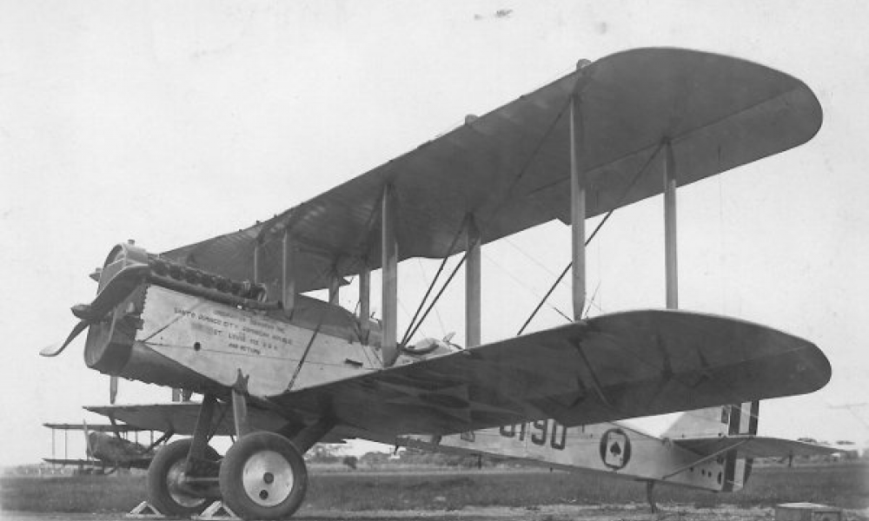
THIS DAY IN AVIATION
April 23
1921 — First Air Squadron, USMC, completes photo mosaic map of Dominican Republic coastline.

Slide 3
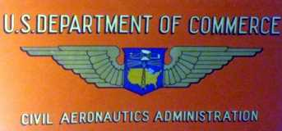
THIS DAY IN AVIATION
April 23
1939 — The United States Civil Aeronautics Authority raises the eligibility age for obtaining a private pilot license to 18 years from the previous 16 years of age.

Slide 4
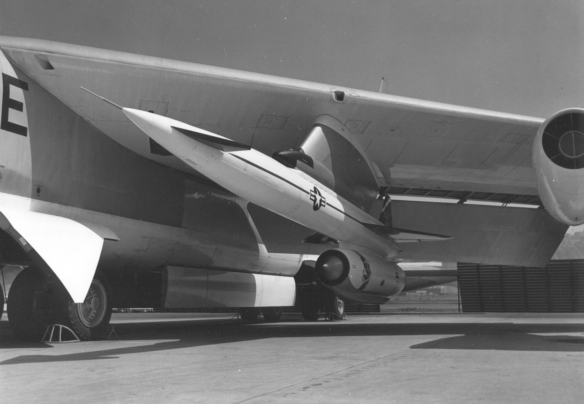
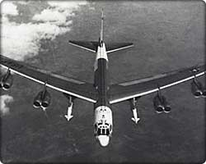
THIS DAY IN AVIATION
April 23
1959 — The North American Aviation GAM-77 “Hound Dog” strategic missile was launched for the first time from a Boeing B-52 “Stratofortress.”

Slide 5
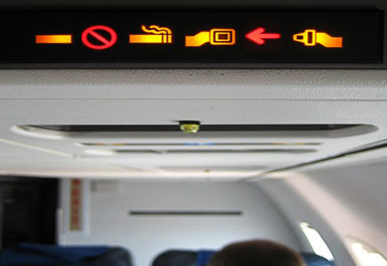
THIS DAY IN AVIATION
April 23
1988 — The United States government's ban on smoking on flights of two hours or less goes into effect.
“No Smoking” signs remain lit on 80% of domestic airline flights.
Flight attendants are to be armed with gum and candy for those in anguish.

Slide 6
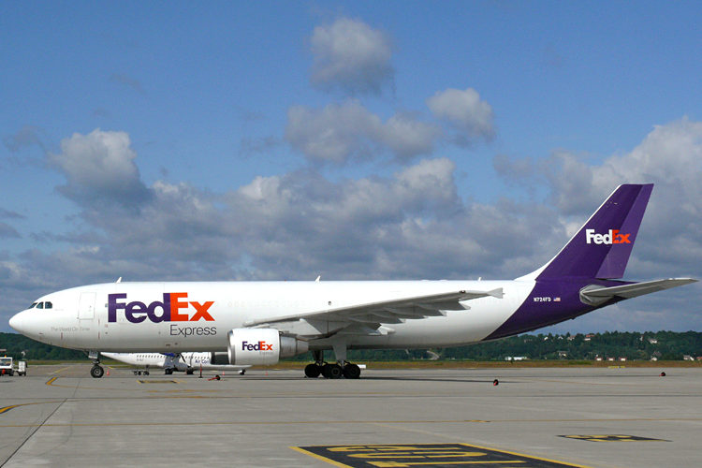
THIS DAY IN AVIATION
April 23
1994 — Airbus delivers the first of 25 Airbus A300-600F dedicated freighters to the specialized package carrier, FedEx.
This all-cargo version can carry up to a maximum payload of 120,855 lb over a range of 1,900 nautical miles.

Slide 7
Questions / Comments

Slide 8
April 2014
Sunday | Monday | Tuesday | Wednesday | Thursday | Friday | Saturday
30 | 31 Chapter 7 Gyro Systems | 1 | 2 Chapter 7 Magnetic Compass | 3 | 4 FltLine Friday Chapter 7 Test | 5 Aviation Day Lady’s Island Airport
6 | 7 | 8 Chapter 8 Flight Manuals | 9 | 10 Chapter 9 Weight & Balance | 11 | 12
13 | 14 SPRING BREAK | 15 SPRING BREAK | 16 SPRING BREAK | 17 SPRING BREAK | 18 SPRING BREAK | 19
20 | 21 Chapter 9 Weight & Balance | 22 | 23 Chapter 9 Weight & Balance Ans Sheet | 24 | 25 Chapter 10 Aircraft Performance FltLine Friday | 26 Aviation Day Hilton Head Airport
27 | 28 | 29 | 30

Slide 9
Questions / Comments

Slide 10
Chapter 9 – Weight and Balance
FAA – Pilot’s Handbook of Aeronautical Knowledge

Slide 11
Today’s Mission Requirements
Mission:
Describe the importance of weight and balance on an aircraft.
Describe what role center of gravity can have on safe flight.
EQ:
Describe the importance of Aeronautical Knowledge for the student pilot learning to fly.

Slide 12
Assignment
Complete Weight and Balance Worksheet on website and turn in for grade.
GS Weight and Balance Worksheet

Slide 13
Questions / Comments

