Slide 1
Warm-Up – 4/17 – 10 minutes
Utilizing your notes and past knowledge answer the following questions:
Name the four type of weather observations.
What are the two methods upper air observations can be made?
Describe convective SIGMETs and what action should pilots take?

Slide 2

Questions / Comments

Slide 3
Warm-Up – 4/17 – 10 minutes
Utilizing your notes and past knowledge answer the following questions:
Name the four type of weather observations.
What are the two methods upper air observations can be made?
Describe convective SIGMETs and what action should pilots take?

Slide 4
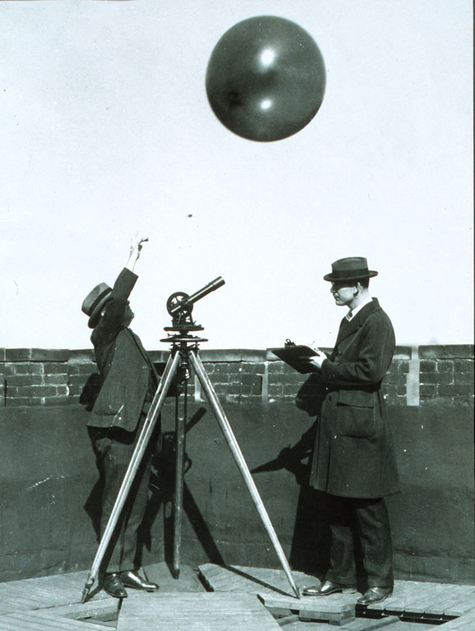
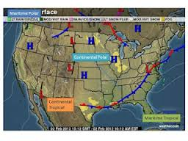
Observations
There are four types of weather observations: surface, upper air, radar, and satellite.

Slide 5
Warm-Up – 4/17 – 10 minutes
Utilizing your notes and past knowledge answer the following questions:
Name the four type of weather observations.
What are the two methods upper air observations can be made?
Describe convective SIGMETs and what action should pilots take?

Slide 6
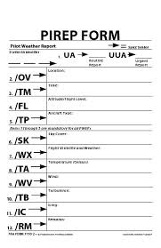
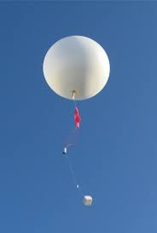
Upper Air Observations
Observations of upper air weather are more challenging than surface observations.
There are only two methods that upper air weather can be observed:
  radiosonde observations
  pilot weather reports (PIREPs).

Slide 7
Warm-Up – 4/17 – 10 minutes
Utilizing your notes and past knowledge answer the following questions:
Name the four type of weather observations.
What are the two methods upper air observations can be made?
Describe convective SIGMETs and what action should pilots take?

Slide 8
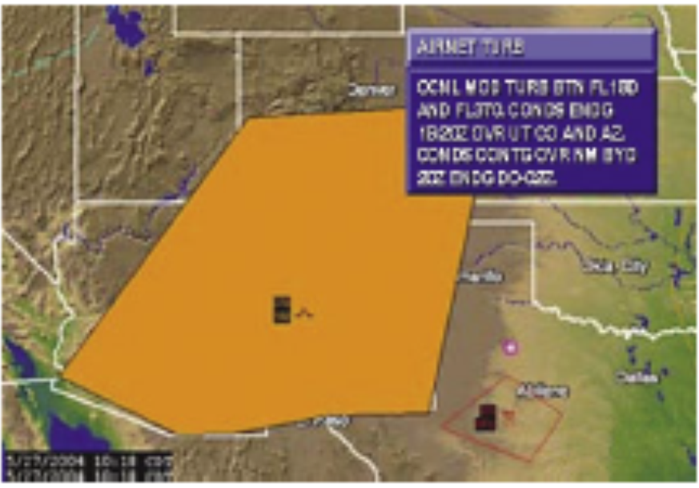
Airmen’s Meteorological Information (AIRMET)
Convective SIGMET's are issued for SEVERE WEATHER. Severe Thunderstorms, etc.
Pilot's DO NOT WANT TO FLY through areas of Convective SIGMET'S.

Slide 9
Questions / Comments

Slide 10
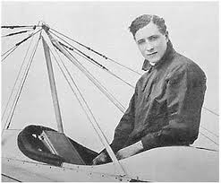
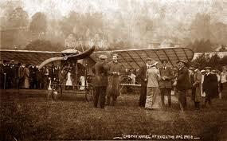
THIS DAY IN AVIATION
April 17
1913 — Briton Gustav Hamel lands after a non-stop flight of 4 hours and 18 minutes from Dover, England, to Cologne, Germany in a Blériot XI.

Slide 11
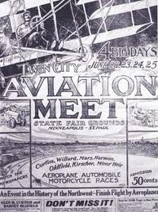
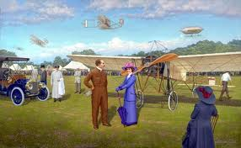
THIS DAY IN AVIATION
April 17
1921 — Aviation meet at Oklahoma City, Oklahoma.

Slide 12
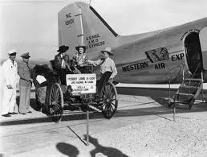

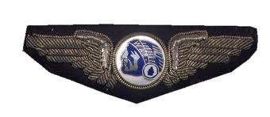
THIS DAY IN AVIATION
April 17
1926 — Western Air Express starts its service between Los Angeles and Salt Lake City.

Slide 13
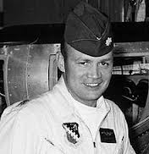
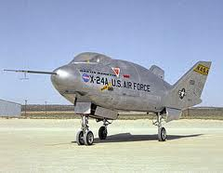
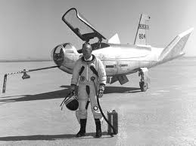
THIS DAY IN AVIATION
April 17
1969 — USAF Maj. Jerauld Gentry pilots the Martin X-24 “Lifting Body” research aircraft on its first free flight.

Slide 14
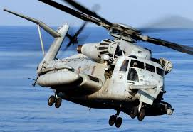
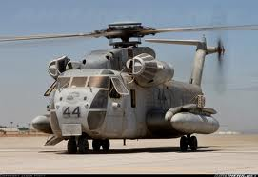
THIS DAY IN AVIATION
April 17
1970 — A Sikorsky CH-53D “Sea Stallion” helicopter flies between London and Paris to demonstrate that modern helicopters can provide reliable inter-city services.

Slide 15
Questions / Comments

Slide 16
March / April 2018
Sunday | Monday | Tuesday | Wednesday | Thursday | Friday | Saturday
25 | 26 Chapter 10 Aircraft Performance | 27 Chapter 10 Aircraft Performance | 28 Chapter 10 Aircraft Performance | 29 Chap 10 Test Flight Line Friday | 30 HOLIDAY | 31
1 EASTER | 2 Chapter 11 Weather Theory | 3 Chapter 11 Weather Theory | 4 Chapter 11 Weather Theory | 5 Chap 11 Weather Theory | 6 Flight Line Friday | 7
8 | 9 SCHOOL VACATION | 10 SCHOOL VACATION | 11 SCHOOL VACATION | 12 SCHOOL VACATION | 13 SCHOOL VACATION | 14
15 | 16 Chapter 12 Aviation Weather Services | 17 Chapter 12 Aviation Weather Services | 18 Chapter 12 Aviation Weather Services | 19 Chapter 12 Aviation Weather Services | 20 Chapter 12 Aviation Weather Services Review and Test | 21

Slide 17
2nd Quarter Requirements
(5 weeks – May 18)
All students will complete the following:
  Take notes - All in class quizzes and tests
  Private Pilot Syllabus
    Lessons 1 – 5 (Taxiing through Air Traffic Control)
    Must pass written with 80%
    Successfully complete 3 times on small sim
    Successfully complete 1 time on Main sim
  Complete ERAU Aviation 101
    3 quizzes and 1 test
  Student will receive zero points for all incomplete work – NO make-up / extra credit
NOTE: All unfinished Student Pilot and ERAU must be complete prior to starting Private Pilot and last 3 quizzes and test for ERAU.

Slide 18
Questions / Comments

Slide 19

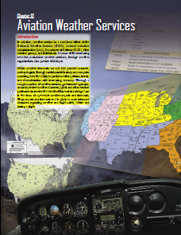
Chapter 12– Aviation Weather Services
FAA – Pilot’s Handbook of Aeronautical Knowledge

Slide 20
Today’s Mission Requirements
Mission:
Describe the combined effort associated with Aviation Weather Services.
Describe how meteorologists can predict weather patterns, trends and characteristics of weather systems.
Identify the various reports available and utilized by pilots.
Describe the basic information provided on reports that enable pilots to make informed decisions regarding weather safety before and during flight.
EQ:
  Describe the importance of Aeronautical Knowledge for the student pilot learning to fly.

Slide 21
Questions / Comments

Slide 22
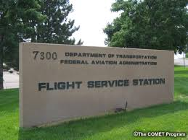
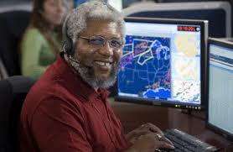
Automated Flight Service Station (AFSS)
A preflight weather briefing from an AFSS can be obtained 24 hours a day by calling 1-800-WX BRIEF from almost anywhere in the United States
The AFSS also provides inflight weather briefing services, as well as scheduled and unscheduled weather broadcasts.

Slide 23
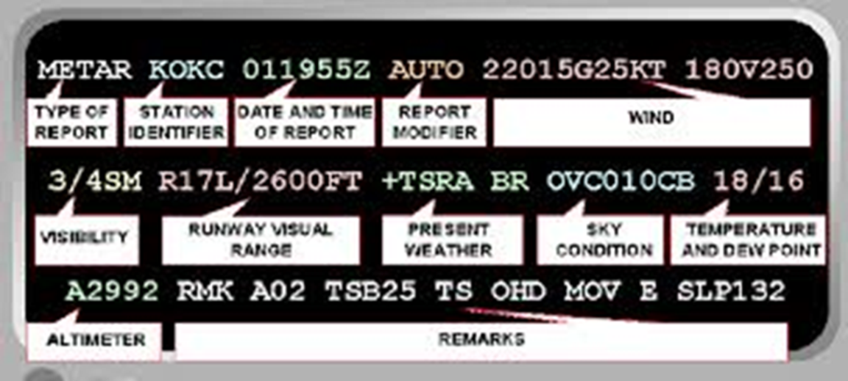
Aviation Routine Weather Report (METAR)
A METAR is an observation of current surface weather reported in a standard international format.
METARS are issued hourly unless significant weather changes have occurred.

Slide 24
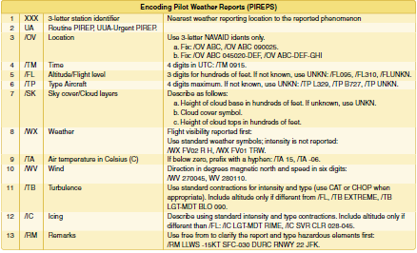
Pilot Weather Report (PIREPs)
PIREPs provide valuable information regarding the conditions as they actually exist in the air, which cannot be gathered from any other source.

Slide 25
Pilot Weather Report (PIREPs)
Pilots can confirm
  height of bases
  tops of clouds,
  locations of wind shear and turbulence
  location of inflight icing.
When unexpected weather conditions are encountered, pilots are encouraged to make a report to a FSS or ATC.

Slide 26
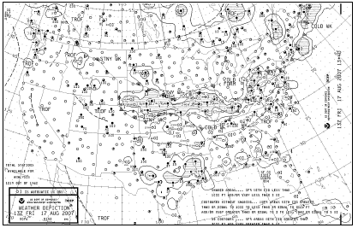
Weather Depiction Chart
A weather depiction chart details surface conditions as derived from METAR and other surface observations.

Slide 27
Weather Depiction Chart
Prepared and transmitted by computer every 3 hours beginning at 0100Z time, and is valid at the time of the plotted data.
It is designed to be used for flight planning by giving an overall picture of the weather across the United States.

Slide 28
Weather Depiction Chart
Provides a graphic display of IFR, VFR, and MVFR (marginal VFR) weather.
Areas of IFR conditions (ceilings less than 1,000 feet and visibility less than three miles) are shown by a hatched area outlined by a smooth line.

Slide 29
Weather Depiction Chart
MVFR regions (ceilings 1,000 to 3,000 feet, visibility 3 to 5 miles) are shown by a nonhatched area outlined by a smooth line.
Areas of VFR (no ceiling or ceiling greater than 3,000 feet and visibility greater than five miles) are not outlined.

Slide 30

Chapter Summary
While no weather forecast is guaranteed to be 100 percent accurate, pilots have access to a myriad of weather information on which to base flight decisions.

Slide 31
Chapter Summary
Pilots use several reports to get an overall picture and gain an understanding of the weather that will affect the safe completion of a flight.

Slide 32
Chapter Summary
Weather products available for preflight planning to en route information received over the radio or via satellite link provide the pilot with the most accurate and up-to-date information available.
Each report provides a piece of the weather puzzle.

Slide 33
Questions / Comments

Slide 34
2nd Quarter Requirements
(5 weeks – May 18)
All students will complete the following:
  Take notes - All in class quizzes and tests
  Private Pilot Syllabus
    Lessons 1 – 5 (Taxiing through Air Traffic Control)
    Must pass written with 80%
    Successfully complete 3 times on small sim
    Successfully complete 1 time on Main sim
  Complete ERAU Aviation 101
    3 quizzes and 1 test
  Student will receive zero points for all incomplete work – NO make-up / extra credit
NOTE: All unfinished Student Pilot and ERAU must be complete prior to starting Private Pilot and last 3 quizzes and test for ERAU.

