Slide 1
Management of Aeronautical Science
Module 8
Aviation Laws and Regulations and Environmental Issues

Slide 2
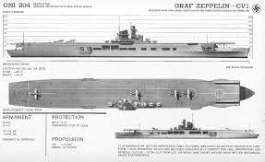
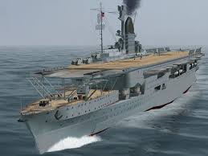
THIS DAY IN AVIATION
December 8
1938 — Germany officially launches its first aircraft carrier, the Graf Zeppelin.
It was the only aircraft carrier launched by Germany during World War II and represented part of the Kriegsmarine's attempt to create a well-balanced ocean going fleet, capable of projecting German naval power far beyond the narrow confines of the Baltic and North Seas.
Construction was ordered on 16 November 1935 and her keel was laid down on 28 December 1936 by Deutsche Werke at Kiel.
Named in honor of Graf (Count) Ferdinand von Zeppelin, the ship was launched on 8 December 1938 but was not completed and was never operational.

Slide 3
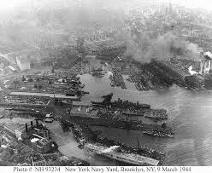
THIS DAY IN AVIATION
December 8
1940 — New York City experiences its first blackout and anti-aircraft exercise, around the Brooklyn Navy Yard.

Slide 4
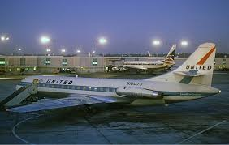
THIS DAY IN AVIATION
December 8
1964 — A United Air Lines “Caravelle” makes the first landing in the United States completely controlled by a computer (automatic touchdown).

Slide 5
Questions / Comments

Slide 6
November/December 2017
SUNDAY | MONDAY | TUESDAY | WEDNESDAY | THURSDAY | FRIDAY | SATURDAY
26 | 27 Module 8 Aviation National and International Laws and Regulations, and Environmental Issues | 28 Module 8 Aviation National and International Laws and Regulations, and Environmental Issues | 29 Module 8 Aviation National and International Laws and Regulations, and Environmental Issues | 30 Beaufort County Airport (ILT) | 1 Flightline Friday | 2
3 | 4 Module 8 Aviation National and International Laws and Regulations, and Environmental Issues | 5 Module 8 Aviation National and International Laws and Regulations, and Environmental Issues | 6 Module 8 Aviation National and International Laws and Regulations, and Environmental Issues Discussion Due | 7 Beaufort County Airport (ILT) | 8 Flightline Friday Review Questions Due Research Paper Due | 9
10 | 11 Module 9 Intro Aviation Weather Theory and Observations | 12 Module 9 Aviation Weather Theory and Observations | 13 Module 9 Aviation Weather Theory and Observations Discussion Due | 14 Module 9 Aviation Weather Theory and Observations | 15 Flightline Friday Review Questions Due FINAL EXAM DUE | 16

Slide 7
Questions / Comments

Slide 8
Readings
Refer to Readings on ERAU Website Mod 8
Title 14 Code of Federal Regulations (CFR) - Please review 14 CFR Parts:
36 and 150.
Textbook – Business and Corporate Aviation Management
Chapter 9: Putting It All Together

Slide 9
Learning Objectives – Module 8 (11/27/17 – 12/8/17) Aviation National and International Laws and Regulations, and Environmental Issues
Management of Aeronautical Science
Upon successful completion of this module, you will be able to:
Describe 14 CFR Part 13 from a management perspective.
Explain the framework of FAA Laws and Regulations that regulate the aviation industry.
Describe why the Federal Register is important to research.
Explain the impact of environmental issues and laws in the aviation industry.
Explain the framework of National Laws and Regulations that regulate air commerce.
Explain the framework of International Laws and Regulations that regulate air commerce.
Discuss the Material Safety Data Sheet (MSDS) or Safety Data Sheet.
Mon/Tues/Wed

Slide 10
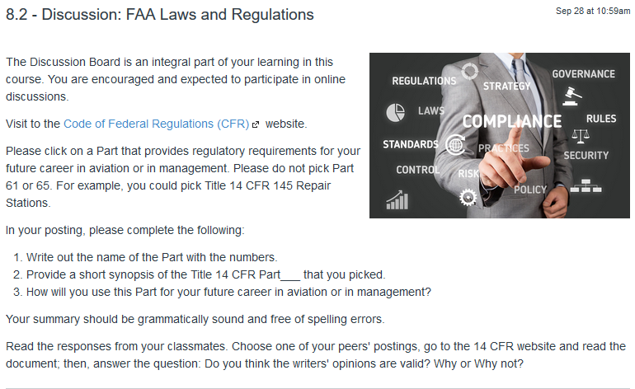
8.2 – Discussion: FAA Laws and Regulations Wed Dec 6

Slide 11
8.5 – Research Project: Report Submission Fri Dec 8
The term paper will consist of a topic related to management of an aerospace company or agency. Your textbook for the course provides excellent information on the operation of Business and Corporate Aviation. There are many subtitles in the textbook to assist you. Also, the activities, module readings, and discussions will provide concepts to consider.
Submit your paper on your approved topic in current APA format. Your Final Term Paper must be at least 12 pages and consist of the following:
A title page
Main text (10 pages)
Reference page (current APA format)
The man text titles should include
Introduction
Description of the Company or Agency (Basically what business are you in)
Operation Description
Equipment or Aircraft
Maintenance Requirements
Manager’s Roles and Responsibilities
Staff Qualifications, Certifications, and Responsibilities
Human Factors
Quality Requirements
Regulations and Laws
Safety
Security
Environmental Responsibilities
Other Management Factors Considered
References (current APA format)

Slide 12
Module 8 Review Questions (Due Fri Dec 8)
Spend quality time responding to the following questions in your own words.
Describe Title 14 CFR Part 13, Investigative and Enforcement Procedures and how it relates to management of your aviation company.
Explain the framework of FAA Laws and Regulations that regulate the aviation industry. Consider 14 CFR from a management perspective. Where can a manager look for proposed rules, request for comments, and final rules to federal laws and regulations?
Analyze the responsibilities required based on Federal Aviation Act of 1958.
Describe two aviation emission requirements that pertain to the Clean Air Act of 1970 and its amendments. What Title 14 CFR part covers emissions? Managers must be able to research the 14 CFR for specific guidance.
Describe the Material Safety Data Sheet (MSDS) or Safety Data Sheet (SDS) from a manager's perspective.

Slide 13
Assignments Due – Module 8 (11/27/17 – 12/8/17)
Management of Aeronautical Science
Review Module 8 Instructions for the following assignments:
Discussion Board Due (FAA Laws and Regs)
(Due – Wed Dec 6) – 2 part (Post and Respond)
Final Paper Due (Student Topic of Choice)
(Due – Fri Dec 8) – (Min 12 pgs – 10 pgs Body)
Review Questions – FAA Laws and Regulations
(Due – Fri Dec 8) – 5 Questions

Slide 14
Questions / Comments

