Slide 1
MGMT 203 Aeronautical Science, Aviation Professionalism, Careers, and Certification
Module 1

Slide 2
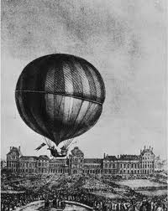
THIS DAY IN AVIATION
August 29
1879 — In Ontario, Nellie Thurston becomes the first Canadian woman to fly in a balloon.

Slide 3
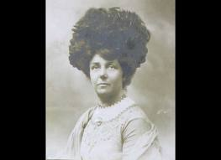
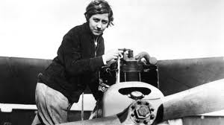
THIS DAY IN AVIATION
August 29
1911 — Mrs. A. Hewlett is the first British woman to gain a pilot's license.

Slide 4
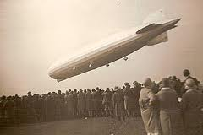
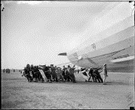
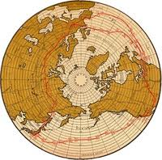
THIS DAY IN AVIATION
August 29
1929 — “Graf Zeppelin” lands at Lakehurst, New Jersey, completing round-the-world flight, begun on 8 August.
The distance flown was 20,000 miles in 21 days 7 hours.
The actual flying time was 263 hours 43 minutes.

Slide 5
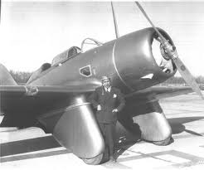
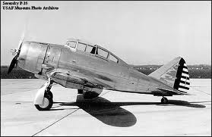
THIS DAY IN AVIATION
August 29
1938 — Flying from New York to Los Angeles, Major Alexander de Seversky makes an east-west transcontinental speed record flight of 10 hours 3 minutes.
The aircraft flown was a Seversky “Pursuit” powered by a Pratt & Whitney “ Twin Wasp” engine.

Slide 6
Questions / Comments

Slide 7
MGMT 203 Aeronautical Science, Aviation Professionalism, Careers, and Certification
Module 1

Slide 8
Learning Objectives – Module 1 (8/21/17 – 9/1/17) Aerodynamics from a Management Standpoint
Management of Aeronautical Science
Upon successful completion of this module, you will be able to:
Explain the qualifications, attributes, ethics, and responsibilities of aviation professionals.
Analyze the financial and educational requirements of aviation careers.
Describe the qualifications, privileges, and limitations of all classes of certification to include pilot, maintenance, avionics, dispatch, and air traffic control.
Research 14 CFR for specific requirements for a career in aviation management.
Explain the dynamics associated with an aviation career and the future availability of employment in the aviation industry.

Slide 9
Learning Objectives – Module 1 (8/21/17 – 9/1/17) Aerodynamics from a Management Standpoint
Management of Aeronautical Science
Upon successful completion of this module, you will be able to:
Research your current or future management position in an aviation career field.
Describe the functions of management in an aviation management career field.
Describe the differences between the three categories of civil aviation operations.
Describe conditions or constraints that reduce aircraft utilization factors (time available for flying).
Analyze the benefits of on-demand business aviation as compared to scheduled airline transportation.

Slide 10
Readings
The Pilot’s Handbook of Aeronautical Knowledge provides a basic overview of aeronautical management.
Chapter 1 - Introduction to Flying (pages 1-13 to 1-20)
Title 14 Code of Federal Regulations (CFR) - federal regulations to gain more information about your future career.
Please review 14 CFR Parts:
21, 61, 63, 65, 119, 121, 135, 145, and 147.

Slide 11
Readings
The textbook will provide you with an excellent knowledge base for managing an aerospace company.
The book has many excellent management tips for you to consider for your aviation management career.
You will learn about setting the stage for on-demand air transportation, justifying your business, aircraft characteristics, determining the transportation needs, and air transportation analysis.
Please pay attention to the management areas because you will have a term paper assignment on managing a company or agency that will be due for module 8.
Chapter 1: Setting the Scene
Chapter 2: Determining the Need

Slide 12
Discussion
Locate a website that supports your future aviation management career.
Write a summary describing how the website provided you with a game plan to obtain your management position.
Your post should be a minimum of 300 words with at least, two sources cited.
Respond to at least one of your classmates.
Your responses to classmates should be at least 100 words

Slide 13
Term Paper Topics
Your Final Term Paper must be at least 12 pages and consist of the following:
A title page
Main text (10 pages)
Reference page (current APA format)
The paper should include some of the headings below as appropriate:
Introduction
Description of the Company or Agency (Basically what business are you in)
Operation Description
Equipment or Aircraft
Maintenance Requirements
Manager’s Roles and Responsibilities
Staff Qualifications, Certifications, and Responsibilities
Human Factors
Quality Requirements
Regulations and Laws
Safety
Security
Environmental Responsibilities
Other Management Factors Considered
References (current APA format)
Aircraft Manufacturing Management
- Chris Corbett
Fire and Crash Rescue Management
- Trent Thompson
Helicopter Operations Management
- Casey Bradford

Slide 14
Module 1 Review Questions
Spend quality time responding to the following questions in your own words.
1. What are the qualifications, certifications, and responsibilities of a commercial pilot?
2. What are the qualifications, certifications, and responsibilities of an Airframe and Powerplant mechanic?
3. What are the qualifications, certifications, and responsibilities of an Air Traffic Controller?
4. Describe conditions or constraints that reduce aircraft utilization factors (time available for flying).
5. Analyze the benefits of on-demand business aviation as compared to scheduled airline transportation.

Slide 15
Assignments Due – Module 1 (8/22/17 – 9/1/17)
Management of Aeronautical Science
Review Module 1 Instructions for the following assignments:
Discussion Board Due (Aviation Manager)
(Due - Wed Aug 30) – 2 part (Post and Respond)
Review Questions – Aviation Professionalism, Careers, and Certification
(Due - Fri Sep 1) – 5 Questions

Slide 16
August / September 2017
Sunday | Monday | Tuesday | Wednesday | Thursday | Friday | Saturday
6 | 7 | 8 | 9 | 10 | 11 | 12
13 | 14 | 15 | 16 | 17 Welcome Back Course Introduction | 18 Flightline Friday | 19
20 | 21 HOLIDAY | 22 Module 1 Aviation Professionalism. Careers | 23 Module 1 Aviation Professionalism. Careers | 24 Module 1 Aviation Professionalism. Careers | 25 Flightline Friday | 26
27 | 28 Module 1 Aviation Professionalism. Careers | 29 Module 1 Aviation Professionalism. Careers | 30 Module 1 Aviation Professionalism. Careers Discussion Due | 31 Module 1 Aviation Professionalism. Careers | 1 Review Questions Due | 2

Slide 17
Questions / Comments

