Slide 1
MGMT 203 Aeronautical Science, Aviation Professionalism, Careers, and Certification
Module 1

Slide 2
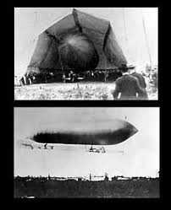
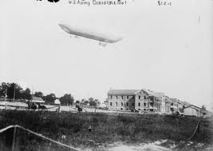
THIS DAY IN AVIATION
August 28
1908 — The United States Army accepts its first dirigible.
It is 96 feet long, with a 20-hp Curtiss engine.

Slide 3
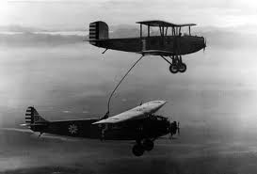
THIS DAY IN AVIATION
August 28
1923 — A New World refueled flight duration record of 37 hours 15 minutes 4.8 seconds set.

Slide 4
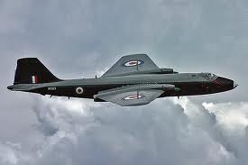
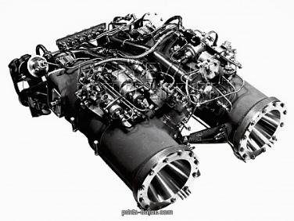
THIS DAY IN AVIATION
August 28
1957 — A record altitude for manned aircraft is achieved by the RAF Canberra serial no. WK 163 piloted by chief test pilot M. Randrup.
He flies the aircraft to 70,310 ft. with the aid of a Double Scorpion rocket motor.

Slide 5
Questions / Comments

Slide 6
MGMT 203 Aeronautical Science, Aviation Professionalism, Careers, and Certification
Module 1

Slide 7
Learning Objectives – Module 1 (8/21/17 – 9/1/17) Aerodynamics from a Management Standpoint
Management of Aeronautical Science
Upon successful completion of this module, you will be able to:
Explain the qualifications, attributes, ethics, and responsibilities of aviation professionals. (LO 1)
Analyze the financial and educational requirements of aviation careers. (LO 1)
Describe the qualifications, privileges, and limitations of all classes of certification to include pilot, maintenance, avionics, dispatch, and air traffic control. (LO 2)
Research 14 CFR for specific requirements for a career in aviation management. (LO 1)
Explain the dynamics associated with an aviation career and the future availability of employment in the aviation industry. (LO 1)

Slide 8
Learning Objectives – Module 1 (8/21/17 – 9/1/17) Aerodynamics from a Management Standpoint
Management of Aeronautical Science
Upon successful completion of this module, you will be able to:
Research your current or future management position in an aviation career field. (LO 1 and LO 2)
Describe the functions of management in an aviation management career field. (LO 2)
Describe the differences between the three categories of civil aviation operations. (LO 2)
Describe conditions or constraints that reduce aircraft utilization factors (time available for flying). (LO 2)
Analyze the benefits of on-demand business aviation as compared to scheduled airline transportation. (LO 2)

Slide 9
Readings
The Pilot’s Handbook of Aeronautical Knowledge provides a basic overview of aeronautical management.
Chapter 1 - Introduction to Flying (pages 1-13 to 1-20)
Title 14 Code of Federal Regulations (CFR) - federal regulations to gain more information about your future career.
Please review 14 CFR Parts:
21, 61, 63, 65, 119, 121, 135, 145, and 147.

Slide 10
Readings
The textbook will provide you with an excellent knowledge base for managing an aerospace company.
The book has many excellent management tips for you to consider for your aviation management career.
You will learn about setting the stage for on-demand air transportation, justifying your business, aircraft characteristics, determining the transportation needs, and air transportation analysis.
Please pay attention to the management areas because you will have a term paper assignment on managing a company or agency that will be due for module 8.
Chapter 1: Setting the Scene
Chapter 2: Determining the Need

Slide 11
Discussion
Locate a website that supports your future aviation management career.
Write a summary describing how the website provided you with a game plan to obtain your management position.
Your post should be a minimum of 300 words with at least, two sources cited.
Respond to at least one of your classmates.
Your responses to classmates should be at least 100 words

Slide 12
Term Paper Topics
Aero Club Management
Air Freight or Air Cargo Management
Air Taxi Operator Management
Air Traffic Control Management
Aircraft Manufacturing Management
Airline Management
Airport Management
Corporate Aviation Management
Dispatcher Operations Management
Fire and Crash Rescue Management
Fixed Base Operator Management
Flight Attendants Management
Flight Management and Scheduling Management
Flight School Management
Ground Handling Service Management
Helicopter Operations Management
Maintenance (in house) Management
Maintenance Outsource) Management
Maintenance School Management
Military Aviation Management (specify department)
Passenger Service Management
Quality Management
Repair Station (Part 145) Management
Safety Management
Security Management
Weather Station Management
Submit your topic choice: Sept 15
Your Final Term Paper must be at least 12 pages and consist of the following:
A title page
Main text (10 pages)
Reference page (current APA format)
The paper should include some of the headings below as appropriate:
Introduction
Description of the Company or Agency (Basically what business are you in)
Operation Description
Equipment or Aircraft
Maintenance Requirements
Manager’s Roles and Responsibilities
Staff Qualifications, Certifications, and Responsibilities
Human Factors
Quality Requirements
Regulations and Laws
Safety
Security
Environmental Responsibilities
Other Management Factors Considered
References (current APA format)

Slide 13
Module 1 Review Questions
Spend quality time responding to the following questions in your own words.
1. What are the qualifications, certifications, and responsibilities of a commercial pilot?
2. What are the qualifications, certifications, and responsibilities of an Airframe and Powerplant mechanic?
3. What are the qualifications, certifications, and responsibilities of an Air Traffic Controller?
4. Describe conditions or constraints that reduce aircraft utilization factors (time available for flying).
5. Analyze the benefits of on-demand business aviation as compared to scheduled airline transportation.

Slide 14
Assignments Due – Module 1 (8/22/17 – 9/1/17)
Management of Aeronautical Science
Review Module 1 Instructions for the following assignments:
Discussion Board Due (Aviation Manager)
(Due - Wed Aug 30) – 2 part (Post and Respond)
Review Questions – Aviation Professionalism, Careers, and Certification
(Due - Fri Sep 1) – 5 Questions

Slide 15
August / September 2017
Sunday | Monday | Tuesday | Wednesday | Thursday | Friday | Saturday
6 | 7 | 8 | 9 | 10 | 11 | 12
13 | 14 | 15 | 16 | 17 Welcome Back Course Introduction | 18 Flightline Friday | 19
20 | 21 HOLIDAY | 22 Module 1 Aviation Professionalism. Careers | 23 Module 1 Aviation Professionalism. Careers | 24 Module 1 Aviation Professionalism. Careers | 25 Flightline Friday | 26
27 | 28 Module 1 Aviation Professionalism. Careers | 29 Module 1 Aviation Professionalism. Careers | 30 Module 1 Aviation Professionalism. Careers Discussion Due | 31 Module 1 Aviation Professionalism. Careers | 1 Review Questions Due | 2

Slide 16
Questions / Comments

