Slide 1
MGMT 203 Aeronautical Science, Aviation Professionalism, Careers, and Certification
Module 1

Slide 2
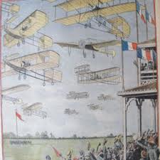
THIS DAY IN AVIATION
August 22
1909 — The first great aviation meeting in Bétheny, France, opens as 23 European airplanes make 87 flights during one week.
The meeting will have a strong influence on the technical and military aspects of flight.

Slide 3
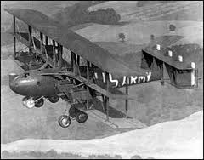
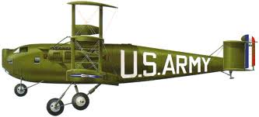
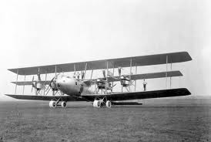
THIS DAY IN AVIATION
August 22
1923 — The Barling bomber made its initial flight.

Slide 4
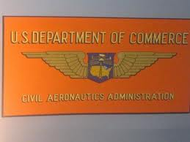
THIS DAY IN AVIATION
August 22
1938 — The Civil Aeronautics Act becomes effective in the United States, coordinating all non-military aviation under the Civil Aeronautics Authority.

Slide 5
Questions / Comments

Slide 6
MGMT 203 Aeronautical Science, Aviation Professionalism, Careers, and Certification
Module 1

Slide 7
Learning Objectives – Module 1 (8/21/17 – 9/1/17) Aerodynamics from a Management Standpoint
Management of Aeronautical Science
Upon successful completion of this module, you will be able to:
Explain the qualifications, attributes, ethics, and responsibilities of aviation professionals. (LO 1)
Analyze the financial and educational requirements of aviation careers. (LO 1)
Describe the qualifications, privileges, and limitations of all classes of certification to include pilot, maintenance, avionics, dispatch, and air traffic control. (LO 2)
Research 14 CFR for specific requirements for a career in aviation management. (LO 1)
Explain the dynamics associated with an aviation career and the future availability of employment in the aviation industry. (LO 1)

Slide 8
Learning Objectives – Module 1 (8/21/17 – 9/1/17) Aerodynamics from a Management Standpoint
Management of Aeronautical Science
Upon successful completion of this module, you will be able to:
Research your current or future management position in an aviation career field. (LO 1 and LO 2)
Describe the functions of management in an aviation management career field. (LO 2)
Describe the differences between the three categories of civil aviation operations. (LO 2)
Describe conditions or constraints that reduce aircraft utilization factors (time available for flying). (LO 2)
Analyze the benefits of on-demand business aviation as compared to scheduled airline transportation. (LO 2)

Slide 9
Readings
The Pilot’s Handbook of Aeronautical Knowledge provides a basic overview of aeronautical management.
Chapter 1 - Introduction to Flying (pages 1-13 to 1-20)
Title 14 Code of Federal Regulations (CFR) - federal regulations to gain more information about your future career.
Please review 14 CFR Parts:
21, 61, 63, 65, 119, 121, 135, 145, and 147.

Slide 10
Term Paper Topics
The term paper will consist of a topic related to the management of an aerospace company or agency.
Each student should write about a different topic within the field of management of an aerospace company or agency, which will be chosen on a first-come, first-serve basis.
On your own, determine that sufficient reference material is available before your final selection of a paper topic.
Please pick a topic that sparks your interest.

Slide 11
Term Paper Topics
Aero Club Management
Air Freight or Air Cargo Management
Air Taxi Operator Management
Air Traffic Control Management
Aircraft Manufacturing Management
Airline Management
Airport Management
Corporate Aviation Management
Dispatcher Operations Management
Fire and Crash Rescue Management
Fixed Base Operator Management
Flight Attendants Management
Flight Management and Scheduling Management
Flight School Management
Ground Handling Service Management
Helicopter Operations Management
Maintenance (in house) Management
Maintenance Outsource) Management
Maintenance School Management
Military Aviation Management (specify department)
Passenger Service Management
Quality Management
Repair Station (Part 145) Management
Safety Management
Security Management
Weather Station Management
Submit your topic choice: Sept 15
Your Final Term Paper must be at least 12 pages and consist of the following:
A title page
Main text (10 pages)
Reference page (current APA format)
The paper should include some of the headings below as appropriate:
Introduction
Description of the Company or Agency (Basically what business are you in)
Operation Description
Equipment or Aircraft
Maintenance Requirements
Manager’s Roles and Responsibilities
Staff Qualifications, Certifications, and Responsibilities
Human Factors
Quality Requirements
Regulations and Laws
Safety
Security
Environmental Responsibilities
Other Management Factors Considered
References (current APA format)

Slide 12
Module 1 Review Questions
Spend quality time responding to the following questions in your own words.
1. What are the qualifications, certifications, and responsibilities of a commercial pilot?
2. What are the qualifications, certifications, and responsibilities of an Airframe and Powerplant mechanic?
3. What are the qualifications, certifications, and responsibilities of an Air Traffic Controller?
4. Describe conditions or constraints that reduce aircraft utilization factors (time available for flying).
5. Analyze the benefits of on-demand business aviation as compared to scheduled airline transportation.

Slide 13
Assignments Due – Module 1 (8/22/17 – 9/1/17)
Management of Aeronautical Science
Review Module 1 Instructions for the following assignments:
Discussion Board Due (Aviation Manager)
(Due - Wed Aug 30) – 2 part (Post and Respond)
Review Questions – Aviation Professionalism, Careers, and Certification
(Due - Fri Sep 1) – 5 Questions

Slide 14
August / September 2017
Sunday | Monday | Tuesday | Wednesday | Thursday | Friday | Saturday
6 | 7 | 8 | 9 | 10 | 11 | 12
13 | 14 | 15 | 16 | 17 Welcome Back Course Introduction | 18 Flightline Friday | 19
20 | 21 HOLIDAY | 22 Module 1 Aviation Professionalism. Careers | 23 Module 1 Aviation Professionalism. Careers | 24 Module 1 Aviation Professionalism. Careers | 25 Flightline Friday | 26
27 | 28 Module 1 Aviation Professionalism. Careers | 29 Module 1 Aviation Professionalism. Careers | 30 Module 1 Aviation Professionalism. Careers Discussion Due | 31 Module 1 Aviation Professionalism. Careers | 1 Review Questions Due | 2

Slide 15
Questions / Comments

Slide 16
MGMT 203 Aeronautical Science, Aviation Professionalism, Careers, and Certification
Module 1

Slide 17
Aviation Careers
There are many occupations to pick from in the aviation career path.
Advancement into management positions is very possible depending upon your qualifications, drive, and education.
Your ERAU degree is a step in the right direction.
Planning your career path requires research into your specific field of interest; exploring qualifications, certifications, regulatory requirements, responsibilities, financial requirements, and educational requirements.

Slide 18
Aviation Careers
To prepare you for your aviation career, you will have to research different websites.
Managers spend time researching regulations, laws, and policies and procedures to determine what course of action must be taken.
What am I legally required to do?
What am I authorized to do by company or agency policies?
What are my duties and responsibilities?
Where can I obtain help?

Slide 19
Code of Federal Regulations
Title 14 Code of Federal Regulations (CFR) http://www.ecfr.gov/cgi-bin/text-idx?tpl=/ecfrbrowse/Title14/14tab_02.tpl
Most managers in the field make to reference to the acronym FAR.
Federal Aviation Regulations (FAR)
In this course, we will make reference to Title # CFR Part # as # CFR Part #
Example: 14 CFR Part #
The FAA website provides useful documents (airworthiness directives, regulations, handbooks, advisory circulars, etc.)
http://www.faa.gov/

Slide 20
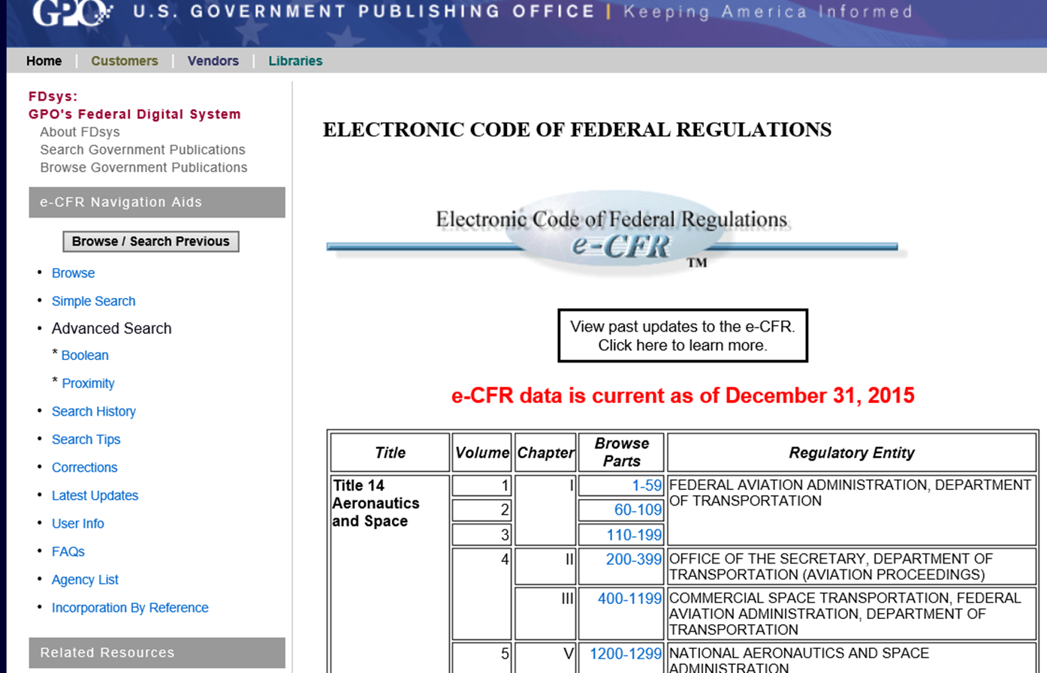
CFR Web site

Slide 21
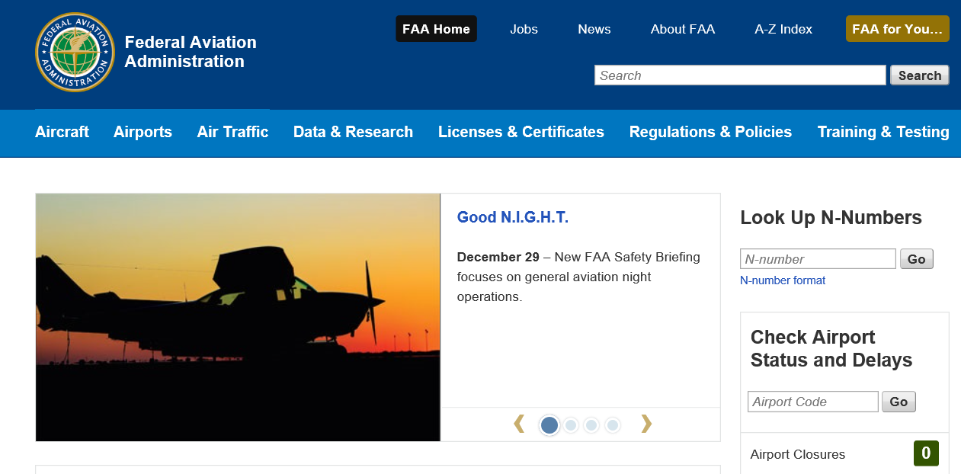
FAA.Gov website

Slide 22
Types of Aviation Careers

Slide 23
Pilot Certifications
14 CFR Part 61 Certification: Pilots, Flight Instructors, and Ground Instructors
Private Pilot
Flies for pleasure or personal business without accepting compensation (specific circumstances apply).
Commercial Pilot
Compensated for flying.
Higher standards than private pilot.
Airline Transport Pilot (ATP)
Highest level of standards.
Required for pilots flying passengers or cargo under 14 CFR Part 121 and some 14 CFR Part 135 operations.
Scheduled airline operations.

Slide 24
Pilot Certificates and Ratings
Private Pilot Certificate (Single-Engine and Multi-Engine).
Instrument Rating (Single-Engine and Multi-Engine).
Commercial Pilot Certificate (Single-Engine and Multi-Engine).
Flight Instructor (Single Engine and Multi-Engine; Instrument).
Also included are fixed wing versus rotary wing, and other forms.

Slide 25
Flight Crewmembers Other Than Pilots
14 CFR Part 63 Certification: Flight Crewmembers Other Than Pilots.
Flight Engineers
Flight Navigators

Slide 26
Flight Attendants
Requirements are stated in 14 CFR Part 121 and 14 CFR Part 135.
Duties, responsibilities, training, and specific conditions.
Flight Attendant Certificate of Demonstrated Proficiency.
Vision 100-Century of Aviation Reauthorization Act 2003.
After December 11, 2004, all flight attendants in the cabin of an aircraft that has 20 or more seats and operates under 14 CFR Part 121 or Part 135 (FAR.gov).

Slide 27
Airmen Other Than Flight Crew Members
14 CFR Part 65 Certification: Airmen Other Than Flight Crew Members.
Air traffic control tower operators
Mechanics or technicians
Repairmen
Aircraft dispatchers
Parachute riggers

Slide 28
Air Traffic Controllers
14 CFR Part 65 Certification.
Employed by the Federal Aviation Administration (FAA).
Coordinate the movement of air traffic.
Verify aircraft stay a safe distance apart.
Minimize delays.
Regulate airport traffic through designated airspaces.
Air route traffic control center (ARTCC) – Center Controllers.
Regulate airport arrivals and departures.
Terminal controllers.
Airport tower controllers.
Flight service stations.

Slide 29
Questions / Comments

Slide 30
Module 1 Review Questions
Spend quality time responding to the following questions in your own words.
1. What are the qualifications, certifications, and responsibilities of a commercial pilot?
2. What are the qualifications, certifications, and responsibilities of an Airframe and Powerplant mechanic?
3. What are the qualifications, certifications, and responsibilities of an Air Traffic Controller?
4. Describe conditions or constraints that reduce aircraft utilization factors (time available for flying).
5. Analyze the benefits of on-demand business aviation as compared to scheduled airline transportation.

Slide 31
Assignments Due – Module 1 (8/22/17 – 9/1/17)
Management of Aeronautical Science
Review Module 1 Instructions for the following assignments:
Discussion Board Due (Aviation Manager)
(Due - Wed Aug 30) – 2 part (Post and Respond)
Review Questions – Aviation Professionalism, Careers, and Certification
(Due - Fri Sep 1) – 5 Questions

