Slide 1
MGMT 203 Aviation Weather Theory and Observations
Module 9

Slide 2
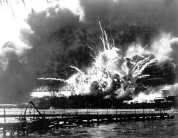
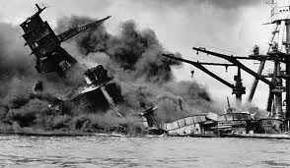
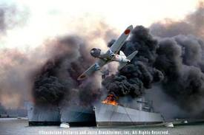
THIS DAY IN AVIATION
December 7
1941 — Japanese surprise attack on Pearl Harbor, Hawaii.
United States enters World War II.

Slide 3
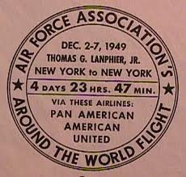
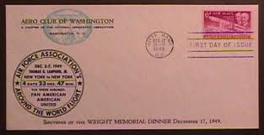
THIS DAY IN AVIATION
December 7
1949 — Thomas G. Lanphier sets round-the-world commercial transport record, flying from LaGuardia field eastward and returns in 119 hours 47 minutes ... 3 minutes less than the scheduled time.

Slide 4
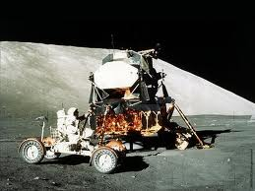
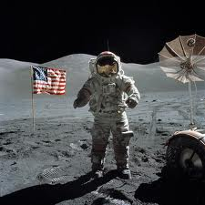
THIS DAY IN AVIATION
December 7
1972 — All USAF crew in Apollo 17 makes the final landing on the moon.

Slide 5
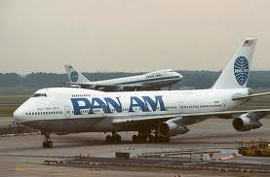
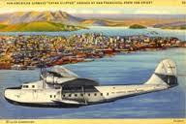
THIS DAY IN AVIATION
December 7
1980 — Pan Am's Boeing 747 China Clipper arrives in Peking from New York via Tokyo to complete the first official flight between China and USA since shortly before 1949

Slide 6
Questions / Comments

Slide 7
Learning Objectives – Module 9 (12/5/16 – 12/16/16) Aviation Weather Theory and Observations
Management of Aeronautical Science
Upon successful completion of this module, you will be able to:
State the four atmospheric layers and describe in what layer weather occurs.
Describe the atmospheric pressure measures and the standard atmosphere at sea level.
Explain how wind is caused and how wind direction is identified at an airport.
Describe atmospheric pressure, and determine the effects of pressure on altitude and on flight.
Explain wind shear and microbursts and associated problems.
Describe precipitation, the four types, and the problems associated with precipitation.
Explain where you may find weather information from at least three federal government agencies.
Explain the difference between weather reports and weather forecasts.
Describe the three types of weather briefings (standard, abbreviated, and outlook) and what type of information is provided by each one.
Describe Surface Aviation Weather Observations especially METAR reports.
Clarify the different air mass circulations that create four types of fronts and describe the flight hazards associated with each type of front.
Describe the three types of weather briefings (standard, abbreviated, and outlook).
Describe the four types of weather observations and the information provided by each observation type.
Evaluate the responsibilities of passengers on aircraft delays.
Mon/Tues/Wed

Slide 8
Questions / Comments

Slide 9
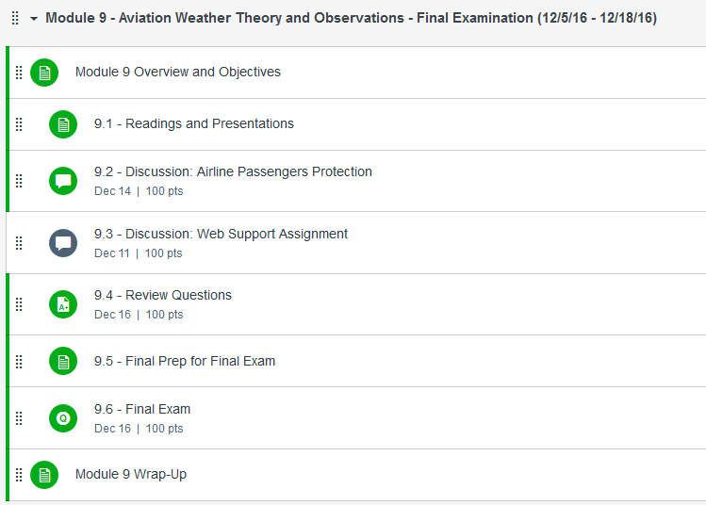

Slide 10
November/December 2016
SUNDAY | MONDAY | TUESDAY | WEDNESDAY | THURSDAY | FRIDAY | SATURDAY
27 | 28 Module 8 Aviation National and International Laws and Regulations, and Environmental Issues | 29 Module 8 Aviation National and International Laws and Regulations, and Environmental Issues | 30 Module 8 Aviation National and International Laws and Regulations, and Environmental Issues Discussion Due | 1 Beaufort County Airport (ILT) | 2 Flightline Friday Review Questions Due Research Paper Due | 3
4 | 5 Module 9 Intro Aviation Weather Theory and Observations | 6 Module 9 Aviation Weather Theory and Observations | 7 Module 9 Aviation Weather Theory and Observations | 8 Beaufort County Airport (ILT) | 9 Flightline Friday | 10
11 | 12 Module 9 Aviation Weather Theory and Observations | 13 Module 9 Aviation Weather Theory and Observations | 14 Module 9 Aviation Weather Theory and Observations Discussion Due | 15 Module 9 Aviation Weather Theory and Observations | 16 Flightline Friday Review Questions Due FINAL EXAM DUE | 17

Slide 11
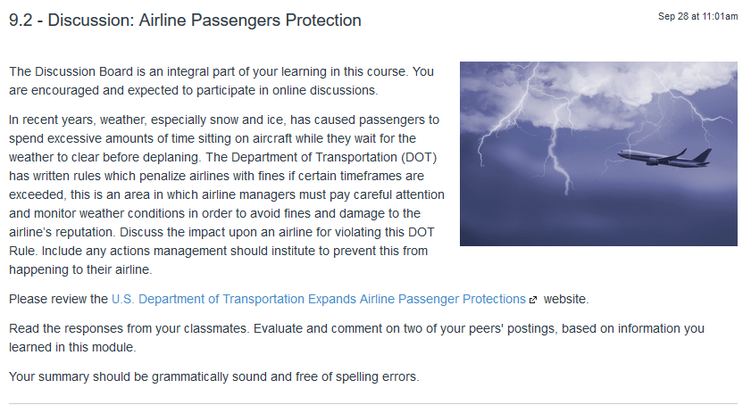
9.2 – Discussion: Airline Passengers Protection Wed Dec 14

Slide 12
9.6 – Final Exam Fri Dec 16 – available Dec 5
This Final Exam consists of 10 questions which cover all the topics you have explored throughout the course.
The final is open-book/open-note, and is comprised of essay questions.
Time limit: There is a two-hour time limit and at the end of the two hours, the exam will close and be automatically submitted for grading. You will get a notification pop-up approximately 10 seconds before time expires. If you leave the exam for any reason, the timer will continue, and the exam will automatically submit when time is up. If you lose your Internet connection, you may reconnect and return to the exam where you left off as long as time has not expired. If you encounter technical difficulties, please contact your instructor.

Slide 13
Module 9 Review Questions (Due Fri Dec 16)
Spend quality time responding to the following questions in your own words.
Describe atmospheric pressure, its measures, and the standard atmosphere at sea level.
Explain the difference between weather reports and weather forecasts. Please provide a few examples.
Describe precipitation, the four types, and the problems associated with precipitation.
Describe Surface Aviation Weather Observations especially a METAR Report.
Describe the three types of weather briefings (standard, abbreviated, and outlook).

Slide 14
Assignments Due – Module 9 (12/5/16 – 12/16/16)
Management of Aeronautical Science
Review Module 9 Instructions for the following assignments:
Discussion Board Due (Airline Passengers Protection)
(Due – Wed Dec 14) – 2 part (Post and Respond)
Review Questions – Aviation Weather Theory and Observations
(Due – Fri Dec 16) – 5 Questions
Final Exam Due (10 question - Essay)
(Due – Fri Dec 16) – available from Dec 5

Slide 15
Questions / Comments

Slide 16
Weather
Condition of the earth’s atmosphere at a specific point in time.
Many different variables.
Weather hazards can cause delays, change aircraft operations; delaying or cancel flights, causing flight diversions, and evacuation of aircraft at airports.
Whether we can fly or not

Slide 17
Atmosphere
Layered and surrounds the earth
Layers
Thermosphere
High energy rays from the sun are absorbed
Hottest layer
Mesosphere (160K to 280K)
Most meteorites burn up here
Stratosphere (Ozone Layer) (20K to 160K feet)
Contain 19% of the atmosphere’s gases
Troposphere (Sea level to 20K feet)
Weather occurs here

Slide 18
Atmospheric Pressure
Weight of the air
Determined by altitude, temperature, and density
Measured in inches of mercury (Barometer)
Atmospheric Pressure on Standard Day
29.92” Hg (1013.3 millibars)
14.7 psi
Plus (+) 59 degrees Fahrenheit or + 15 degrees Celsius

Slide 19
Temperature
Temperature is the measure of heat energy
Higher heat results in increased molecular movement.
Hot air expands or rises
Results in less density or less pressure
Lower heat results in decreased molecular movement.
Cold contraction or sinks
Results in more density or higher pressure
Temperature scales are Fahrenheit or Celsius

Slide 20
Temperature
Atmospheric Pressure Temperature
Standard Temperature is 15 Celsius (59 Fahrenheit).

Slide 21
Altitude
Indicated Altitude
Read on altimeter when set to current local altimeter setting.
Absolute altitude
Height above the surface.
True altitude
True height above Mean Sea Level (MSL).
Pressure altitude
Altitude indicated when altimeter setting dial is at 29.92.
Density altitude
Pressure altitude corrected for non-standard temperature and/or pressure.

Slide 22
Turbulence
Caused by wind conditions and thunderstorms.
Wake of aircraft taking off.
Also caused by facilities, obstructions, and mountains.
Improved airborne real-time turbulence sensing systems.
National Weather Service (NWS) develops and provides turbulence forecasts.

Slide 23
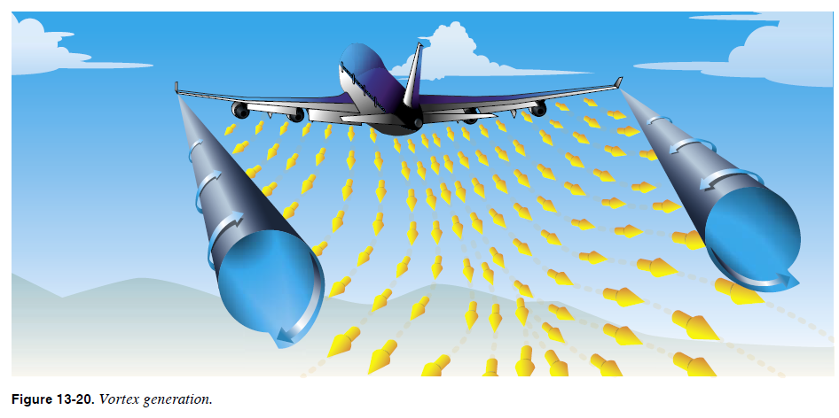
Turbulence
Cause drag – Winglets reduce drag and improve fuel economy
FAA. (2008). FAA-H-8083-25 Pilot's Handbook of Aeronautical Knowledge. p. 13-16

Slide 24
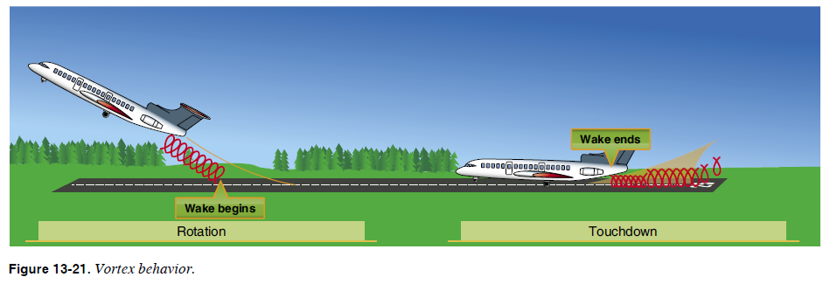
Turbulence
FAA. (2008). FAA-H-8083-25 Pilot's Handbook of Aeronautical Knowledge. p. 13-17

Slide 25
Wind
Wind is caused by earth’s surface being heated unevenly.
Air moves from high pressure to low pressure areas.
Wind direction can be identified by observing a Wind Sock, Wind Tee, or Weather Vane.
Wind direction is reported by the direction from which it originates.

Slide 26
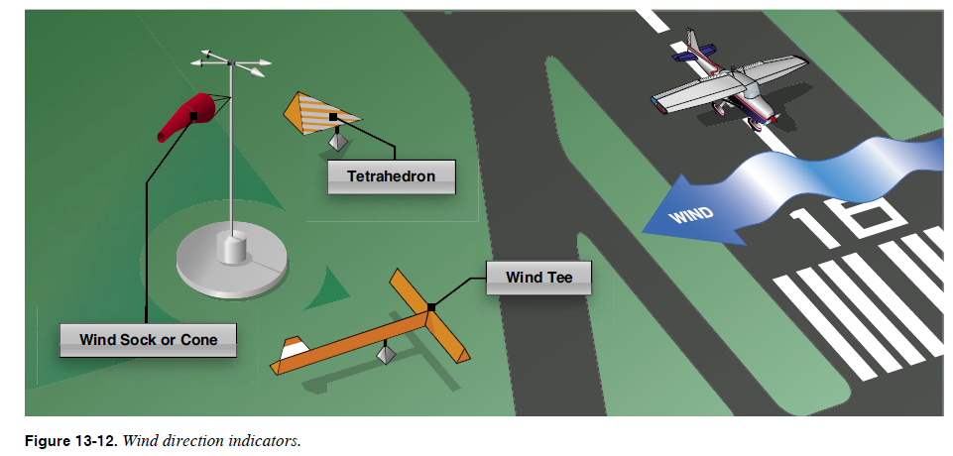
Wind
FAA. (2008). FAA-H-8083-25 Pilot's Handbook of Aeronautical Knowledge. p. 13-10

Slide 27
Wind Shear
Sudden and drastic change in wind speed and/or direction over a relatively short distance in the atmosphere.
Difficult or impossible to maintain control.
Prevention
3 pronged approach was developed
Training crews on avoidance
Detection systems for flight crew
Maximum aircraft performance if wind shear encountered
Simulator training is essential
Equipment
Wind Shear Alert Systems
Predictive Wind Shear Equipment (PWE)
Ground spurt radars (many types)
AC 00-54 (1988) Pilot Wind Shear Guide.

Slide 28
Microbursts
Are difficult to detect
Can have wet or dry microbursts that occur in confined areas
3 stages in their life cycle
Downburst (downdraft)
Outburst
Cushion
May result from thunderstorms
Duration can last a few seconds to several minutes
Very dangerous and has caused aircraft accidents

Slide 29
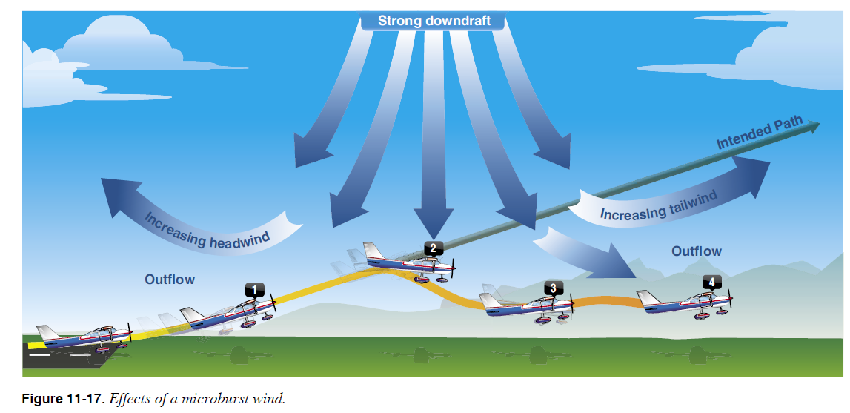
Microbursts
FAA. (2008). FAA-H-8083-25 Pilot's Handbook of Aeronautical Knowledge. p. 11-11

Slide 30
Humidity and Dew Point
Sun heats water and the water evaporates creating water vapor.
Humidity
Amount of water or water vapor in the air.
85% humidity means air is holding 85% of water.
Saturation is the air cannot hold anymore water vapor.
Dew Point
Temperature where moisture or water vapor saturates the air.
Relative Humidity
Measure of amount of water vapor present in the air compared to the amount needed for saturation at a specific temperature.

Slide 31
Precipitation
When the humidity is at saturation point or has too much moisture, water falls to earth.
Air temperature (heat energy) determines the 4 types of precipitation.
Rain (droplets of water)
Hail (frozen drops of water)
Sleet (below freezing at surface, sleet forms)
Snow (air below freezing forms water into snowflakes)
Results in reduced visibility, affecting aircraft performance, and producing icing conditions.
Airport equipment needed especially for sleet and snow removal.

Slide 32
Ice
Disruption of airflow over wing.
Crew must understand aircraft limitations under adverse weather conditions.
Aircraft have anti-ice and deice systems.
Aircraft equipped with float-type carburetors are susceptible to carburetor icing (Ice forms in the carburetor's venturi area).

Slide 33
Questions / Comments

Slide 34
Lightning and Thunderstorms
Consists of gusty winds, heavy rain, and hail
Aircraft structure built to withstand lightning strikes
Bonding, static eliminators, metal to metal connection, and metal composite materials.
Navigation and communication equipment failure

Slide 35
Cloud Types
Clouds form from water vapor and how air is cooled
4 main types (Others are a combination)
Cirrus
Curled or feathered
High in the atmosphere
Made up of ice crystals
Fair to pleasant weather
Cumulus
Look like cotton or flat with gray bases, and puffy, bright tops
Mid-atmosphere
Good weather condition depending upon atmospheric conditions
Stratus
Formed in layers
Low atmosphere, uniform grayish clouds cover majority of sky
May have drizzling rain
Nimbus (Nimbostratus)
Storm clouds that may become violent

Slide 36
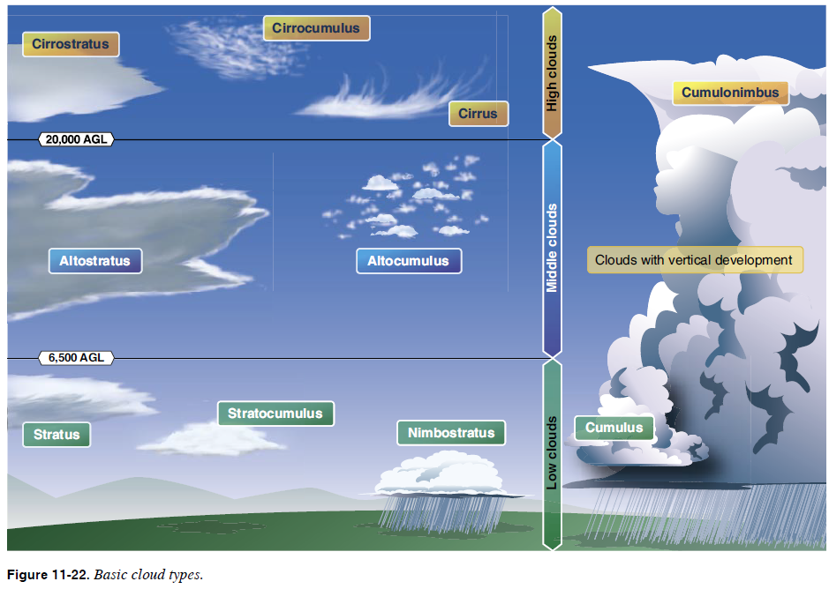
Cloud Types

Slide 37
Air Fronts
Boundary between two air masses containing different density, moisture, or temperature.
4 types
Warm Front (slow moving)
Warm air replaces a colder air mass.
Cold Front (fast moving)
Cold, dense, and stable air replaces a warm air mass.
Stationary
Warm and cold mass are equal.
Occluded
Fast moving cold front meets a slow moving warm front.

Slide 38
Volcanic Ash
Ash residue causes serious engine problems.
Avoid areas where volcanic eruption occurred.
Global surveillance satellites track volcanic ash.

Slide 39
Weather Service
National Weather Service (NWS)
U.S. government agency
Provides weather prediction and distribution
Flight Advisory Weather Service (FAWS)
Flight advisory and fore­cast service
Federal Aviation Administration
Department of Defense

Slide 40
4 Types of Weather Observations
Surface (provide local weather observations)
Automated Weather Observing Systems (AWOS)
Automated Surface Observing Systems (ASOS)
Air Route Traffic Control Center (ARTCC) facilities
Etc.
Upper air observations
Balloon with suspended radiosonde package
Pilot weather reports (PIREPs) provided during flight to FSS or ATC facility
Use a standard reporting form

Slide 41
4 Types of Weather Observations
Radar Observations
Provide precipitation and wind observations
4 Types
Doppler radar
FAA terminal doppler radar (TDWR)
FAA airport surveillance radar
Airborne radar
Radar Weather Reports or Storm Detections (SD)
Satellite Weather
Weather uplinks

Slide 42
Weather Reports
Meteorological conditions observed at a specified place and time
Not considered a forecast
Aviation Routine Weather Report (METARS)
Wind, Visibility, Weather, Sky Conditions, Temperature, Dew point, and Altimeter Standard
International format code-based report
Radar Weather Reports or Storm Detections (SD)
Pilot Weather Reports (PIREPs)

Slide 43
Aviation Weather Forecasts
Weather condition reports - Prediction of future weather
Specific location or wide area
Used in preflight planning
Terminal Aerodrome Forecast (TAF)
Provided within 5 miles radius from airport
Area Forecast (FA)
Provides clouds, weather conditions, visual meteorological conditions for several states
Route operations information
In-Flight Weather Advisories
Provided to en-route aircraft to forecast potentially hazardous weather conditions

Slide 44
Aviation Weather Forecasts
Winds and Temperature Aloft Forecast (FD)
Specific location forecasts for United States
Temperature in Celsius
Wind speed is also forecast

Slide 45
Weather Charts
Surface Analysis Chart
Computer prepared analysis report for surface weather.
Weather Depiction Chart
Surface conditions for major fronts or pressure areas.
Radar Summary Chart
Provide collective graphic displays of radar weather reports.
Significant Weather Prognostic Charts
Significant weather from surface to Flight Levels (FL) 240 (24,000 feet) and from FL 250 to FL 600.

Slide 46
Title 14 CFR Parts Weather Requirements
Part 91 General Operating and Flight Rules
Part 135 Operating Requirements: Commuter and On Demand Operations and Rules Governing Persons On Board Such Aircraft
Part 121 Operating Requirements: Domestic, Flag, and Supplemental Operations
Part 139 Certification of Airports

Slide 47
Questions / Comments

Slide 48
References
Federal Aviation Administration (FAA). (2008). FAA-H-8083-25 Pilot's handbook of aeronautical knowledge. Oklahoma City OK: United States Department of Transportation.
Sheehan, J. J. (2013). Business and corporate aviation management (2nd. ed.). New York, NY: McGraw-Hill Education.
Wells, A. T., & Young, S. B. (2004). Airport planning and management. New York: NY. McGraw-Hill.

