Slide 1
MGMT 203 Aviation Weather Theory and Observations
Module 9

Slide 2
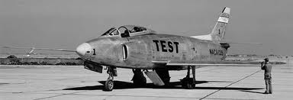
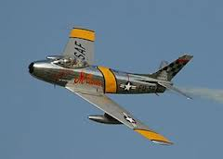
THIS DAY IN AVIATION
December 13
1949 — Prototype Of North American Aviation XF-93, Air Force jet penetration fighter, arrives at Edwards Air Force Base, California for testing.
The XF-93 is a new version of the basic North American F-86 “Sabre” design, with a 38-foot wingspan and 44 foot length, powered by a Pratt & Whitney J-42 engine.

Slide 3
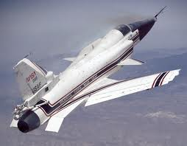
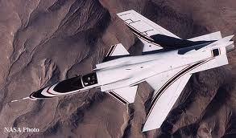
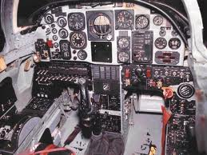
THIS DAY IN AVIATION
December 13
1984 — First flight of the Grumman X-29 FSW (Forward Swept Wing) research aircraft.

Slide 4
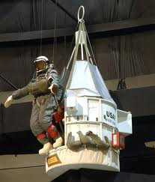
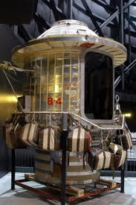
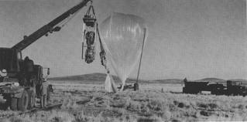
THIS DAY IN AVIATION
December 13
1962 — USAF Stargazer balloon reached an altitude of 82,000 feet

Slide 5
Questions / Comments

Slide 6
November/December 2017
SUNDAY | MONDAY | TUESDAY | WEDNESDAY | THURSDAY | FRIDAY | SATURDAY
26 | 27 Module 8 Aviation National and International Laws and Regulations, and Environmental Issues | 28 Module 8 Aviation National and International Laws and Regulations, and Environmental Issues | 29 Module 8 Aviation National and International Laws and Regulations, and Environmental Issues | 30 Beaufort County Airport (ILT) | 1 Flightline Friday | 2
3 | 4 Module 8 Aviation National and International Laws and Regulations, and Environmental Issues | 5 Module 8 Aviation National and International Laws and Regulations, and Environmental Issues | 6 Module 8 Aviation National and International Laws and Regulations, and Environmental Issues Discussion Due | 7 Module 8 Aviation National and International Laws and Regulations, and Environmental Issues | 8 Flightline Friday Review Questions Due Research Paper Due | 9
10 | 11 Module 9 Intro Aviation Weather Theory and Observations | 12 Module 9 Aviation Weather Theory and Observations FINAL EXAM DUE | 13 Module 9 Aviation Weather Theory and Observations Discussion Due | 14 Module 9 Aviation Weather Theory and Observations | 15 Flightline Friday Review Questions Due | 16

Slide 7
Questions / Comments

Slide 8
Learning Objectives – Module 9 (12/11/17 – 12/15/17) Aviation Weather Theory and Observations
Management of Aeronautical Science
Upon successful completion of this module, you will be able to:
State the four atmospheric layers and describe in what layer weather occurs.
Describe the atmospheric pressure measures and the standard atmosphere at sea level.
Explain how wind is caused and how wind direction is identified at an airport.
Describe atmospheric pressure, and determine the effects of pressure on altitude and on flight.
Explain wind shear and microbursts and associated problems.
Describe precipitation, the four types, and the problems associated with precipitation.
Explain where you may find weather information from at least three federal government agencies.
Explain the difference between weather reports and weather forecasts.
Describe the three types of weather briefings (standard, abbreviated, and outlook) and what type of information is provided by each one.
Describe Surface Aviation Weather Observations especially METAR reports.
Clarify the different air mass circulations that create four types of fronts and describe the flight hazards associated with each type of front.
Describe the three types of weather briefings (standard, abbreviated, and outlook).
Describe the four types of weather observations and the information provided by each observation type.
Evaluate the responsibilities of passengers on aircraft delays.
Mon/Tues/Wed

Slide 9
Readings
Refer to Readings on ERAU Website Mod 9
Title 14 Code of Federal Regulations (CFR) - Please review 14 CFR Parts:
91, 135, 121 and 139.
Textbook – Business and Corporate Aviation Management
Chapter 12: Weather Theory
Chapter 13: Aviation Weather Service

Slide 10
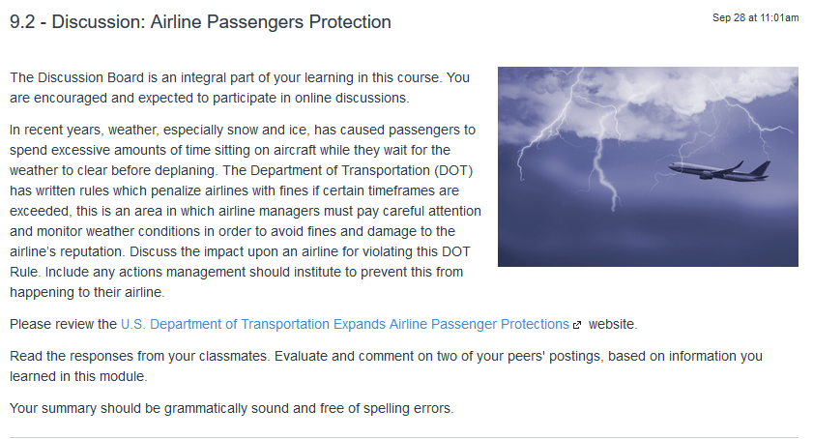
9.2 – Discussion: Airline Passengers Protection Wed Dec 13

Slide 11
9.6 – Final Exam Tues Dec 12 – available Dec 9
This Final Exam consists of 10 questions which cover all the topics you have explored throughout the course.
The final is open-book/open-note, and is comprised of essay questions.
Time limit: There is a two-hour time limit and at the end of the two hours, the exam will close and be automatically submitted for grading. You will get a notification pop-up approximately 10 seconds before time expires. If you leave the exam for any reason, the timer will continue, and the exam will automatically submit when time is up. If you lose your Internet connection, you may reconnect and return to the exam where you left off as long as time has not expired. If you encounter technical difficulties, please contact your instructor.

Slide 12
Module 9 Review Questions (Due Fri Dec 15)
Spend quality time responding to the following questions in your own words.
Describe atmospheric pressure, its measures, and the standard atmosphere at sea level.
Explain the difference between weather reports and weather forecasts. Please provide a few examples.
Describe precipitation, the four types, and the problems associated with precipitation.
Describe Surface Aviation Weather Observations especially a METAR Report.
Describe the three types of weather briefings (standard, abbreviated, and outlook).

Slide 13
Assignments Due – Module 9 (12/11/17 – 12/15/17)
Management of Aeronautical Science
Review Module 9 Instructions for the following assignments:
Final Exam Due (10 question - Essay)
(Due – Tues Dec 12) – available from Dec 9
Discussion Board Due (Airline Passengers Protection)
(Due – Wed Dec 13) – 2 part (Post and Respond)
Review Questions – Aviation Weather Theory and Observations
(Due – Fri Dec 15) – 5 Questions

Slide 14
Questions / Comments

