Slide 1
Hangar Maintenance (on-Aircraft)
Jake Snider

Slide 2
Typical hangar activities
Scheduled checks
Aircraft modifications due to airworthiness directives, engineering orders and other services bulletins
Fleet campaign directives
Engine removal and installation
Painting
Interior modifications
Special inspections

Slide 3
Organization of Hangar Maintenance
Manager under the director of aircraft maintenance (DOM)
Supervisor of aircraft maintenance
Supervisor of GSE
Supervisor of support shops

Slide 4
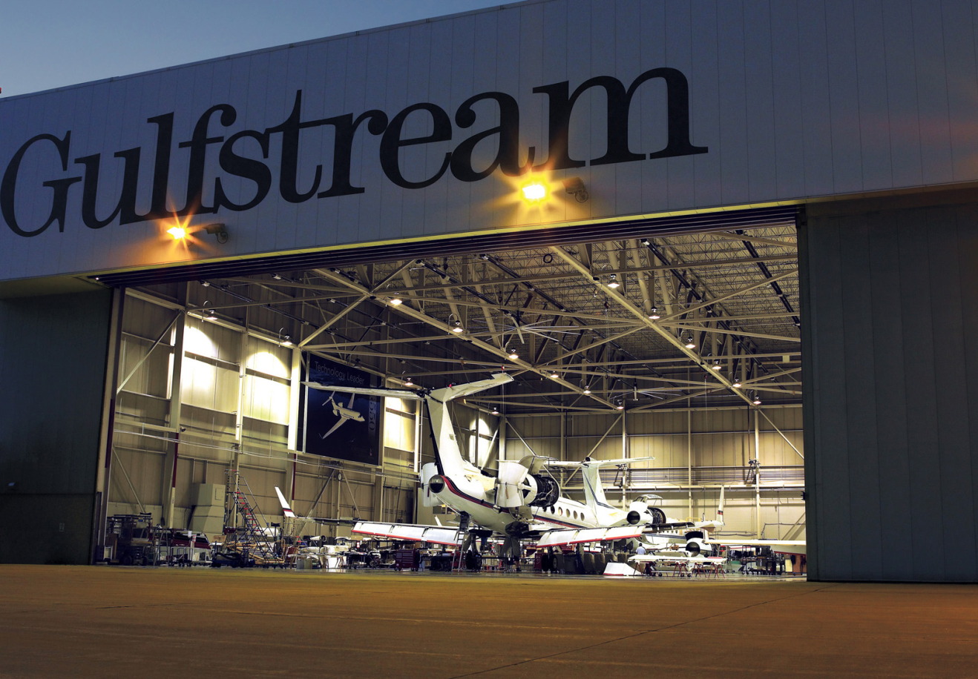
Problems in Hangars
Nonroutine items
Parts Availability
Parts Robbing

Slide 5
“C” Check
Preparation
Preliminary
Conduction
Completion and sign off
Return to service
Morning meetings

Slide 6
Support and Overhaul Shops Organization
Manager of overhaul shops is responsible for the overhaul shops
Types of Shops
Sheet metal
Aircraft interior
Engine
Avionics
Shop data collection

Slide 7
Ground support Equipment
Equipment to support the servicing and handling of operational aircraft while engaged in flight turnaround and ground movement activities
Equipment used to facilitate maintenance whether at turnaround or during scheduled or unscheduled downtime.

