Slide 1
MGMT 203 Aeronautical Science, Aviation Professionalism, Careers, and Certification
Module 1

Slide 2
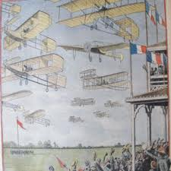
THIS DAY IN AVIATION
August 22
1909 — The first great aviation meeting in Bétheny, France, opens as 23 European airplanes make 87 flights during one week.
The meeting will have a strong influence on the technical and military aspects of flight.

Slide 3
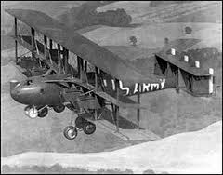
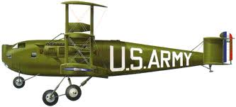
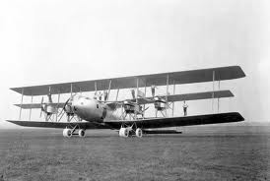
THIS DAY IN AVIATION
August 22
1923 — The Barling bomber made its initial flight.

Slide 4
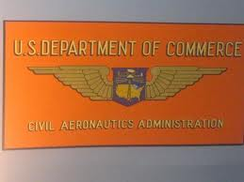
THIS DAY IN AVIATION
August 22
1938 — The Civil Aeronautics Act becomes effective in the United States, coordinating all non-military aviation under the Civil Aeronautics Authority.

Slide 5
Questions / Comments

Slide 6
MGMT 203 Aeronautical Science, Aviation Professionalism, Careers, and Certification
Module 1

Slide 7
Aviation Careers
There are many occupations to pick from in the aviation career path.
Advancement into management positions is very possible depending upon your qualifications, drive, and education.
Your ERAU degree is a step in the right direction.
Planning your career path requires research into your specific field of interest; exploring qualifications, certifications, regulatory requirements, responsibilities, financial requirements, and educational requirements.

Slide 8
Aviation Careers
To prepare you for your aviation career, you will have to research different websites.
Managers spend time researching regulations, laws, and policies and procedures to determine what course of action must be taken.
What am I legally required to do?
What am I authorized to do by company or agency policies?
What are my duties and responsibilities?
Where can I obtain help?

Slide 9
Code of Federal Regulations
Title 14 Code of Federal Regulations (CFR) http://www.ecfr.gov/cgi-bin/text-idx?tpl=/ecfrbrowse/Title14/14tab_02.tpl
Most managers in the field make to reference to the acronym FAR.
Federal Aviation Regulations (FAR)
In this course, we will make reference to Title # CFR Part # as # CFR Part #
Example: 14 CFR Part #
The FAA website provides useful documents (airworthiness directives, regulations, handbooks, advisory circulars, etc.)
http://www.faa.gov/

Slide 10
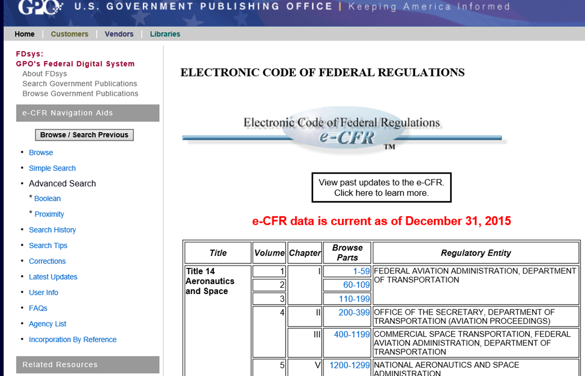
CFR Web site

Slide 11
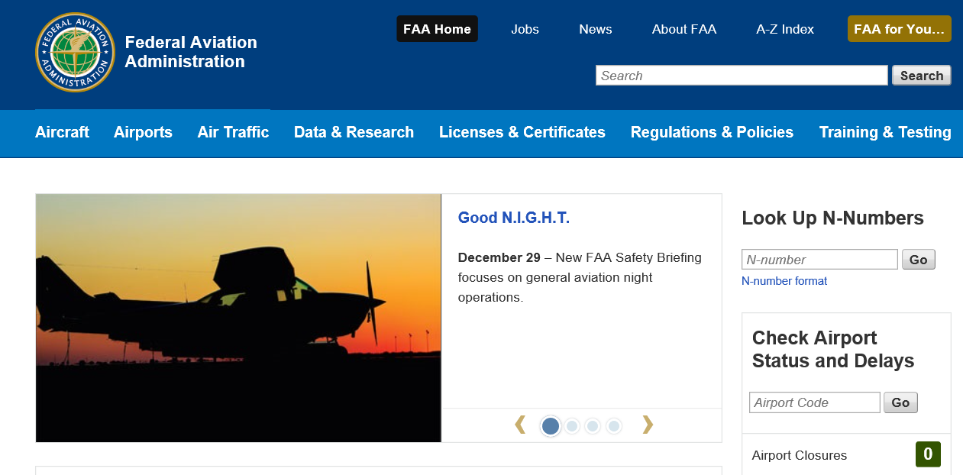
FAA.Gov website

Slide 12
Types of Aviation Careers

Slide 13
Pilot Certifications
14 CFR Part 61 Certification: Pilots, Flight Instructors, and Ground Instructors
Private Pilot
Flies for pleasure or personal business without accepting compensation (specific circumstances apply).
Commercial Pilot
Compensated for flying.
Higher standards than private pilot.
Airline Transport Pilot (ATP)
Highest level of standards.
Required for pilots flying passengers or cargo under 14 CFR Part 121 and some 14 CFR Part 135 operations.
Scheduled airline operations.

Slide 14
Pilot Certificates and Ratings
Private Pilot Certificate (Single-Engine and Multi-Engine).
Instrument Rating (Single-Engine and Multi-Engine).
Commercial Pilot Certificate (Single-Engine and Multi-Engine).
Flight Instructor (Single Engine and Multi-Engine; Instrument).
Also included are fixed wing versus rotary wing, and other forms.

Slide 15
Flight Crewmembers Other Than Pilots
14 CFR Part 63 Certification: Flight Crewmembers Other Than Pilots.
Flight Engineers
Flight Navigators

Slide 16
Flight Attendants
Requirements are stated in 14 CFR Part 121 and 14 CFR Part 135.
Duties, responsibilities, training, and specific conditions.
Flight Attendant Certificate of Demonstrated Proficiency.
Vision 100-Century of Aviation Reauthorization Act 2003.
After December 11, 2004, all flight attendants in the cabin of an aircraft that has 20 or more seats and operates under 14 CFR Part 121 or Part 135 (FAR.gov).

Slide 17
Airmen Other Than Flight Crew Members
14 CFR Part 65 Certification: Airmen Other Than Flight Crew Members.
Air traffic control tower operators
Mechanics or technicians
Repairmen
Aircraft dispatchers
Parachute riggers

Slide 18
Air Traffic Controllers
14 CFR Part 65 Certification.
Employed by the Federal Aviation Administration (FAA).
Coordinate the movement of air traffic.
Verify aircraft stay a safe distance apart.
Minimize delays.
Regulate airport traffic through designated airspaces.
Air route traffic control center (ARTCC) – Center Controllers.
Regulate airport arrivals and departures.
Terminal controllers.
Airport tower controllers.
Flight service stations.

Slide 19
A&P Mechanics or Technicians
14 CFR Part 65 Certification.
Ratings
Airframe
Powerplant
Experience Requirements
Graduate from aviation maintenance school certified by FAA under 14 CFR Part 147 Aviation Maintenance Technician Schools.
Or documented evidence of at least the following
18 months experience for A or P.
30 months practical experience for A&P.
Required to take written.
Duration: until it is surrendered, suspended, or revoked.

Slide 20
A&P Mechanics or Technicians
Inspection Authorization (IA)
To be eligible for an IA an applicant must
Hold an A&P for 3 years
Actively engaged for at least 2 year period
Have a fixed base of operations
Have data to perform task
Pass a written test
IA Duration
Expires 31 March every 2 years
IA Renewal
Prove experience requirement concerning IA performance or retake the test.

Slide 21
Repair Station Repairman
14 CFR Part 65 covers repairman certification.
14 CFR Part 145 covers Repair Stations.
States requirements for repair station's certification and lists the different classes of domestic repair stations.
Must have a repair station certificate.

Slide 22
Avionics Technicians
May work in repair stations, back shops, or on the flight line.
Many have an Airframe, A&P license, Powerplant, or in the case of a repair station have a repairman’s certificate (14 CFR Part 65).
U.S. Federal Communications Commission (FCC) licenses may be required.
General Radiotelephone Operator’s License
Radar endorsement is highly recommended as without it you cannot work on radar systems.
14 CFR Part 147 Aviation Maintenance Technician Schools offer specialty courses in avionics.

Slide 23
Aircraft Dispatchers
14 CFR Part 65
FAA licensed
Legally responsible for the safety of the flight
Flight planning for corporate and airline operations
Considers payloads (such as passengers, mail, cargo)
May be weather specialists
Liaison between the pilot and ground service personnel
Familiar with all types of aircraft operated by the company

Slide 24
Operations Management
Airport management
Aviation consulting
Aviation managers (airline, corporate, FBOs)
Aviation safety and accident prevention
Business and technical aviation consulting
Governmental organizations
Educational and training
Many other opportunities
24
Notes:
24

Slide 25
Manufacturing and Repair
14 CFR Part 21 Certification Procedures For Products and Parts.
Aircraft and parts manufacturing
Engines and parts manufacturing
Avionics and parts manufacturing
Repair Stations (Previously discussed)
14 CFR Part 145 Repair Stations
To find repair stations, FAA Repair Station Search
http://av-info.faa.gov/repairstation.asp

Slide 26
Top Management Positions
Chief Executive Officer (CEO)
Chief Financial Officer (CFO)
Chief Operations Officer (COO)
Corporate Officers
President
Vice President
Secretary
Treasurer

Slide 27
Top Management Positions
Management Personnel (14 CFR Part 119 and 121).
Director of Operations
Director of Maintenance
Director of Safety
Chief Pilot
Chief Inspector

Slide 28
Management

Slide 29
Management
In every aviation career field, there are management opportunities.
Most managers use the five functions of management.
Planning
(Operational Planning, Aviation Management Planning, etc.)
Organizing
Staffing
Leading or Execution
Controlling
Briefly, let’s discuss the five functions.

Slide 30
Operational Planning
Consists of short-range goals and objectives.
Involves setting specific measurable objectives for a specific time period .
Usually a budget period of 1 year.

Slide 31
Planning Tools and Techniques
Planning and Forecasting
Multiple types of plans depending upon company or agency
Forecasting (demand, competition, market, etc.)
Budgets
Cost allocation
Managers must consider all costs in this competitive market
Break-even analysis (revenue = costs)
Schedules
Gantt
Milestone
Network

Slide 32
Aviation Management Planning
There are many types of plans to consider
Business Plan
Financial Plan
Flight and Fleet Plan
Human Resource Plan
Maintenance Plan
Marketing Plan
Quality Plan
Risk Plan
Security Plan
Safety Plan
Strategic Plan
Emergency Response Plan

Slide 33
Organizing
Organizational structure depends upon company's requirements and capabilities.
Centralized vs. Decentralized
Centralized at corporate level
Decentralized at field locations
Departments
Flight Department or Operations
Maintenance Department
Quality Department
Hiring 3rd Party companies or outsourcing.
Maintenance
Management
Logistics or supply chain management
Strategic Alliances or Joint Ventures

Slide 34
Staffing
Obtaining and managing the human resources
Having a hiring process in place
Hiring the right person
Experience
Certification
Qualification
Education
Understanding Union Requirements
Know the labor management agreement or contract
What are you authorized to do?
Discipline
Working conditions
Grievances and their resolution

Slide 35
Staffing
Safety
Security
Labor laws (federal and state)
Duty limitations
Workman’s compensation
Performance standards
Training
Orientation
One time
Recurring
Simulators
Upgrade training
On-the-job training

Slide 36
Staffing
Authorized vs. Assigned Labor Document
Consider skill breakout (skilled vs. trainee)
Considerations
Attrition rate
Learning curve
Personnel cost
Direct cost is what an employee receives per hour
Overhead is fringe benefits
Personnel productivity, etc.

Slide 37
Leading or Executing
Guiding and directing the work to be accomplished in accordance with plans, regulations, laws, policies, and procedures.
Requires excellent communication .
70-90% of manager’s time is spent communicating.
Requires a feedback loop.
Key is superb customer satisfaction.

Slide 38
Controlling
Without a plan – you have no control.
3 Basic Steps
Setting the standard.
Measure the actual performance .
Taking action if there is a deviation.
Feedback is important.
Requires measurements or metrics.
Schedule variance
Budget variance
Quality
Financial ratios & productivity ratios
Scorecard

Slide 39
Future Outlook of Employment
The Secretary of Labor, Bureau of Labor Statistics publishes Employment Projections for the labor market for the future.
http://www.bls.gov/emp/
Occupational Outlook Handbook

Slide 40
Questions / Comments

Slide 41
Module 1 Review Questions
Spend quality time responding to the following questions in your own words.
1. What are the qualifications, certifications, and responsibilities of a commercial pilot?
2. What are the qualifications, certifications, and responsibilities of an Airframe and Powerplant mechanic?
3. What are the qualifications, certifications, and responsibilities of an Air Traffic Controller?
4. Describe conditions or constraints that reduce aircraft utilization factors (time available for flying).
5. Analyze the benefits of on-demand business aviation as compared to scheduled airline transportation.

