Slide 1
Warm-Up – 9/24 – 10 minutes
Utilizing your notes and past knowledge answer the following questions:
What is the maximum speed at which an aircraft may be stalled safely called?
Define limit load.
High speed dives or acrobatics involving speed above the known maneuvering speed should never be practiced under what conditions?
Any airspeed greater than ___________ provides a positive lift capability sufficient to damage the aircraft?

Slide 2

Questions / Comments

Slide 3
Warm-Up – 9/24 – 10 minutes
Utilizing your notes and past knowledge answer the following questions:
What is the maximum speed at which an aircraft may be stalled safely called?
Define limit load.
High speed dives or acrobatics involving speed above the known maneuvering speed should never be practiced under what conditions?
Any airspeed greater than ___________ provides a positive lift capability sufficient to damage the aircraft?

Slide 4
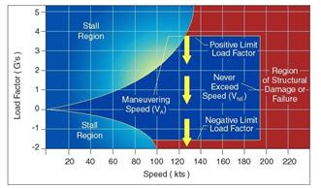
Load Factors and Stalling Speeds
The maximum speed at which an aircraft may be stalled safely is now determined for all new designs.
This speed is called the “design maneuvering speed” (VA).

Slide 5
Warm-Up – 9/24 – 10 minutes
Utilizing your notes and past knowledge answer the following questions:
What is the maximum speed at which an aircraft may be stalled safely called?
Define limit load.
High speed dives or acrobatics involving speed above the known maneuvering speed should never be practiced under what conditions?
Any airspeed greater than ___________ provides a positive lift capability sufficient to damage the aircraft?

Slide 6
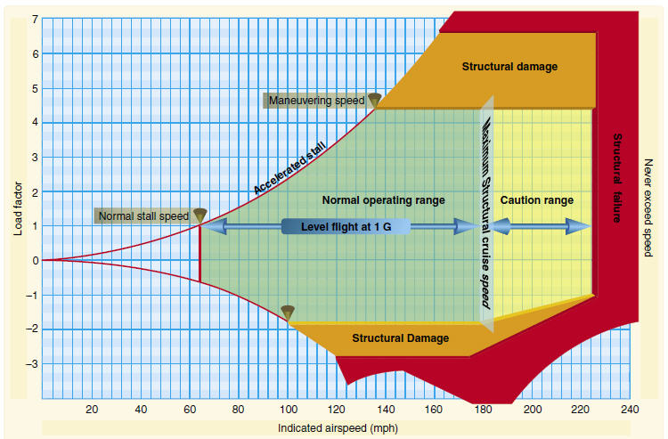
Load Factors and Flight Maneuvers
The limit load is a force applied to an aircraft that causes a bending of the aircraft structure that does not return to the original shape.

Slide 7
Warm-Up – 9/24 – 10 minutes
Utilizing your notes and past knowledge answer the following questions:
What is the maximum speed at which an aircraft may be stalled safely called?
Define limit load.
High speed dives or acrobatics involving speed above the known maneuvering speed should never be practiced under what conditions?
Any airspeed greater than ___________ provides a positive lift capability sufficient to damage the aircraft?

Slide 8
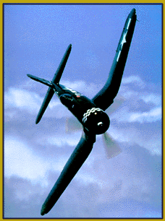
Load Factors and Flight Maneuvers
High speed dives or acrobatics involving speed above the known maneuvering speed should never be practiced in rough or turbulent air.

Slide 9
Warm-Up – 9/24 – 10 minutes
Utilizing your notes and past knowledge answer the following questions:
What is the maximum speed at which an aircraft may be stalled safely called?
Define limit load.
High speed dives or acrobatics involving speed above the known maneuvering speed should never be practiced under what conditions?
Any airspeed greater than ___________ provides a positive lift capability sufficient to damage the aircraft?

Slide 10
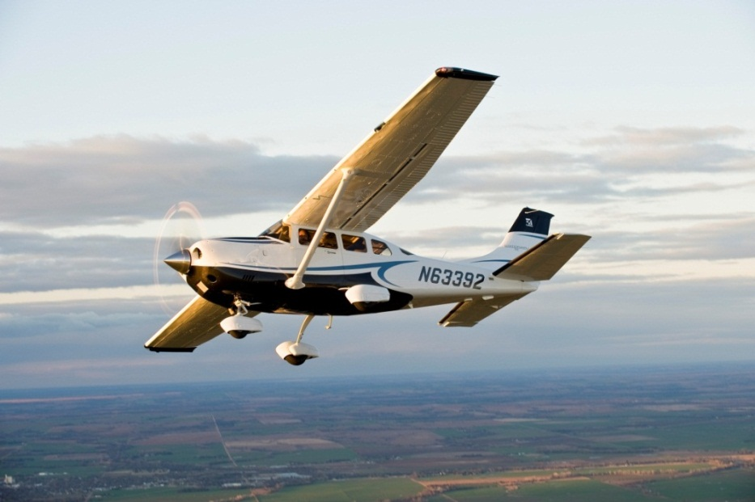
Load Factors and Flight Maneuvers
Any airspeed greater than this provides a positive lift capability sufficient to damage the aircraft.

Slide 11


Slide 12
Questions / Comments

Slide 13
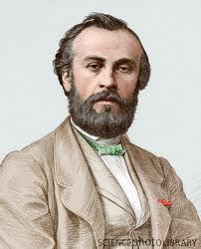
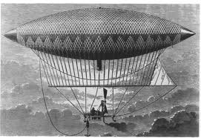
THIS DAY IN AVIATION
September 24
1852 — French engineer, Henri Giffard, flies the first powered, manned airship.
Powered by a steam engine and propeller, the airship flies at about 5-mph and covers 17 miles from Paris to Trappes, France.
The craft marks the beginning of the practical airship.

Slide 14
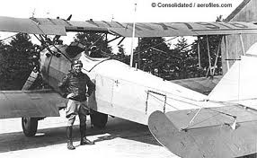
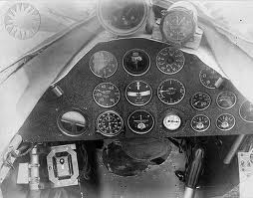
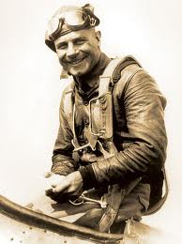
THIS DAY IN AVIATION
September 24
1929 — Lt. James H. Doolittle makes the first blind, all-instrument flight.

Slide 15
Questions / Comments

Slide 16
September 2015
Sunday | Monday | Tuesday | Wednesday | Thursday | Friday | Saturday
6 | 7 HOLIDAY | 8 Chapter 4 Principles of Flight | 9 Chapter 4 Principles of Flight | 10 Chapter 4 Principles of Flight | 11 QUIZ Flightline Friday | 12
13 | 14 Chapter 4 Principles of Flight | 15 Chapter 4 Principles of Flight | 16 Chapter 4 Principles of Flight | 17 Chapter 4 Principles of Flight | 18 QUIZ Flightline Friday | 19
20 | 21 Chapter 4 Principles of Flight | 22 Chapter 4 Principles of Flight | 23 Progress Reports Due | 24 Chapter 4 Principles of Flight | 25 Quiz Progress Reports Sent Home | 26

Slide 17
1st Quarter Requirements
(15 Class Meetings – Oct 14)
All students will complete the following:
  Take notes - All in class quizzes and tests
    Each day is worth 20pts - (4 day week 25pts)
  Complete Flight Sim. Tutorials (1 – 5 x3 + 1)
  Aircraft Fam. and Student Pilot Syllabus
    Lessons 1 – 7 (Straight & Level Flight through First Solo)
    Must pass written with 80%
    Successfully complete 3 times on small sim
    Successfully complete 1 time on Main sim
  Complete ERAU Aviation 101
    6 quizzes and 2 tests
  Student will receive zero points for all incomplete work – NO make-up / extra credit

Slide 18
Questions / Comments

Slide 19

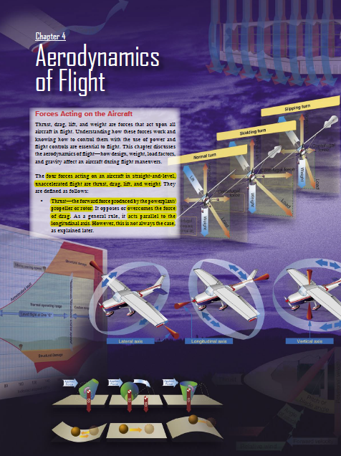
Chapter 4 – Aerodynamics of Flight
FAA – Pilot’s Handbook of Aeronautical Knowledge

Slide 20
Today’s Mission Requirements
Mission:
Identify in writing the forces acting on an aircraft in flight.
Describe how the forces of flight work and how to control them with the use of power and flight controls essential to flight.
Describe in writing how design, weight, load factors, and gravity affect an aircraft during flight maneuvers.
EQ:
  Describe the importance of Aeronautical Knowledge for the student pilot learning to fly.

Slide 21
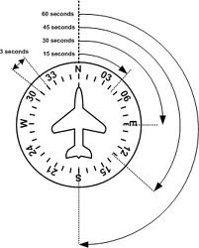
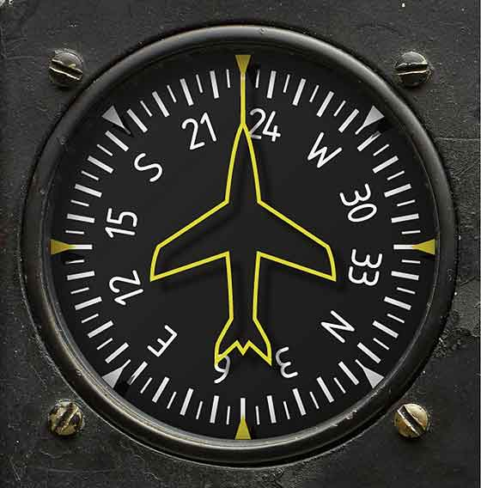
Load Factors and Flight Maneuvers
Rate of Turn
  The rate of turn (ROT) is the number of degrees (expressed in degrees per second) of heading change that an aircraft makes.

Slide 22
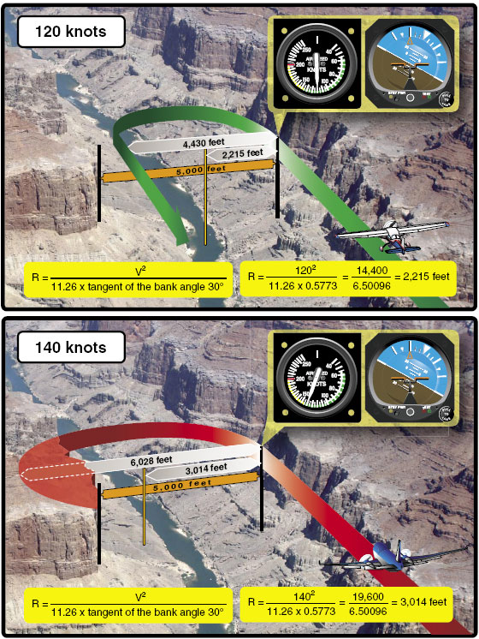
Load Factors and Flight Maneuvers
Radius of Turn
  If the bank angle is held constant and the airspeed is increased, the radius of the turn changes (increases).
  A higher airspeed causes the aircraft to travel through a longer arc due to a greater speed.

Slide 23
Two aircraft have flown into a canyon by error. The canyon is 5,000 feet across and has sheer cliffs on both sides. The pilot in the top image is flying at 120 knots. After realizing the error, the pilot banks hard and uses a 30° bank angle to reverse course. This aircraft requires about 4,000 feet to turn 180°, and makes it out of the canyon safely.

Slide 24
The pilot is flying at 140 knots and also uses a 30° angle of bank in an attempt to reverse course. The aircraft, although flying just 20 knots faster than the aircraft in the top image, requires over 6,000 feet to reverse course to safety. Unfortunately, the canyon is only 5,000 feet across and the aircraft will hit the canyon wall. The point is that airspeed is the most influential factor in determining how much distance is required to turn. Many pilots have made the error of increasing the steepness of their bank angle when a simple reduction of speed would have been more appropriate.

Slide 25
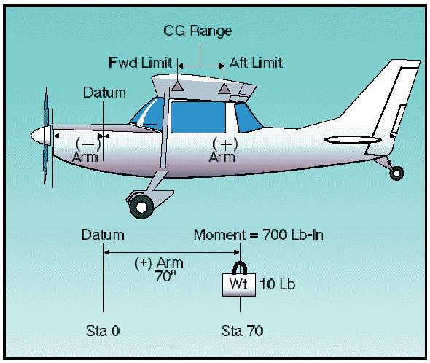
Weight and Balance
Weight and balance computations should be part of every preflight briefing.
Never assume three passengers are always of equal weight.

Slide 26
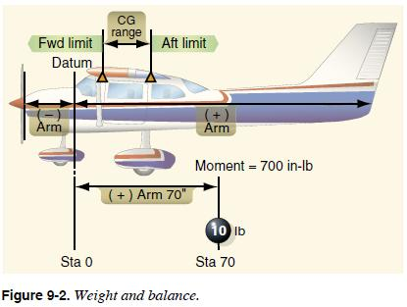
Weight and Balance
It is recommended that all bags be weighed to make a precise computation of how the aircraft CG is positioned.

Slide 27
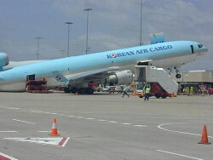
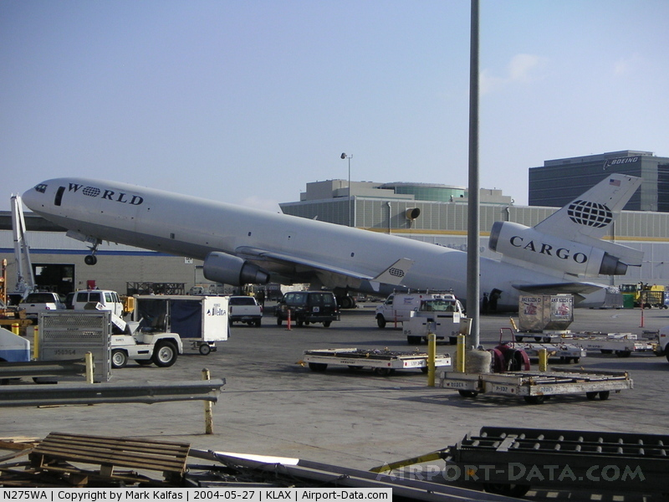
Weight and Balance
Aircraft are certificated for weight and balance for two principal reasons:
  1. The effect of the weight on the aircraft’s primary structure and its performance characteristics.
  2. The effect of the location of this weight on flight characteristics, particularly in stall and spin recovery and stability.

Slide 28
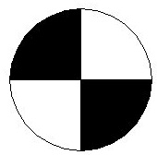
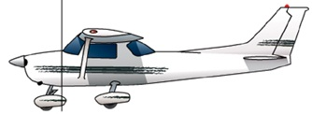

Weight and Balance
Datum is at front face of firewall
Force
Weight (lb)
Distance
Arm (in.)
Moment (in.-lb)
M = Fd = weight ● arm
Item
Empty weight
1,460
37.4
54,604
?
Pilot
160
37.0
5,920
180
37.0
6,660
Co-pilot
Fuel
240
45.3
10,872
Rear seat passengers
340
72.8
24,752
Baggage 1
20
94.9
1,898
Baggage 2
0
n/a
0
Total
?
2,400
?
104,706
What now?
Determine whether the plane is safe to fly.
Notes:
Weight and balance calculations are the same as the torque concept learned in the POE curriculum. Moment is another term for torque. Torque is calculated by multiplying force applied at a right angle to distance from a pivot point. The force in this example is weight and arm is the distance between the pivot point and the force applied at a 90° angle. Note that in aviation operations the term weight is used in place of force as a specific force being considered for the weight and balance calculation. The term arm is used in place of distance as a specific distance being considered.

Slide 29


Weight and Balance
From Pilot Operating Handbook (POH)
Center of Gravity Moment Envelope
2,500
2,400
2,300
2,200
Safe to fly?
2,100
Barely!
2,000
Loaded Airplane Weight (lb)
1,900
1,800
1,700
1,600
1,500
45
50
60
70
80
90
100
110
Loaded Airplane Moment (in.-lb/1000)
Notes:
This is a weight and balance chart from the manufacturer often found in a Pilot Operating Handbook (POH). The weight and moment must fall within these boundaries for the airplane to be controllable. If the center of gravity lies too far back, then the aircraft is inclined to pitch up, potentially entering a stall condition. If the center of gravity is too far forward, then the aircraft is inclined to pitch down.
A pilot and supporting ground crew, if applicable, need to perform several important tasks prior to flight. Weight and balance calculations and adjustments are performed by the pilot or supporting ground crew and verified by the pilot. If the ground crew performs this task, then the information is delivered to the pilot on a piece of paper prior to closing the main cabin door. You may have found yourself in the situation on a small commuter aircraft where the flight attendant asks for passengers to change seats. This is to adjust the weight and balance of the aircraft to a more ideal flight condition.
An advanced assignment could be to assign students a more advanced aircraft and then assign seats and position cargo for a safely loaded aircraft.
Note that the change of slope in the upper limit of the graph is because the stability of the aircraft with respect to the weight distribution is more complex than a linear relationship such as applying a load to a wrench. This graph is the result of extensive modeling and testing by aerospace engineers.

Slide 30
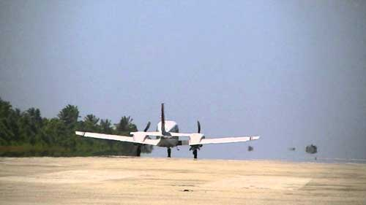
Effect of Weight on Flight Performance
A heavier gross weight results in a longer takeoff run and shallower climb, and a faster touchdown speed and longer landing roll.

Slide 31

Effect of Weight on Flight Performance
The detrimental effects of overloading on performance are not limited to the immediate hazards involved with takeoffs and landings.

Slide 32
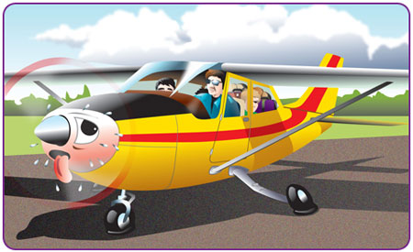
Effect of Weight on Flight Performance
Overloading has an adverse effect on all climb and cruise performance which leads to overheating during climbs, added wear on engine parts, increased fuel consumption, slower cruising speeds, and reduced range.

Slide 33
Effect of Weight on Flight Performance
In some aircraft, it is not possible to fill all seats, baggage compartments, and fuel tanks, and still remain within approved weight or balance limits.
For example, in several popular four-place aircraft, the fuel tanks may not be filled to capacity when four occupants and their baggage are carried.
In a certain two-place aircraft, no baggage may be carried in the compartment aft of the seats when spins are to be practiced.
It is important for a pilot to be aware of the weight and balance limitations of the aircraft being flown and the reasons for these limitations.

Slide 34
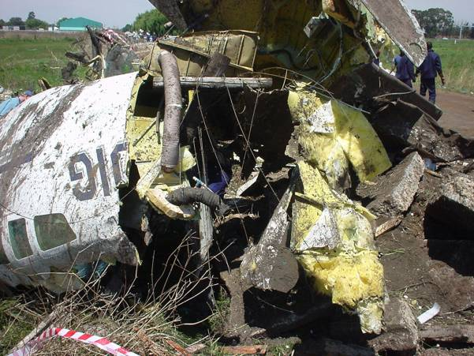
Effect of Weight on Aircraft Structure
Structural failures which result from overloading may be dramatic and catastrophic, but more often they affect structural components progressively in a manner that is difficult to detect and expensive to repair.

Slide 35
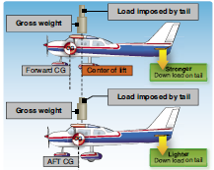
Chapter Summary
For information on stall speeds, load factors, and other important aircraft data, always consult the AFM/POH for specific information pertaining to the aircraft being flown.

Slide 36
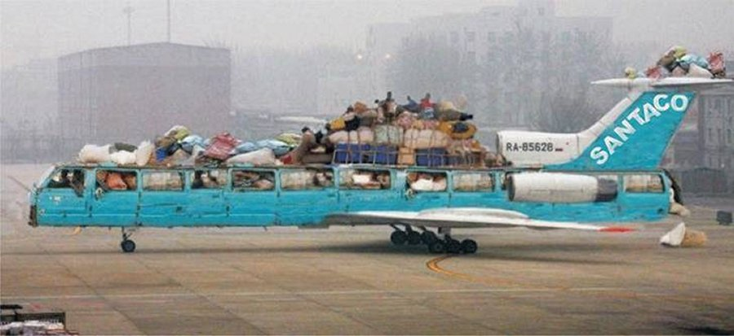

Slide 37
Questions / Comments

Slide 38
1st Quarter Requirements
(15 Class Meetings – Oct 14)
All students will complete the following:
  Take notes - All in class quizzes and tests
    Each day is worth 20pts - (4 day week 25pts)
  Complete Flight Sim. Tutorials (1 – 5 x3 + 1)
  Aircraft Fam. and Student Pilot Syllabus
    Lessons 1 – 7 (Straight & Level Flight through First Solo)
    Must pass written with 80%
    Successfully complete 3 times on small sim
    Successfully complete 1 time on Main sim
  Complete ERAU Aviation 101
    6 quizzes and 2 tests
  Student will receive zero points for all incomplete work – NO make-up / extra credit

Slide 39
Lesson Closure - 3 – 2 - 1
3. List 3 things you learned today.
2. List 2 things you have questions about today’s lesson.
1. Create (1) quiz question with answer about today’s lesson.

