Slide 1
Warm-Up – 3/12 – 10 minutes
Utilizing your notes and past knowledge answer the following questions:
What are the basic components of a hydraulic system?
What is another name for tail dragger or tail wheel aircraft?
What is advantage with visibility for a tricycle landing gear aircraft?
What is a disadvantage with tail wheel aircraft and steering?
What are the two classifications for aircraft landing gear?

Slide 2
Questions / Comments

Slide 3
Warm-Up – 3/12 – 10 minutes
Utilizing your notes and past knowledge answer the following questions:
What are the basic components of a hydraulic system?
What is another name for tail dragger or tail wheel aircraft?
What is advantage with visibility for a tricycle landing gear aircraft?
What is a disadvantage with tail wheel aircraft and steering?
What are the two classifications for aircraft landing gear?

Slide 4
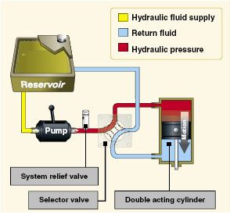
Aircraft Systems Hydraulic Systems
A basic hydraulic system consists of a:
reservoir
pump (either hand, electric, or engine driven),
a filter to keep the fluid clean
selector valve to control the direction of flow
relief valve to relieve excess pressure
and an actuator.

Slide 5
Warm-Up – 3/12 – 10 minutes
Utilizing your notes and past knowledge answer the following questions:
What are the basic components of a hydraulic system?
What is another name for tail dragger or tail wheel aircraft?
What is advantage with visibility for a tricycle landing gear aircraft?
What is a disadvantage with tail wheel aircraft and steering?
What are the two classifications for aircraft landing gear?

Slide 6
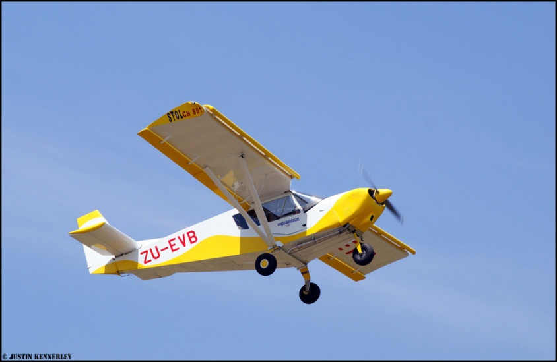
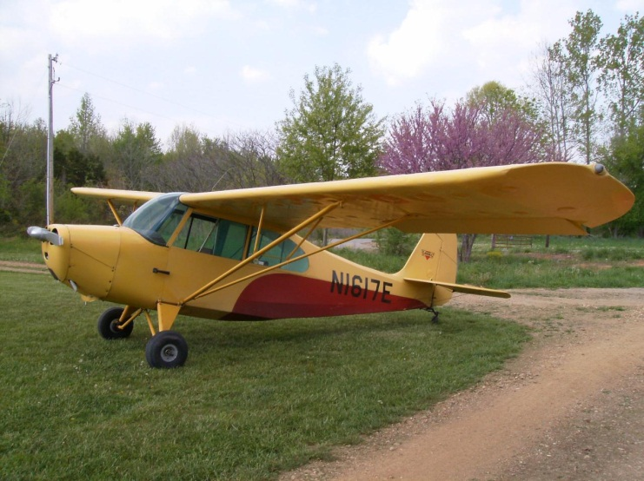
Aircraft Systems Landing Gear
The landing gear on small aircraft consists of three wheels: two main wheels (one located on each side of the fuselage) and a third wheel positioned either at the front or rear of the airplane.
Landing gear employing a rear-mounted wheel is called conventional landing gear.

Slide 7
Warm-Up – 3/12 – 10 minutes
Utilizing your notes and past knowledge answer the following questions:
What are the basic components of a hydraulic system?
What is another name for tail dragger or tail wheel aircraft?
What is advantage with visibility for a tricycle landing gear aircraft?
What is a disadvantage with tail wheel aircraft and steering?
What are the two classifications for aircraft landing gear?

Slide 8
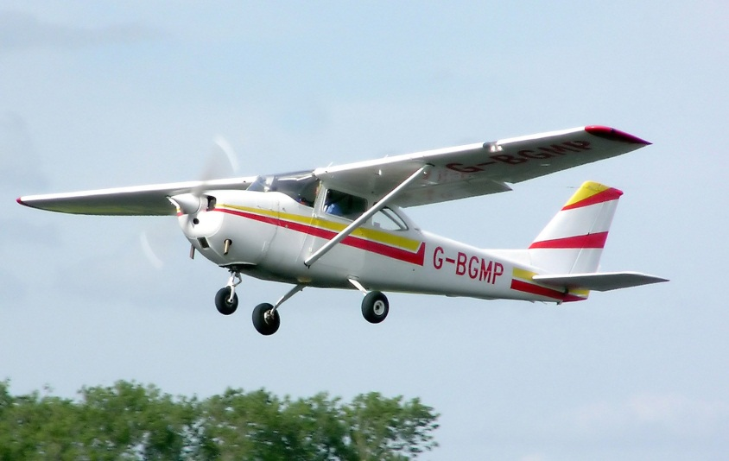
Aircraft Systems Tricycle Landing Gear
2. It permits better forward visibility for the pilot during takeoff, landing, and taxiing.

Slide 9
Warm-Up – 3/12 – 10 minutes
Utilizing your notes and past knowledge answer the following questions:
What are the basic components of a hydraulic system?
What is another name for tail dragger or tail wheel aircraft?
What is advantage with visibility for a tricycle landing gear aircraft?
What is a disadvantage with tail wheel aircraft and steering?
What are the two classifications for aircraft landing gear?

Slide 10
Aircraft Systems Tricycle Landing Gear
3. It tends to prevent ground looping (swerving) by providing more directional stability during ground operation since the aircraft’s center of gravity (CG) is forward of the main wheels.

Slide 11
Warm-Up – 3/12 – 10 minutes
Utilizing your notes and past knowledge answer the following questions:
What are the basic components of a hydraulic system?
What is another name for tail dragger or tail wheel aircraft?
What is advantage with visibility for a tricycle landing gear aircraft?
What is a disadvantage with tail wheel aircraft and steering?
What are the two classifications for aircraft landing gear?

Slide 12
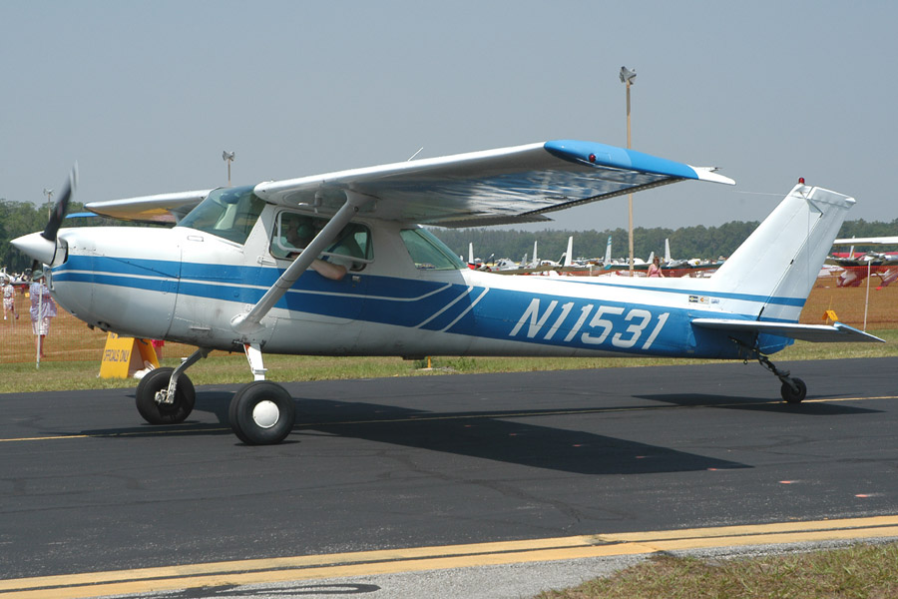
Aircraft Systems Fixed and Retractable Landing Gear
Landing gear can be classified as either fixed or retractable.
A fixed gear always remains extended and has the advantage of simplicity combined with low maintenance.

Slide 13
Questions / Comments

Slide 14
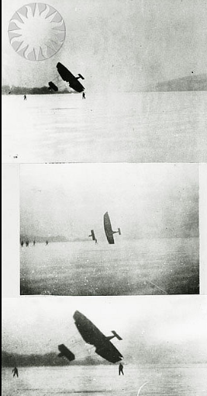
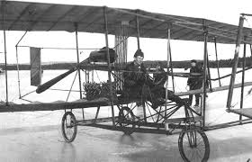
THIS DAY IN AVIATION
March 12
1908 — The first flight of the first airplane built by the United States Aerial Experiment Association takes place when Thomas Baldwin flies the “Red Wing” (Aerodrome No.1).
The flight of the biplane ends in a crash landing.

Slide 15
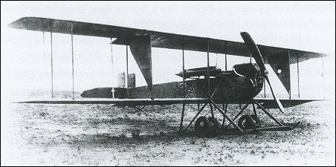
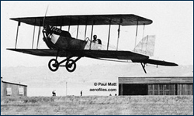
THIS DAY IN AVIATION
March 12
1915 — A Burgess H biplane (No. 28) sets a world endurance record for a pilot and two passengers by remaining in the air for 7 hours 5 minutes.
This particular airplane has been modified by Grover C. Loening at the Army Training School in San Diego.

Slide 16
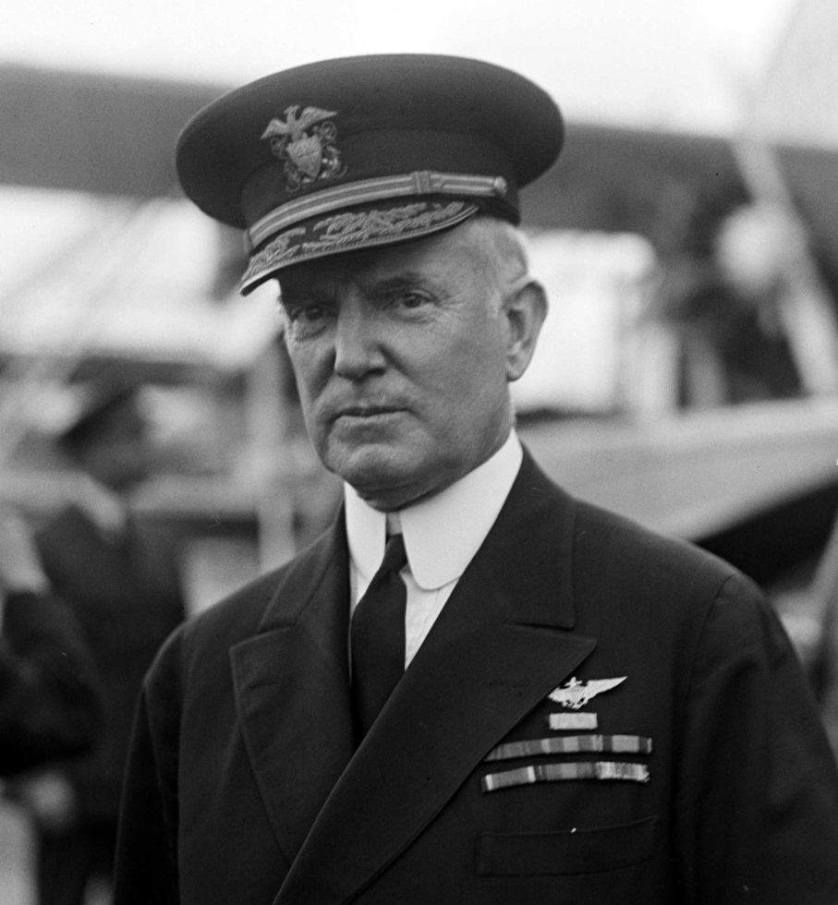
THIS DAY IN AVIATION
March 12
1929 — Adm. William A. Moffett reappointed as chief of the Bureau of Aeronautics of the Navy Dept.

Slide 17
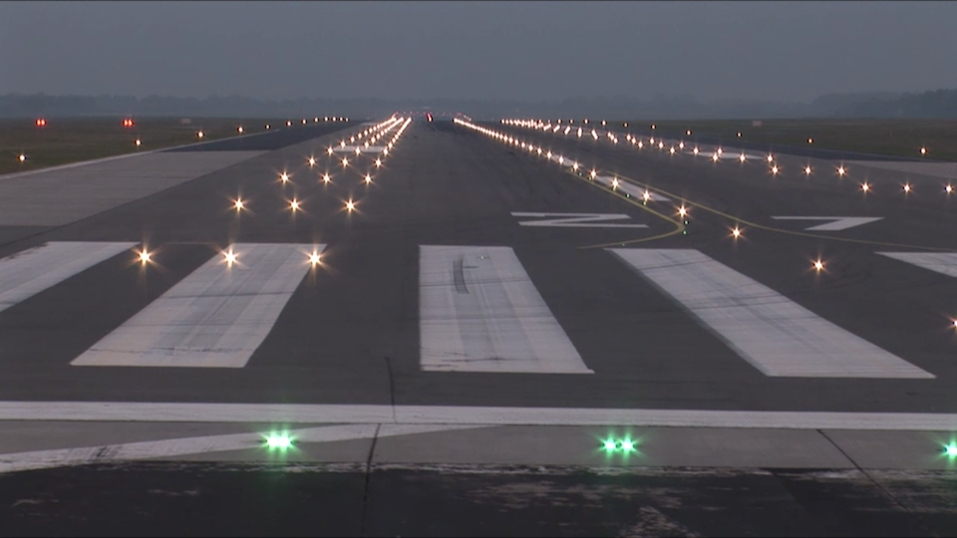
THIS DAY IN AVIATION
March 12
1932 — New landing aids are installed in Newark, New Jersey, at the busiest airport in the world, to supplement the night landing facilities already in existence there.
In 1930 alone there were some 28,000 landings and the airport handled 20,000 passengers.

Slide 18
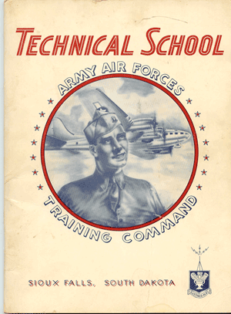
THIS DAY IN AVIATION
March 12
1946 — The Army Air Forces School is redesignated Air University.

Slide 19
Questions / Comments

Slide 20
March 2014
Sunday | Monday | Tuesday | Wednesday | Thursday | Friday | Saturday
2 | 3 | 4 Fuel Systems | 5 | 6 Electrical Systems | 7 | 8
9 | 10 Chapter 6 Hydraulic Systems | 11 | 12 Chapter 6 Test | 13 | 14 FltLine Friday | 15
16 | 17 | 18 | 19 | 20 | 21 | 22
23 | 24 NO SCHOOL | 25 | 26 | 27 | 28 | 29
30

Slide 21
Questions / Comments

Slide 22
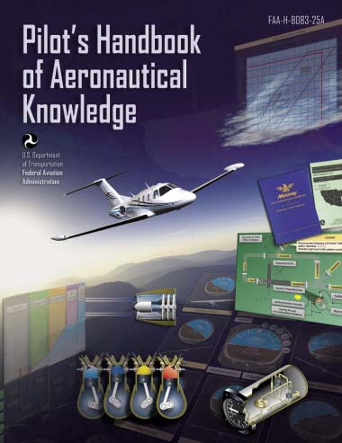
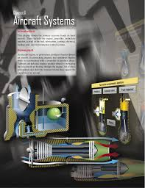
Chapter 6 – Aircraft Systems
REVIEW

Slide 23
Chapter 6 – Aircraft Systems
TEST

Slide 24
Questions / Comments

