Slide 1
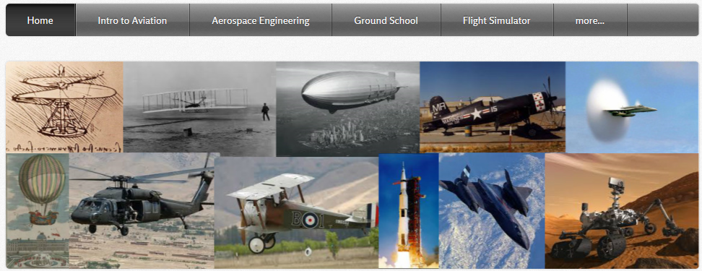
BCHS Aviation Program
Zenith CH-701
Rudder Starter Kit

Slide 2
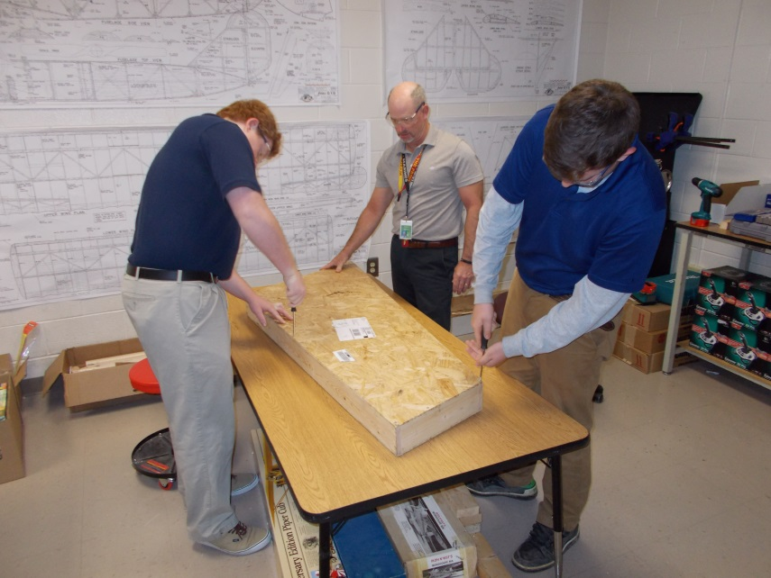
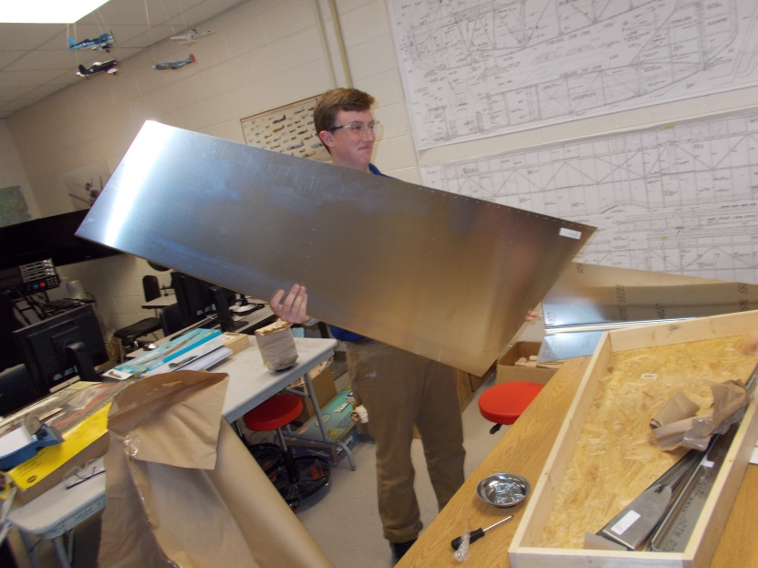
Success of Grant
Building the CH-701 Starter Rudder kit is probably one of the most challenging and rewarding things we have ever accomplished.
This opportunity, the grant provided, allowed the students to utilize basic aircraft tools and assemble an aircraft rudder kit.

Slide 3
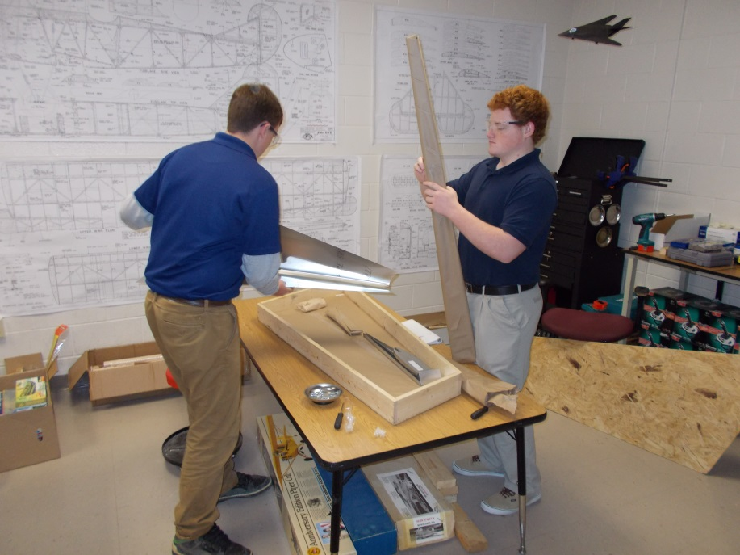
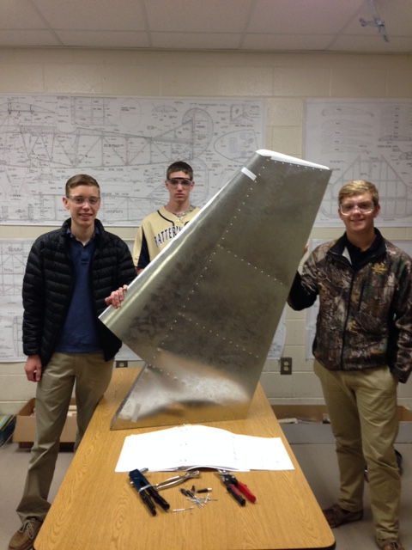
Benefits Achieved
The ability for students to have hands-on experience to assemble an actual piece of an aircraft was extremely beneficial.
The “hands-on” element supplemented the classroom instruction and added the “real world” application that only those in the field ever experience.

Slide 4
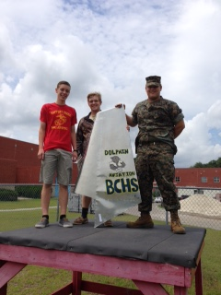
Thank you
From my students and myself, “Thank you” for the grant from the ‘Foundation for Educational Excellence’ and this lifetime learning opportunity.
Sincerely,
Anthony Petrucci
Aerospace Engineering Aviation Instructor

