Slide 1
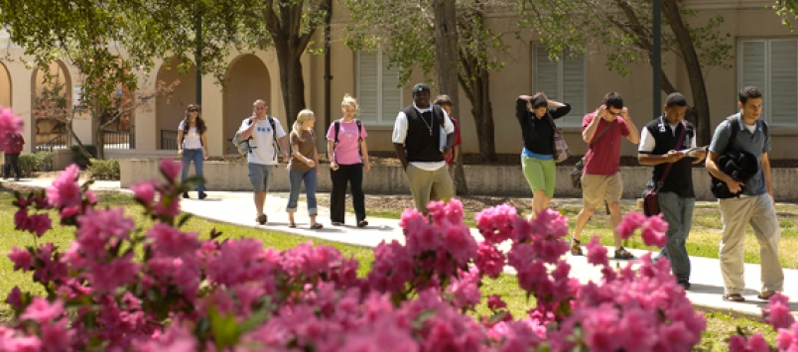
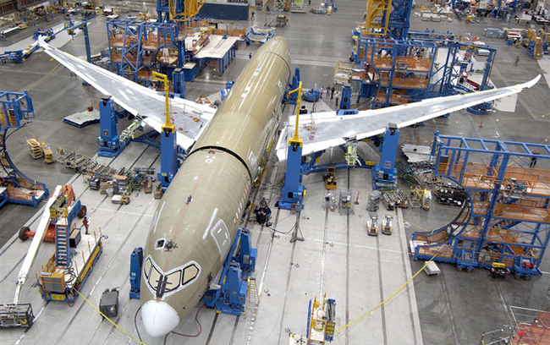
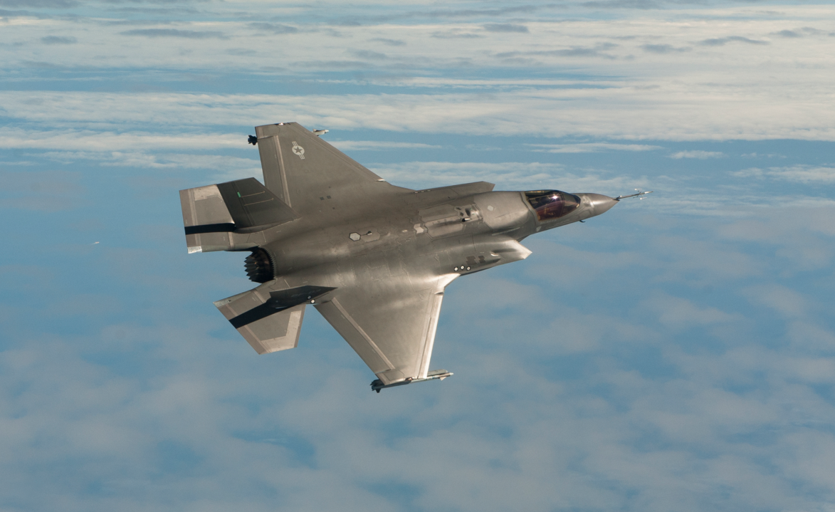
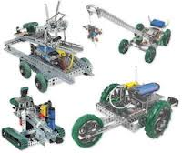
Battery Creek High School Aerospace Engineering Program
College
Careers
Pilot / Maintenance

Slide 2
Vision Statement
Develop a multidimensional Engineering and Aviation program that fosters college and career readiness to prepare students for the many opportunities in Aerospace and other STEM related industries.

Slide 3
Aviation and Engineering
Grade Freshman Sophomore Junior Senior | Aviation (College / Career Ready) Intro to Aviation Basic Aviation Science (Ground School) and / or Aerospace Engineering Embry-Riddle (Dual Enrollment) (Aviation Legislation ; Aviation Safety) or TCL (Dual Enrollment) (AC/DC; Intro to Avionics) Embry-Riddle (Dual Enrollment) (Air Traffic Control I; Air Traffic Control II) or TCL (Dual Enrollment) (Avionic Systems; Digital Electronics) | Engineering (College/Career) Intro to Engineering (IED) Principles of Engineering Aerospace Engineering Engineering, Design and Development(EDD)

